Slide 1
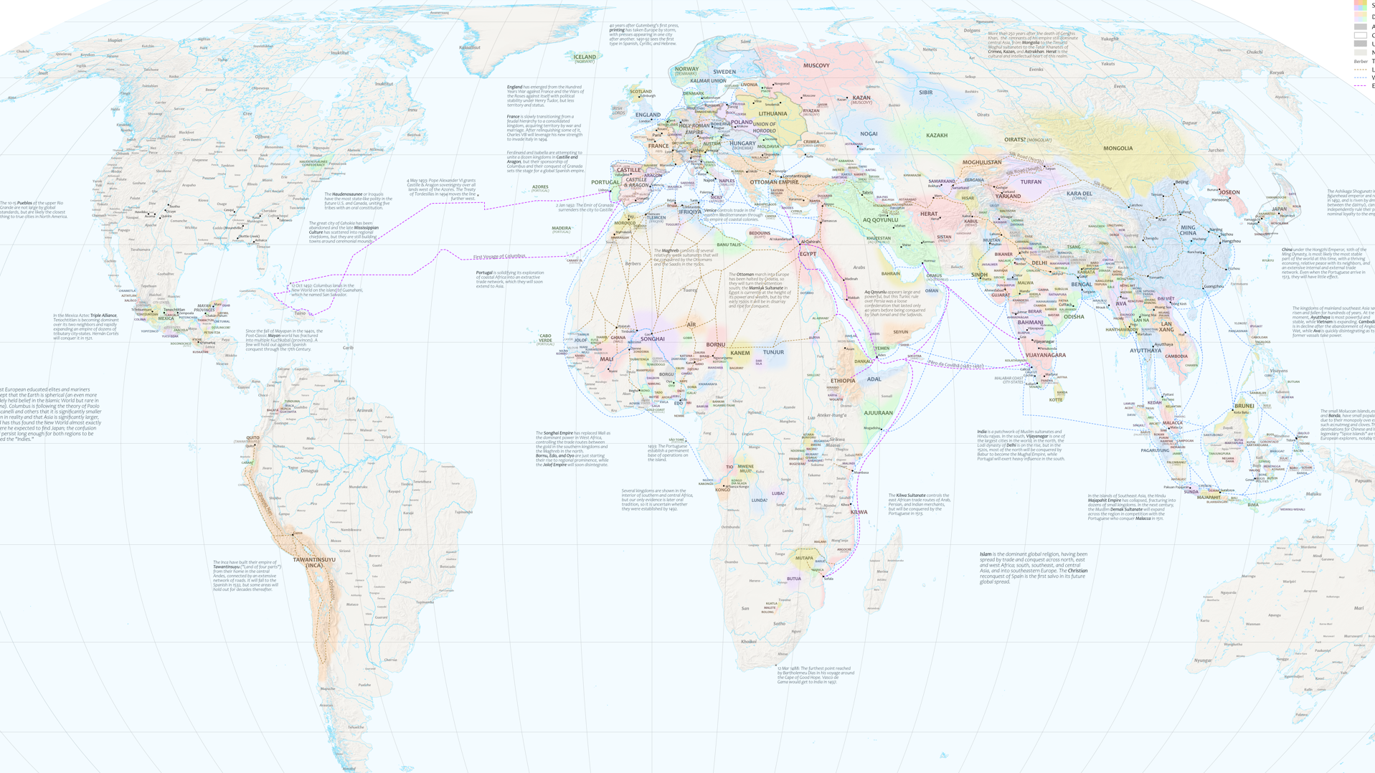
Visualizing 1492
Brandon Plewe
Brigham Young University
Notes:
Today I’d like to share some work I’ve been doing on a map of the World in the year 1492.

Slide 2
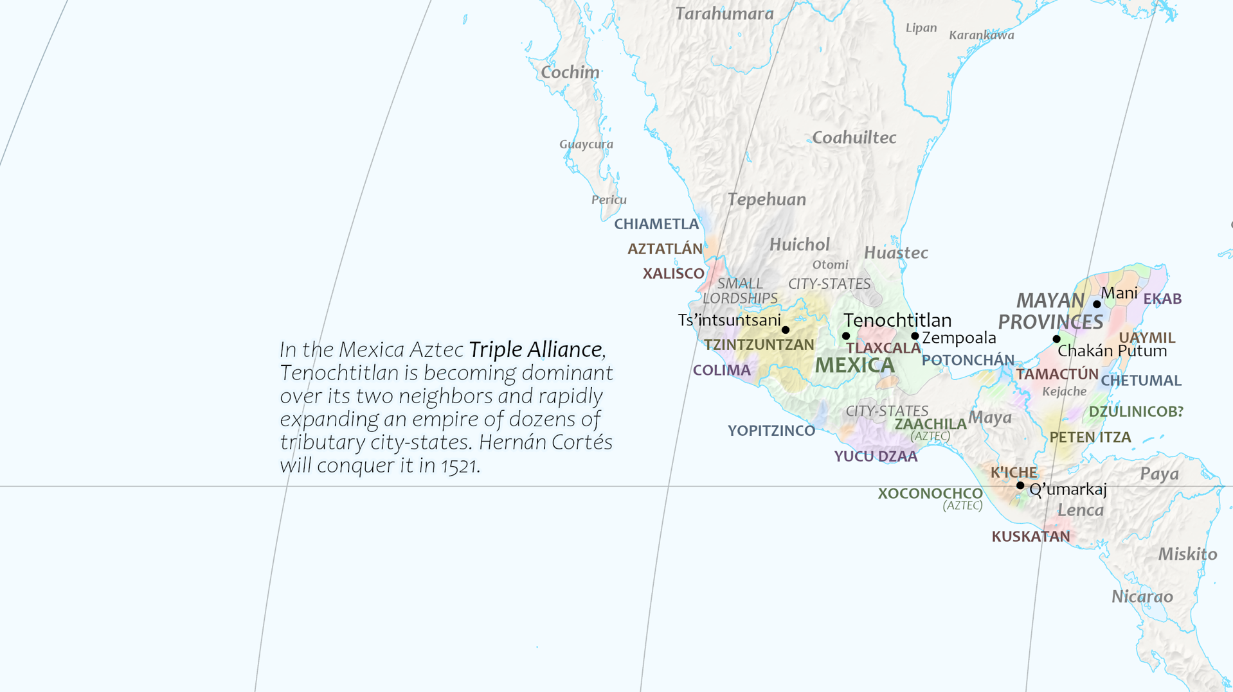
Why 1492?
The eve of European hegemony
The world on its own terms
700+ states!
I like “it’s complicated”
Notes:
Why that year? We all know it as the year Columbus first arrived in the Caribbean. So it is the eve of Imperial Europe; within 100 years, Europe will have profound influence on the entire world. So this year represents a world of hundreds of states that have emerged on their own. And it is a profoundly interesting world. I loved learning about it. But my favorite thing about it is that it is really complicated; for 35 years now, I cannot resist trying to represented the most complex geographies.

Slide 3
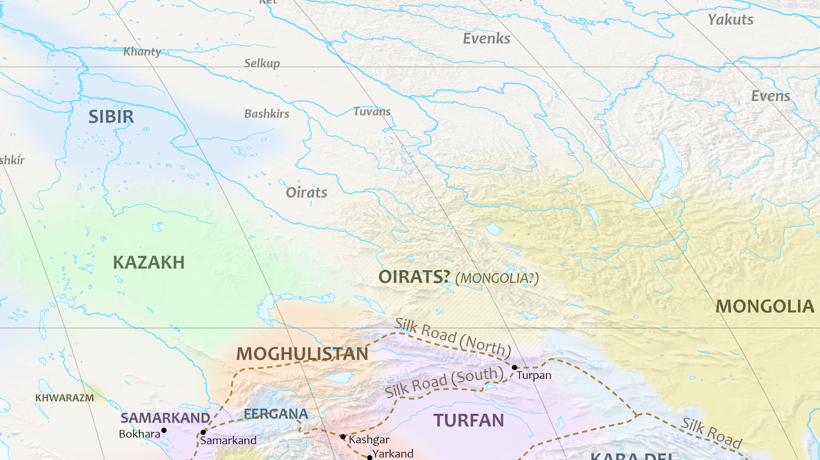
The state in 1492
Montevideo 1933, but…
State-ness
Sovereign-ness
Territory-ness
Knowledge-ness
Notes:
Notably, political geography was downright weird. In our world today, we have a fairly consistent notion of what constitutes a sovereign state. Most people refer to a definition of state established at a conference in Uruguay in the 1930s, which employed a simple checklist that clearly distinguishes what is a sovereign state and what is not. Well…not quite. What we find in 1492 are a lot of places where today’s ideal doesn’t really apply. Here is an example of several complexities: The confederacy of the four Oirats was only sort-of a state by our definition; it was sort-of sovereign and sort-of dependent on Mongolia; there was a lot of frontier where it only sort-of had territorial control; and all of this has very little documentation and may or may not have even been the case in this year. And they are not unusual.

Slide 4
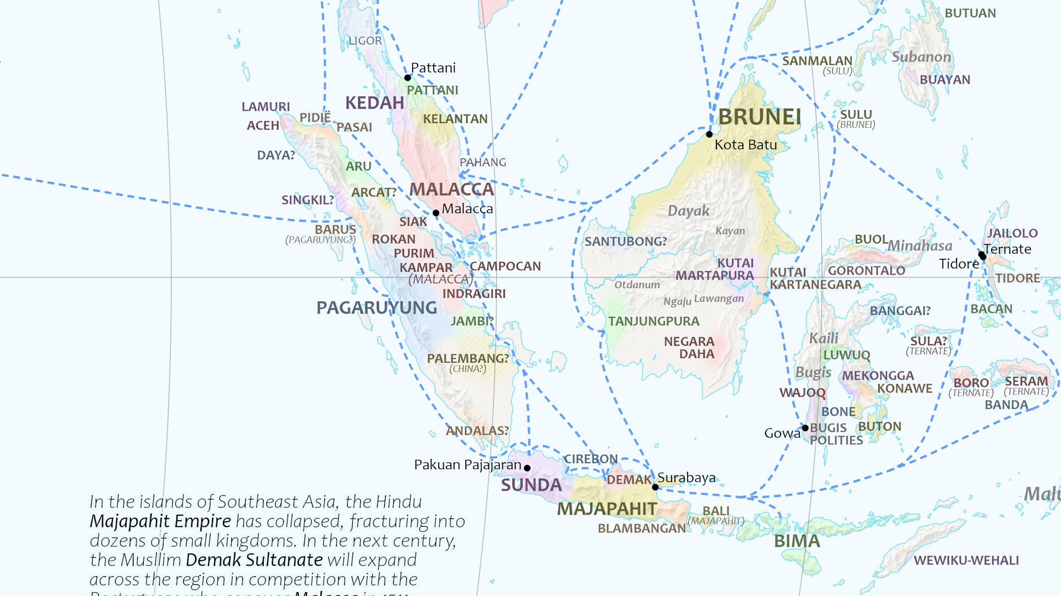
But do we care?
Audience, purpose, scale
“ish” is enough
  Fuzzy sets
  MacEachren CP 1992
  Plewe 2003
Something a historian could actually do
Reproducible, automatable
Notes:
How do we deal with all this complexity? Almost 25 years ago, I published a paper on a GIS data model that could simultaneously store various kinds of vagueness and uncertainty with great precision; it was beautiful, but absolutely useless. I couldn’t even make myself use it because it was too complicated. For this purpose as a basic world map, it just isn’t that important that I clearly differentiate these various types of complexity. It is probably enough to combine them all into basic visual cues that just give a hint of things being “ish,” like out-of-focus borders that have been used for decades and documented by Alan MacEachren 35 years ago (in our own Cartographic Perspectives even!). I needed data that was simple enough that a normal historian could build based on existing (usually vague) sources. And I needed a technique that could be generated automatically, not manually creating gradient fills in each polygon in Illustrator or something.

Slide 5
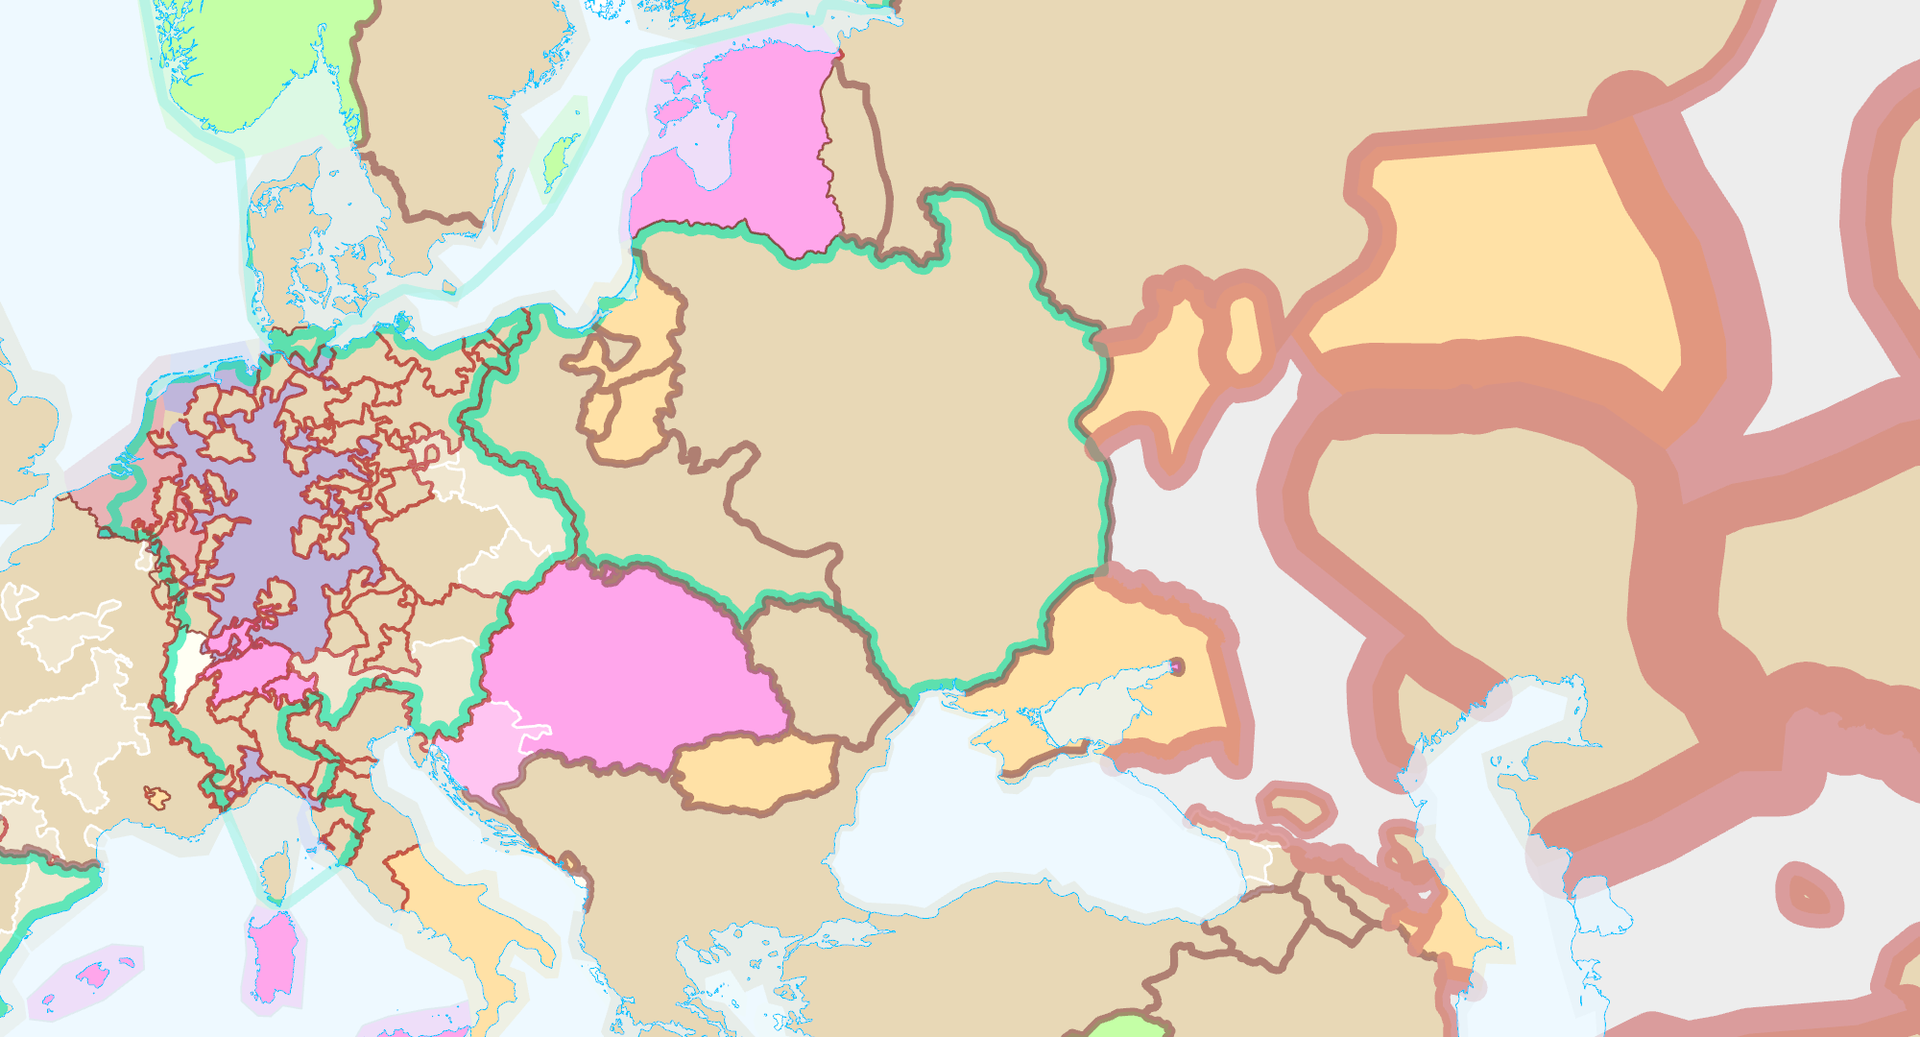
The Data
State polygons
  Levels of sovereignty: sovereign states, dependent states, supra-states
  Uncertain existence flag
Boundary lines
  Disaggregated by certainty
  Transition zone width (order-ish of magnitude)
  1=200-500m . . . 4 = 5-12km . . . 8 = 200-500km
Notes:
So first, the GIS data. As we digitized the polygons for each state, they were placed in one of three layers: one for states that had the highest degree of sovereignty, one for semi-sovereign states that were dependent on another state (say, the Kingdom of Hungary being under the Crown of Bohemia), and confederations and other “supra-states” that collected multiple states with a limited shared sovereignty, such as the Holy Roman Empire. These could be flagged if we were uncertain whether they even existed in 1492 (a very common situation in many regions without written languages yet). The boundaries were digitized separately, so different portions of a boundary could have different degrees of uncertainty. Each was coded with an ordinal scale value representing the width of a frontier zone to an order of magnitude. This is important because it was rare that we could quantify exactly how wide a frontier was, but it was usually fairly easy to place it in a wide range.

Slide 6
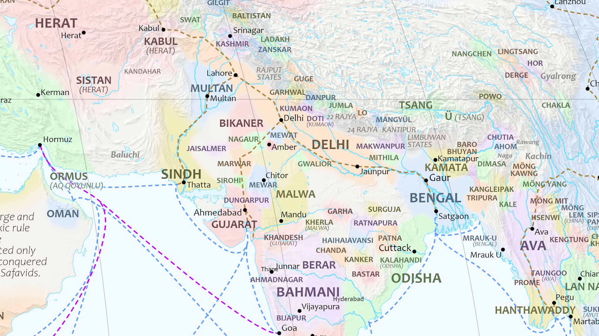
Processing . . .
Buffer boundaries at min + max widths
Add to, subtract from polygons
  Iso-sovs(???) with membership
  Dependent states lower
TIN
Raster of membership field for each color
6+1 colors, fuzzy edges, interblended
1
0.8
0.3
0
Notes:
Let me describe how the data was turned into the map in reverse, since that is how I developed it. I wanted a map of 6 colors of states (+ gray for regions of microstates) with variably fuzzy edges that blended into each other. So I decided to process all of the countries in each color as a group, one color at a time creating 7 raster grids of fields of intensity for each color. So first I created buffers of each boundary line, at its minimum and maximum width. Then for all of the polygons of a particular color, we used overlays to create four alternative polygons, each coded with a membership value for its boundary—perhaps we could call these “iso-sovs?” I have to think about that some more. The original polygon minus the max width is a full membership of 1, minus the min width is a little less, at the original polygon boundary is a little less than 50% (kind of a “no-man’s land”), and plus the max width is the absolute limit of minimally possible territorial control. The lines for dependent states were coded with a proportionally lower value. These lines were then triangulated into a membership surface of sorts as a TIN, which was then interpolated into a global raster grid for that color. Now, how precise are these exact membership values in the fuzzy set; sorry, that’s kind of a meaningless question; it’s all fuzzy and uncertain, and as long as it looks like a smooth blend, it’s good enough for this application.

Slide 7
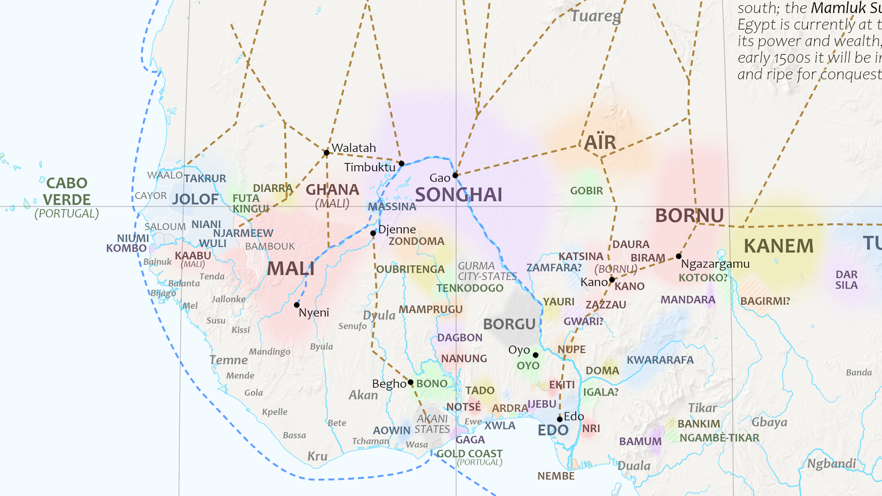
Compositing
Transparency ramp
Uncertain existence hatched
Cities, non-state societies, trade routes
Static fine
Interactive?
Notes:
Now each of the seven color rasters were symbolized with a color ramp of constant color but variable opacity, so they naturally blended in the frontiers. You can see here states with very fuzzy, wide frontiers, and much more crisp, more clearly defined boundaries. Then I could add other features like cities, tribal identities and non-state societies, and trade and exploration routes, explanatory notes, and the static map is ready to go. I’ve started on an interactive version, but changing scales will lead to some new issues with this method.

Slide 8

Thank you!
plewe@byu.edu
github.com/bplewe/1492
Notes:
Well that’s about it. Feel free to check it out in the map gallery, or go look at it here on github, where I also have the GIS data and the python code. I’d love your feedback on the content and the design.

