Slide 1

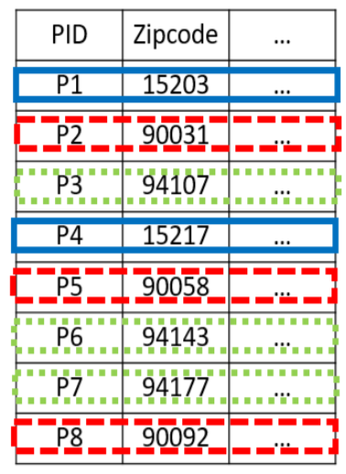
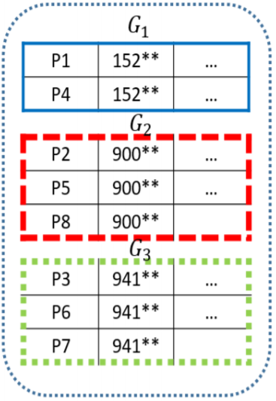

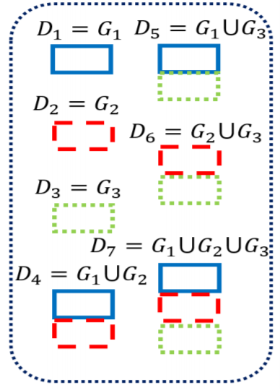
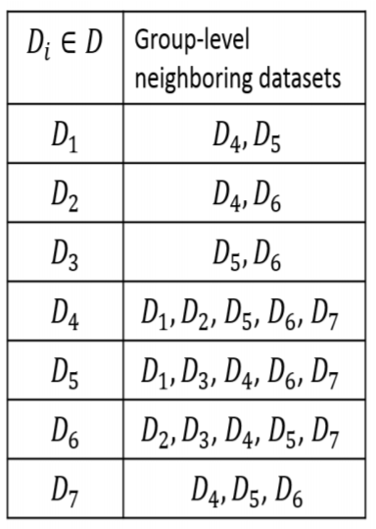

Group Differential Privacy-preserving Disclosure of Multi-level Association Graphs
Balaji Palanisamy, Chao Li, Prashant Krishnamurthy
School of Information Sciences, University of Pittsburgh
Differential privacy
Group differential privacy
Group level adjacent dataset
Without differential privacy:
A dataset outputs a determinate answer to a query.
The traditional differential privacy mechanisms only protect the individual differential privacy.
The aggregate (statistical) information about individuals may not be safe for disclosure because the aggregate information itself can be sensitive and needs protection.
Example: Drug purchases of patients
With differential privacy:
The query answer is randomized.
Adjacent dataset:
two datasets differ by at most one record.
which drug an individual bought
Definition
Differential privacy
Definition 2 (GROUP DIFFERENTIAL PRIVACY).
A randomized algorithm $𝒜$ guarantees $ε_{g}$- group differential privacy if for all adjacent data sets $D_{1}$ and $D_{2}$ differing by at most one group, $G_{i}∈G$, and for all possible results $S⊆Range\left(𝒜\right),$ $\operatorname{Pr}\left[𝒜\left(D_{1}\right)=S\right]≤e^{ε_{g}}×\operatorname{Pr}\left[𝒜\left(D_{2}\right)=S\right].$
which zipcode has the highest purchases on psychiatric drugs

