Slide 1

Differentially Private Trajectory Analysis for Points-of-Interest Recommendation
Chao Li, Balaji Palanisamy, James Joshi
School of Information Sciences
University of Pittsburgh

Slide 2
Outline
Introduction
Concepts and model
Differential private trajectory analysis
Experiments
Conclusion

Slide 3
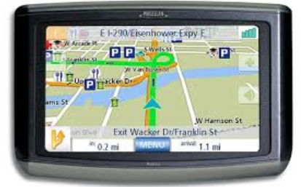
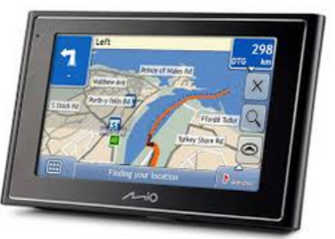


The increasing GPS market
The GPS market generated $9.1 billion in 2011 and is expected to generate $26.36 billion by 2016 at a CAGR of 23.7% from 2011 to 2016.

Slide 4
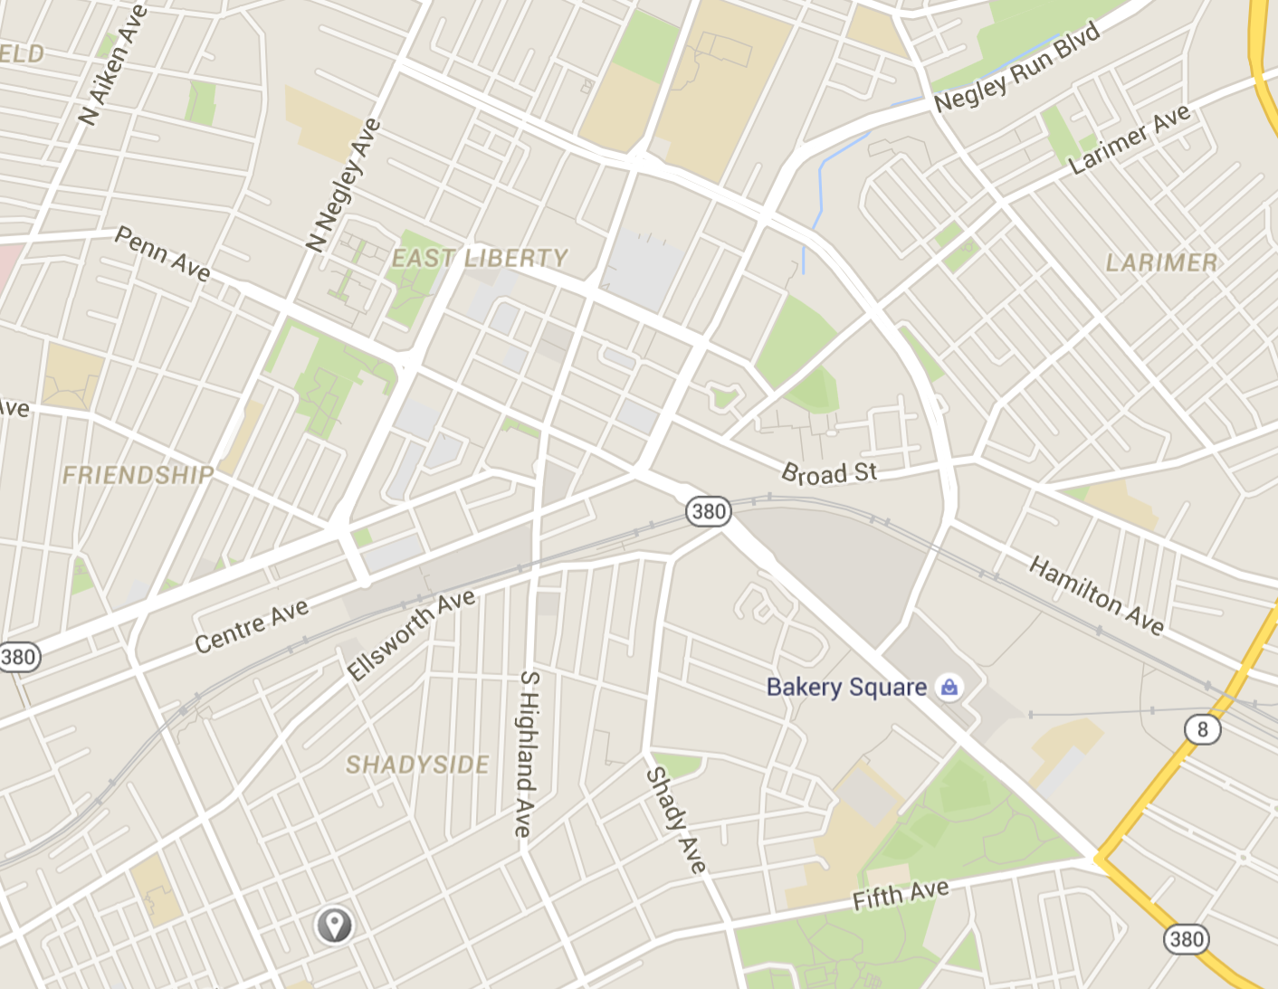





Trajectory
A trajectory represents a sequence of location information formed by a series of (latitude, longitude, timestamp) triple.
$$(x_{3},y_{3},t_{3})$$
A trajectory can capture a variety of travel information of the users:
user’s movement pattern
travel paths
travel destination
$$(x_{4},y_{4},t_{4})$$
$$(x_{2},y_{2},t_{2})$$
$$(x_{1},y_{1},t_{1})$$

Slide 5





Trajectory-based travel recommendation
Trajectories of an individual mobile user can be analyzed to understand her personal travel recommendations.
The mobile users implicitly recommend their visited places to the new visitors.
‘I visited this shopping mall, it may be also worth a visit for you.’
$$My recommendations$$

Slide 6


Trajectory-based travel recommendation
Aggregate analysis of historical trajectory data belonging to different mobile users can provide more generalized travel recommendations, such as:
‘Where are the top-10 points-of-interest in a given city?’
‘Which shopping mall is the most popular in this area?’
‘Which users have frequently visited this restaurant?’
$$Most popular$$

Slide 7
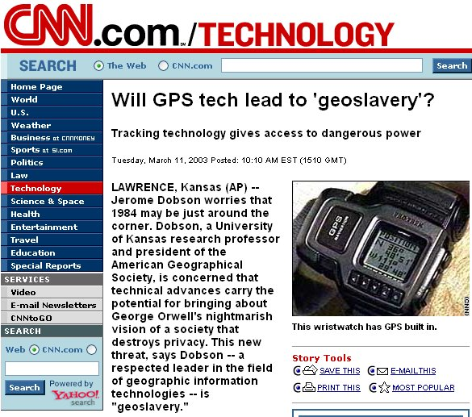
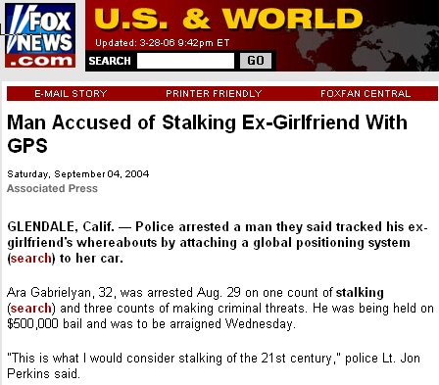

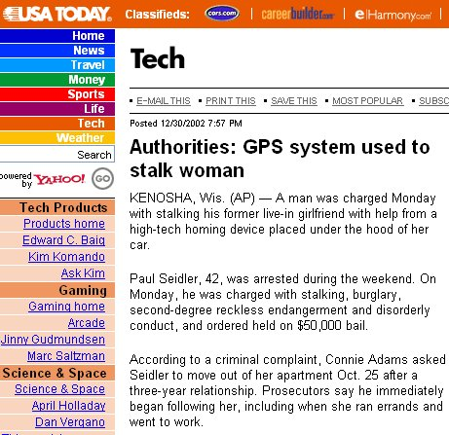
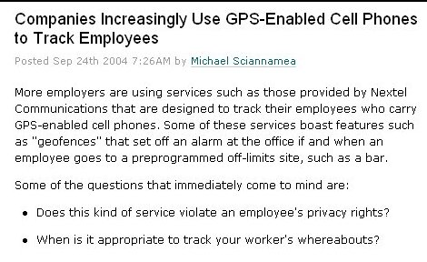
Privacy threats
Although historical personal trajectory data provide immense information to generate accurate and useful points-of-interest recommendation, the exposure of the sensitive trajectory information can pose significant privacy risks that can invade the location privacy of the users.

Slide 8




Privacy threats
In particular, the location information of the travel destination is often associated with a semantic meaning.
The disclosure of the association between a mobile user and such a location may reveal private information such as the health conditions.
$$Alice$$
$$visited$$
$$Treatment center$$
$$Alice has XXX disease$$

Slide 9
Differentially private trajectory analysis for points-of-interest recommendation
In this paper, we propose the privacy-preserving trajectory mining that can both:
do points-of-interest recommendation by analyzing the trajectory dataset.
protect the privacy of the exposed trajectories with differential privacy guarantees.
Steps:
Our algorithm first transforms the raw trajectory dataset into a bipartite graph.
It then extracts the association matrix representing the bipartite graph to inject carefully calibrated noise to meet differential privacy guarantees.
Finally, a post-processing of the perturbed association matrix is performed to suppress noise prior to performing a Hyperlink-Induced Topic Search (HITS) on the transformed data that generates an ordered list of recommended points-of-interest.

Slide 10
Outline
Introduction
Concepts and model
Differential private trajectory analysis
Experiments
Conclusion

Slide 11




















User-location bipartite graph representation
For the purpose of points-of-interest recommendation considered in this work, the raw trajectory dataset is transformed to be processed as a bipartite graph.
Five steps:
Raw trajectory dataset.
Stop points detection.
Stop points clustering.
Association construction.
Bipartite graph.
$$u_{1}$$
$$l_{2}$$
$$l_{4}$$
$$l_{1}$$
$$u_{2}$$
$$u_{5}$$
$$u_{4}$$
$$u_{3}$$
$$l_{2}$$
$$u_{6}$$
$$u_{3}$$
$$l_{3}$$
$$l_{1}$$
$$u_{4}$$
$$l_{3}$$
$$u_{5}$$
$$u_{1}$$
$$u_{2}$$
$$l_{4}$$
$$u_{6}$$
We identify the stop points for all the users. A stop point is defined as a spatial region that the trajectory data fluctuates within a distance threshold for at least a time threshold .
We can connect each stop point with its associated location with an arrow line pointing to the location, which denotes that the user of this stop point has visited the location once.
These stop points (triangles) are clustered through well-known clustering techniques such as k-means, DBSCAN or OPTICS clustering algorithms, which implicitly recommends those regions covered by the clusters as attractive places.

Slide 12

Differential privacy
dataset
probability
Without differential privacy:
A dataset outputs a determinate answer to a query (e.g. count of records with attribute ***).
query answer
100
count
With differential privacy:
The query answer is randomized.
probability
dataset
query answer
Adjacent dataset:
two datasets differ by at most one record.
100
count
probability distribution of query answers
Differential privacy:
Informally, the differential privacy can perturb the answer of a query with randomized mechanisms so that the probability to infer individual information from the released statistical query answer is mathematically restricted by parameters in a controllable way.
adjacent datasets
very close

Slide 13
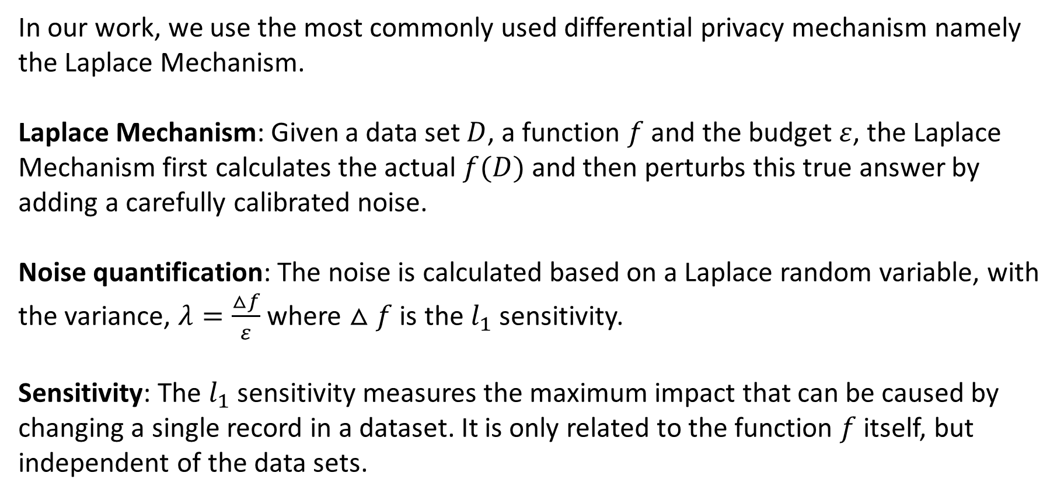
Laplace mechanism
In our work, we use the most commonly used differential privacy mechanism namely the Laplace Mechanism.
Laplace Mechanism: Given a data set $D$, a function $f$ and the budget $ε$, the Laplace Mechanism first calculates the actual $f(D)$and then perturbs this true answer by adding a carefully calibrated noise.
Noise quantification: The noise is calculated based on a Laplace random variable, with the variance, $λ=\frac{△f}{ε}$ where $△f$ is the $l_{1}$ sensitivity.
Sensitivity: The $l_{1}$ sensitivity measures the maximum impact that can be caused by changing a single record in a dataset. It is only related to the function $f$ itself, but independent of the data sets.

Slide 14
Outline
Introduction
Concepts and model
Differential private trajectory analysis
Experiments
Conclusion

Slide 15











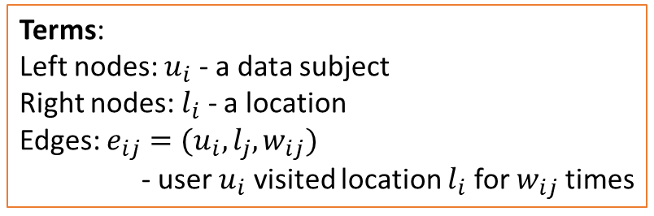






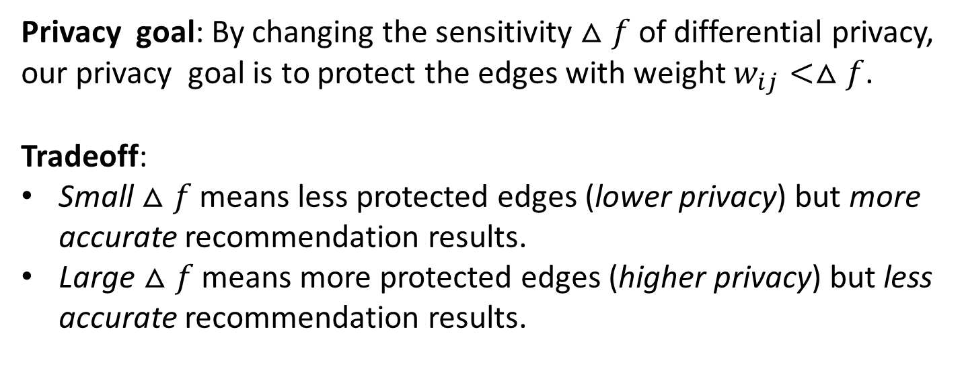







Privacy goal
We start from presenting the privacy goal, namely what is needed to be protected by the differential privacy mechanism.
$$u_{1}$$
$$w_{11}$$
$$w_{12}$$
$$l_{1}$$
Terms:
Left nodes: $u_{i}$ - a data subject
Right nodes: $l_{i}$ - a location
Edges: $e_{ij}=(u_{i},l_{j},w_{ij})$
- user $u_{i}$ visited location $l_{i}$ for $w_{ij}$ times
$$w_{21}$$
$$u_{2}$$
$$w_{31}$$
$$w_{23}$$
$$u_{3}$$
$$w_{32}$$
$$l_{2}$$
$$w_{24}$$
$$w_{42}$$
$$u_{4}$$
$$w_{51}$$
Privacy goal: By changing the sensitivity $△f$ of differential privacy, our privacy goal is to protect the edges with weight $w_{ij}<△f$.
Tradeoff:
Small $△f$ means less protected edges (lower privacy) but more accurate recommendation results.
Large $△f$ means more protected edges (higher privacy) but less accurate recommendation results.
$$w_{44}$$
$$l_{3}$$
$$w_{53}$$
$$u_{5}$$
$$w_{54}$$
$$w_{63}$$
$$l_{4}$$
$$w_{64}$$
$$u_{6}$$

Slide 16
Hyperlink-Induced Topic Search (HITS)
Among the recommendation algorithms, the one that fits the bipartite graph structure best is the HITS-based algorithm.
HITS feature:
It defines a hub as a web page with many links pointing to other web pages and an authority as a web page pointed by many other web pages.
It assumes a good hub points to many good authorities and a good authority is pointed by many good hubs.
Apply HITS to trajectory-based recommendation:
hub -> user
authority -> location
good hub -> more experienced user
good authority -> more popular location

Slide 17
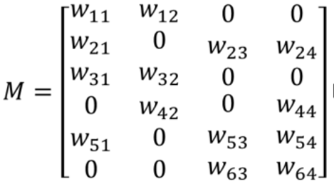
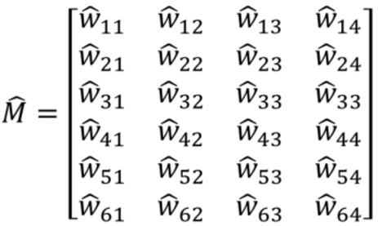
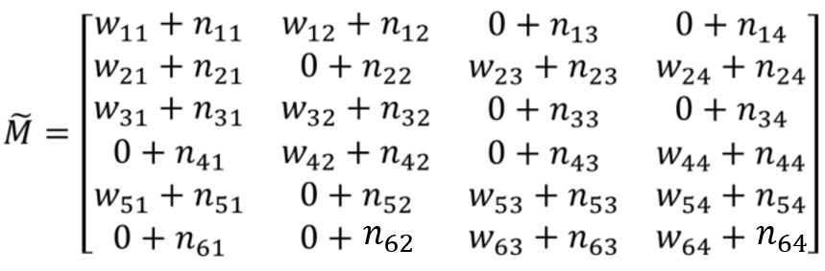
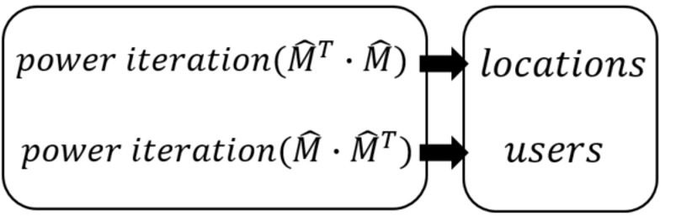


















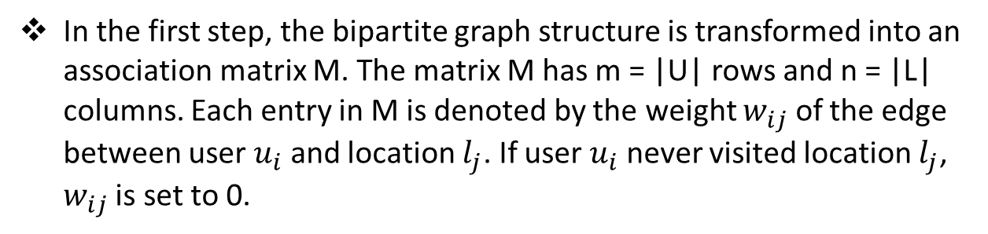







Differentially private Points-of-Interest Recommendation
The differentially private mining algorithm consists of four steps:
matrix construction
noise addition
noise suppression
HITS
$$u_{1}$$
$$w_{11}$$
$$w_{12}$$
$$l_{1}$$
$$w_{21}$$
$$u_{2}$$
$$w_{31}$$
$$w_{23}$$
$$u_{3}$$
$$w_{32}$$
$$l_{2}$$
$$w_{24}$$
$$w_{42}$$
$$u_{4}$$
$$w_{51}$$
$$w_{44}$$
$$l_{3}$$
In the first step, the bipartite graph structure is transformed into an association matrix M. The matrix M has m = |U| rows and n = |L| columns. Each entry in M is denoted by the weight $w_{ij}$ of the edge between user $u_{i}$ and location $l_{j}$. If user $u_{i}$ never visited location $l_{j}$, $w_{ij}$ is set to 0.
Then, in the second step, each entry $w_{ij}$ is perturbed using noise calculated by Laplace Mechanism
In the third step, we apply consistency constraints to post-process the matrix to suppress noise and improve the recommendation accuracy.
zero consistency constraint(zero-CC): In M, all the entries are non-negative. So the perturbed entries should also be non-negative.
up consistency constraint (up-CC): In M, all the entries are sorted from 0 to max, so the perturbed entries should keep a non-decreasing order.
down consistency constraint(down-CC) ): In M, all the entries are sorted from max to 0, so the perturbed entries should keep a non-increasing order.
$$w_{53}$$
$$u_{5}$$
$$w_{54}$$
$$w_{63}$$
$$l_{4}$$
$$w_{64}$$
$$u_{6}$$

Slide 18
Outline
Introduction
Concepts and model
Differential private trajectory analysis
Experiments
Conclusion

Slide 19
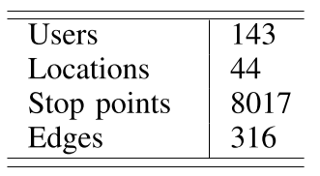
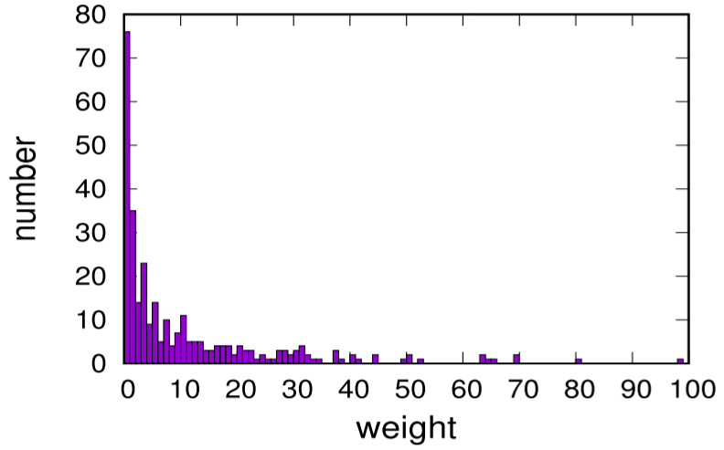
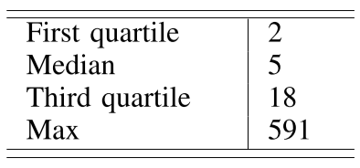
Experimental setup
In our experiments, we apply the Geolife GPS trajectory dataset, which contains 17621 trajectories collected from 182 users for five years.
We first follow the user-location bipartite graph construction scheme to process the raw trajectory dataset and generate the user-location bipartite graph.
Each edge in the user-location bipartite graph is assigned a weight representing the number of visits. The distribution of weights among the 316 edges is shown in right figure and the statistics of weights is shown in the right table.

Slide 20
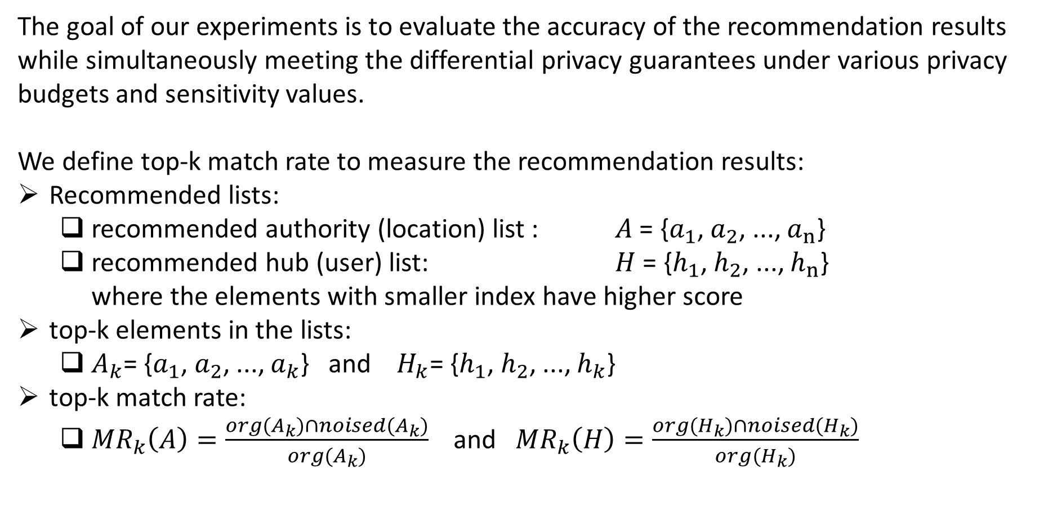
Measurement
The goal of our experiments is to evaluate the accuracy of the recommendation results while simultaneously meeting the differential privacy guarantees under various privacy budgets and sensitivity values.
We define top-k match rate to measure the recommendation results:
Recommended lists:
recommended authority (location) list : $A$ = {$a_{1}$, $a_{2}$, ..., $a_{n}$}
recommended hub (user) list: $H$ = {$h_{1}$, $h_{2}$, ..., $h_{n}$}
where the elements with smaller index have higher score
top-k elements in the lists:
$A_{k}$= {$a_{1}$, $a_{2}$, ..., $a_{k}$} and $H_{k}$= {$h_{1}$, $h_{2}$, ..., $h_{k}$}
top-k match rate:
${MR}_{k}\left(A\right)=\frac{org(A_{k})∩noised(A_{k})}{org(A_{k})}$ and ${MR}_{k}\left(H\right)=\frac{org(H_{k})∩noised(H_{k})}{org(H_{k})}$
In other words, for a query like ‘show me top-5 recommended locations in this city’, we expect the replied 5 locations do not change after adding noise.

Slide 21




Impact of varying privacy budget (list A)
$$ε=1$$
$$ε=0.7$$
$$ε=0.4$$
$$ε=0.1$$

Slide 22
Impact of varying privacy budget (list H)
$$ε=1$$
$$ε=0.7$$
$$ε=0.4$$
$$ε=0.1$$

Slide 23




Impact of varying sensitivity (list A)
$$∆f=2$$
$$∆f=5$$
$$∆f=18$$
$$∆f=591$$

Slide 24
Impact of varying sensitivity (list H)
$$∆f=2$$
$$∆f=5$$
$$∆f=18$$
$$∆f=591$$

Slide 25
Conclusion
In this paper, we propose a differentially private trajectory analysis algorithm for travel recommendation that aims at increasing the accuracy of the recommendation results while protecting the differential privacy of the trajectory data.
The proposed approach transforms the raw trajectory dataset into a user-location bipartite graph and injects a carefully calibrated noise to meet the required differential privacy guarantees.
We propose three consistency constraint schemes to suppress the noise added in the process which improves the accuracy of the obtained recommendation results.
Our extensive experiments on a real trajectory dataset show that our algorithm is efficient, scalable and demonstrates good recommendation accuracy while meeting the required differential privacy guarantees.

Slide 26
Thank you. Questions?

