Slide 1


You Don’t
Know JaC?
Managing Jenkins jobs and
pipelines as code
Gluecon
5/17/2018
Brian Mericle
@bpmericle

Slide 2
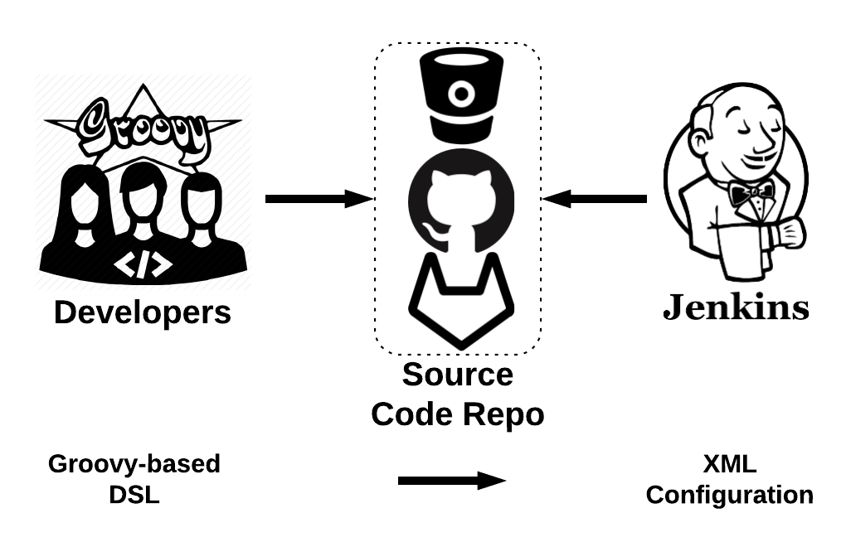
What do I mean by “Jenkins as Code”?
@bpmericle

Slide 3
Why do this?
Changes can be versioned in source control, tested and peer reviewed
Libraries can lead to reusability
Automatic creation/modification of referenced jobs
Automatic deletion of unreferenced jobs
Flexibility to enhance built-in components
Apply programmatic job permissions
@bpmericle

Slide 4
Possible Challenges
DSL learning curve
Lead time to job creation/modification
Assigning, and holding responsibility & accountability
@bpmericle

Slide 5
What makes this possible?
Groovy-based DSL
+
Jenkins Plugins
@bpmericle

Slide 6
Domain-Specific Language (DSL)
Groovy-based domain-specific language
Allows total manipulation of job configuration xml through code
Provides built-in functions for job configuration
@bpmericle

Slide 7
Jenkins JobDSL Plugin
Allows DSL scripts to be executed within a job
Allows DSL scripts to be pulled from source control
Allows multiple DSL scripts to be referenced at time
@bpmericle

Slide 8
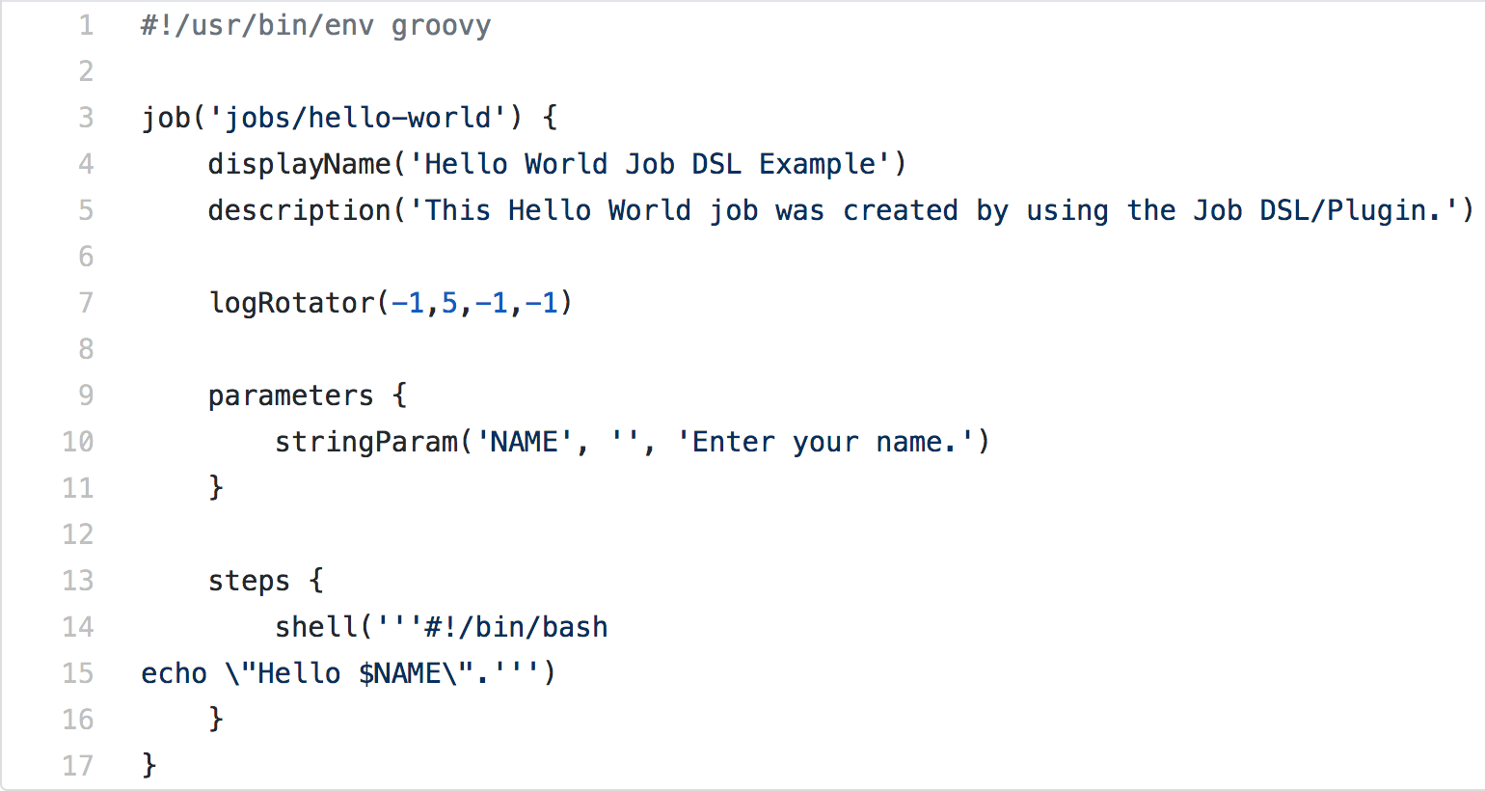
Jenkins Freestyle Job Definition

Slide 9
Jenkins Pipeline Plugins
A suite of plugins that lets you orchestrate simple to complex automation processes
Supports scripted or declarative modeling of pipeline definitions
Provides durability, pausabilty, versatility and extensibility features
@bpmericle

Slide 10
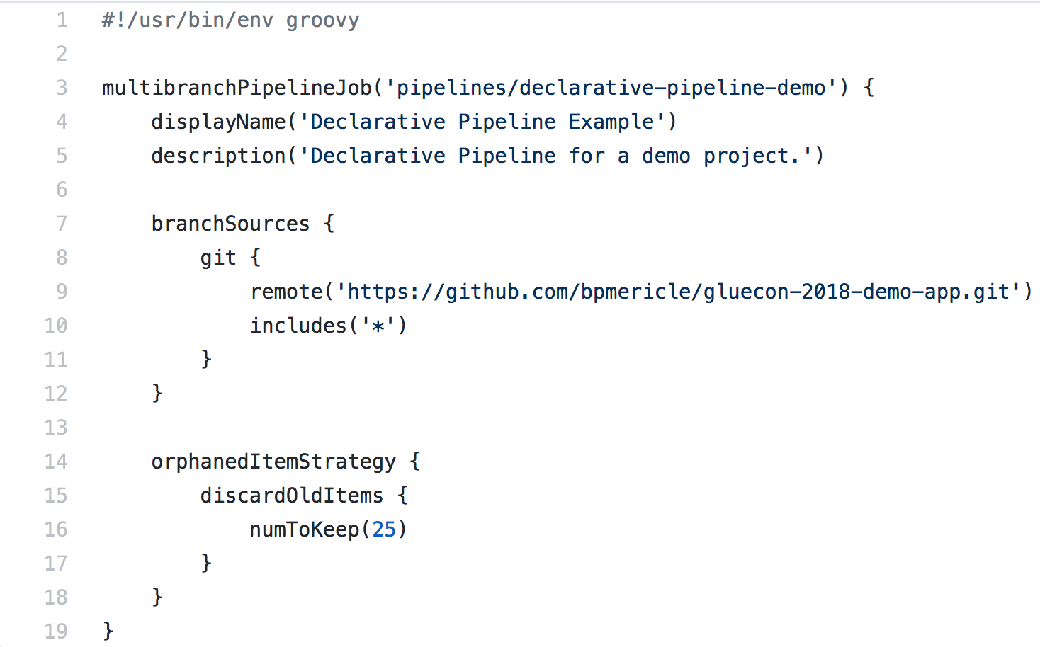
Jenkins Pipeline Job Definition

Slide 11
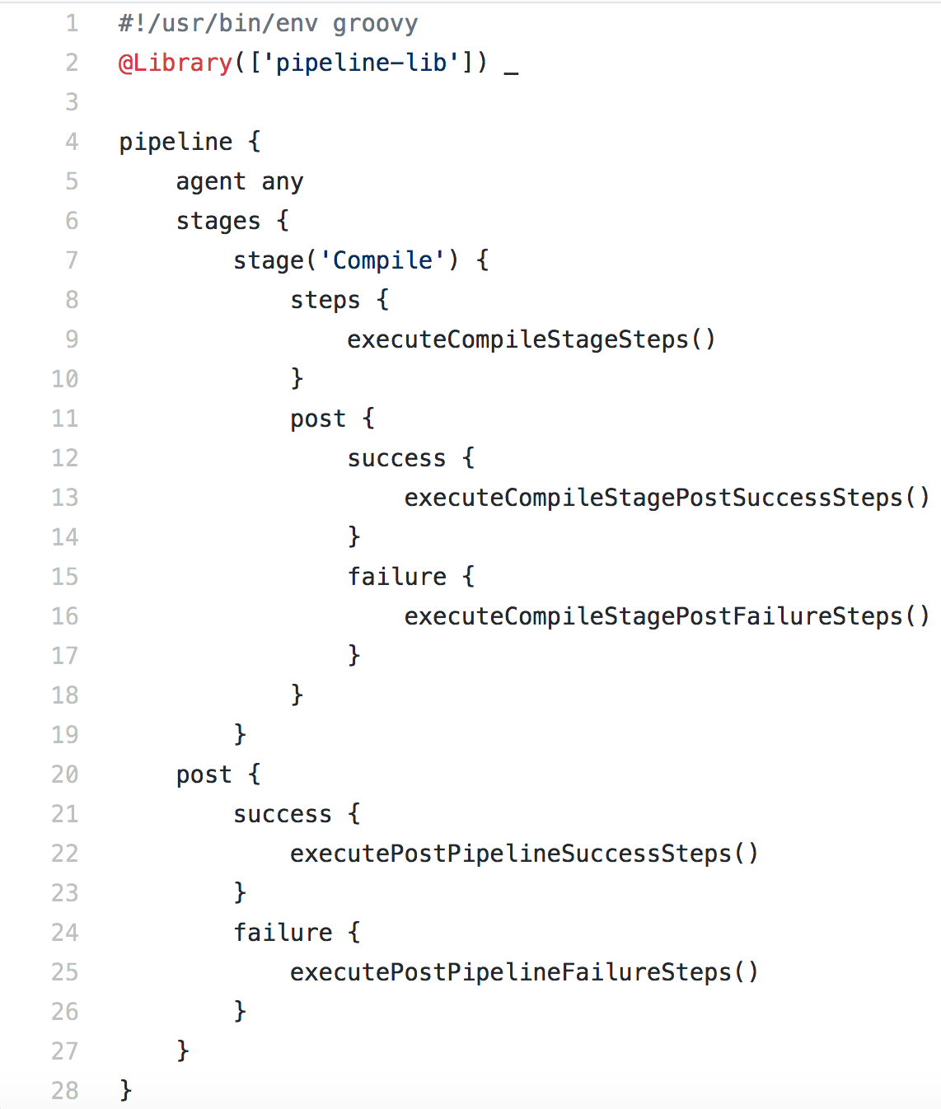
Jenkins Pipeline Definition

Slide 12
Steps to Execute
Write and check-in your job script to a source code repository
Create “seed” job that references your DSL script from the source code repository
Execute “seed” job
Execute created job

Slide 13
Demo
@bpmericle

Slide 14

@bpmericle

Slide 15

Thank You!
Email:
brian.mericle@gmail.com
Twitter:
@bpmericle
LinkedIn:
https://www.linkedin.com/in/brianpmericle/
Slides:
Search for “Gluecon 2018 JaC” on https://www.slideshare.net
Github:
https://github.com/bpmericle/gluecon-2018-JaC

Slide 16
Resources
Job DSL Plugin:
https://github.com/jenkinsci/job-dsl-plugin/wiki
Job DSL API:
https://jenkinsci.github.io/job-dsl-plugin/
Groovy API:
http://groovy-lang.org/gdk.html
Script Security Plugin:
https://wiki.jenkins.io/display/JENKINS/Script+Security+Plugin
Authorize Project Plugin:
https://wiki.jenkins.io/display/JENKINS/Authorize+Project+plugin
Pipeline Plugin:
https://jenkins.io/doc/book/pipeline/
Pipeline Declarative Model:
https://github.com/jenkinsci/pipeline-model-definition-plugin/wiki/getting-started
Pipeline Shared Libraries:
https://jenkins.io/doc/book/pipeline/shared-libraries/
Pipeline Steps:
https://jenkins.io/doc/pipeline/steps/
Pipeline Basic Steps:
https://jenkins.io/doc/pipeline/steps/workflow-basic-steps/
Pipeline Utility Steps:
https://jenkins.io/doc/pipeline/steps/pipeline-utility-steps/
@bpmericle

