Slide 1

YOU DON'T KNOW JAC?
Managing Jenkins as Code
GLUECON 2018
5/17/2018
Brian Mericle
@bpmericle

Slide 2

ABOUT ME
18 years of software development experience
8 years of IT leadership experience
6 years of CI/CD² automation experience
Jenkins user since 2005
@bpmericle

Slide 3
AGENDA
Jenkins Jobs as Code
Demo
Jenkins Pipelines as Code
Demo
Q&A
What will be covered
@bpmericle

Slide 4
JENKINS JOBS AS CODE
Programmatic Usage
@bpmericle

Slide 5
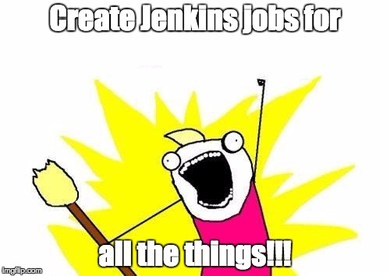

Slide 6
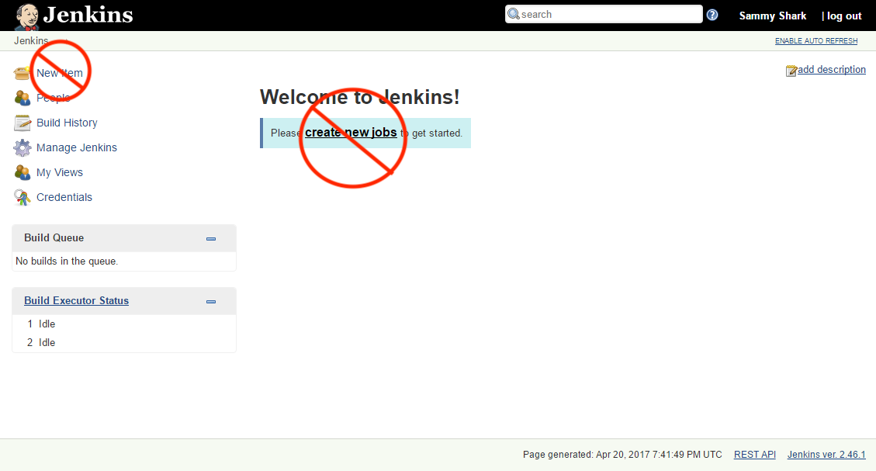
WHAT DO I MEAN BY PROGRAMMATIC USAGE?

Slide 7
SHOULD YOU DO THIS?
Pros
Cons
Changes can be versioned in source control, tested and peer reviewed
Libraries can lead to reusability
Automatic creation/modification of referenced jobs
Automatic deletion of unreferenced jobs
Flexibility to enhance built-in components
Apply programmatic job permissions
DSL learning curve
Lead time to job creation/modification
Assigning responsibility & accountability
@bpmericle
Notes:
Example of flexibility is around programmatically prefilling job parameters.

Slide 8
JOB DSL/PLUGIN
DSL
Plugin
Groovy-based domain specific language (DSL)
Allows total manipulation of job configuration xml through code
Provides common functions for job configuration
Allows DSL scripts to be executed within a job
Allows DSL scripts to be pulled from source control
Allows multiple DSL scripts to be referenced at time
@bpmericle

Slide 9
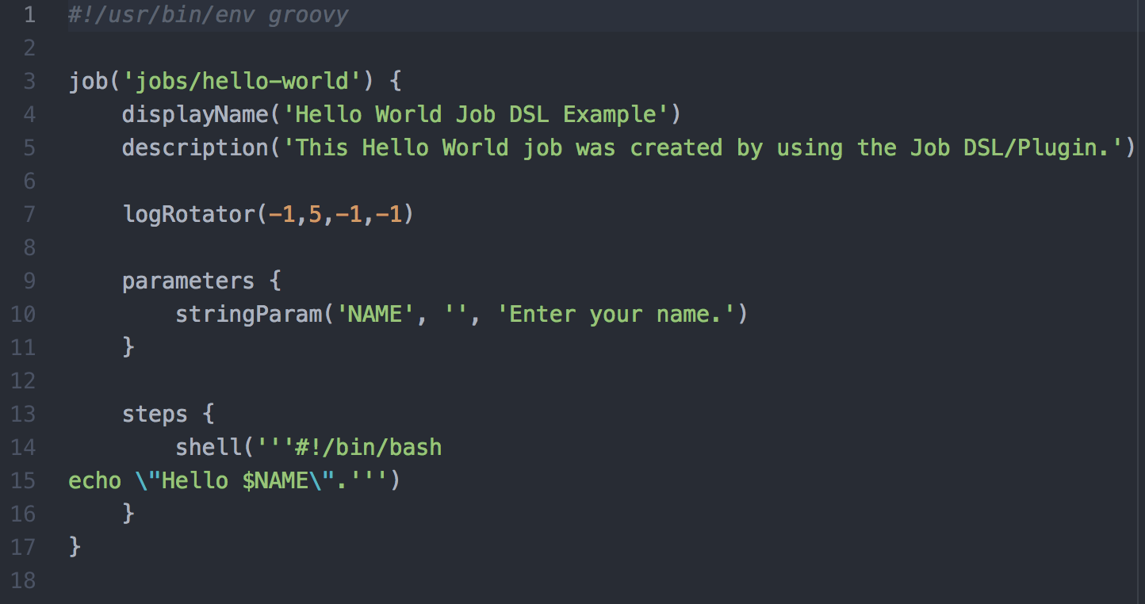
EXAMPLE: HELLO WORLD JOB DSL
@bpmericle
Notes:
best practice to use .groovy extension and use groovy declaration on the first line

Slide 10
FIRST JOB
Write and check-in your job script to a source code repository
Create “seed” job that references your DSL script from the source code repository
Execute “seed” job
Execute created job
Hello World…
@bpmericle
Notes:
Mention that you can also execute raw DSL through the UI, but where is the fun in that.

Slide 11
DEMO PREREQUISITES
Job DSL Plugin installed
Script names may only contain letters, digits and underscores, but may not start with a digit
A “seed” job is created through UI to execute DSL
Won’t work otherwise…
@bpmericle

Slide 12

DEMO
Jenkins Job as Code in Action

Slide 13
NOT SO FAST
ERROR: script not yet approved for use
Options?
Script Approval (All operations need administrator approval)
Groovy Sandboxing (All non-whitelisted operations need administrator approval)
Requires additional plugin and configuration (authorize-project)
Disable script security (All operations are allowed)
One more thing…
@bpmericle

Slide 14
JENKINS PIPELINES AS CODE
Programmatic Usage
@bpmericle

Slide 15
WHAT IS A PIPELINE?
Workflow process that typically follows continuous integration, delivery and deployment methodologies with the goal of taking an artifact from development to production.
Sequential set of stages, each containing steps specific to the goal of each stage.
Supports scripted and declarative methodologies
Why would I use that?
@bpmericle

Slide 16
FIRST PIPELINE
Write and check-in your pipeline DSL script
Update “seed” job to reference your pipeline DSL script
Execute “seed” job
Execute created pipeline job
Automated workflow…
@bpmericle

Slide 17
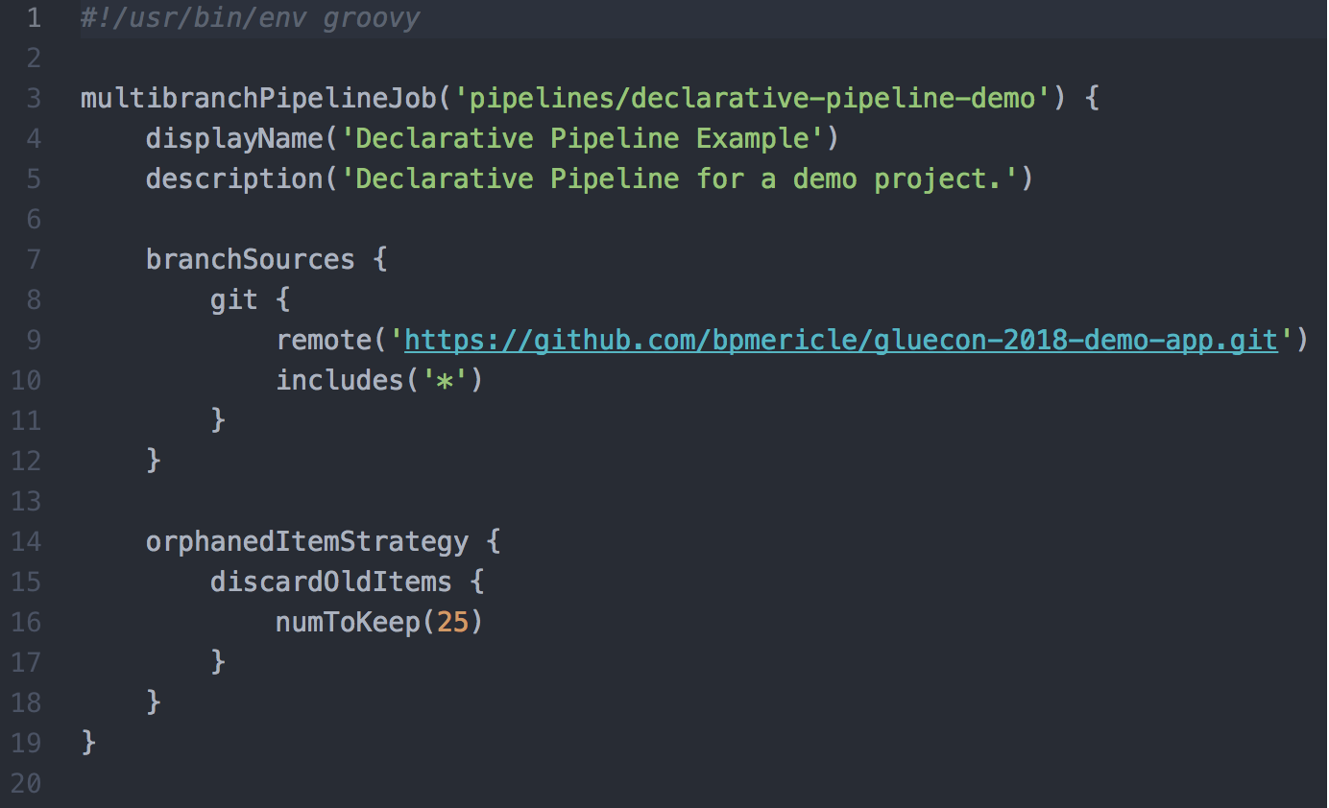
EXAMPLE: DECLARATIVE PIPELINE JOB DSL
@bpmericle
Notes:
best practice to use .groovy extension and use groovy declaration on the first line

Slide 18
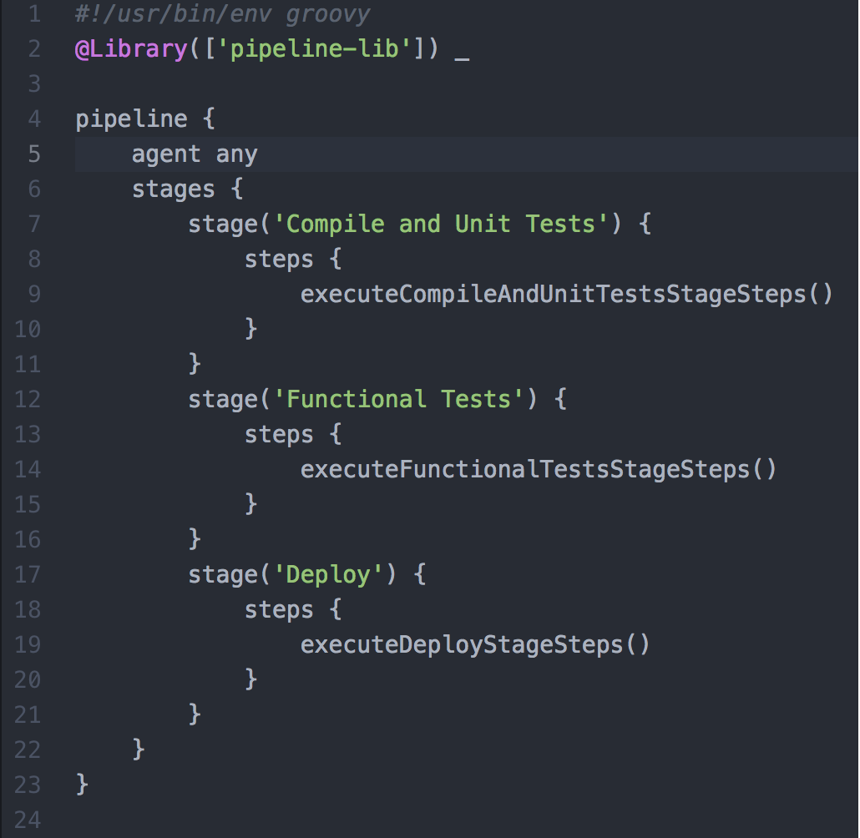
EXAMPLE: DECLARATIVE PIPELINE DEFINITION
@bpmericle

Slide 19
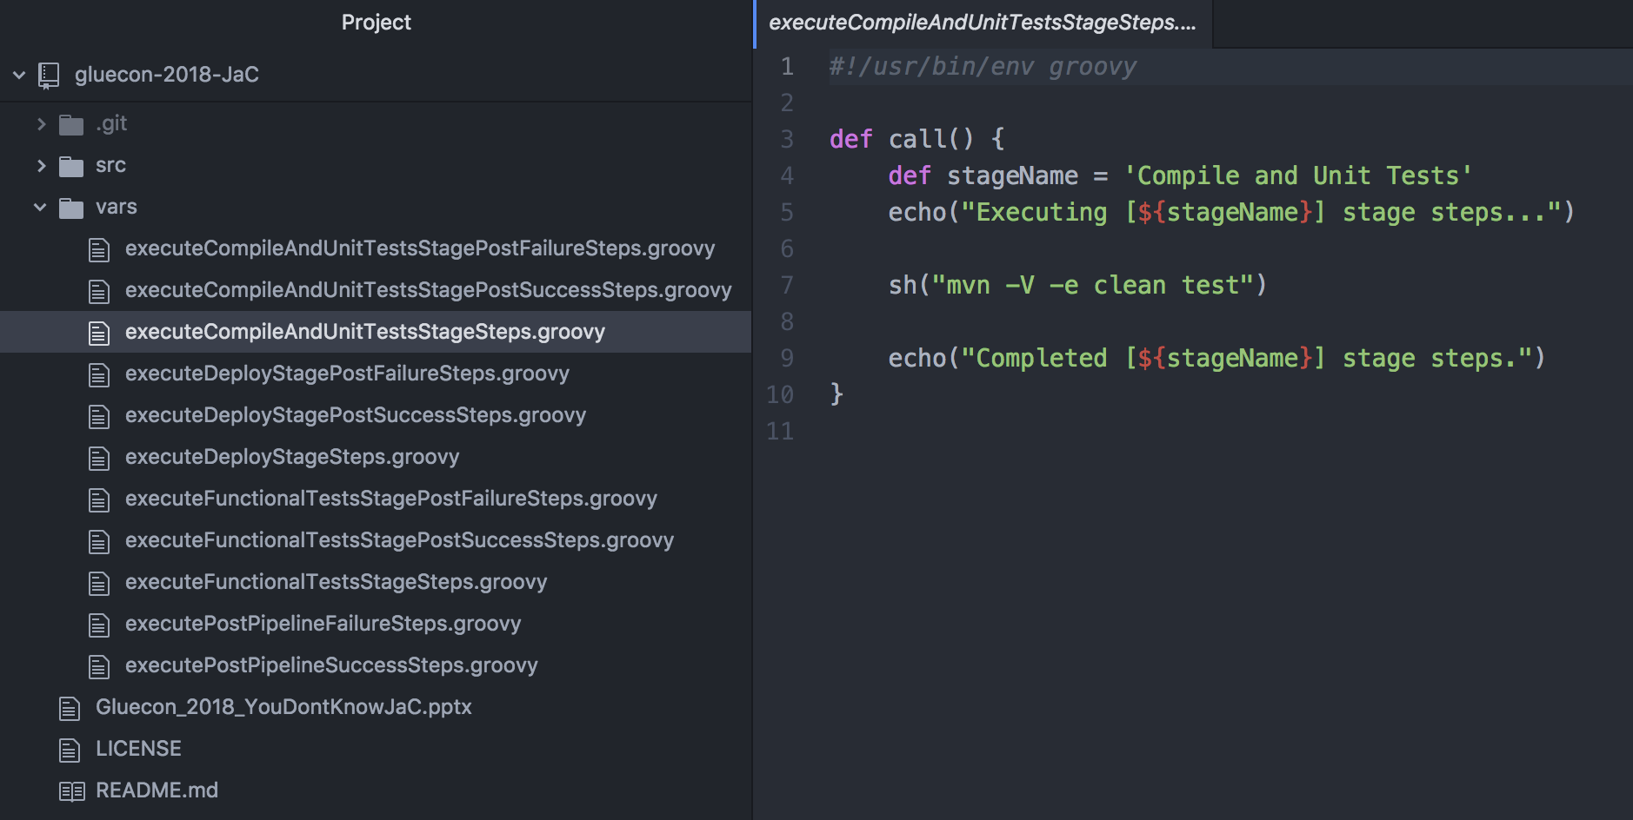
EXAMPLE: Pipeline Library Function
@bpmericle

Slide 20
DEMO PREREQUISITES
Job DSL Plugin installed
Authorize Project Plugin installed
Script names may only contain letters, digits and underscores, but may not start with a digit
A “seed” job is created through UI to execute DSL
Won’t work otherwise…
@bpmericle

Slide 21
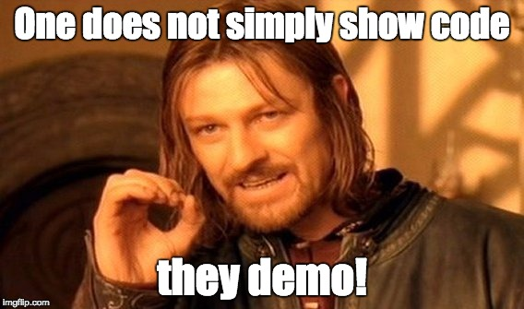
Notes:
Demo seed job creation and execution

Slide 22

RESOURCES
Job DSL
Job DSL API
Groovy API (Documentation)
Script Security Plugin
Authorize Project Plugin
Pipeline
Pipeline Declarative Model
Pipeline shared Libraries
Pipeline Steps
Basic Steps
Utility Steps

Slide 23


Slide 24





THANK YOU!
Contact Information
brian.mericle@gmail.com
@bpmericle
https://www.linkedin.com/in/brianpmericle
https://www.slideshare.net/BrianMericle/gluecon-2018-JaC
https://github.com/bpmericle/gluecon-2018-JaC

