Slide 1

You don't know JaC?
Managing Jenkins as Code
DFW Jenkins Area Meetup
9/05/2017
Brian Mericle
Distinguished Engineer,
Choice Hotels

Slide 2

About Me
Distinguished Engineer (1st @ Choice Hotels)
Seventeen years of software development experience
Seven years of IT leadership experience
Five years of CI/CDD automation experience
Jenkins user since 2005

Slide 3
Agenda
Jenkins as Code
Demo
Q&A
What will be covered

Slide 4
Jenkins as Code
Programmatic Usage

Slide 5
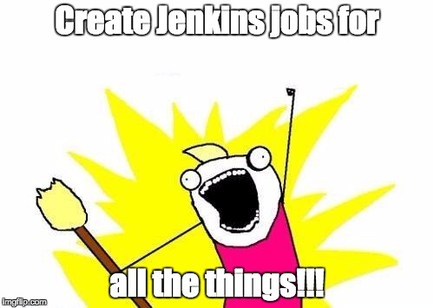

Slide 6
Job dsl/Plugin
DSL
Plugin
Scriptable groovy-based domain specific language (DSL)
Allows total manipulation of job configuration xml
Provides common functions for job configuration
Allows DSL scripts to be executed within a job
Allows DSL scripts to be pulled from source control
Allows multiple DSL scripts to be referenced at time

Slide 7
Interesting Facts about Job DSL/Plugin
Plugin forked from Java Posse Roundup in 2011
64 versions since 2011
59 releases since 2011
153 contributors since 2011
Maybe…

Slide 8
Should I use this?
Pro
Con
Changes can be versioned in source control, tested and peer reviewed
Libraries can lead to reusability
Automatic creation/modification of referenced jobs
Automatic deletion of unreferenced jobs
Flexibility to enhance built-in components
Apply programmatic job permissions
DSL learning curve
Lead time to job creation/modification
Assigning responsibility & accountability
Notes:
Example of flexibility is around programmatically prefilling job parameters.

Slide 9
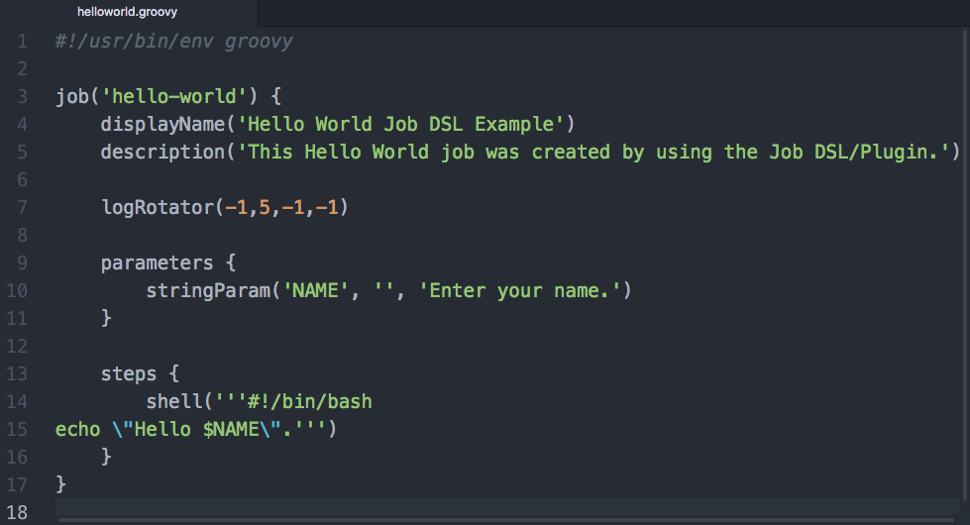
Example: Hello World Job DSL
Notes:
best practice to use .groovy extension and use groovy declaration on the first line

Slide 10
Demo
Jenkins as Code in Action

Slide 11
Prerequisites
Job DSL Plugin installed
Script names may only contain letters, digits and underscores, but may not start with a digit
A “seed” job is created through UI to execute DSL
Won’t work otherwise…

Slide 12
First Job
Write and check-in your job script to a source code repository
Create “seed” job that references your DSL script from the source code repository
Execute “seed” job
Execute created job
Hello World…
Notes:
Mention that you can also execute raw DSL through the UI, but where is the fun in that.

Slide 13

Notes:
Demo seed job creation and execution

Slide 14
Not so fast
ERROR: script not yet approved for use
Options?
Script Approval (All operations need administrator approval)
Groovy Sandboxing (All non-whitelisted operations need administrator approval)
Requires additional plugin and configuration (authorize-project)
Disable script security (All operations are allowed)
One more thing…

Slide 15
Pipeline?
Workflow process that typically follows continuous integration, delivery and deployment methodologies with the goal of taking an artifact from development stage to production.
Sequential set of stages, each containing steps specific to the goal of each stage.
Supports scripted and declarative methodologies
Why would I use that?

Slide 16
Continuation-passing style (CPS)
Methods don’t return, they result in a call to a supplied function (continuation/callback)
Custom Groovy Interpreter (groovy-cps)
Pipeline Groovy Plugin (main use case)
All pipeline variables need to be serializable for durability
Only subset of Groovy functionality available due to interpreter
Leverage broader subset of Groovy functionality with @NonCPS annotation
I know what you will do next…

Slide 17
First Pipeline
Write and check-in your pipeline DSL script
Update “seed” job to reference your pipeline DSL script
Execute “seed” job
Execute created pipeline job
Hello World Redux…

Slide 18
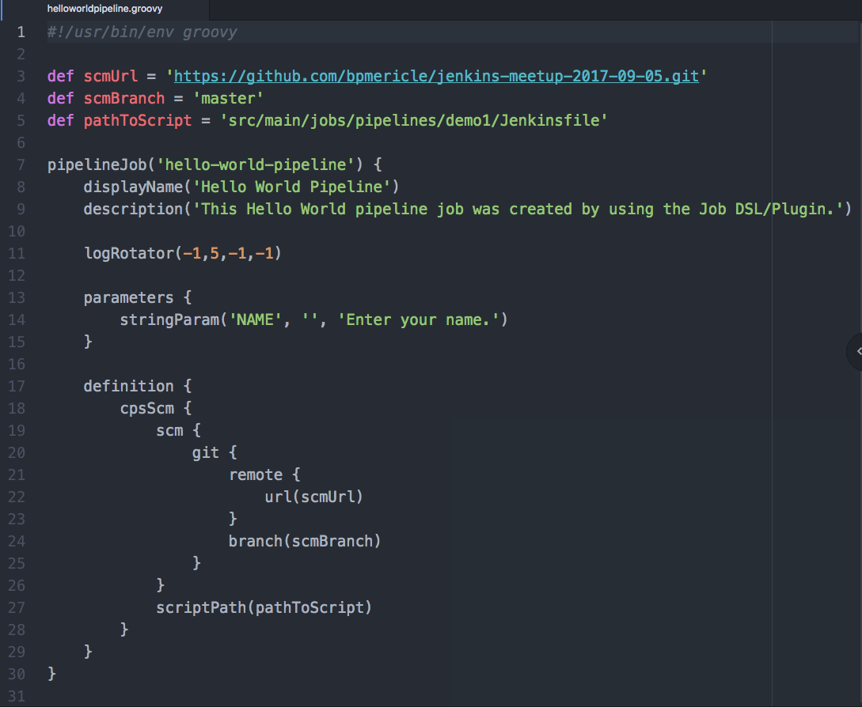
Example: Hello World PipeLine Job DSL
Notes:
best practice to use .groovy extension and use groovy declaration on the first line

Slide 19
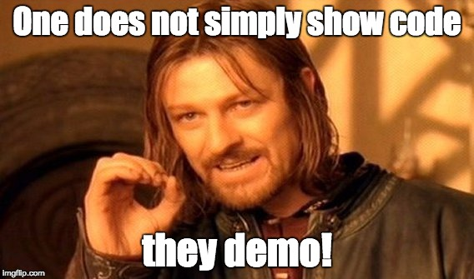
Notes:
Demo seed job creation and execution
Update seed to reference new path: src/main/jobs/pipelines/demo1/helloworldpipeline.groovy

Slide 20
Second Pipeline
Write and check-in your pipeline DSL script using a shared library
Update “seed” job to reference your pipeline DSL script
Execute “seed” job
Execute created pipeline job
Hello World Tertiary…

Slide 21

Notes:
Demo seed job creation and execution
Update seed to reference new path: src/main/jobs/pipelines/demo2/helloworldpipeline.groovy

Slide 22

Resources
Job DSL
Job DSL API
Groovy API (Documentation)
Script Security Plugin
Authorize Project Plugin
Pipeline
Pipeline Declarative Model
Pipeline shared Libraries
Pipeline Steps
Basic Steps
Utility Steps

Slide 23


Slide 24






Thank you!
www.choicehotels.com
brian.mericle@choicehotels.com
Contact Information
@bpmericle
https://www.linkedin.com/in/brianpmericle
https://www.slideshare.net/BrianMericle/managing-jenkins-as-code
https://github.com/bpmericle/jenkins-meetup-2017-09-05

