Slide 1
A radical new way to write
Patrick Kinsella

Slide 2
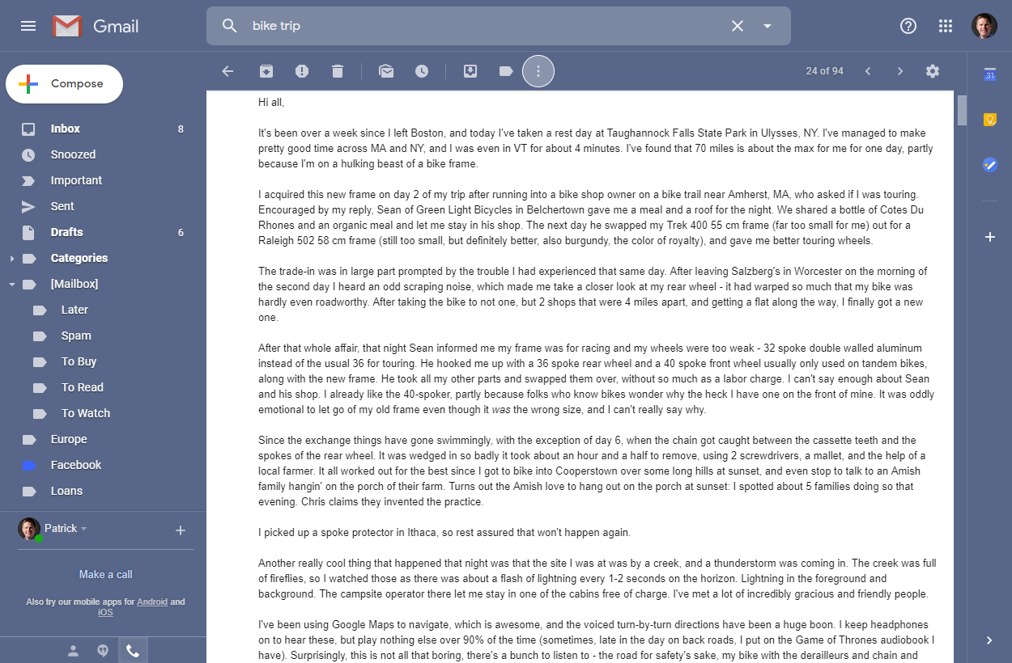
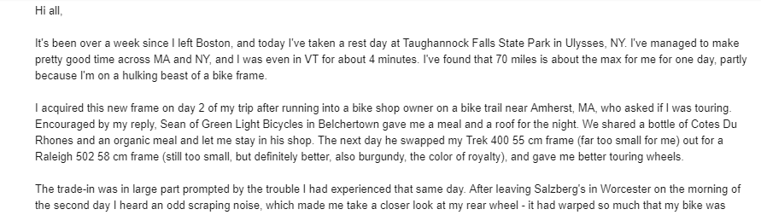
BACKGROUND
I love to write. When I write to share, I prefer email. The example below could also be a journal entry, if I had chosen to keep it private.
Subject heading: Bike Trip Update Date and time sent: June 20, 2014, 4:00 PM
Notes:
I love to write. One of my favorite things to do is write down whatever comes to mind - pure stream of consciousness.
It’s like the act of writing reveals within me aspects of myself I would not otherwise see. Putting words on a page is like an experiment, a test to see what I really meant in the first place. Journaling is really important to me, and I set out to make it easier to do on my computer.

Slide 3
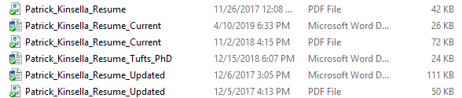
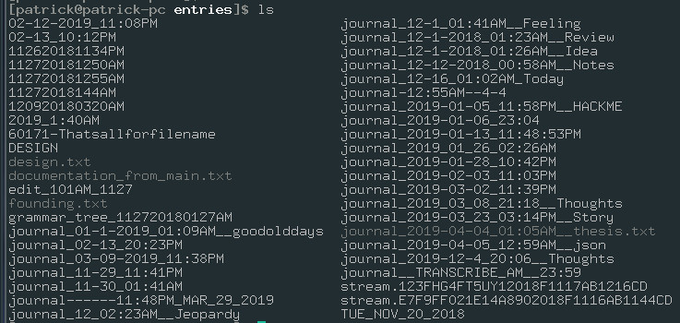
BACKGROUND
When I want the best possible guarantee of digital privacy, I have to name and organize entries on my local machine. And my filesystem is a mess!
Actual screenshot of a folder of journal entries from a time before I became enlightened
Notes:
I enjoy the challenge, and it often takes a lot of attempts before I write something I feel is worth reading again. I get distracted very easily.
My filesystems are organized about as well as I can manage. By which I mean my filesystems are incredibly disorganized. Picture the closet of a college junior on parent’s weekend.
A Web application creates an opportunity to abstract away the challenges of file management, and make my entries available from any device.

Slide 4
THE PROBLEM
If you want to journal digitally, you face the following issues:
Client applications often couple content and formatting, and have proprietary formats
Applications like Microsoft Word make it hard to extract the text of a journal entry
Online applications often put purpose before content, and have mixed incentives
This clutters the interface with things unrelated to writing
Saving entries on my machine requires large organizational overhead
Organizing folders and naming files is a challenge that prevents new writing and retrieval of old writing
Using a filesystem makes it very challenging to store and query entry metadata
Saving entries online blurs privacy boundaries
The client/server model from social media companies like Facebook blurs privacy boundaries, despite what Mark Zuckerberg tells you
Notes:
If you’re writing a journal entry, there’s no shortage of apps to choose from. However, very few actually support the needs of a journal: a simple interface where entries are very easily created, organized, and retrieved.

Slide 5






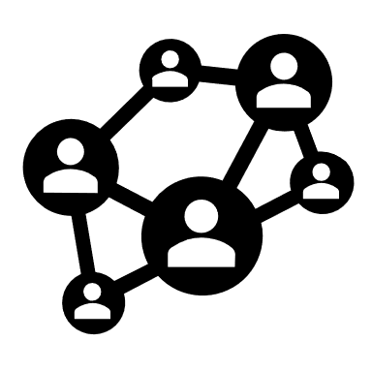


THE SOLUTION
Make it as easy as possible to record text
Make it easy to retrieve – from any device or application
Make it possible to apply a context to it later
Notes:
The goal is to make it as easy as possible to record your thoughts. A simple text prompt is all that’s necessary for writing, just like putting a pen to paper.
You should be able to do so from any of your devices. The current Web offers an excellent medium for doing so, due to its universal adoption and availability across platforms.
You should have the freedom to do what you want with that content, whether it be downloading, sharing, or sending messages in short or long form.
Throughout this all we must do as much as possible to maintain reasonable privacy guarantees.

Slide 6


QUICK EXPERIMENT
Let’s do a quick experiment: Write something down on an electronic device.
Write whatever comes to mind in the next 15-30 seconds.
Here is something to time yourself with if you need.
Notes:
Bear with me I promise this is going somewhere.

Slide 7
QUICK EXPERIMENT
Did you use a mobile device or a laptop? What application did you use?
Notes:
Your choice of application often affects your ability to use the content you created. If you used a client-side application, you probably had to save your entry in a proprietary format, as discussed earlier. You likely also had to save the file somewhere and give it a name.
If you used an online or a mobile application, your text is probably locked up in that application, only available with whatever share options are available in the application. For example, using Apple’s Notes, you can easily access your content from another Apple device… but how could you get this content from another device? You’d likely have to message it to yourself. If you used one device over another, you certainly shouldn’t be locked into using that device.

Slide 8
QUICK EXPERIMENT
Did you use a mobile device or a laptop? What application did you use?
How long did it take you to start writing?
Notes:
If it took more than opening the application to start writing, then we have a problem.

Slide 9
QUICK EXPERIMENT
Did you use a mobile device or a laptop? What application did you use?
How long did it take you to start writing?
In its current form, would it be possible to share what you wrote? How?
Notes:
This part is critical. Platforms have an incentive to keep content creators on their platform, so they can generate profit by serving content with ads or by some other means. These incentives are not often aligned with your own as a writer.
If you can only share content within the platform, or if there are significant hurdles to sharing content outside the platform, then that platform is dictating your use of the content.

Slide 10
IMPLEMENTATION
Overview
I chose to implement JournalPro as a Web application written in Flask with a sqlite/postgres backend
Database models are supported with sqlalchemy, and migrations are supported with flask-migrate, a wrapper for alembic.
This means all database code is written in Python and converted to SQL with flask commands
Styling is done with bootstrap, which enabled me to get up and running quickly. I underestimated the amount of time it would take to fully understand bootstrap

Slide 11
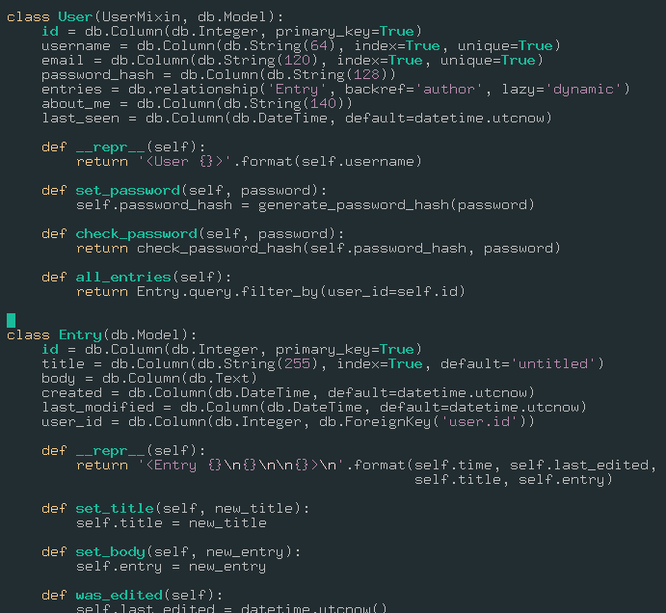
IMPLEMENTATION
app/models.py
The User and Entry models are shown here
flask-sqlalchemy needs a class defined for each table, inheriting from db.Model
Each table has a set of fields which are given a type, and may be indexed or unique for better performance
The Entry table has a foreign key pointing to the author field
An entry has one author
An author has many entries
The generate_ and check_password_hash functions come from werkzeug
All of this Python is turned into SQL by flask-sqlalchemy and flask-migrate
After writing the Python, you only need to:
flask db migrate –m “message”
flask db upgrade
versions are stored in migrations/versions and can be rolled back

Slide 12
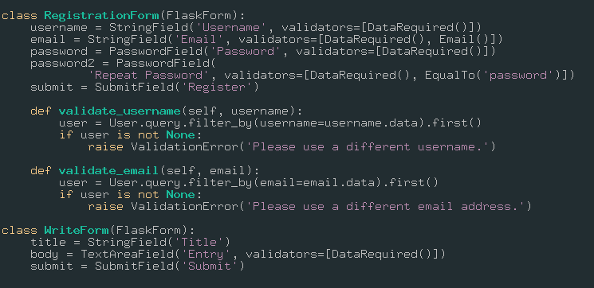
IMPLEMENTATION
app/forms.py
Forms in Flask are classes that inherit from FlaskForm
The flask-wtform package provides some validators by default, for example, DataRequired() make sure that data is provided in the form field
Custom validators may be supplied. In this example, user emails are validated on registration to ensure they are unique

Slide 13
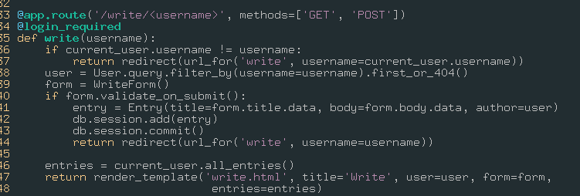
IMPLEMENTATION
app/routes.py
/write/<username>
The @login_required decorator ensures current_user (a proxy for the current user made available from the flask-login extension) is logged in
Checks whether user is current user
Presents the write form
Allows HTTP GET and POST methods
On a GET, the Write form is retrieved from app/forms.py, validate_on_submit() is false, and the route renders the page
On a POST, validate_on_submit() returns true if the form validates, in which case the entry is committed to the database and the user is returned to /write/<username> using a GET request – creating a brand new form

Slide 14
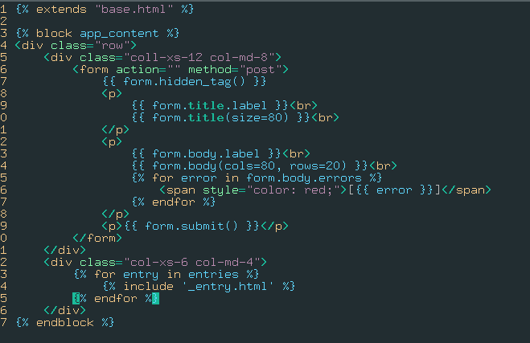
IMPLEMENTATION
form.hidden_tag() inserts a token in the page to prevent CSRF attacks!
When route called render_template(), it passes a view which is saved in the app/templates/ directory
This is the view for the /write/<username> route
The template uses Jinja2 to allow Python syntax in {% %} blocks for control flow and {{ }} blocks for dereferences
A template may extend another and insert content by using a given block name
Templates can also include the entire contents of another template using “include”

Slide 15
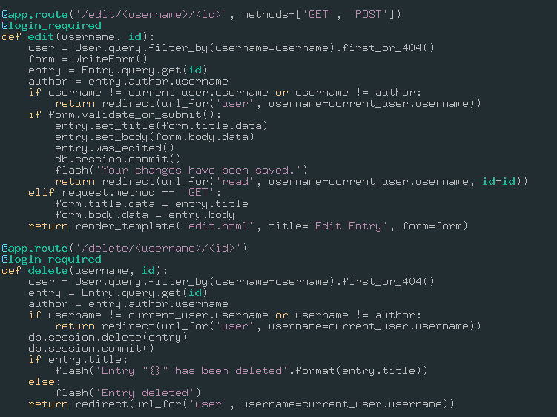
IMPLEMENTATION
app/routes.py
/edit/<username>/<id>
This route is very interesting: first, we verify that the user requesting the page is authorized
If the HTTP request method is POST, we check whether the form validates and commit the changes to the database
However, if the request method is GET, we pre-populate the title and body fields of the form so the user knows what was in the post they are trying to edit

Slide 16
IMPLEMENTATION
app/routes.py
/delete/<username>/<id>
This route is very similar to the last few
Importantly, the user is again authorized before an entry may be deleted
db changes must always be committed to persist
A message is flashed to the user that the entry has been deleted, including the title if there is one, and they are redirected to the user route, which renders all posts the user has written

Slide 17
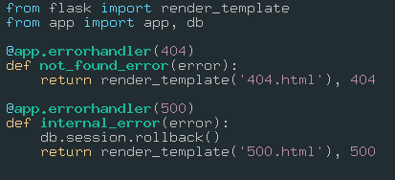
IMPLEMENTATION
The above covers the most interesting routes within my application
I also wrote some views not displayed here, including the entry and edit views
Flask offers an excellent base for starting a project, and it’s very easy to use built-in decorators and functions as well as those provided by extensions to get going
A cool example of the power of decorators. Decorators register callbacks for a function. In any other function, if the app returns a 404 or 500 HTTP status, these functions are registered as handlers and render templates for these errors so the user doesn’t see the direct error output from the server.

Slide 18
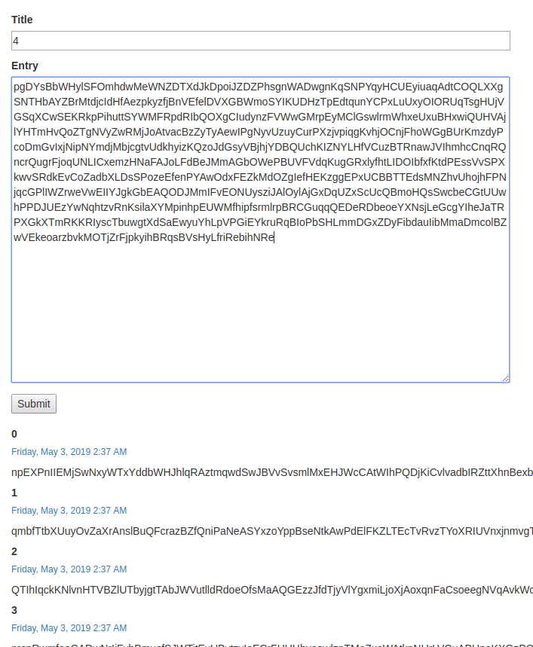
TESTING
To test, I created a test script named test.py using Selenium WebDriver
Selenium WebDriver is awesome
Selenium uses Chrome in automation mode
The test checks whether a user is logged in, and if so logs them out
It then logs in as the test user. If the test user does not exist, it registers one
It deletes any posts for the test user if they exist
Then it creates an arbitrary number of posts, and reports whether they were successfully created

Slide 19
TESTING
To use test.py, first install selenium with pip install selenium
test.py may take no arguments, in which case it creates 10 posts of 1000 characters each, titled 0-9, using only ascii letters
You can also supply arguments:
arg 1 is the number of posts you want
arg 2 is length of each post
arg 3 is 0 if you want ascii letters, 1 if you want all printable characters
All printable characters currently crashes the test script! I believe this is because it includes a character that submits the entry prematurely

Slide 20
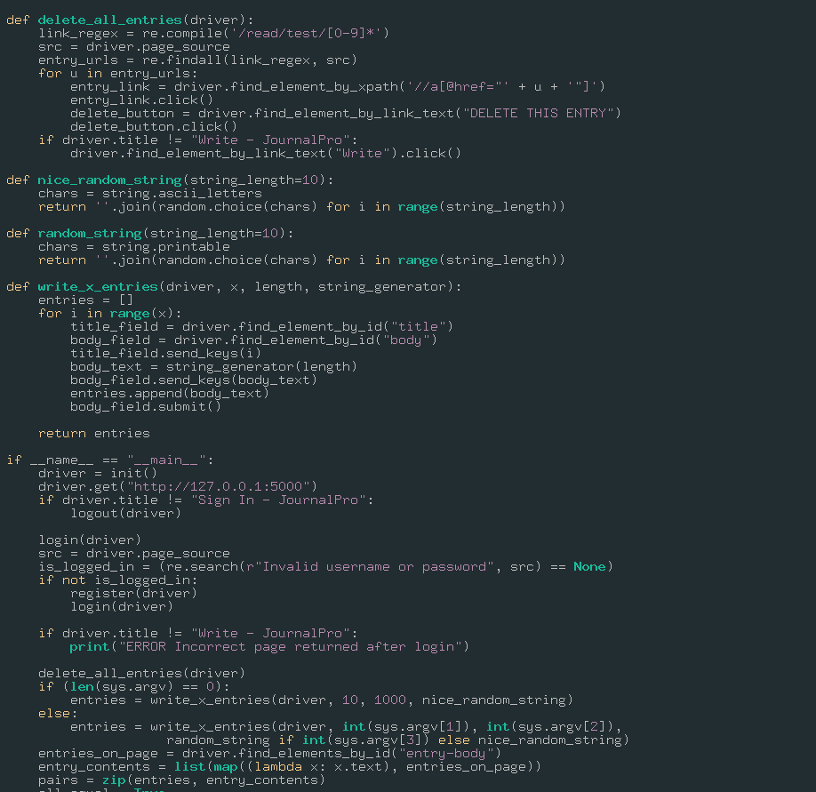
TESTING
Selenium could be extended to test lots more!
A sqlite db can be used to save posts over successive runs
It can test whether posts that should be private are visible by other users
It can test mutability of entries over time
and lots more!!
Notes:
I feel I have only scratched the surface of what WebDriver can do

Slide 21
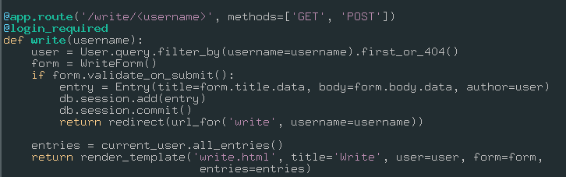
CHALLENGES
It’s VERY easy to make routes authorize users incorrectly
You can’t just use the @login_required decorator, in fact, a whole lot more is necessary.
As an example, I originally did not verify that the current user visiting the /write/<username> route had username <username>
This meant that user could create posts for any other user
Original code for this route only checks that the user exists in the database (User.query…)
It should also check that current_user.username == username

Slide 22
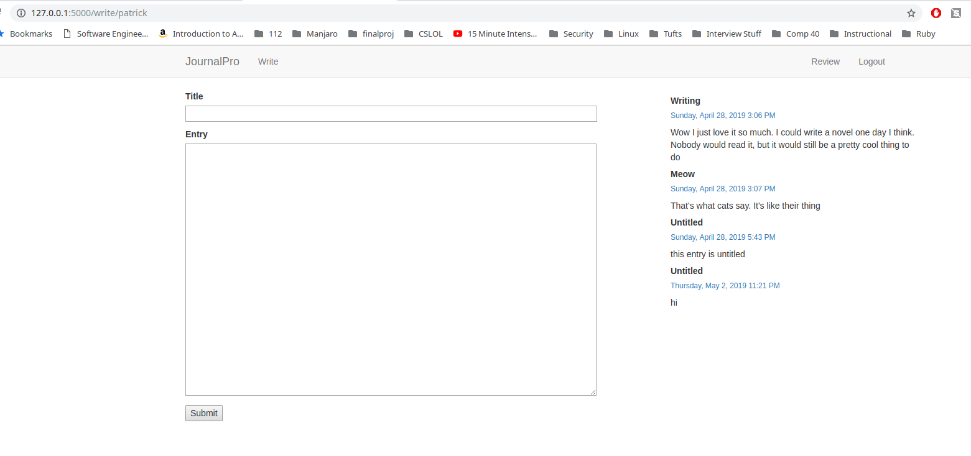
CHALLENGES
URL traversal illustrated Originally, I am logged in as the user Patrick. The /write/<username> route for username=patrick correctly shows my entries.

Slide 23
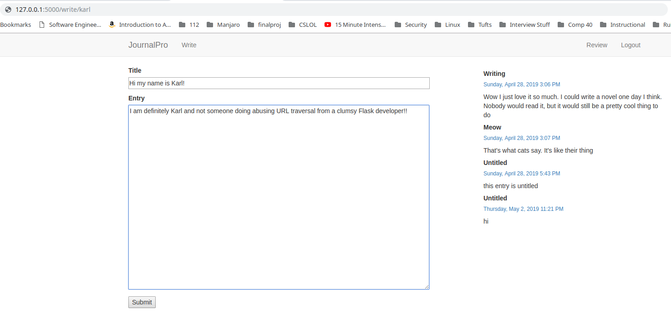
Challenges
URL traversal illustrated Writing karl in the username field of the URL, another user I created for testing, and refreshing the page, I see my posts again… but When I enter info in the form it will be added to karl’s entries

Slide 24
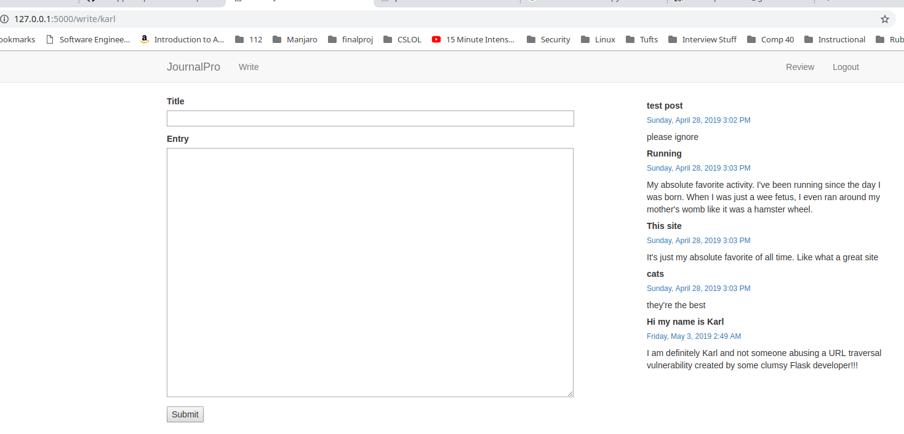
CHALLENGES
URL traversal illustrated Logging in as Karl we can see at the bottom of the posts list the malicious post… that’s bad!!

Slide 25
CHALLENGES
The updated code for the /write/<username> route is shown here
In the first two lines of the code, we now verify that the current user’s username is equal to that passed into the function
It’s a small but very important detail!

Slide 26
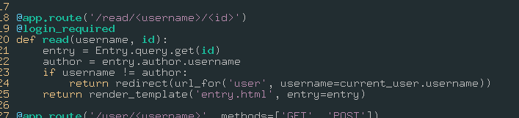
CHALLENGES
Originally, you could also traverse entries for other users as well, before I added similar logic to the above in the /read/<username>/<id> and /edit/<username>/<id> routes
These routes should use an entry hash instead of an id for this reason

Slide 27
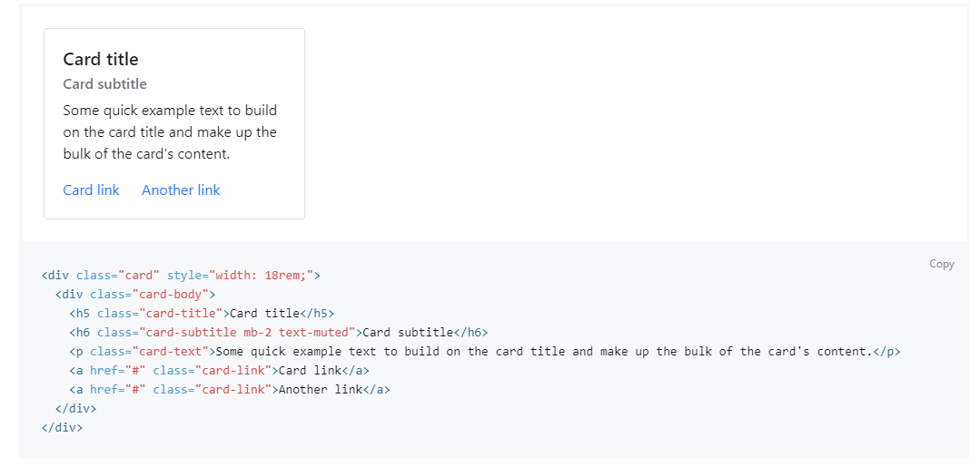
CHALLENGES
Styling is harder than it looks
Even when using bootstrap, certain styles did not look like they did in the bootstrap documentation
Although I tried manually including the stylesheet, I wasn’t able to successfully style these
Each of these cards should look like this

Slide 28
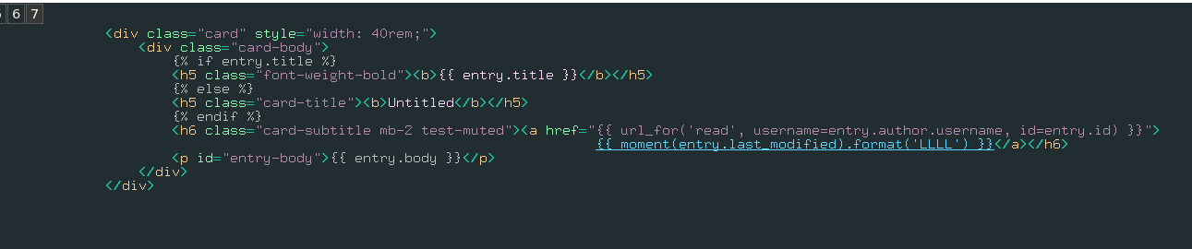
CHALLENGES
My CSS for each entry in /app/templates/_entry.html, using the card class from bootstrap
The same CSS from the bootstrap documentation for the card style

Slide 29

FUTURE WORKS
I want to make significant updates to the user experience for both styling content and ease of use
It would be awesome if a new entry was created for a double carriage return
I could accomplish this with some Javascript
This would allow users to create entries without clicking submit
Some formatting options like those in markdown documents would also be very useful to the user and a fun programming exercise
* bulleted lists
_italicized text_
*emphasis*
These could all be parsed by an engine on the backend, or with Javascript on the front-end

Slide 30
FUTURE WORKS
I have CRUD functionality up and running for the user interface, so I’d like to make this available over a REST interface
Documents would be delivered using JSON
This is key if the tool is to be used alongside existing modes of communication

Slide 31
FUTURE WORKS
nE11…
466553BD
47E62E6D
4999A24F
5114E4C6
52096FCA
2EC43E9C
5D7B0F03
B3B58F96
BBC65167
BBEF34FA
C14A5B94
E1136A57
EB6A6045
In the final stages of the tool’s development, I’d like to create a peer-to-peer back-end using a distributed hash table
This would offer the best privacy guarantees
When I say privacy guarantee, it’s a soft guarantee
Nodes would use the REST interface to communicate
nE11…
n5D7…
n47E…
n499…

Slide 32
FUTURE WORKS
Some additional QoL improvements are listed on the project’s README
Share by email
Follow other users
Upload files from your local filesystem

Slide 33
THANK YOU
Thank you Ming for all the support over the last couple years!!!
I couldn’t have gotten started on this gargantuan idea without you.
Working on this project has given me a foothold to learn and build even more. It forced me to make some very abstract ideas concrete, and also taught me that some of the things I thought would be simple are not so simple. And sometimes, it’s just a matter of getting started!

