Slide 1
Modeling, Control, and Planning of a 3-Wheel Omni Robot
Bhavya Oza
N19241430
Autonomous Mobile Robots

Slide 2
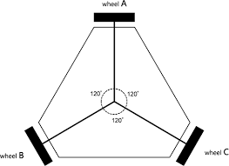
Project Overview
This project explores the complete AMR pipeline using a 3-wheel omni-directional robot, covering:
System modeling (kinematics & dynamics)
Advanced control (PI, Sliding Mode Control)
Safe navigation using Control Barrier Functions (CBF)
Motion planning using Potential Fields
Simulation in MATLAB / Simulink and Python
All work version-controlled using Git

Slide 3
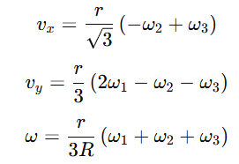
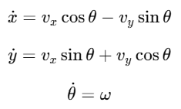
System Modelling
3-Wheel Omni Robot
Holonomic, fully actuated platform
Wheel speed → Body velocity ; Body Frame → World transformations:
Parameters: wheel radius, robot geometry, sampling time
💡Why dynamics? Enables realistic control and robustness testing.
First-order motor dynamics per wheel
Discrete transfer function model in Simulink

Slide 4
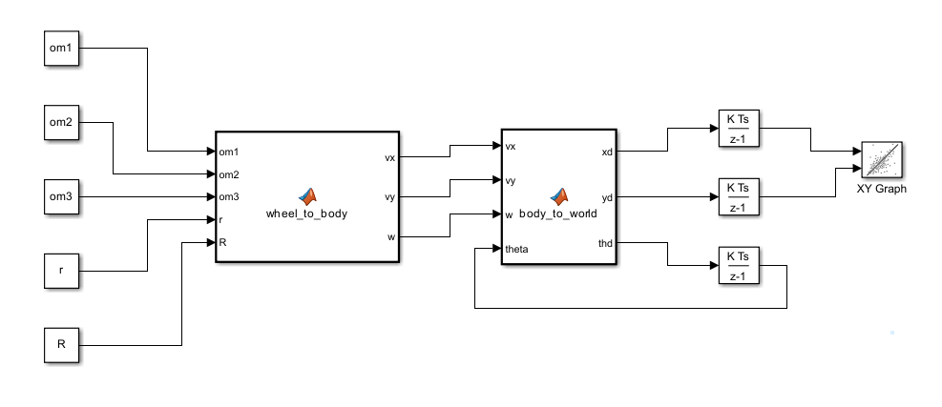
Kinematic model
Robot Parameters:
r→ wheel radius
R→ dist from robot center to each wheel
Vx → body-frame velocity in x (forward)
Vy → body-frame velocity in y (sideways)
w → body angular velocity
x_d → world-frame velocity in x
y_d → world-frame velocity in y
th_d → world angular velocity = θ
Om1, om2, om3 → wheel speeds
Wheel speeds om1, om2, om3 in rad/s determine the direction of robot

Slide 5
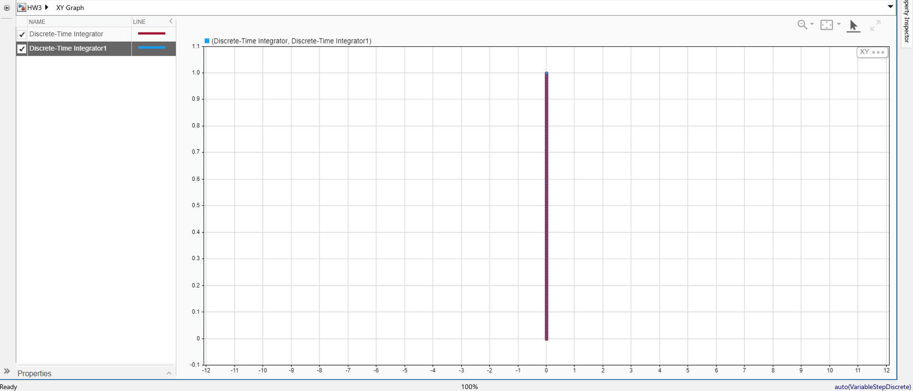
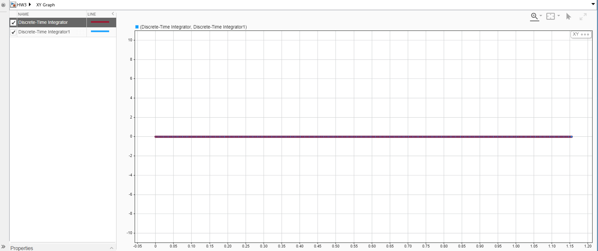
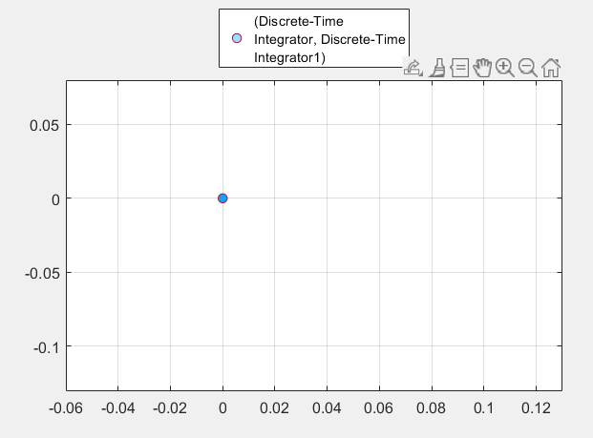
Outputs
Test case 1: om1=2, om2=-1, om3=-1
Test case 2: om1=0, om2=-2, om3=2
Test case 3:om1=2, om2=2, om3=2 (Spin in place)

Slide 6
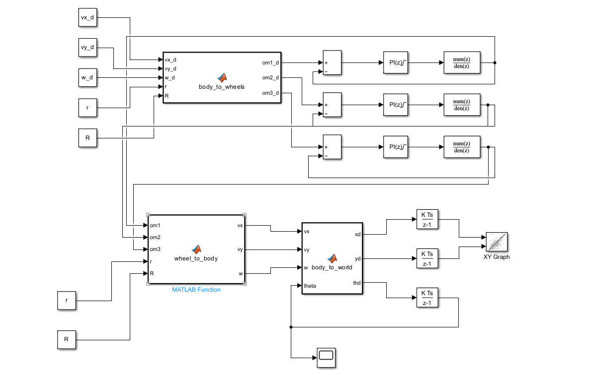
Simulink model with dynamic controller
Body velocities Vx, Vy, ⍵d determine motion in given command- straight line, spin or circular motion

Slide 7
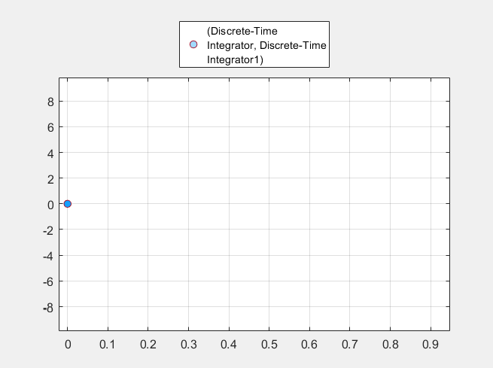
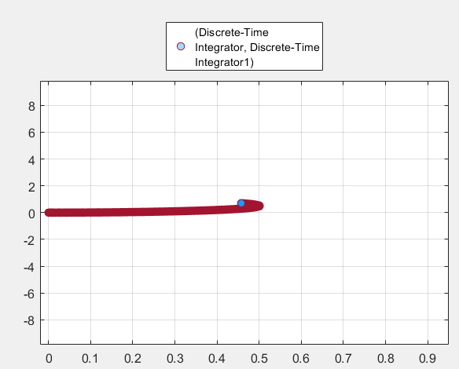
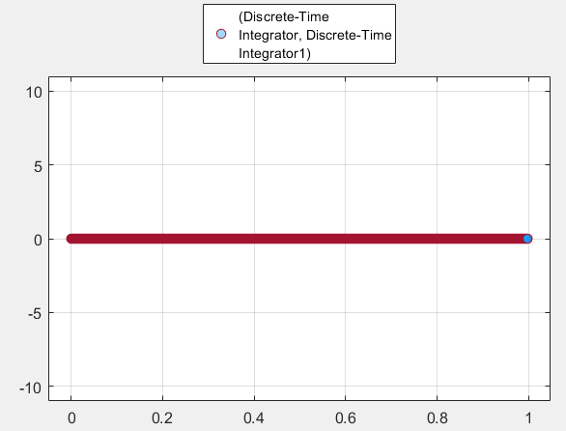
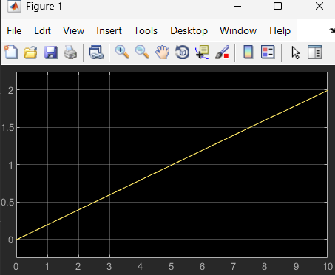
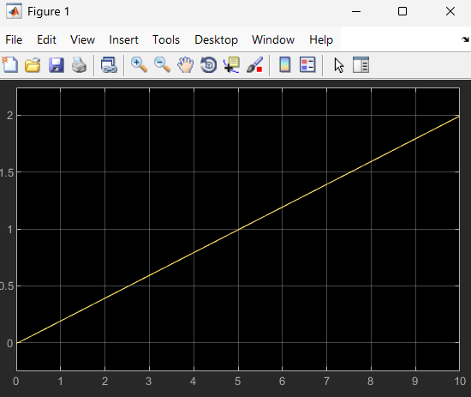
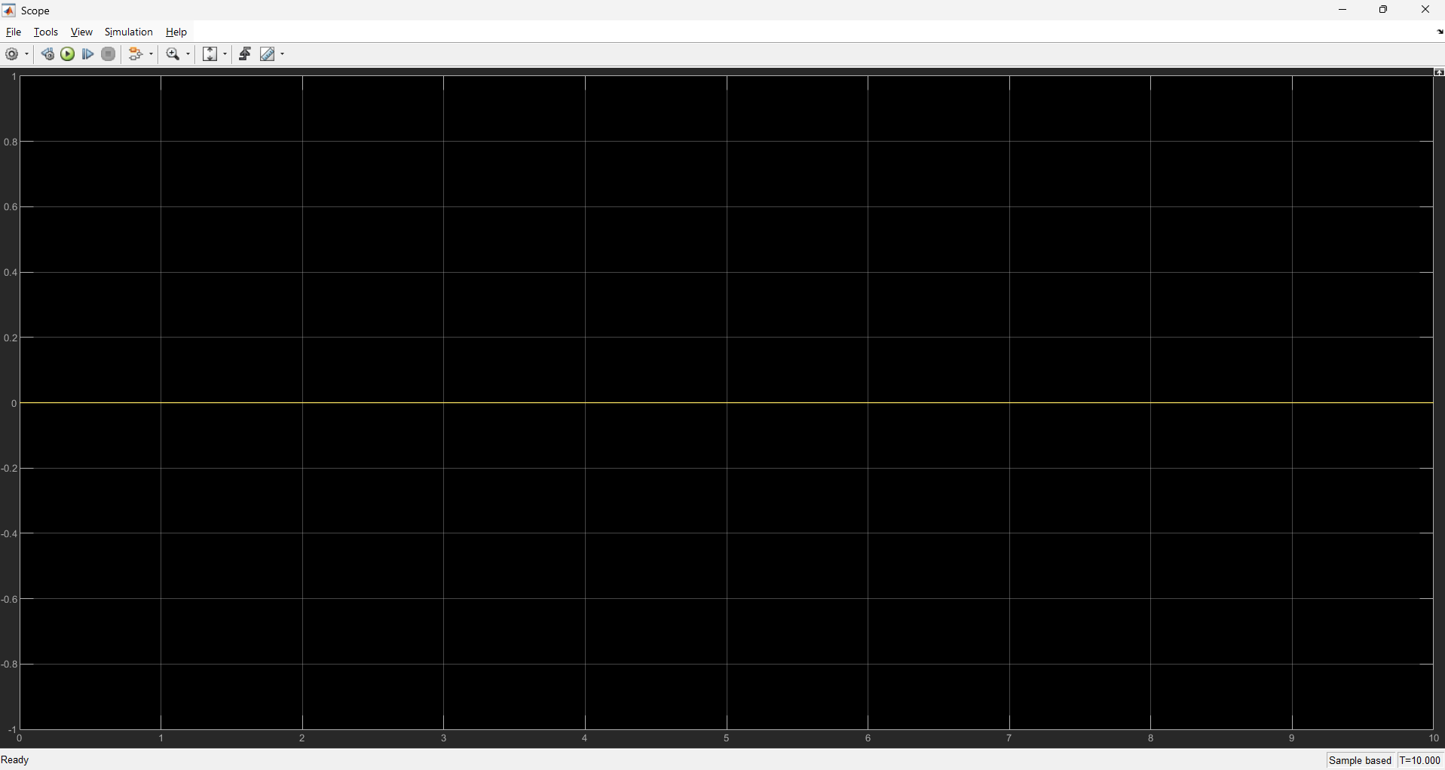
Outputs
Test case 1: Pure spin at same position
Test case 2: Circular Motion
Test case 3: Straight line motion

Slide 8

Control Methodology
Baseline: PI Control
Removes steady-state error
Simple but disturbance-sensitive
Advanced: Sliding Mode Control (SMC)
Robust to uncertainties
Enforces convergence using sliding surface:

Slide 9


Sliding Mode Control Details
SMC Control law:
c →Sliding surface gain
u →Control input to wheel motor
This guarantees:
Reachability condition:
Fast error convergence
Stable wheel tracking

Slide 10
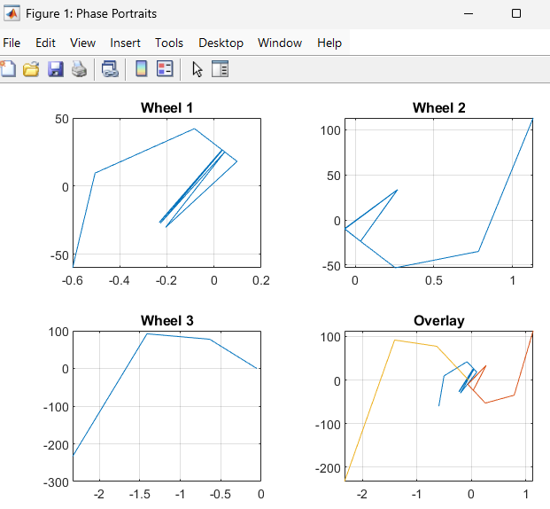
Control Results
Observed Results
Phase portraits: e vs ė
Sliding surfaces bounded and stable
Accurate tracking for:
  Straight line
  Spin in place
  Circular motion
📊 Demonstrates closed-loop stability

Slide 11
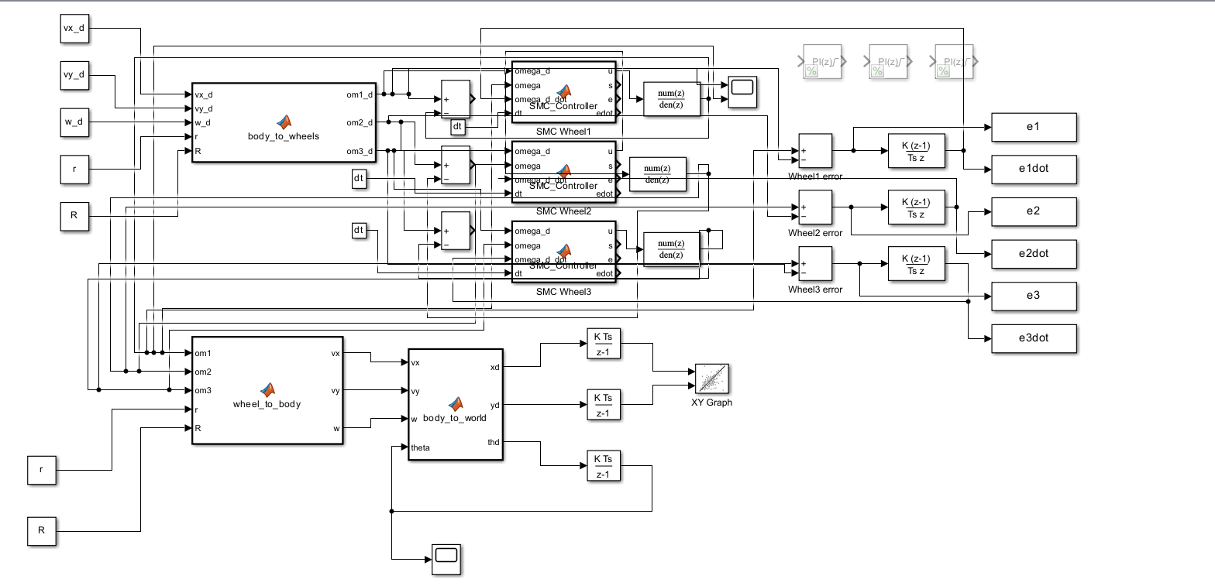
Updated simulink model with Sliding Mode Controller (SMC), wheel-level error feedback, discrete wheel dynamics, kinematic transformations

Slide 12
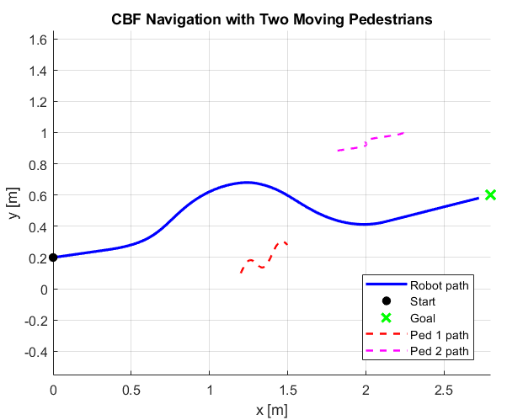

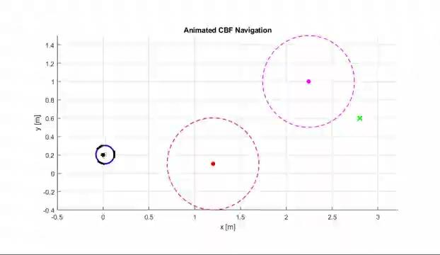
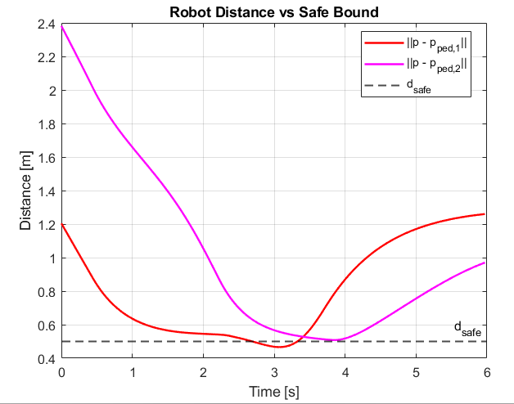
Safe navigation with CBF
Goal: Reach target while avoiding pedestrians
Barrier function:
CBF condition:
Guarantees safety at all times

Slide 13
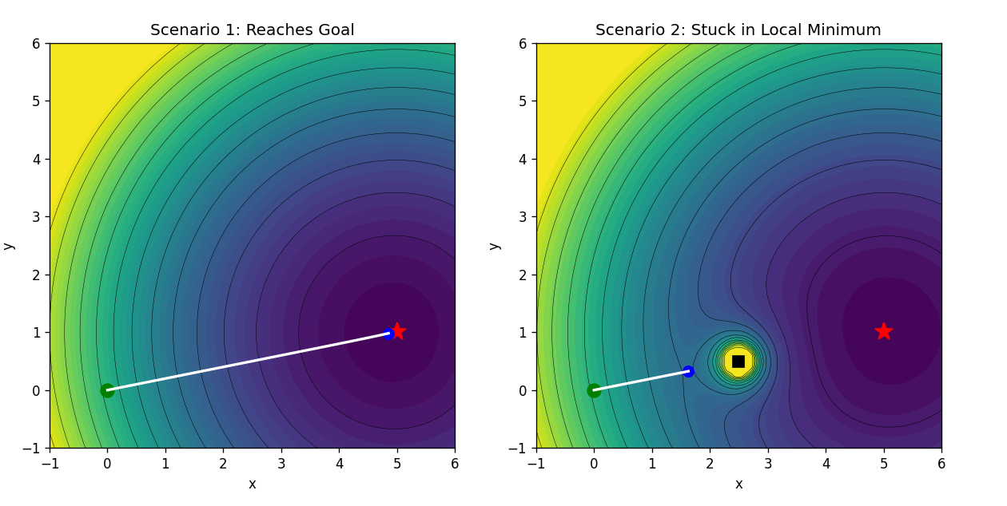

Motion Planning (Potential Fields)
Total potential:
Attractive force → goal
Repulsive force → obstacles
Two scenarios:
Success: robot reaches goal
Failure: robot stuck in local minimum
📌 Shows strengths and limitations of potential fields

Slide 14
Results & Challenges
Results:
Robust tracking via SMC
Safe navigation via CBF
Clear planning success & failure cases
Full animations generated
Challenges
Simulink signal dimensions
Workspace logging
Local minima
Git cache management
✔ Resolved through tuning & structure

Slide 15
Conclusion
Complete AMR workflow implemented
Strong link between theory and simulation
Clear understanding of control, safety, and planning
🔗GitHub Repository

Slide 16
THANK
YOU

