Slide 1
Bhavya Oza
N19241430
AMR HW1
Project topic proposal
Title - 3 wheeled omni Robot
The 3-wheel omni robot is unique because it is holonomic; it can move in any direction and rotate at the same time. This capability makes it flexible, efficient in tight spaces, and a good choice for indoor robotics and research platforms.
Why This Robot
I have chosen the 3-wheel omni robot because it provides a clear and balanced example to study the three main aspects of AMRs:
Modeling: The robot has simple equations of motion that directly relate wheel speeds to motion in x, y, and rotation. This makes it easier to analyze.
Control: Since it is fully actuated(DoF = number of actuators), different controllers can be applied, ranging from simple linear methods to advanced predictive approaches.
Planning: The omni robot does not have turning radius limitations, so path planning algorithms can generate feasible paths more easily.
Conclusion
The 3-wheel omni robot was selected because it combines simplicity in modeling, flexibility in control, and ease of integration with planning algorithms. It also provides a strong contrast to non-holonomic robots, making it useful for understanding key AMR concepts.
References
https://ieeexplore.ieee.org/stamp/stamp.jsp?tp=&arnumber=7399030
https://www.sciencedirect.com/science/article/pii/S1474667016335807
https://ieeexplore.ieee.org/abstract/document/9105899

Slide 2
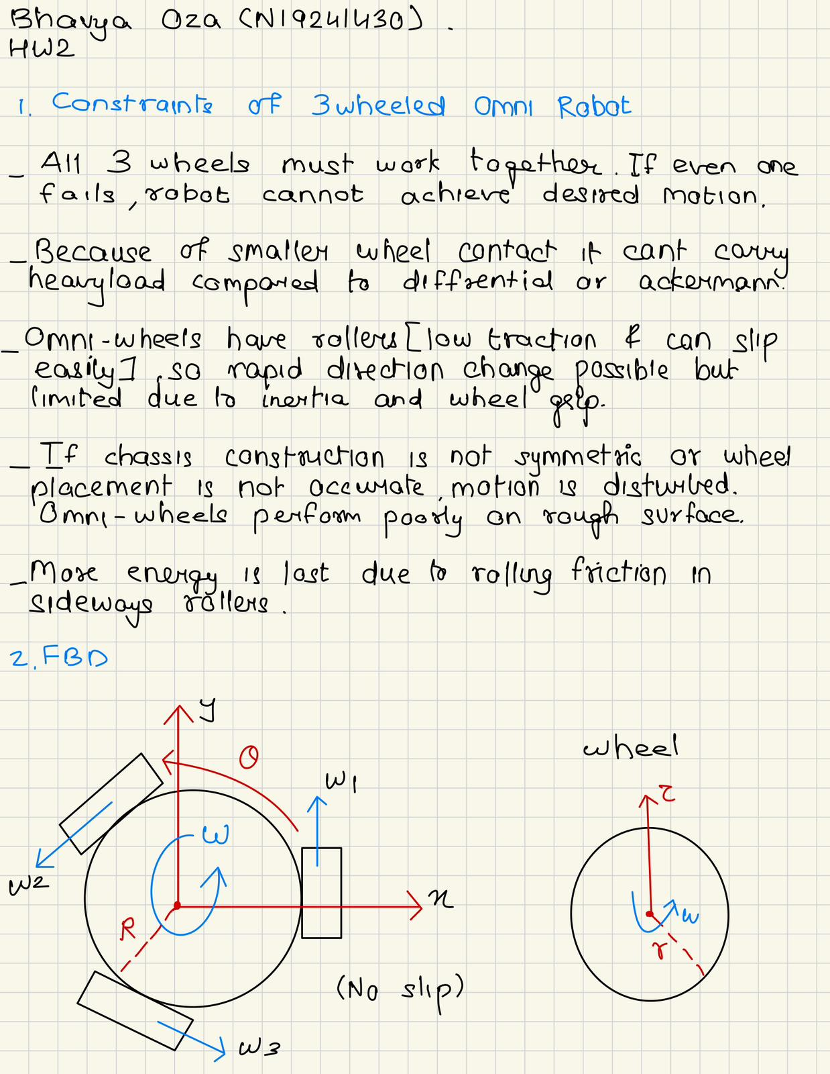
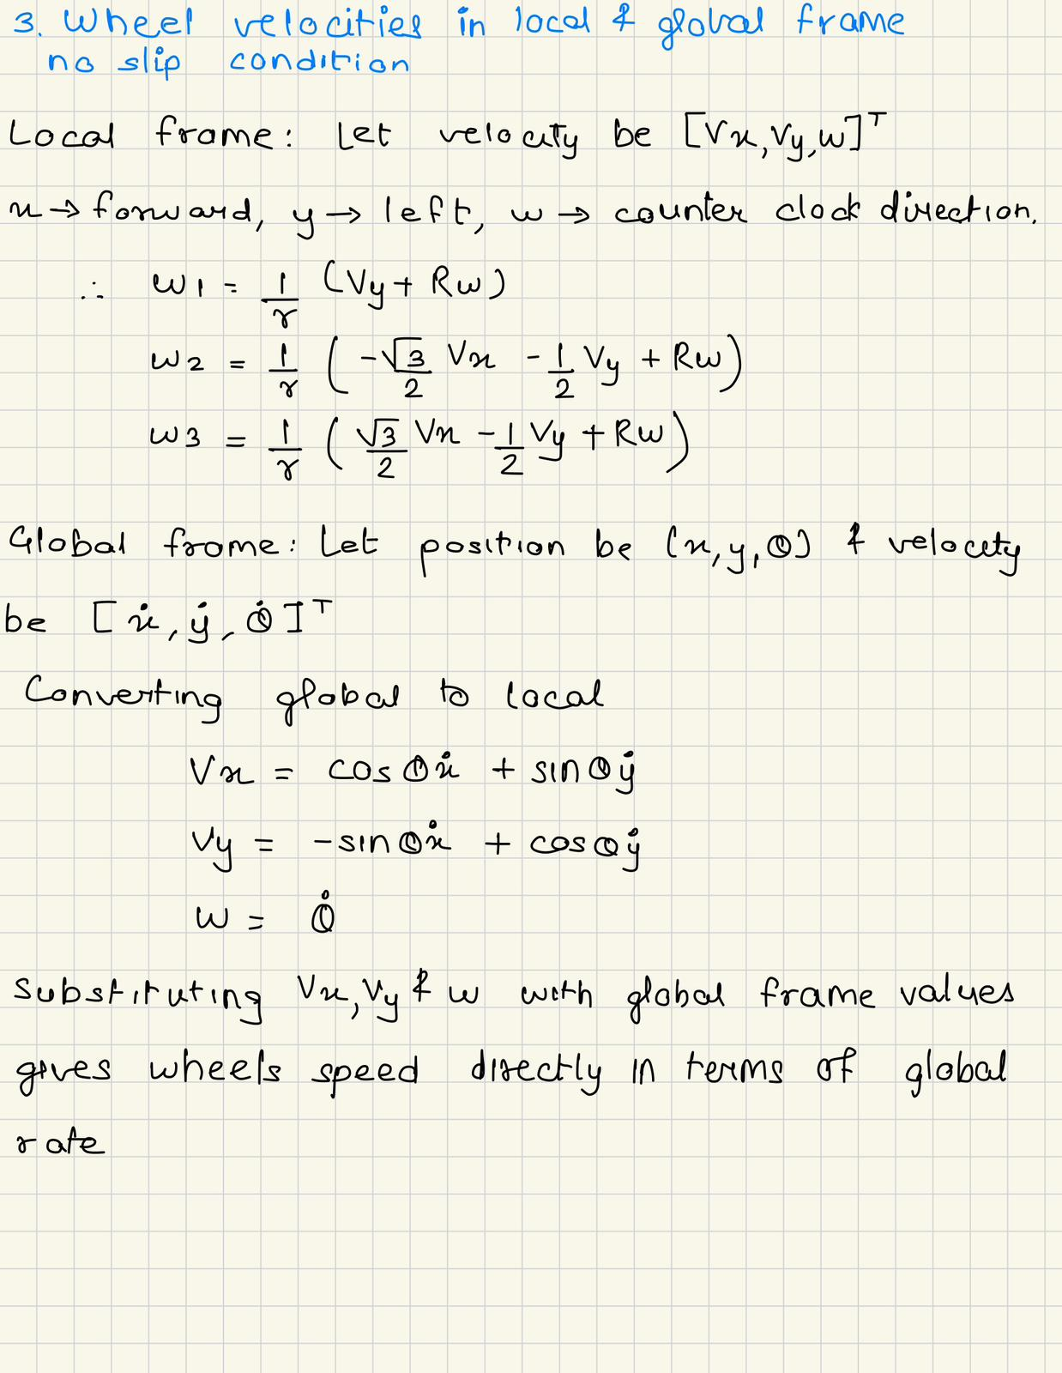
Bhavya Oza
N19241430
AMR HW2

Slide 3
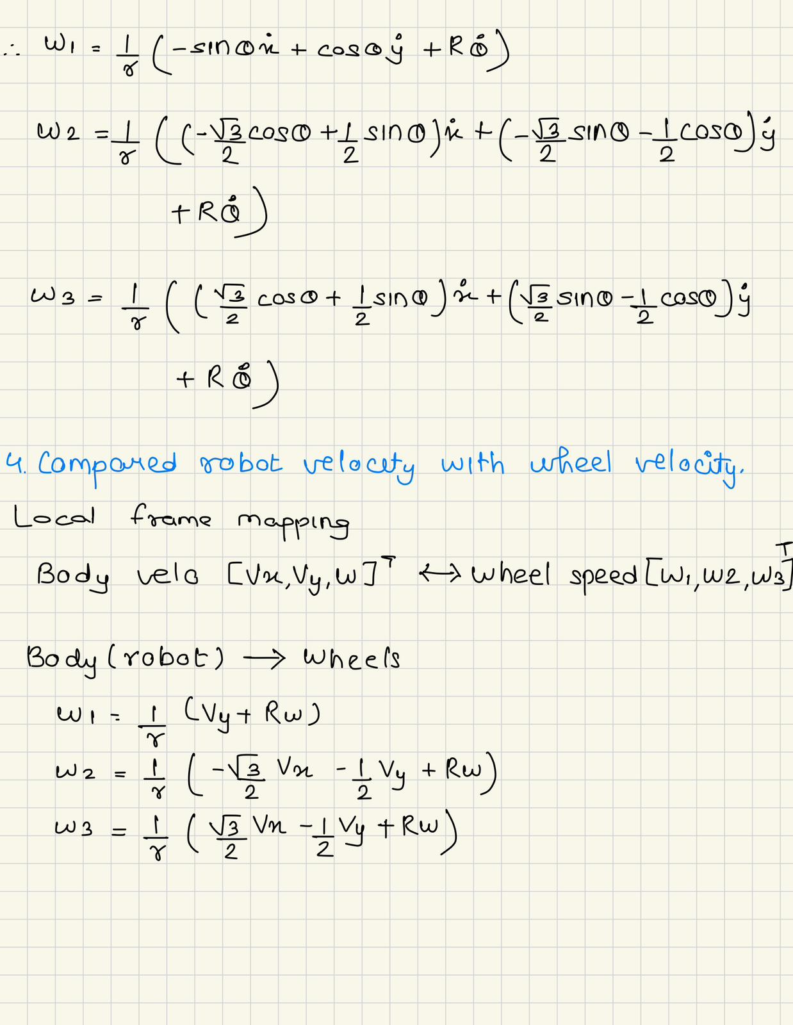
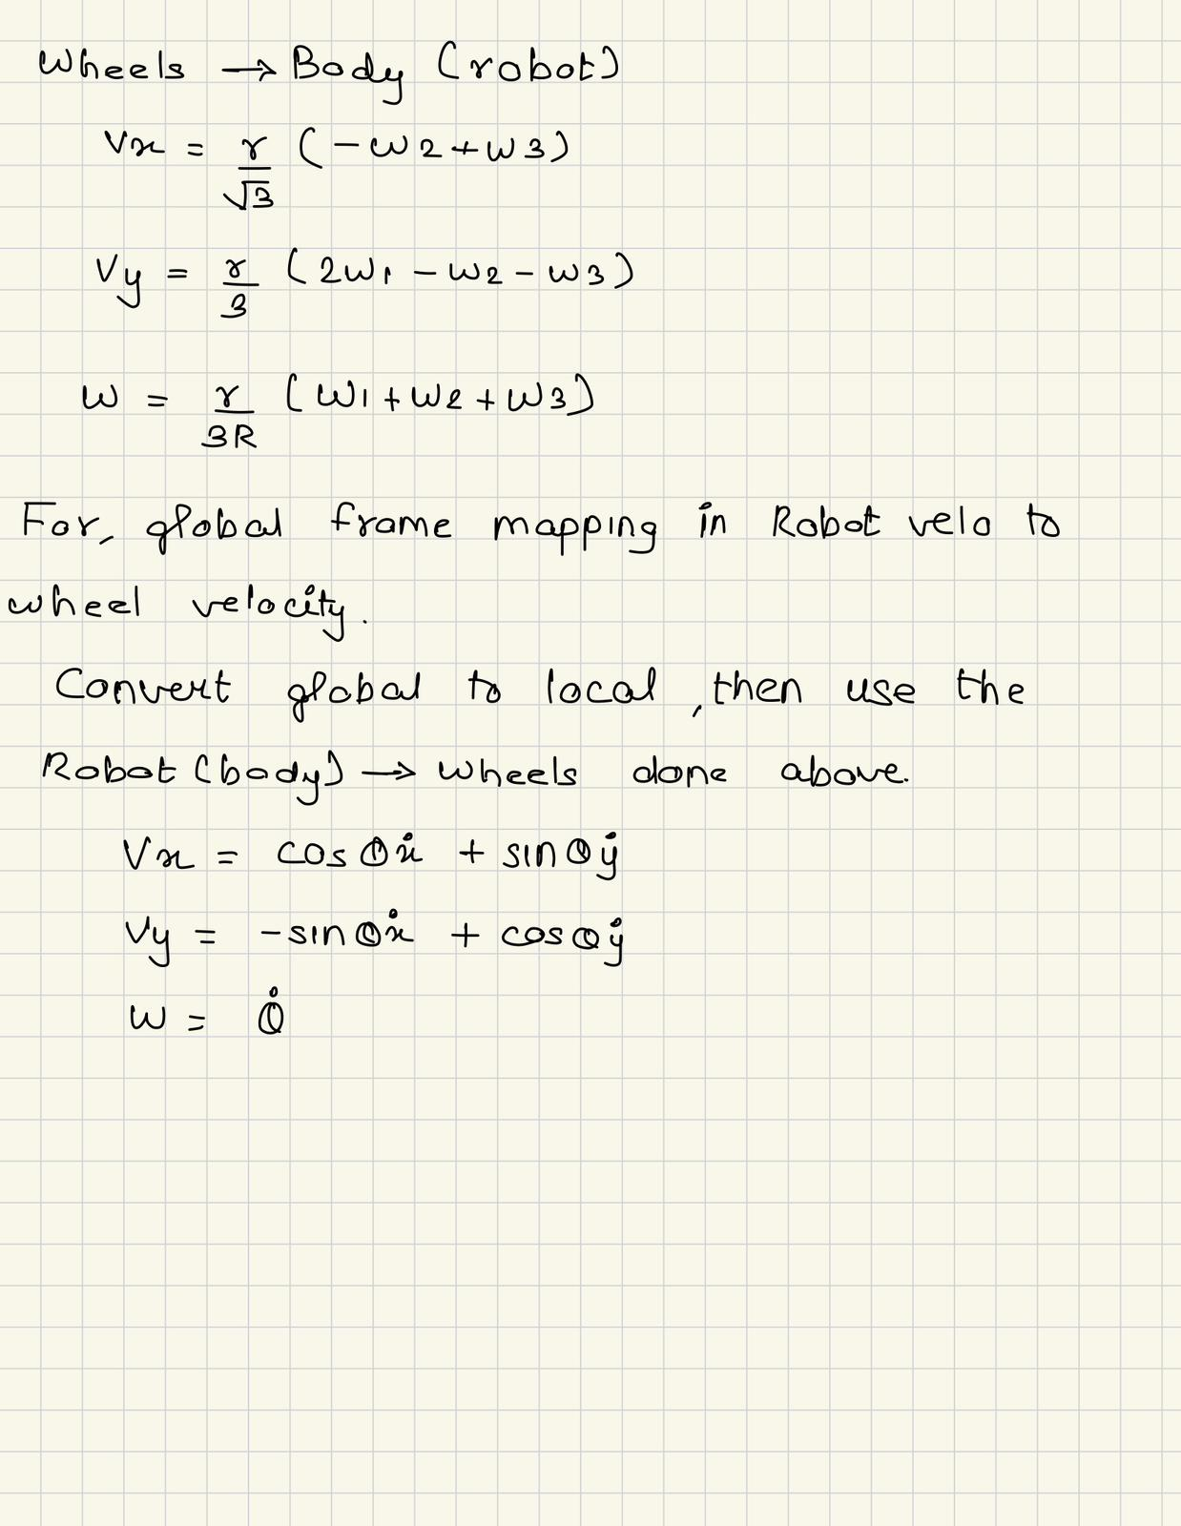

Slide 4
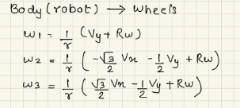

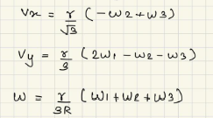
Bhavya Oza
N19241430
AMR HW3
For Robot to wheel mapping :
EOM for body to world :
Robot Parameters:
r→ wheel radius
R→ dist from robot center to each wheel
dt→ simulation step size
x0,y0→ initial X&Y position
th0→ initial orientation angle
vx → body-frame velocity in x (forward)
vy → body-frame velocity in y (sideways)
w → body angular velocity
xd → world-frame velocity in x
yd → world-frame velocity in y
thd → world angular velocity = θ
Om1, om2, om3 → wheel speeds
For wheel to body mapping :

Slide 5
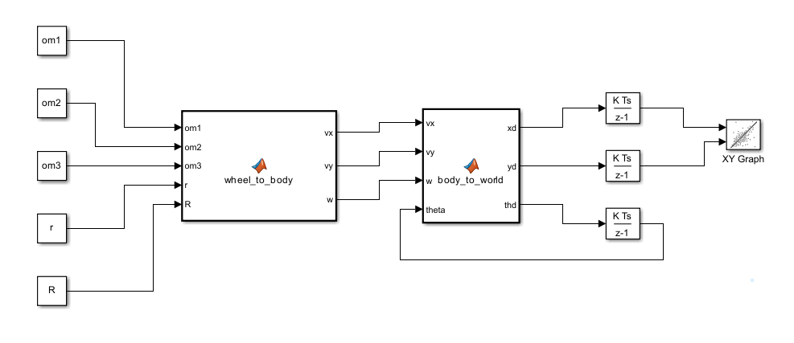
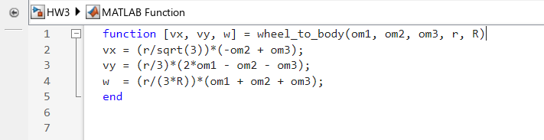
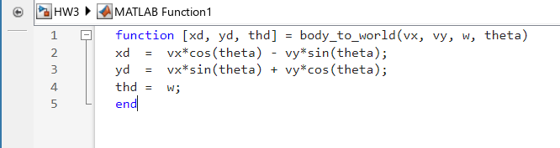
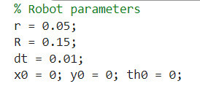
Simulink model:

Slide 6
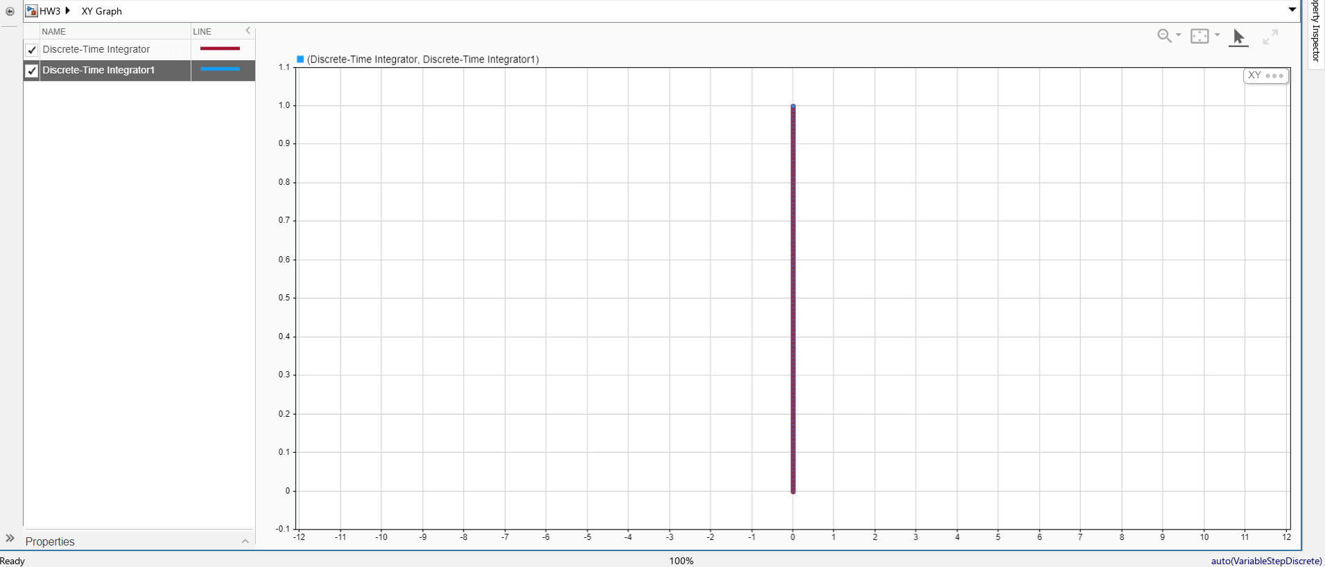
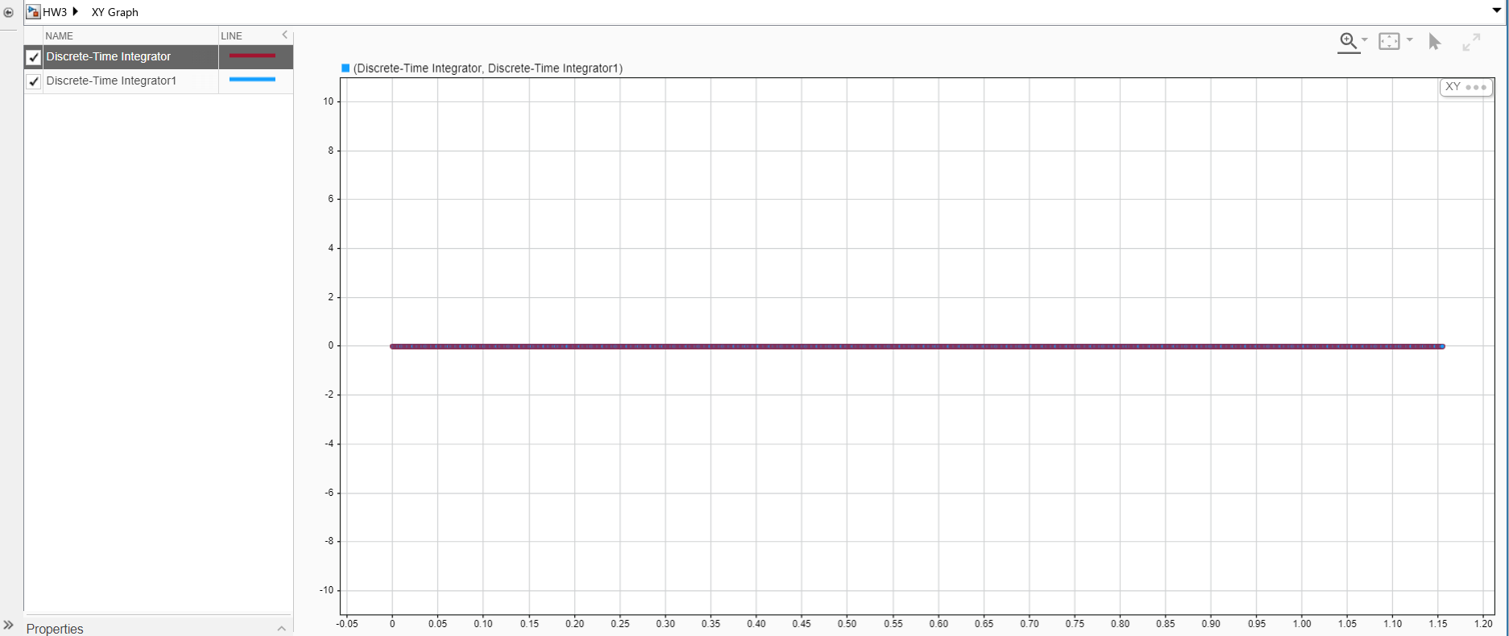
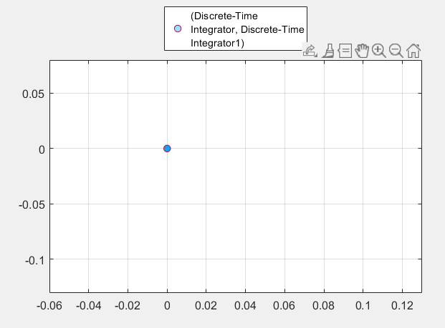
Test case 1: om1=2, om2=-1, om3=-1
Test case 2: om1=0, om2=-2, om3=2
Test case 3:om1=2, om2=2, om3=2 (Spin in place)

Slide 7
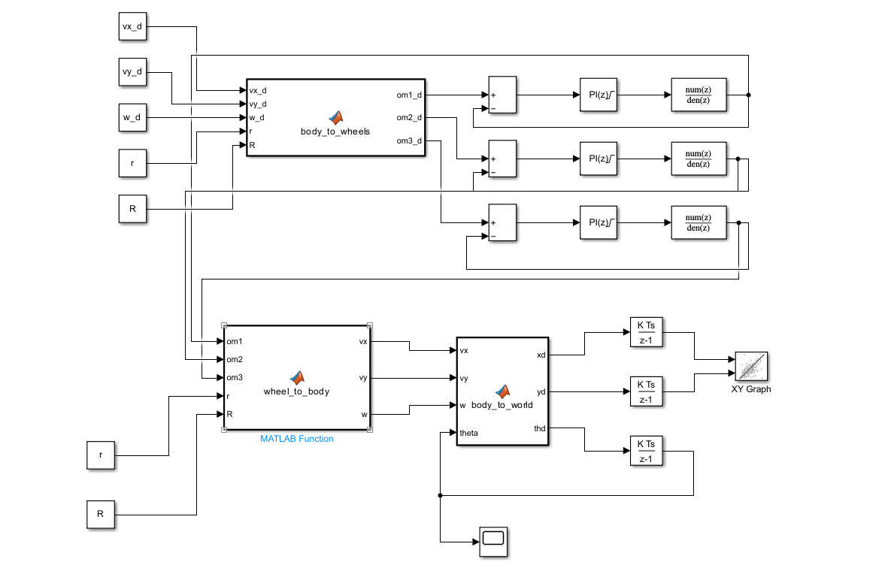
Bhavya Oza
N19241430
AMR HW4
% Robot parameters
r = 0.05;
R = 0.15;
dt = 0.01;
x0 = 0; y0 = 0; th0 = 0;
% wheel speeds in rad/s
%om1 = 2;
%om2 = -1;
%om3 = -1;
% Body velocities
vx_d = 0.10; vy_d = 0; w_d = 0; % straight line
%vx_d = 0; vy_d = 0; w_d = 0.2; % pure spin
%vx_d = 0.10; vy_d = 0; w_d = 0.2; % circle
tau1 = 0.10; K1 = 1;
tau2 = 0.10; K2 = 1;
tau3 = 0.10; K3 = 1;
% Then in each Discrete Transfer Fcn block:
% Wheel 1
Numerator = K1*(1 - exp(-dt/tau1)) ;
Denominator = [ 1 -exp(-dt/tau1) ];
% Wheel 2
Numerator = K2*(1 - exp(-dt/tau2)) ;
Denominator = [ 1 -exp(-dt/tau2) ];
% Wheel 3
Numerator = K3*(1 - exp(-dt/tau3)) ;
Denominator = [ 1 -exp(-dt/tau3) ];
% Controller gains
Kp=5; Ki=50;
Updated Simulink model with dynamic controller:

Slide 8
Matlab function block added:
Parameters:
K1, K2, K3 → Static gain of wheel motor 1, 2, 3 tau1, tau2, tau3→Time constant (τ) of motor dynamics for each wheel seconds (s) Kp→Proportional gain of the PI controller.Determines how strongly error affects control signal (reacts to current error). Ki→Integral gain of the PI controller.Eliminates steady-state error by integrating past errors. Numerator, Denominator→Coefficients of the Discrete Transfer Function represents discrete-time wheel dynamics

Slide 9
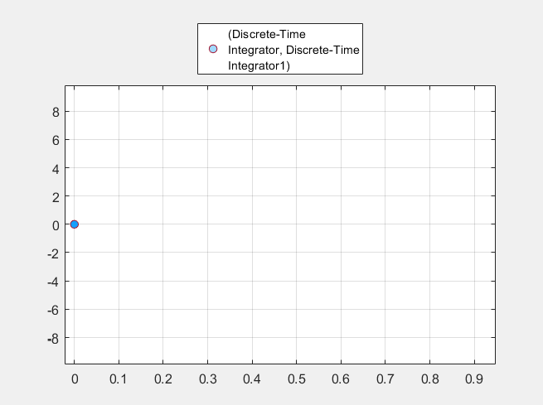
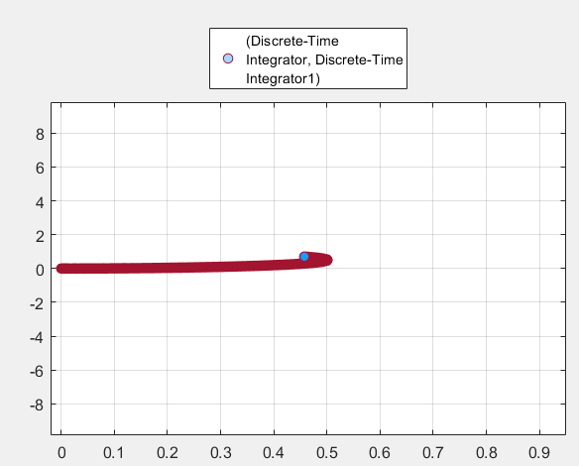
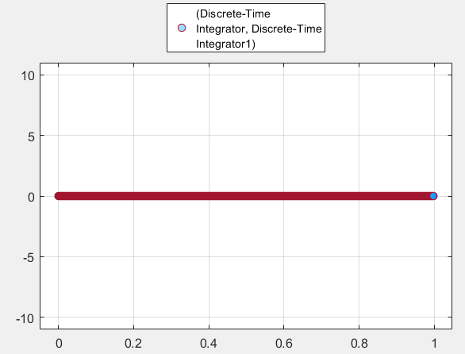
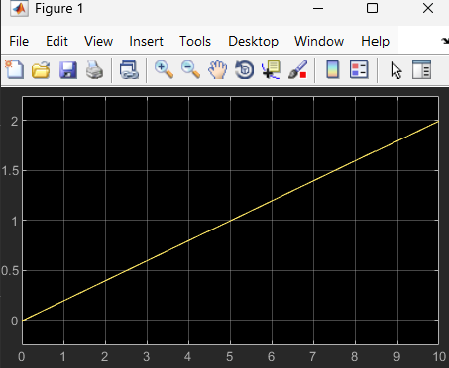
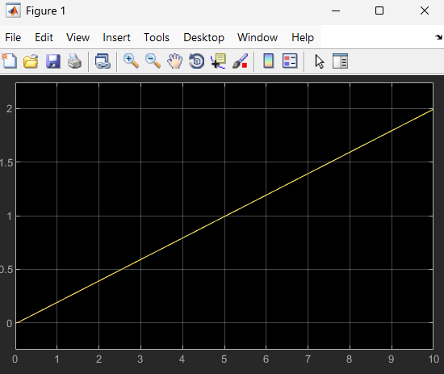
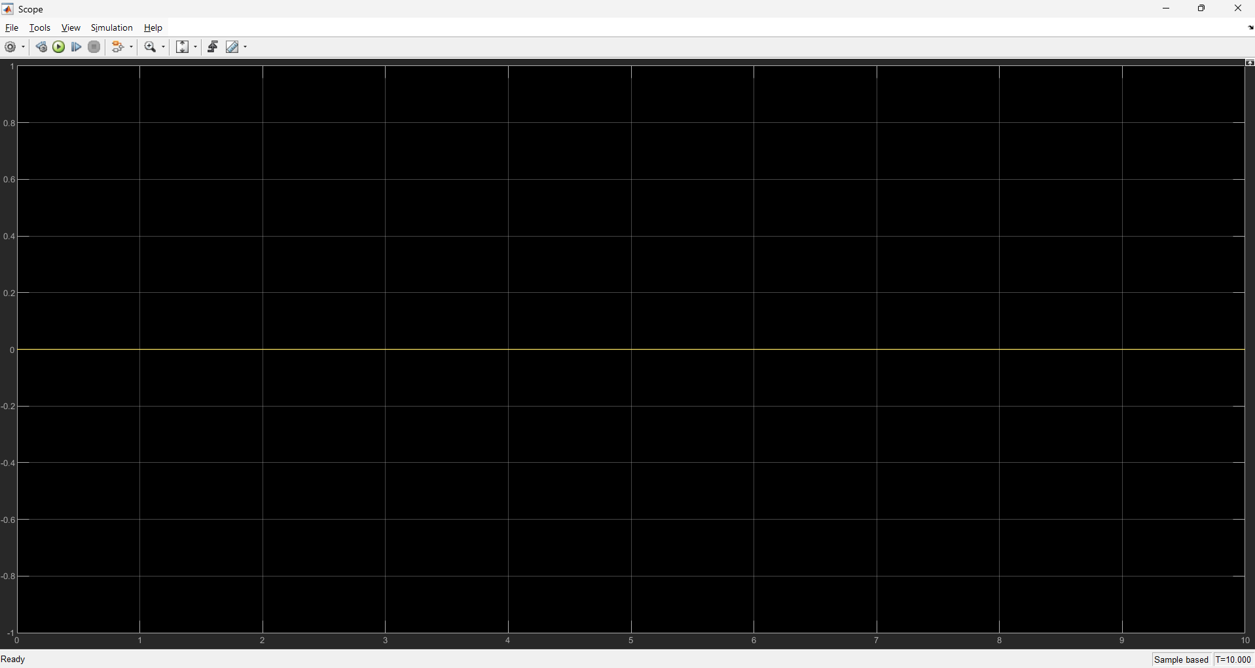
Test Cases:
1.Pure spin at same position
2.Circular motion
3.Straight line

Slide 10
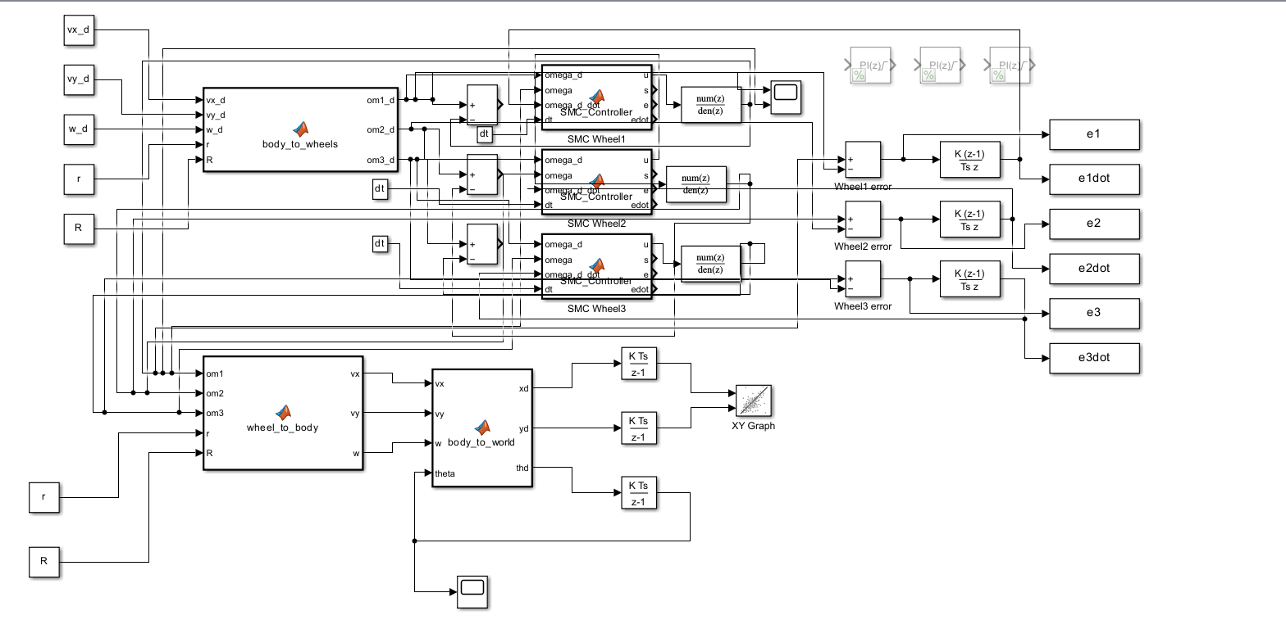
Bhavya Oza
N19241430
AMR HW5
Updated simulink model with Sliding Mode Controller (SMC), wheel-level error feedback, discrete wheel dynamics, kinematic transformations

Slide 11
SMC Controller block code:
Parameters updated file:
Run_SMC code:
function [u, s, e, edot] = SMC_Controller(omega_d, omega, omega_d_dot, dt)
%#codegen
% outputs to initialize
u = 0.0;
s = 0.0;
e = 0.0;
edot = 0.0;
% gains (tune)
c = 5.0; % sliding surface gain
k = 2.0; % switching gain
phi = 0.05; % smoothing for tanh to avoid chattering
% discrete derivative of omega (using dt)
persistent omega_prev
if isempty(omega_prev)
omega_prev = omega;
end
e = omega_d - omega;
edot = omega_d_dot - (omega - omega_prev)/dt;
% sliding surface
s = c*e + edot;
% control (equivalent + switching; you may use c*e or c*edot depending on design)
u = c*e + k*tanh(s/phi);
% alternative: u = -k*sign(s) + c*e;
omega_prev = omega;
end
% Robot parameters
r = 0.05;
R = 0.15;
dt = 0.01;
x0 = 0; y0 = 0; th0 = 0;
% wheel speeds in rad/s
%om1 = 2;
%om2 = -1;
%om3 = -1;
% Body velocities
%vx_d = 0.10; vy_d = 0; w_d = 0; % straight line
%vx_d = 0; vy_d = 0; w_d = 0.2; % pure spin
vx_d = 0.10; vy_d = 0; w_d = 0.2; % circle
tau1 = 0.10; K1 = 1;
tau2 = 0.10; K2 = 1;
tau3 = 0.10; K3 = 1;
% Then in each Discrete Transfer Fcn block:
% Wheel 1
Numerator1 = K1*(1 - exp(-dt/tau1)) ;
Denominator1 = [ 1 -exp(-dt/tau1) ];
% Wheel 2
Numerator2 = K2*(1 - exp(-dt/tau2)) ;
Denominator2 = [ 1 -exp(-dt/tau2) ];
% Wheel 3
Numerator3 = K3*(1 - exp(-dt/tau3)) ;
Denominator3 = [ 1 -exp(-dt/tau3) ];
% Controller gains
Kp=5; Ki=50;
clear; clc; close all;
run('PARAMETERS.m'); % loads dt etc.
model = 'HW3'; load_system(model);
out = sim(model);
%fetch To-Workspace arrays
if ~evalin('base','exist(''e1'',''var'')')
error('e1/e2/e3 not found. Check To Workspace block names & wiring.');
end
e1 = evalin('base','e1'); e1dot = evalin('base','e1dot');
e2 = evalin('base','e2'); e2dot = evalin('base','e2dot');
e3 = evalin('base','e3'); e3dot = evalin('base','e3dot');
% time vector
if evalin('base','exist(''tout'',''var'')')
t = evalin('base','tout');
else
N = numel(e1); t = (0:N-1)'*dt;
end
% sliding surfaces
c = 5;
s1 = c*e1 + e1dot; s2 = c*e2 + e2dot; s3 = c*e3 + e3dot;
% Phase portraits
figure('Name','Phase Portraits','Color','w');
tiledlayout(2,2);
nexttile; plot(e1, e1dot); grid on; title('Wheel 1');
nexttile; plot(e2, e2dot); grid on; title('Wheel 2');
nexttile; plot(e3, e3dot); grid on; title('Wheel 3');
nexttile; plot(e1, e1dot, e2, e2dot, e3, e3dot); grid on; title('Overlay');
% sliding surfaces
figure('Name','Sliding Surfaces','Color','w');
plot(t,s1,'r',t,s2,'g',t,s3,'b','LineWidth',1.5); grid on;
xlabel('Time (s)'); ylabel('s_i = c e_i + \ite_i'); legend('s_1','s_2','s_3');
% Optional time plot
figure('Name','Wheel Speed Error vs Time','Color','w');
plot(t, e1, t, e2, t, e3, 'LineWidth',1.2); grid on;
xlabel('Time (s)');
ylabel('Error (rad/s)');
legend('e_1','e_2','e_3');
title('Wheel Speed Errors');

Slide 12
PARAMETERS.m loads:
r, R, dt, tau1–tau3
vx_d, vy_d, w_d (circle, spin, straight line case)
controller gains numerator/denominator for all motors
Run_SMC.m:
Extract e1, e1dot, e2, e2dot, e3, e3dot
Construct time vector
Compute sliding surfaces s1, s2, s3
Plot:
Phase portraits (error vs error rate)
Sliding surface convergence
Error signals over time
SMC Block code:
The SMC block takes the desired wheel speed ωd\omega_dωd​, the measured wheel speed ω\omegaω, and the rate of change ω˙d\dot{\omega}_dω˙d​, and computes the control input using sliding mode control.
It forms the sliding surface s=ce+e˙s = c e + \dot{e}s=ce+e˙, where e=ωd−ωe = \omega_d - \omegae=ωd​−ω, and applies a robust switching law u=ce+k tanh⁡(s/ϕ)u = c e + k\,\tanh(s/\phi)u=ce+ktanh(s/ϕ) to drive the system toward s=0s = 0s=0.
This ensures fast convergence, robustness to uncertainties, and stable wheel speed tracking.

Slide 13
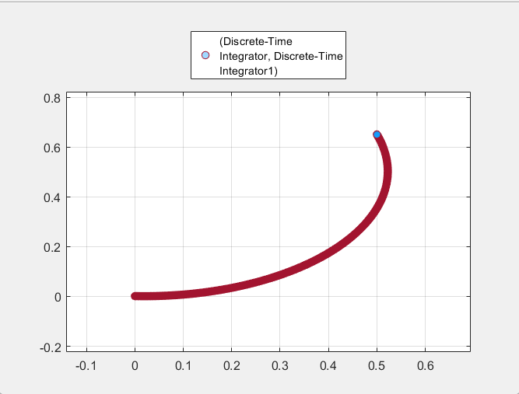
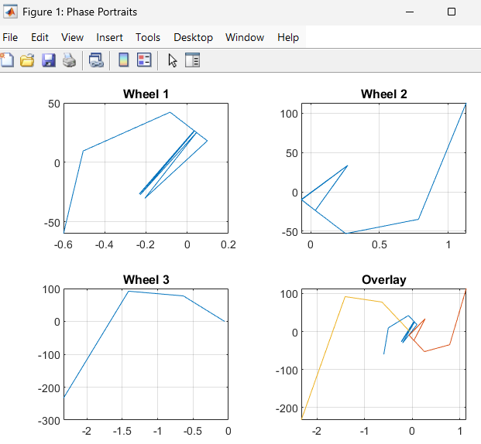
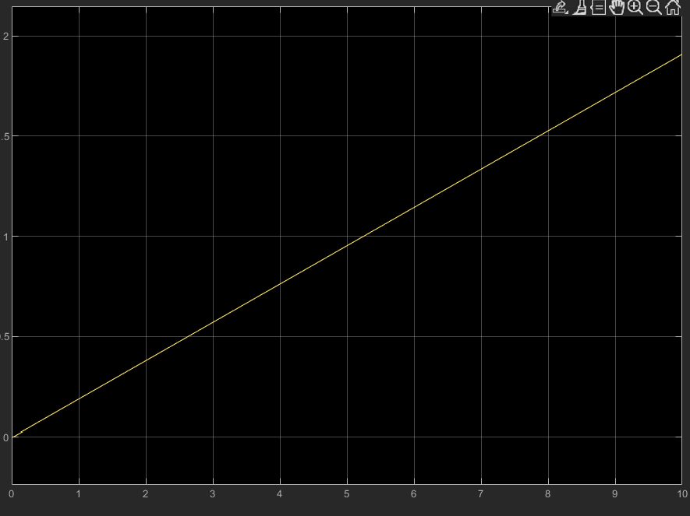
Outputs:
The output given below is for the circular motion of robot.For spin at place and straight line motion they can be done by commenting out the circle case and implementing the other 2 one by one from the PARAMETERS.m file

Slide 14
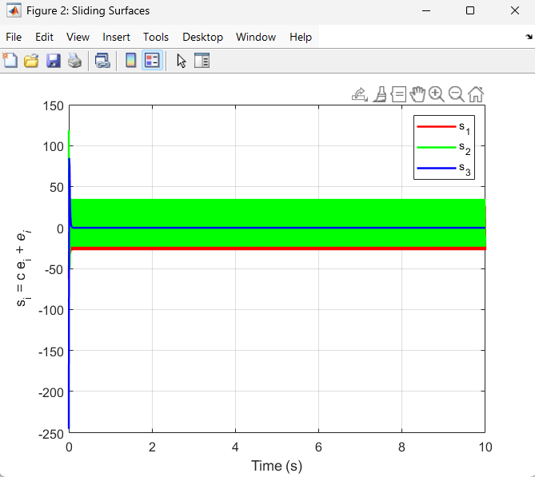
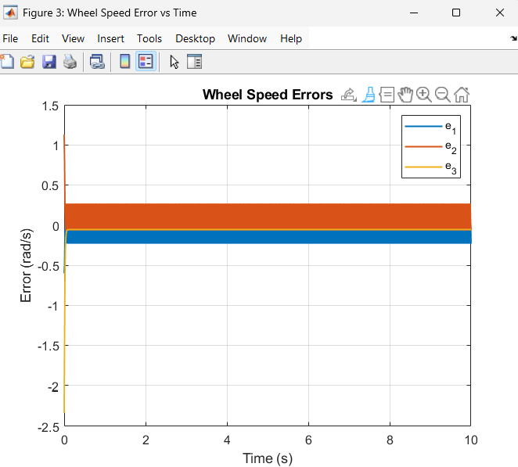

Slide 15
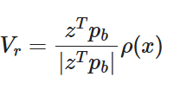

is part of the formal Sliding Mode Control (SMC) derivation, specifically the robust or reaching term in the control law.
This Comes From: Vr​ term represents the robust control input that compensates for uncertainties or disturbances. In the standard SMC structure:
u = u_{eq} + u_{sw}
u_{eq}​ = equivalent control, which keeps the sliding surface s=0.
u_{sw}= switching (robust) control, designed to ensure reachability and reject disturbances.
This term mathematically ensures:
which guarantees sliding and robustness.

Slide 16

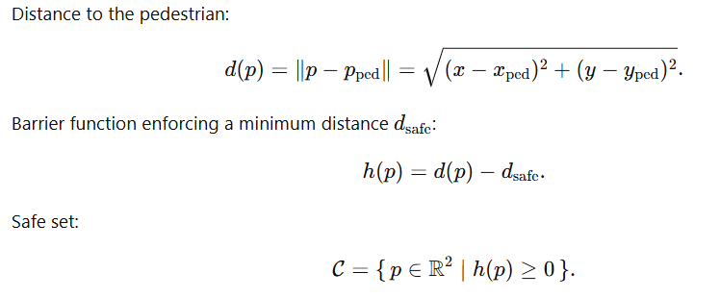
Bhavya Oza
N19241430
AMR HW6
Safe Robot Navigation by applying CBF
Equations :
System Dynamics :
Barrier Function:

Slide 17
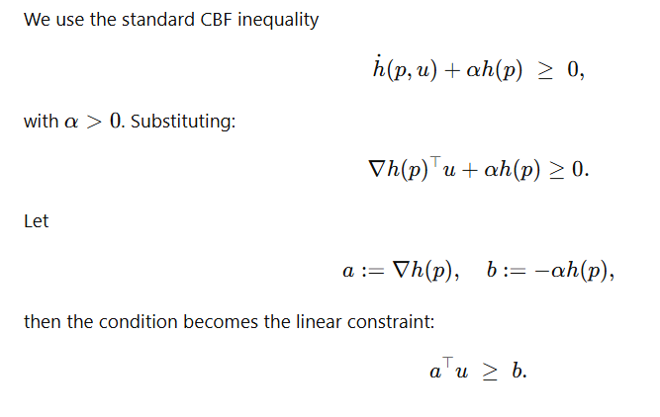


3. CBF Condition:
4. Distance formula:
5. Control bounds:

Slide 18

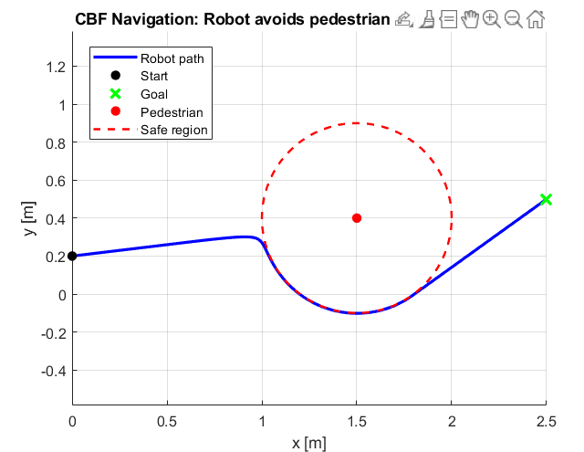
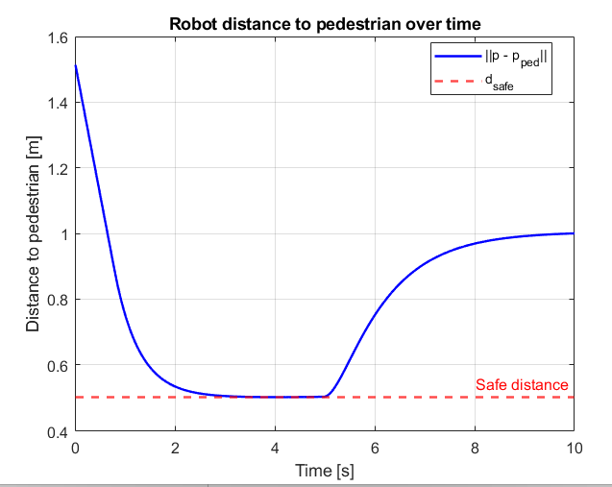
Outputs:

Slide 19



Bhavya Oza
N19241430
AMR HW7
Plotting Potential fields
Scenario where the robot successfully reaches the goal.
Scenario where the robot gets stuck in a local minimum (failure case).
Attractive potential towards goal:
Repulsive potential from obstacles:
Total Potential:

Slide 20
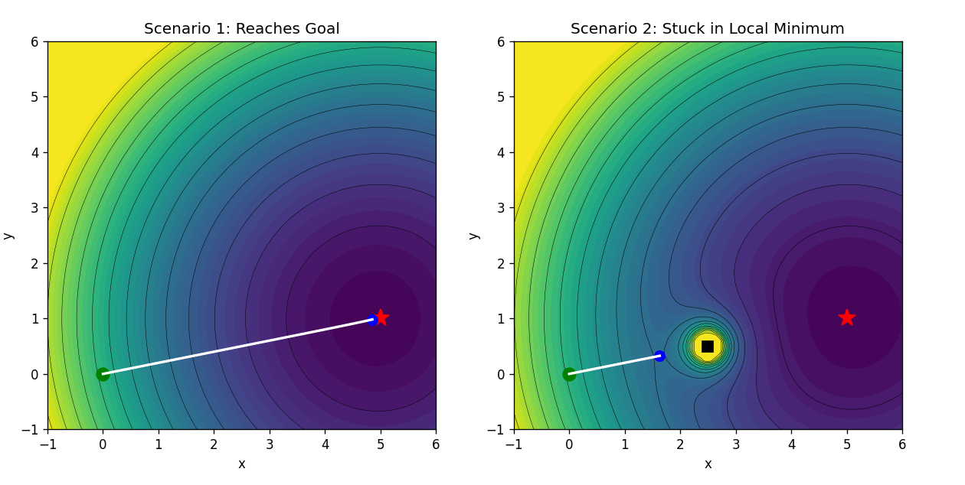
Output:

