Slide 1
MOD
Multipurpose Omnidirectional Drone platform

Slide 2
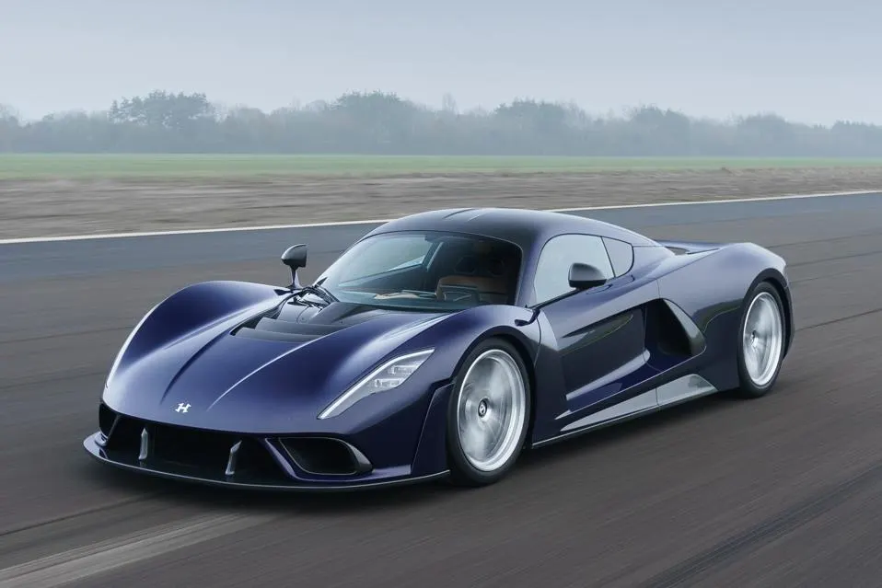
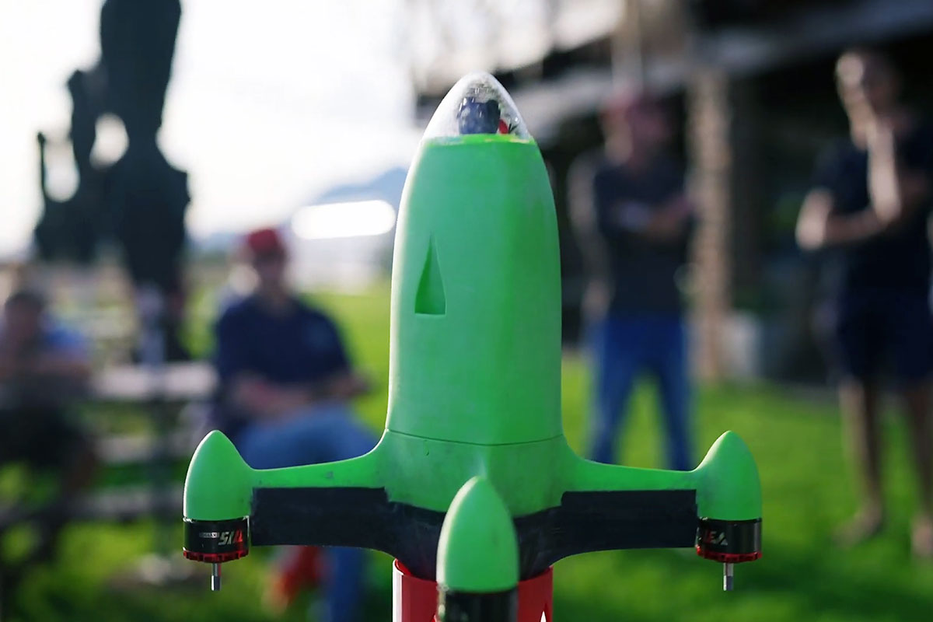
Introduction
We have different types of drones, just like we have different types of cars. We have drones like sports cars.

Slide 3
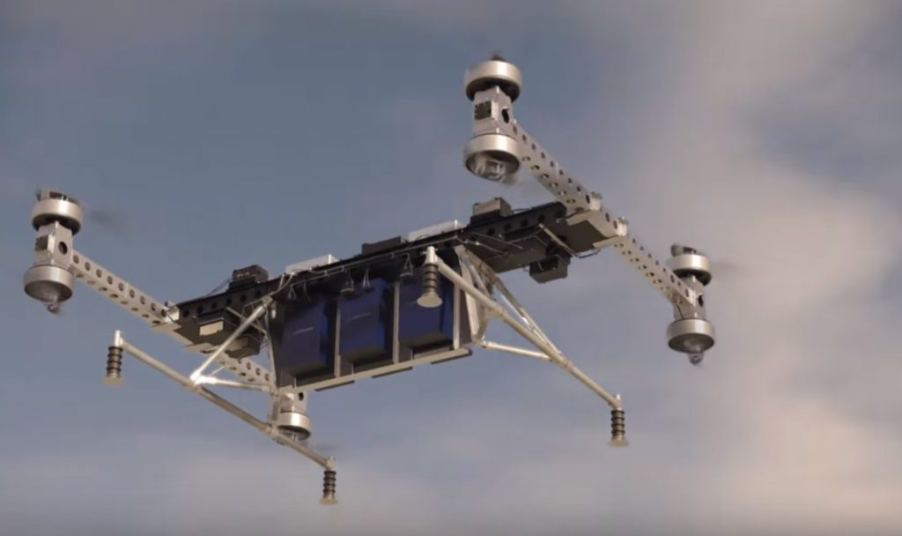
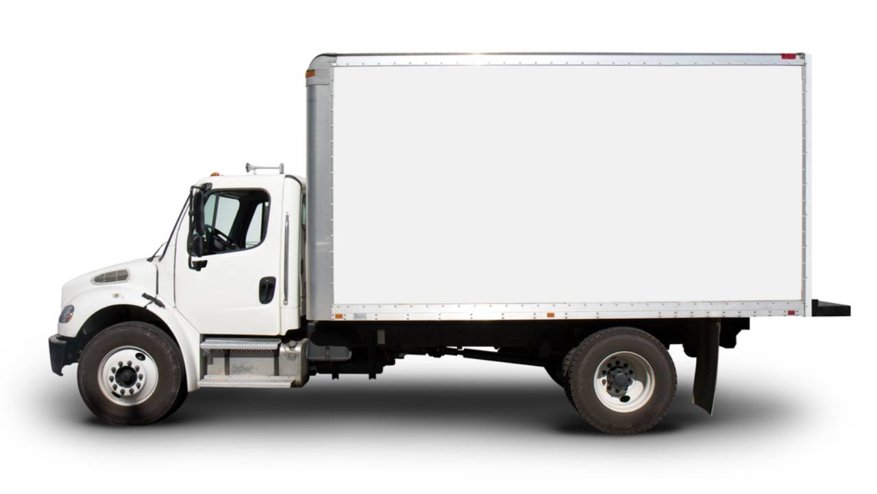
Introduction
We have drones like trucks.

Slide 4
Introduction
We have small drones and big drones, fast and slow.
All these types of drones have common problems:
drones are very specialized
drones are very sensitive to conditions or operator skills
That's why we need something easy to operate and not specialized.
Something like...

Slide 5
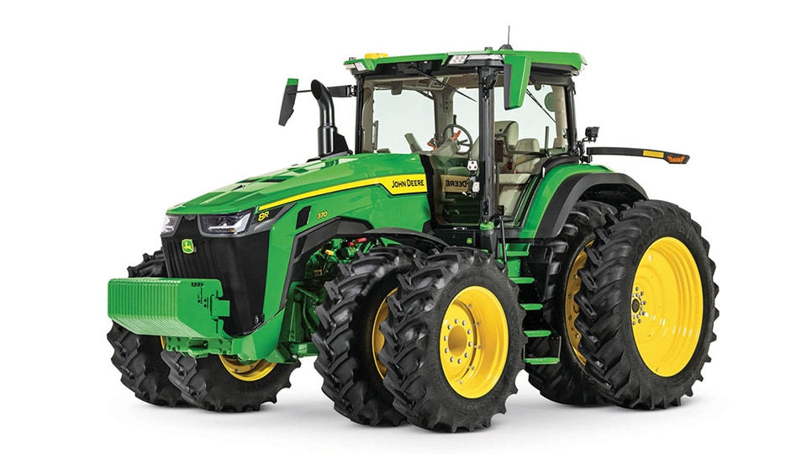
Tractor

Slide 6
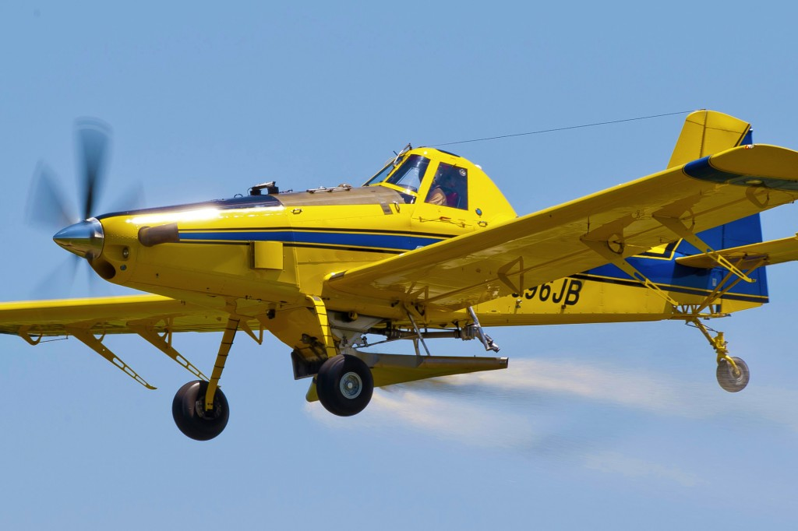
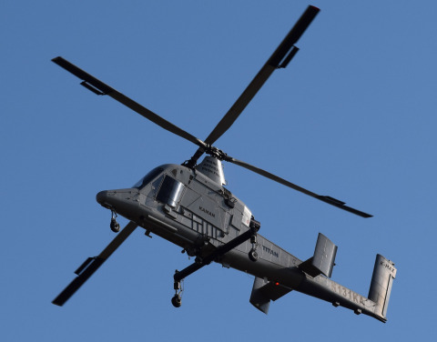
Existing Flying Tractors
Plane-tractor Helicopter-tractor

Slide 7
Drone-tractor?
But we still don't have a tractor drone.
That's because a tractor is not just a single machine, but...

Slide 8
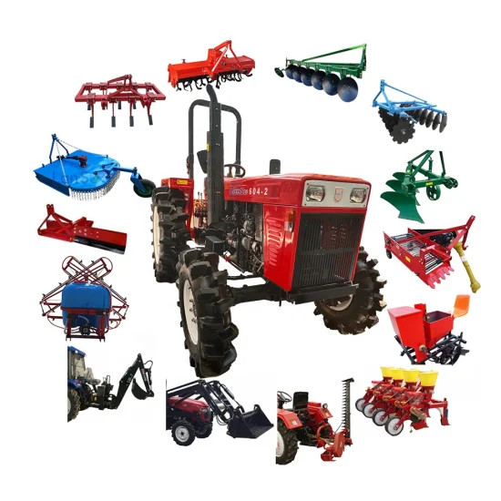
The capabilities of a tractor are determined by its attachments and implements

Slide 9
Where is drone-tractor?
But why can't other drones be used as tractors?
First, let me explain what an omnicopter is and what the difference is between omnicopters and regular drones...

Slide 10
Definition of omnicopter
An omnicopter is a type of aircraft capable of full six-degree-of-freedom (6DoF) movement,
meaning it can independently control its position and orientation in all directions:
Translation: Forward/backward, left/right, up/down
Rotation: Pitch, yaw, roll
An omnicopter can change direction without tilting, unlike drones that tilt to move.
An omnicopter can move without changing its orientation.
An omnicopter can change orientation without changing its position.

Slide 11
Omnicopter vs. regular drone
Problem | Ordinary drone | Omnicopter
Operating in windy conditions | May be unstable | Still maintains position and orientation
Work in strong airflow gradients near obstacles | May be unstable or fall | May change orientation but still fly
Counteracts the forces caused by implements | May be unstable or fall | May change orientation but still fly
Hit an obstacle | Falls in most cases | Changes orientation and still flies
Damage one of the rotors | Falls in most cases | Changes orientation and still flies
Get caught on an obstacle | Falls | Changes orientation and still flies
Carries a long additional load and loses balance | Falls | Changes orientation and still flies
As you can see, only omnicopters allow you to work between obstacles and carry large implements.
It's like a tractor that can work on rough terrain in all weather conditions, carrying large implements.
Omnicopters are safer by design. Without cameras and collision detectors.
With cameras and collision detectors, omnicopters can become much safer.

Slide 12
MOD platform description
The MOD platform consists of two main parts:
thrust-vectoring node (TVN)
common base frame

Slide 13
Common Base Frame
The family of base frames may vary in size, but have common properties:
very simple and lightweight
foldable without losing in weight or strength at the joints
allow connection to other frames
allow mounting of implements on either side of the frame and through the frame
About the latter: mounting implements through the frame is a key feature for balancing large implements.

Slide 14
Thrust-vectoring node (TVN)
Each TVN type is a combination of a different number of motors and different types of rotors or other propulsion systems. Some types of TVN are interchangeable, just like a tractor, you can change the types of wheels or even replace them with tracks. Look how many different TVN there can be (what is not marked as "ref" is developed by me).
Type | Reorientation speed | Complexity | Thrust / weight | Dimensions | Usage proposal
Hex | Medium | Low | Low-medium | XS-L | Multipurpose
Square | Fast | Medium | Low-medium | XS-XL | Multipurpose, auxillary
DoubleJoint | Slow | Medium+ | Low | XS-XL | Multipurpose
FullTilt | Slow | High | High | XS-XXL | Multipurpose, toys, auxillary
Ref: Cyclorotor | Fast | High+ | Medium | XXS-L | Multipurpose, auxillary
TrueOmni | Slow | Ultra+ | Low | XXS-S | Camera, toys, auxillary
OmniFlapper | Fast | Ultra | Low | XXS | Camera, indoor, toys
Ref: ETH Avero | Prototype is very slow but can be medium | Medium | Very low | XS | Multipurpose, indoor, toys

Slide 15
Benefits for markets
Agriculture and services: safe, predictable and precise operation in difficult conditions with various types of implements.
Pro camera operator: safe, predictable and precise operation in difficult conditions at high speeds, allows large cameras to be aimed at any angle.
Non-pro camera operator, toys, entertainment, education: safe, predictable and precise operation with speed limiters opens up endless possibilities for enjoyment.
Drone shows: safe, fastest and most precise drones and drone chains. Large versions allow visibility in daylight.
All of these capabilities are based on just the basic frame type with add-ons.
Many of these features do not require much study.

Slide 16
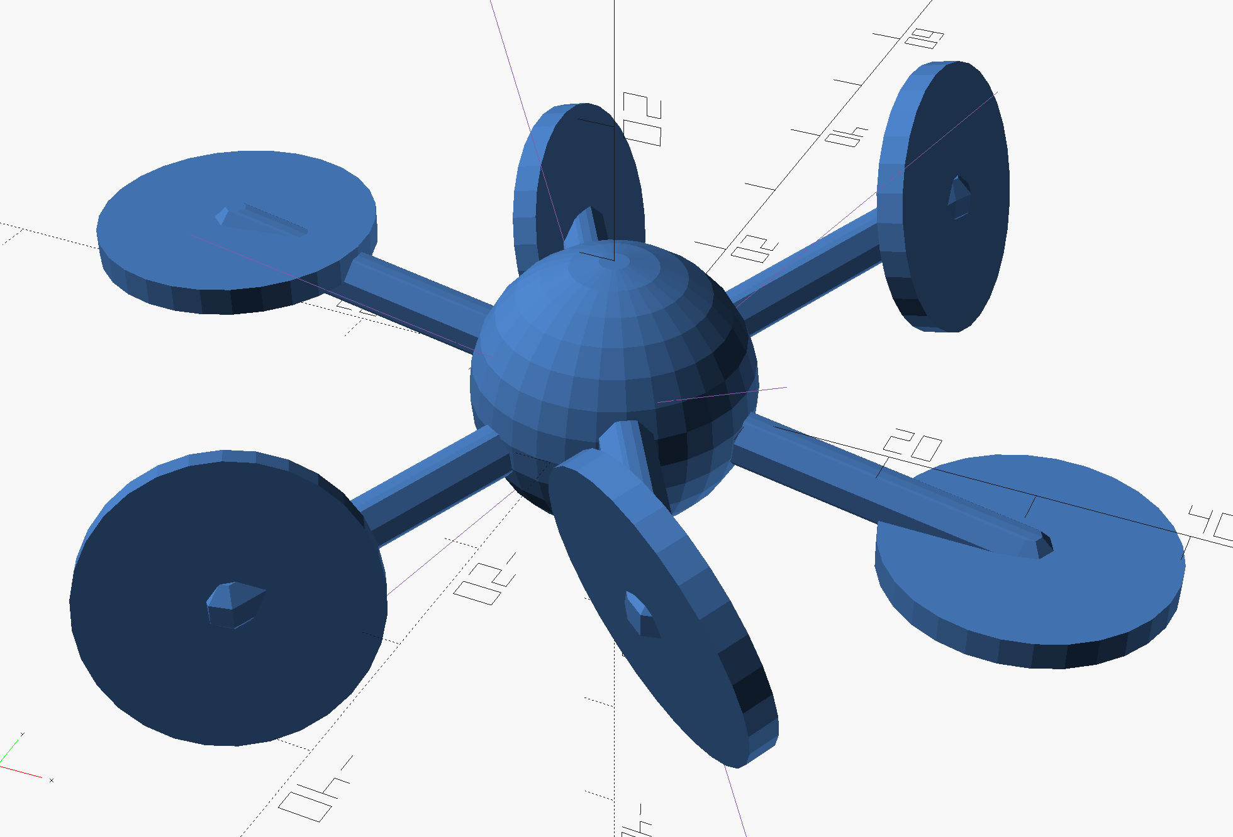
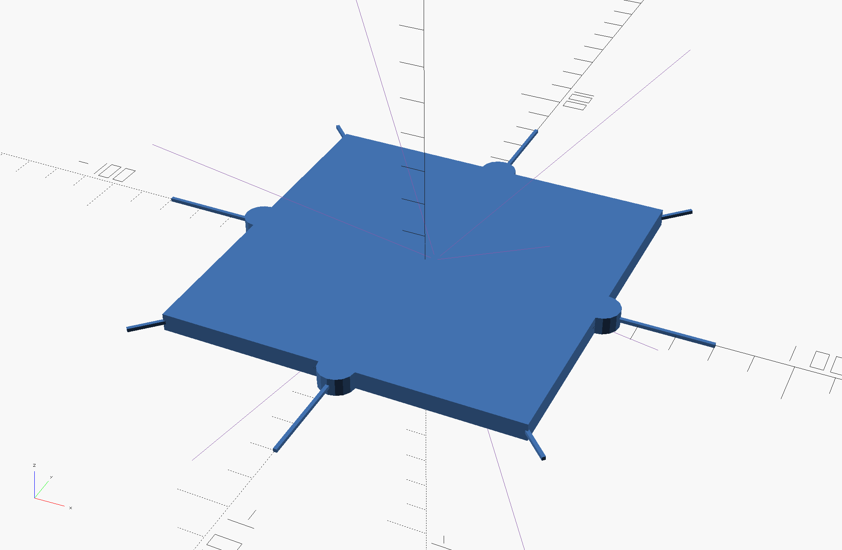

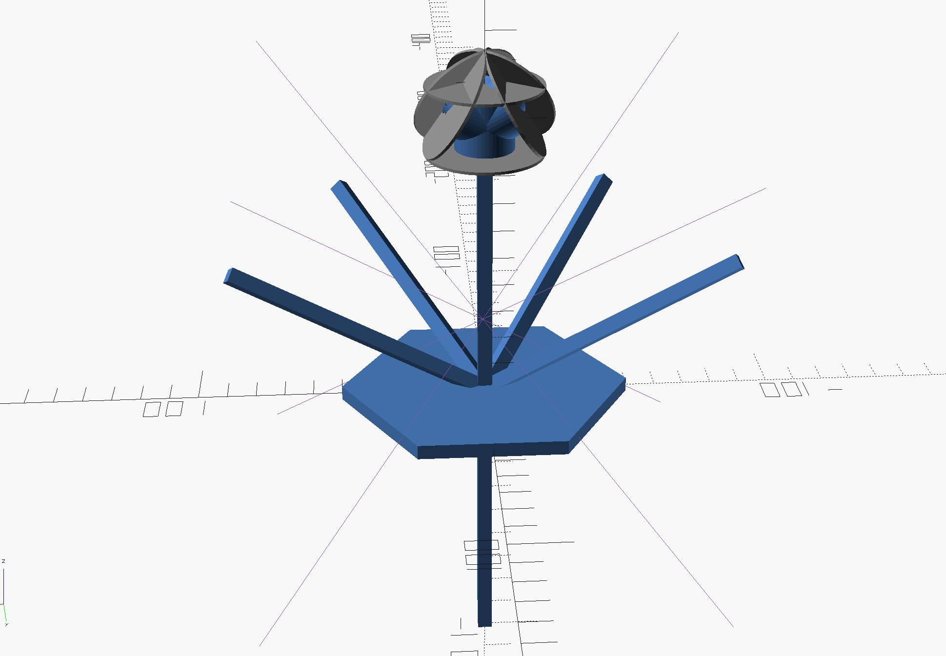
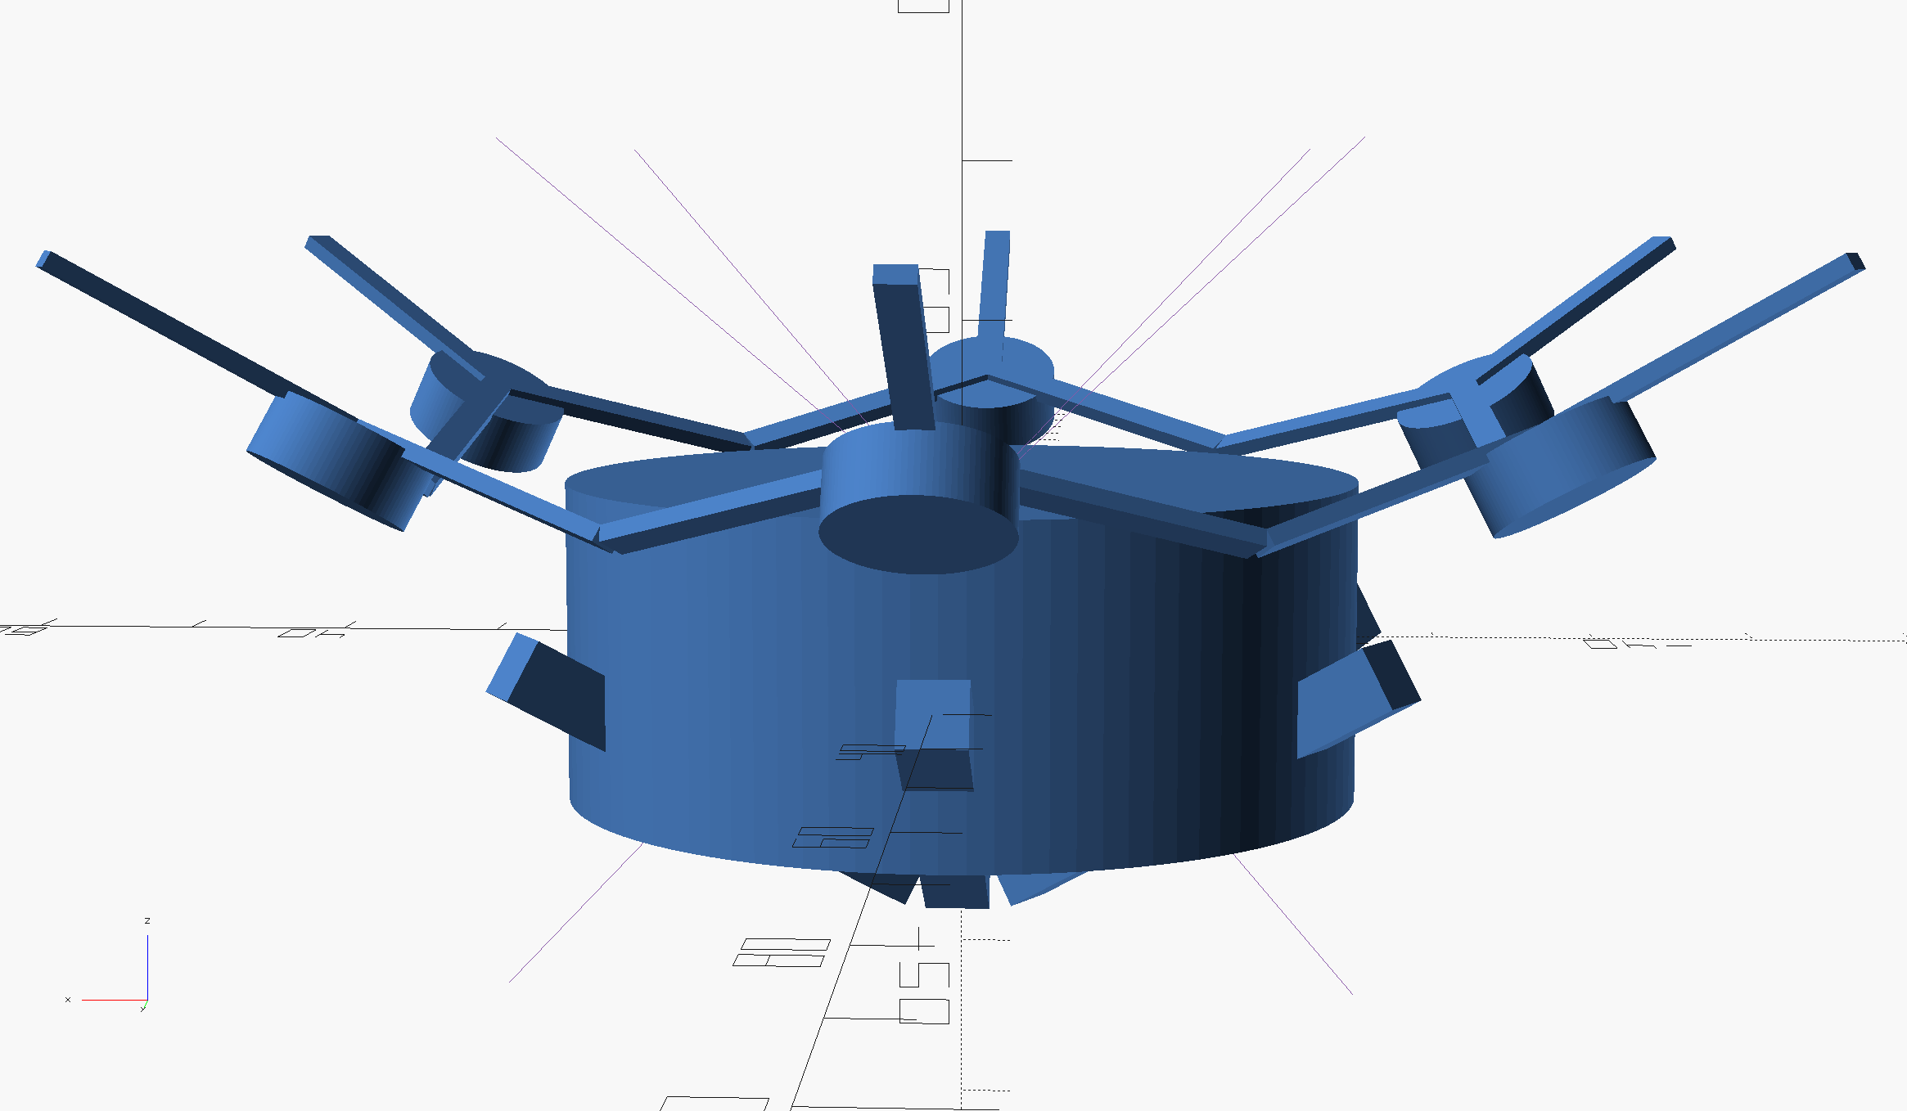
More info and my contacts
All public MOD files, links to omnicopter projects and my contacts are available on my github:
https://github.com/bpodchezertsev/MOD
Also, you can look short article "How AI understands omnicopters".

