Slide 1
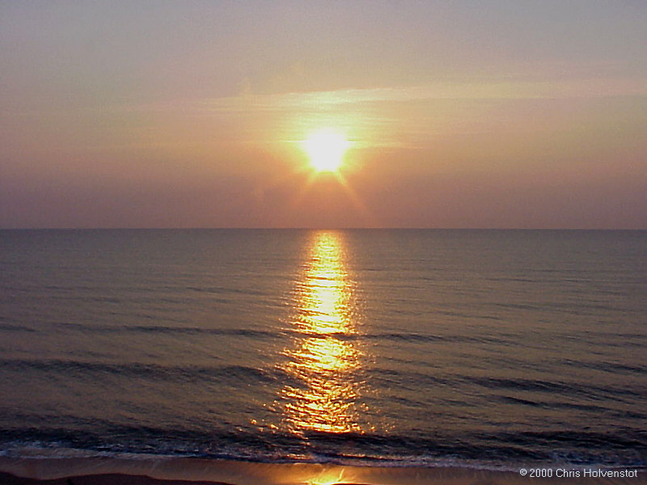
Notes:
Play nice music.

Slide 2

Practical
Extraction and
Report
Language
Welcomes to the
“Programming republic of PERL”
Notes:
Welcome the team to session “Programming republic of PERL”.
We are sure that you will realize the power of PERL

Slide 3
Course Details
Course Title: PERL Programming
Duration: 2days
Faculty:
      Bhavani Prasad
Notes:
Explain about the experiences of Faculty.

Slide 4
PERL Course Objectives.
To make users familiar with PERL features.
Making the developers ready for Advanced Programming in PERL.

Slide 5
Course Contents.
Overview of PERL
The PERL Distribution
PERL Variables
Flow Control
The PERL Debugger
Arrays and Hashes
Operators

Slide 6
Course Contents Continued …
I/O :Input Operations and File I/O File handles
Regular Expressions
Subroutines
Packages and Modules
Project


Slide 7
History
Larry Wall, creator of PERL
It is Open Source
1987 October 18 - PERL 1.0 is released
2000 March - PERL 5.6.1 is released
Available for Linux, Unix, windows and other Operating Systems.
Notes:
Explain about why Larry Wall developed the PERL.

Slide 8
Features
Perl is a language optimized for scanning arbitrary text files, extracting information from those text files, and printing reports based on that information.
The language is intended to be practical (easy to use, efficient, complete) rather than beautiful (tiny, elegant, minimal).
The Perl programming language combines the features and capabilities of C, `sed', `awk', and `sh'.
Notes:
Give nice examples and uses of PERL.

Slide 9
The Perl Distribution
Perl is bundled with many Unix and Linux flavors.
It is free distribution under GNU license.
There is no much differences.
Win 32 Vs Unix and Linux
Down load from www.perl.com

Slide 10
Valuable Links
http://www.gnu.org
http://www.perl.com
http://www.perl.org
http://www.perlguy.com/perl/
http://www.activestate.com/ - for win 32

Slide 11
Pre-checks before we start
$perl --version
$perl --help
$man perl
$which perl
$file /usr/bin/perl
Notes:
Tiet your belts to start working with PERL.
$file /usr/bin/perl – see the message. It is using shared libraries.
So that we can develop such libraries or we can use third party libraries.

Slide 12
Hello world program–
Code walkthrough
#####-----#####-----#####-----#####-----#####-----#####-----#####
# File Name : hai.pl
# Date : 30/August/2001
# Author : Bhavani Prasad Polimetla
# Description : The first program in Perl.
# It will help the user to understand the basic structure.
#####-----#####-----#####-----#####-----#####-----#####-----#####
#!/usr/bin/perl
print "\nWelcome to Programming republic of PERL\n";
#end of the script hai.pl
#####-----#####-----#####-----#####-----#####-----#####-----#####
$perl -c hai.pl
$perl hai.pl
Notes:
File extension
File structure
File header
#/usr/bin/perl importance
Executing the program

Slide 13
Data Structures (Data types)
Scalars
Arrays of scalars
Associative arrays of scalars (hashes)

Slide 14
Scalars
Scalar values are always named with '$‘
It can hold Strings, Numbers and References
Scalar behaves as Boolean
  Not Null String or not 0 or not “0” is TRUE
  0 or “0” or “” is FALSE
Notes:
We are doing example in next chapter

Slide 15
Scalars – Numeric Data
Numeric data can be in the following format.
  12345 #Numeric
  12345.67 #Float
  .23E-10 #Scientific
  0xffff # hex
  0377 # octal
  4_294_967_296 # underline for legibility
  Example Script: scalars1.pl

Slide 16
Scalars – String Data
Try to print the statement
  "The Perl Book Price Is $9"
Example Script: scalars2.pl
Notes:
Ask the team to write the program.
Later give the access rights on scalars2.pl to view the contents

Slide 17
Scalars – Reference
$numx = 3.14159; # numeric
$refx = \$numx; # reference
$tglobx = *numx; # typeglob (different from file name globbing)
Notes:
Read more on type glob

Slide 18
Array of Scalars
Normal arrays are indexed by number, starting with 0. Negative subscripts count from the end.
Arrays / Lists -- We shall use the terms interchangeably.
Declaration
  @days;
  @lang_id=(1000,1001,1002);
  @alpha_bet=('a','c');
  @week=('Mon','Tue','Wed');
Example Script: arrays1.pl

Slide 19
Hashes
Hashes are indexed by strings.
It is very useful to search on given string.
Example:
  #!/usr/bin/perl
  %age = ( 'ram',27,
  ‘sita',28,
  'radha',23);
  print(%age);
  print("\n");
Notes:
We are discussing in detail in next chapters.

Slide 20
Flow Control Structures
 | C | Perl
same | if () { ... } | if () { ... }
diff | } else if () { ... } | } elsif () { ... }
same | while () { ... } | while () { ... }
diff | do while (); | do while (); (See below)
same | for (aaa;bbb;ccc) { ... } | for (aaa;bbb;ccc) { ... }
diff | N/A | foreach $var (@array) { ... }
diff | break | last
diff | continue | next
similar | 0 is FALSE | 0, "0", and "" is FALSE
similar | != 0 is TRUE | anything not false is TRUE

Slide 21
If Statement
Code Walkthrough
print("\n\nIf Statement Demo ...\n");
$bFlag='TRUE';
if ($bFlag)
{
print("\nTRUE -- flag value-->$bFlag");
}
else
{
print("\nFALSE -- flag value-->$bFlag");
}

Slide 22
While Statement
Code Walkthrough
#While Statement Demo
print("\n\nWhile Statement Demo\n");
$iCount=0;
while ( $iCount <= 10)
{
  print("-->$iCount");
  $iCount = $iCount + 1;
}

Slide 23
Do-while Statement
Code Walkthrough
#Do-While Statement Demo
print("\n\nDo-While Statement Demo\n");
$iCount2=20;
do
{
  print("-->$iCount2");
  $iCount2 = $iCount2 + 1;
}while ( $iCount2 <= 30);

Slide 24
For-Statement
Code Walkthrough
#For Statement Demo
print("\n\nFor Statement Demo\n");
for ($iCount=30;$iCount <= 40;$iCount++)
{
print("-->$iCount");
}

Slide 25
For-Each Statement
Code walkthrough
#For Each Statement Demo
print("\n\nFor each Statement Demo\n");
@numbers=(1,'one',2,'two',3,'three',4,'four',5,'five');
foreach $i (@numbers)
{
print("-->$i");
}

Slide 26
Strings - Quotes
$str1 = 'single \'quotes\' use escape sequence';
$str2 = q/single 'quotes' use q/;
$str3 = "double \"quotes\" use escape sequence";
$str4 = q/double "quotes" use q/;
Example Script: str_quote.pl

Slide 27
String - Sub string
#$value = substr($string, $offset, $count);
#$value = substr($string, $offset);
$str1 = "Programming Republic of PERL";
print("\nSub String Demo");
$str2 = substr($str1,12,8);
$str3 = substr($str1,24);
print("\nGiven-->$str1");
print("\n$str2\n$str3");
Example Script: str_substring.pl

Slide 28
String – Default Value
$str1 = "hai";
#$str2 = '';
$value = defined($str2) ? $str2 : $str1;
print("\nDefault value Demo");
print("\n$value");
Example Script: str_default.pl

Slide 29
String
Exchange values without using third variable
$str1 = "hai";
$str2 = 'ram';
print("\Exchange Demo");
print("\nBefore changing");
print("\nvalue1-->$str1\nvalue2-->$str2");
($str1,$str2)=($str2,$str1);
print("\nAfter changing");
print("\nvalue1-->$str1\nvalue2-->$str2");
Example Script: str_xchange.pl

Slide 30
String – Other Functions
ASCII and Values
$ascii_value = ord(“e”); # now 101
$character = chr(101); # now “e”
Reversing a String
$revstring = reverse ($string);
Example Script: str_chr_rev.pl

Slide 31
String – Controlling Case
Code walk through
$str_given = "aAbBcCdDeDfF";
$str_uc = uc($str_given); #Entire word to upper case
$str_lo = lc($str_given); #Entire word to lower case
$str_uc1 = "\u$str_given"; #First Character to upper case
$str_lo1 = "\l$str_uc1"; #First Character to lower case
Example Script: str_case.pl

Slide 32
Numbers
Rounding, Series and Random Numbers
Rounding the floating point numbers
$a = 0.255;
$b = sprintf(“%.2f”,$a);
Operating on series of integers
for each $i (3..10) {
print(“\n$i”);
}
Random Numbers
$rand = rand(6); #Give the number with in 6
Example Script: numbers1.pl

Slide 33
Date and Time
Code Walk through
use Time::localtime;
$tm = localtime;
($day, $month, $year) = ($tm->mday, $tm->mon, $tm->year);
print("\n\nDate and Time Demo");
print("\nday-->$day");
print("\nmonth-->$month");
print("\nyear-->".($year + 1900));
Assignment: Print Hours, Minutes and Seconds

Slide 34
PERL - $pecial Variables
$? – The status returned by the last command.
$0 – Name of the file containing the Perl script.
$& - String matched by the last successful pattern match.
Note: The list is available in the course material
Example Script: variables.pl

Slide 35
PERL – Environment Variables
PERL will use the following environment variables.
  HOME
  LOGDIR
  PATH
  PERL5LIB

Slide 36
PERL Debugger
Points to ponder
It is not for testing.
Before coming for debugging we need to
  Follow the coding standards
  Do the code reviews
Instead of depending on values in variables try to understand the problem.
Try to use all options during debugging.

Slide 37
PERL Debugger
Points to ponder continued …
Please remember Debugging is last option.
Debugging is an art.
-w prints warnings about possible spelling errors and other error-prone constructs in the script.
Perl debugger is not a separate program

Slide 38
The art of debugging …
Example 1:
$one = 1;
$three = $one / 0;
Try $perl –c debug.pl and $perl –w debug.pl
Example Script: debug.pl
Notes:
Ask students to tell the deference between –c and –w for above example.

Slide 39
Debugging - options
$perl –d degub.pl
q - quit
r - restart
exit - to terminate the debugging
l – list all the program
l +2 – will give next two lines
s – will execute step by step
n - next
b 14 – put the break point at line 14.
c - continue up to break point
d – delete break point
p – print variables
Note: For more help please use h or h h command in debugger.
Notes:
Please distribute debugger_hlp.txt file to participants.

Slide 40
Arrays – Detailed Study
Assignment with q operator
@array1 = ("this","is","difficult");
@array_qw = qw(This is with qw operator);
Reversing the Array elements
@a2 = reverse @a3;
Appending the two arrays
Push(@a1,@a2);
Example Script: array2.pl
Assignment: Try the other operators

Slide 41
Arrays – push, pop and sort
Array is treated as stack.
It provides push and pop options.
  $word = pop(@array1);
  push(@array1,"fox");
  @a3=sort(@a2);
  Example Script: array3.pl

Slide 42
Hashes – operations
%staff = ( 'ram',27,'robert',28,'raheem',23);
delete $staff{"raheem"};
%staff2 = reverse (%staff);
while (($name,$age) = each(%staff))
{
print("\nname-->$name-->age-->$age");
}
Example Script: hash2.pl
Assignment: sorting and merging hashes.

Slide 43
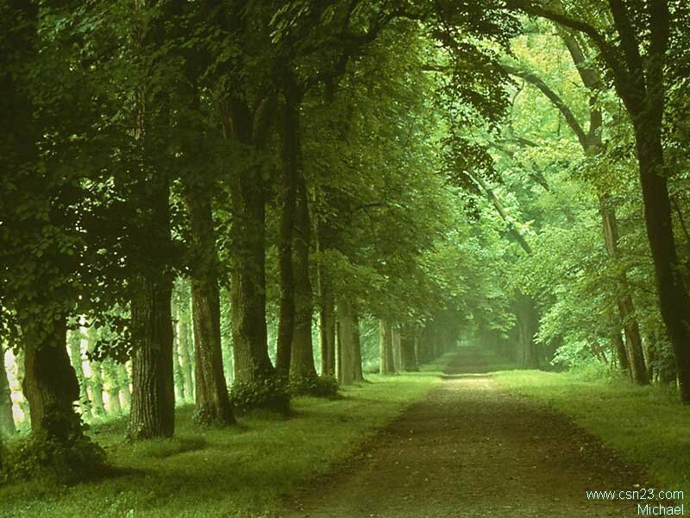
Notes:
Let us review before we start

Slide 44
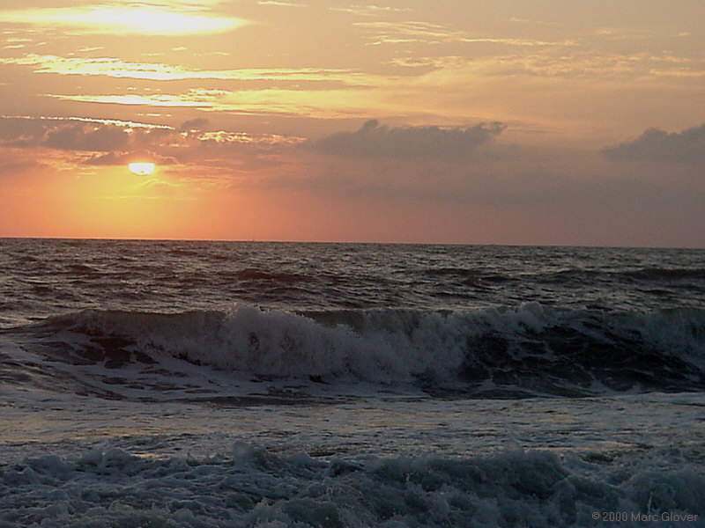
Notes:
End of the Session

