Slide 1


WWT Asynchrony Labs
Ben Pomerenke / Software Engineer

Slide 2
Who are we?
We are Agile gurus who learn, apply, and refine our processes then play rock n' roll on the weekends.
We are quality advocates who automate and test from start to finish then play board-games on Game Night.
We are technical artists who craft beautiful, usable software then play Rocket League on our lunch breaks.
http://www.asynchrony.com/

Slide 3
No Really….
Founded in 1999, St. Louis based
Custom Software Development
Project based development in a variety of tech stacks
Follow Agile principles to form self organizing teams that deliver working software early and often
Springfield office opened in April 2015 (from 1 to 20 in 18 months)
Acquired by World Wide Technology in July 2015

Slide 4
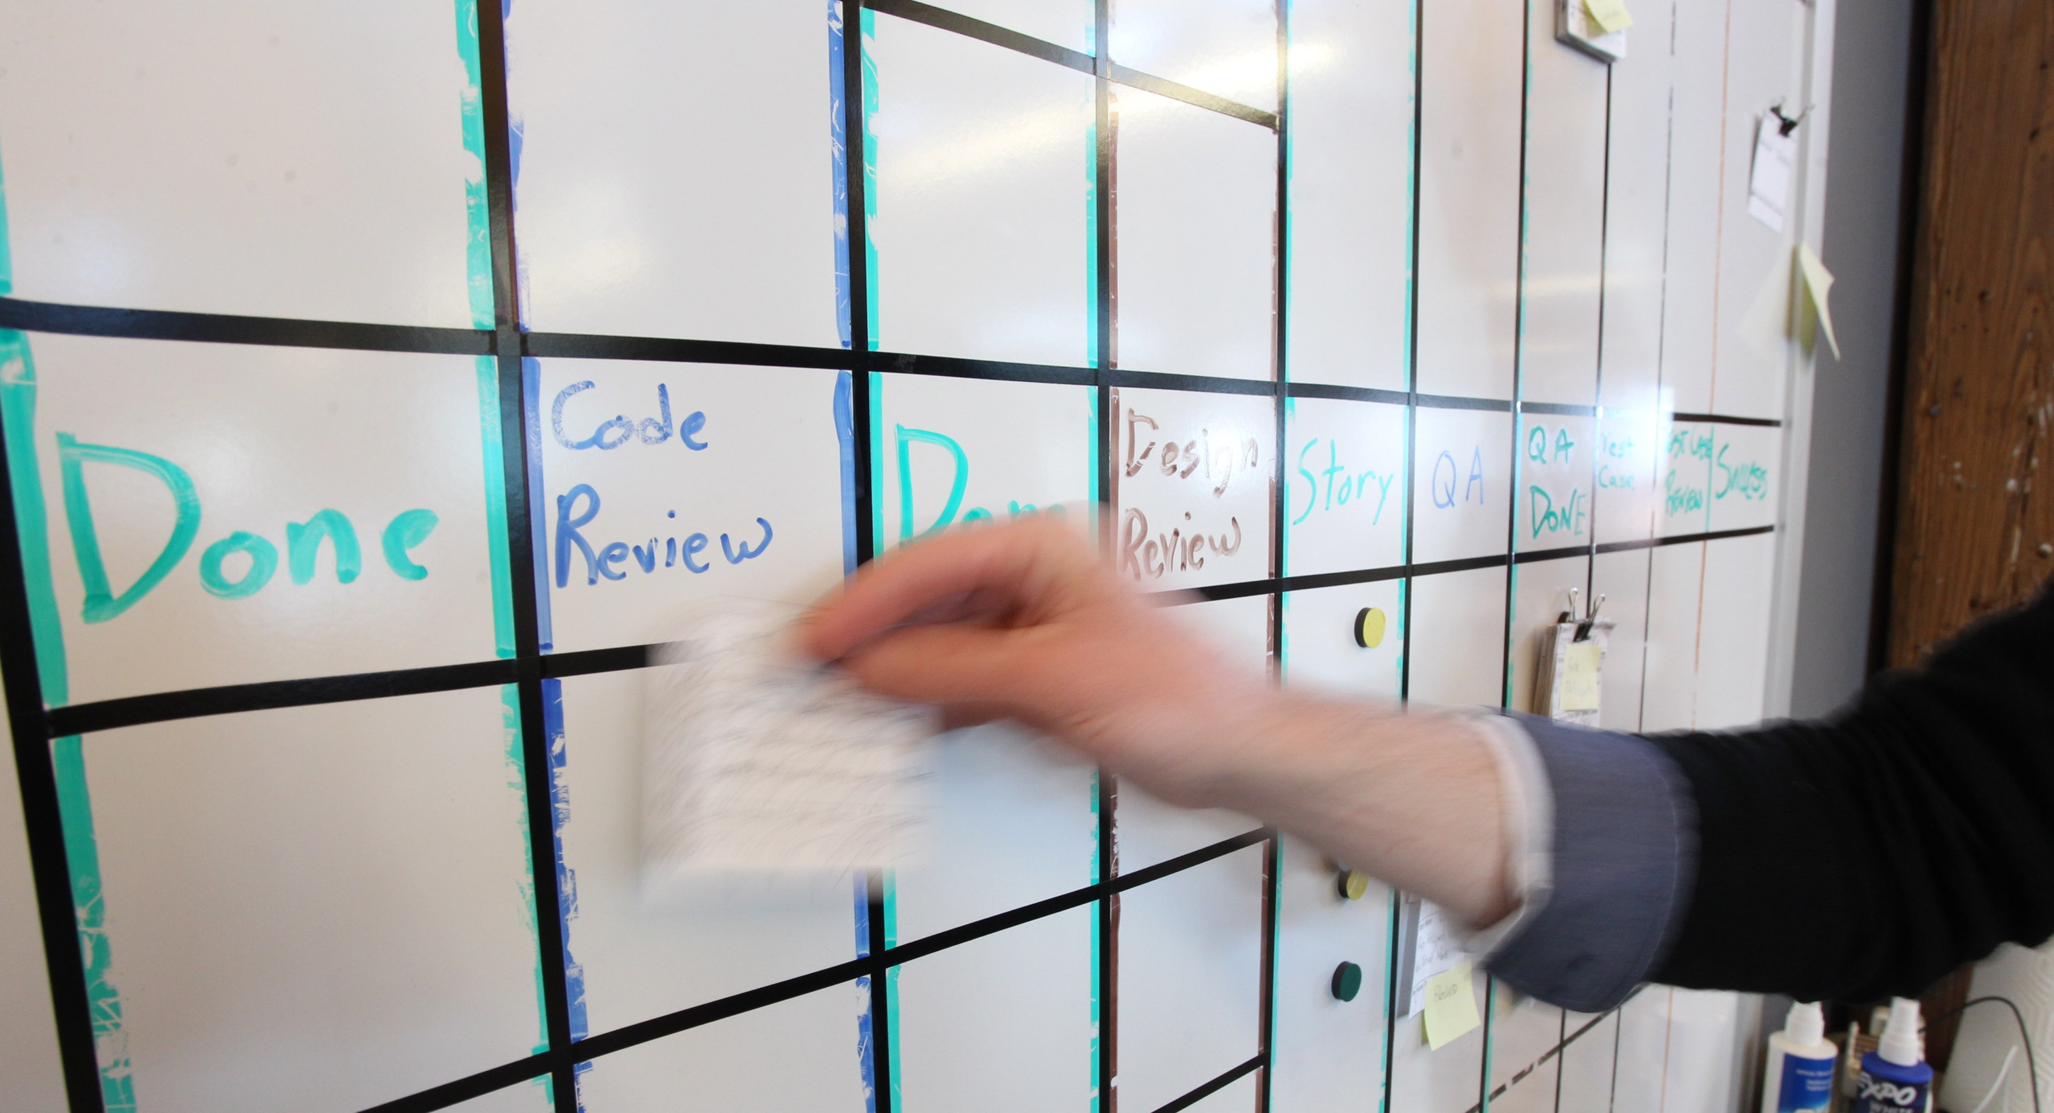
Please enjoy pizza and drinks throughout the presentation

Slide 5
Angular / Web API
Ben Pomerenke / Software Engineer

Slide 6


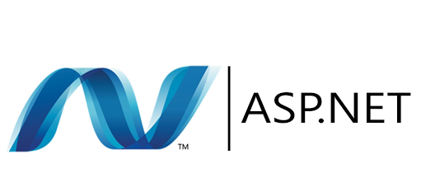
What is Angular?
AngularJS is a structural framework for dynamic web apps. It lets you use HTML as your template language and lets you extend HTML's syntax to express your application's components clearly and succinctly. Angular's data binding and dependency injection eliminate much of the code you would otherwise have to write..
What is Web API?
ASP.NET Web API. ASP.NET Web API is a framework that makes it easy to build HTTP services that reach a broad range of clients, including browsers and mobile devices. ASP.NET Web API is an ideal platform for building RESTful applications on the .NET Framework.

Slide 7
Why use Angular?
Allows for modularization of application code
Two-way data binding
Built with Testing in mind
Reduces amount of “boilerplate” JavaScript
Uses HTML as template language
Full application framework (encompasses all aspects needed for a robust web application)

Slide 8
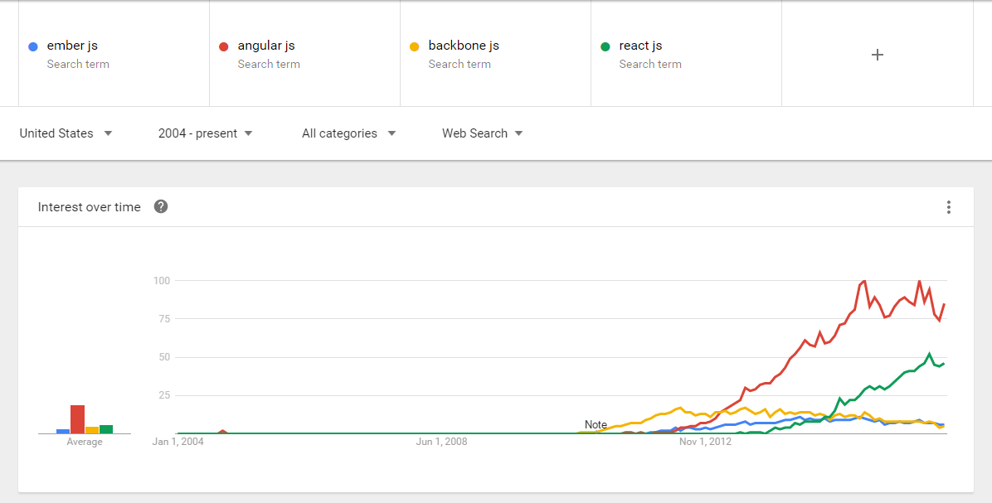
Why not some other JS Framework?
Graph thanks to Google Trends (click here to see more)

Slide 9
Why not Angular2 ?

Slide 10
Why WebAPI?
Similar to MVC (Routes, Controllers, Model Binders, etc.)
Easy to change / modify formatters for any protocol
Easy to wire up dependency injection
Easy to setup / get started building APIs (if you’re already familiar with .NET stack)
Can be hosted on IIS

Slide 11
Demo – What will be covered
Angular
Creating a basic angular application (controllers, services, directives)
Leveraging dependency injection in Angular
2-way data binding
Modularizing HTML / Logic
WebAPI
Basic WebAPI setup
Simple Controller with basic operations
Configuring JSON formatter to convert POCOs to camel casing

Slide 12
Demo – what will not be covered
Unit testing in Angular or in WebAPI
Persisting data via EntityFramework (or other ORM)
Dependency injection in WebAPI
Cache busting assets

Slide 13
Code available: https://github.com/bpomerenke/sgf_dnug_angular_demo
Questions?

