Slide 1
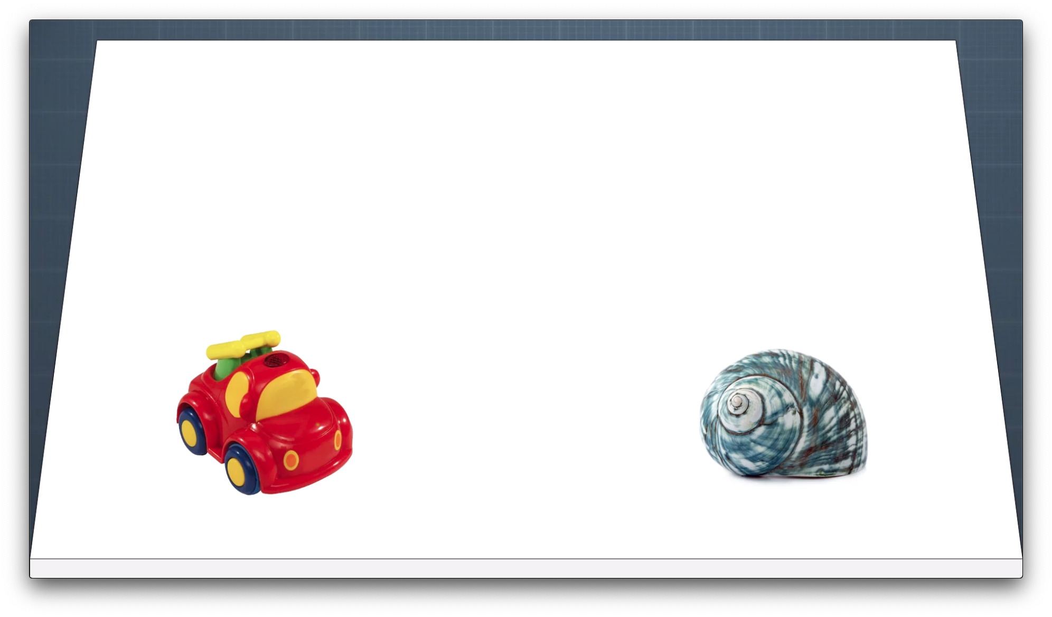
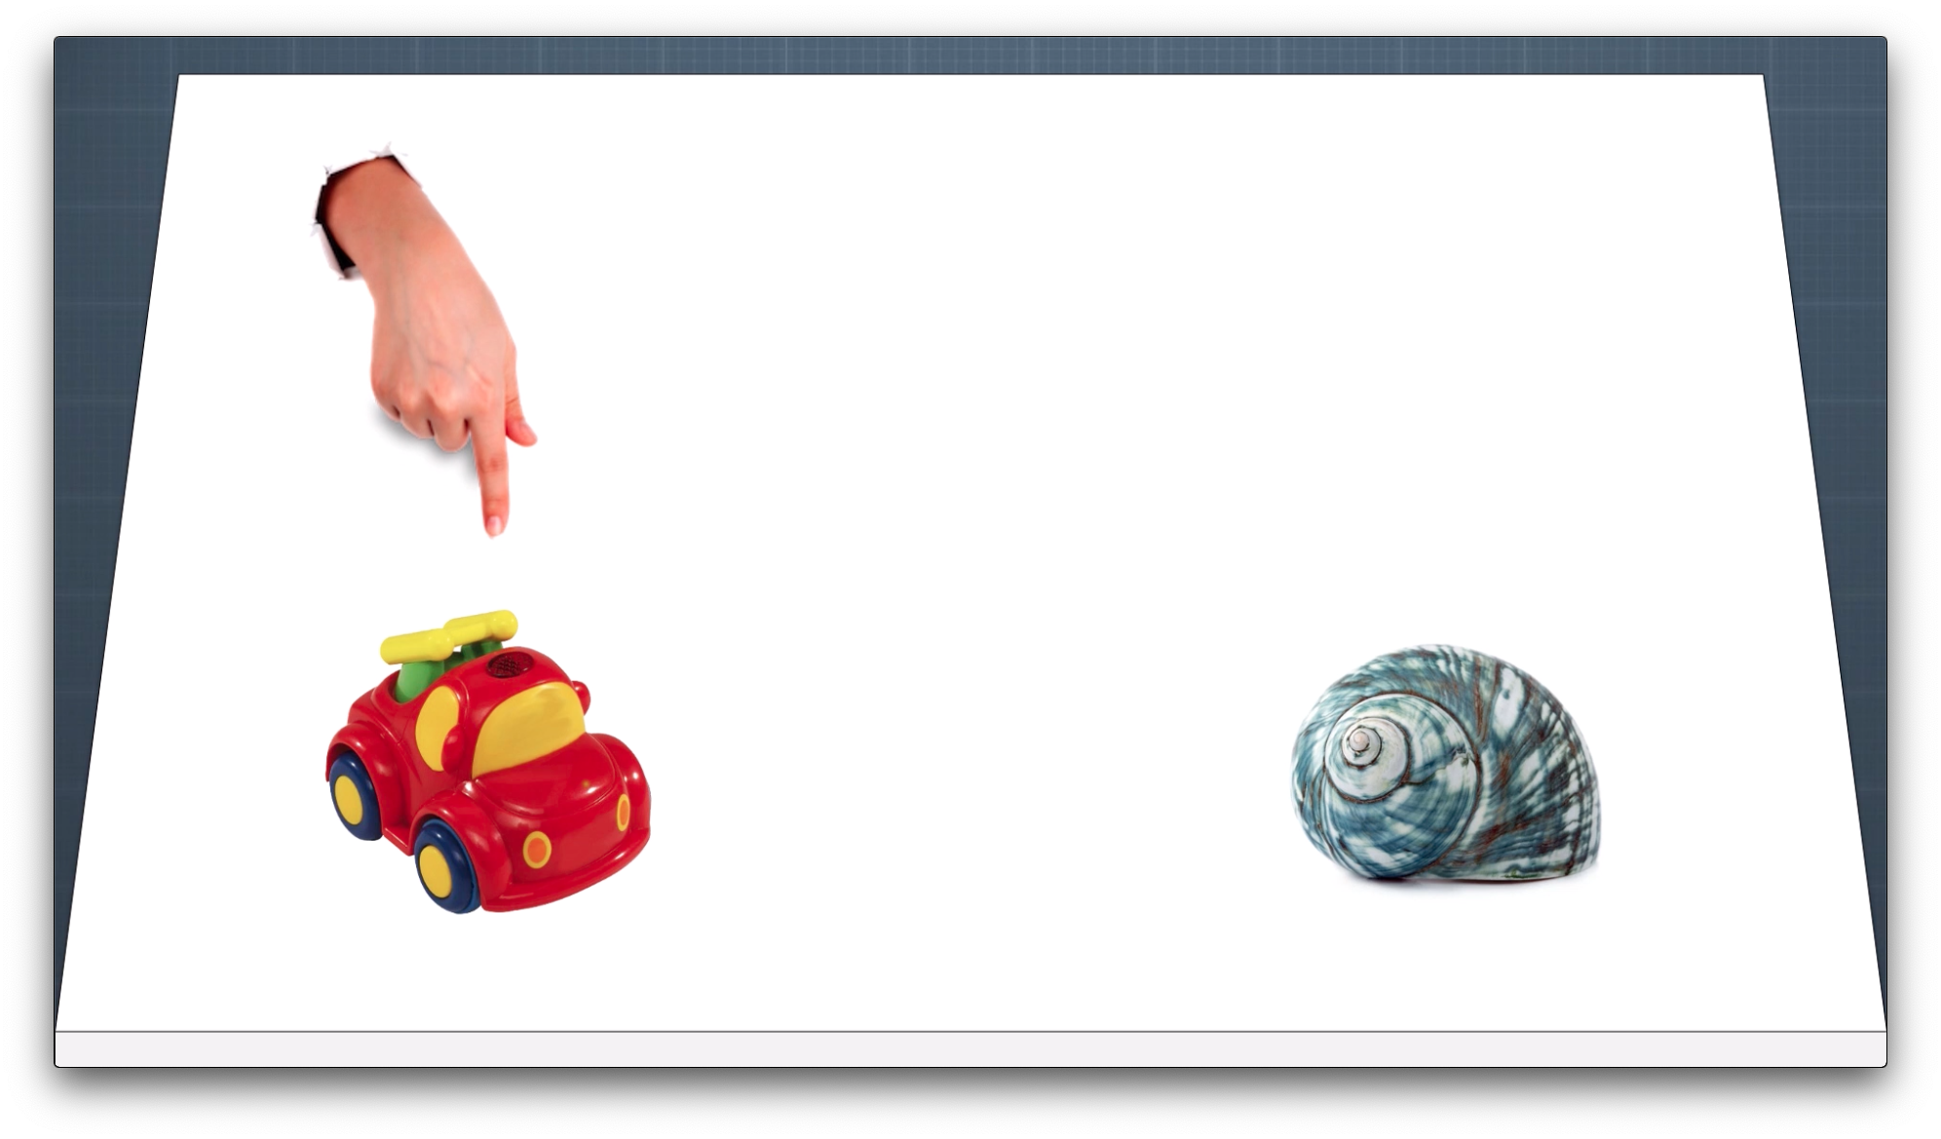

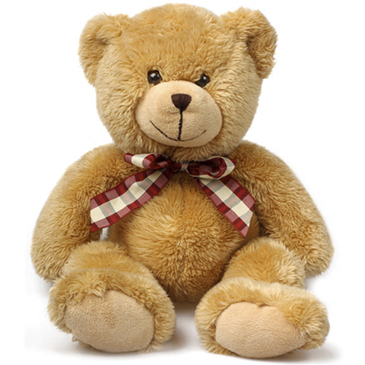
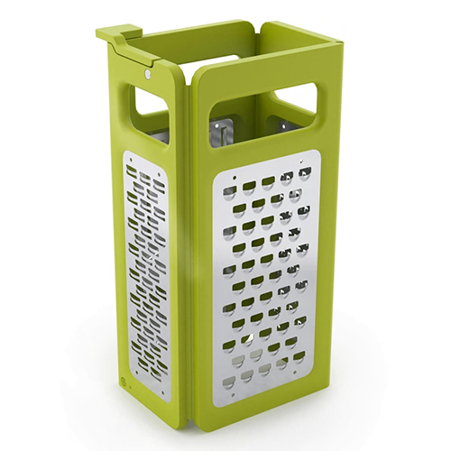
A
Experimental condition | Experiments 1-2
Familiar-word condition
Speech
stimuli
No speech
Where
is the car?
Car. Car.
Visual
stimuli
Novel-word condition
Speech
stimuli
No speech
Where
is the moxi?
Moxi. Moxi.
Visual
stimuli
Trial
phase
Baseline
2 s
Highlighting
3 s
Pretest
0.75 s
Attention getter Test question
variable duration
Test
5 s
B
Control condition
Experiment 1
Experiment 2
Movement
3 s
No movement
3 s

