Slide 1

Agile Presentation
By: Brandon Porter

Slide 2
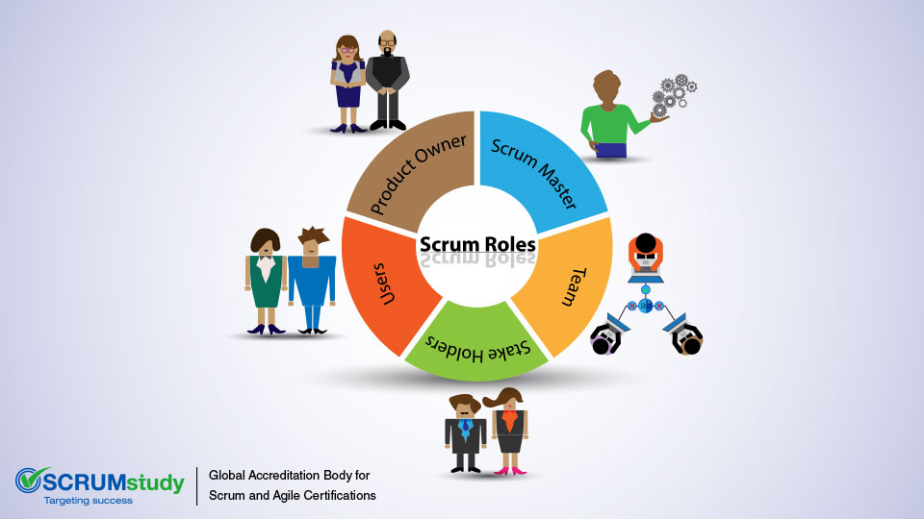
Various roles
Scrum Master: The servant-leader, facilitates the process, Removes impediments, cultural improvement and responsible for the organization
Product Owner: Prioritizing and backlogging, user stories and their tasks. They are the voice for customer and stakeholder decisions, ensure team works on priority first.
Development Team: Testers and development team compose of cross function members. Self organized and figure out how to complete tasks timley during sprint. They collaborate, develop and test the products based on the team need.
Additional roles
Stake Holders: Not part of the scrum team but have interests in the project. They influance product priority and get follow ups from the daily scrums.
Users: These are the end users of the product who may be involved in user acceptance testing and provide feedback on the product's usability and functionality.

Slide 3
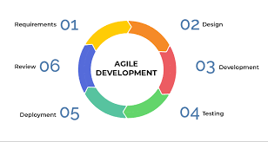
SDLC in Agile Approach
Requirements: Collaborating between the product owner and the developers to understand the goal. User stories will be needed and high level discriptions
Design: Agile teams focus on just-in-time and just-enough design. Come from the needs of the user story and cannot be over designed.
Development: Small increments within short timeframes (sprints). Teams work on a subset of requirements during each sprint. Continuous integration and testing are integral, ensuring that code is tested and integrated frequently to maintain the quality of the product.
Tests are made in the development process to ensure the product is up to par.
Development: Agile needs to ship increments at the end of each sprint. Software must be deployable. Results in faster feed back from users
Review: Feedback and iteration from stakeholders, users and testing to ensure improvements. Showcase completed work after every sprint.

Slide 4
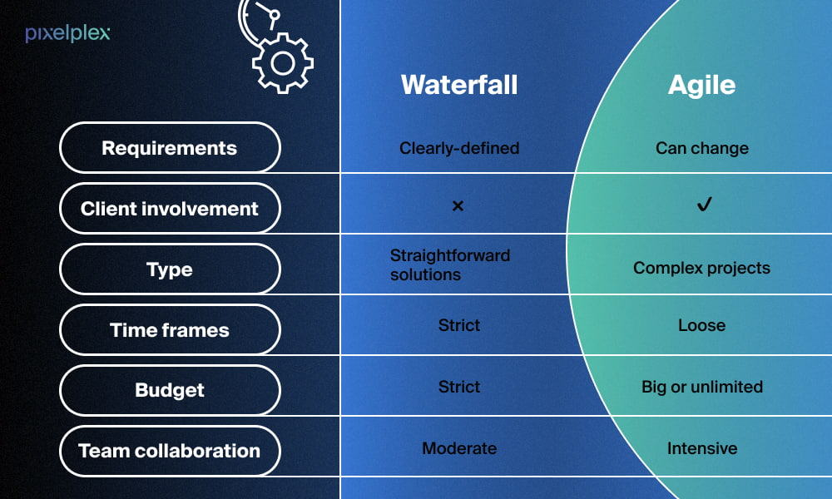
The difference between waterfall and agile
Waterfall is defined and cannot change. It is a top down approach where as Agile is changeable for the better of the situation and the product.
Waterfall is straightforward and Agile is more complex making it harder at first but a better approach at the end.
Time frame is strict with waterfall and it is not with Agile but there is typically a timeline regardless of the approach.
Agile works with an open budget concept but of course there is always a budget and waterfall is a cut and dry approach and it’s a strict budget line.
Team collaboration is huge, in Agile that is much noticed where waterfall can be a more work as you go collaboration and that makes it messy.

Slide 5
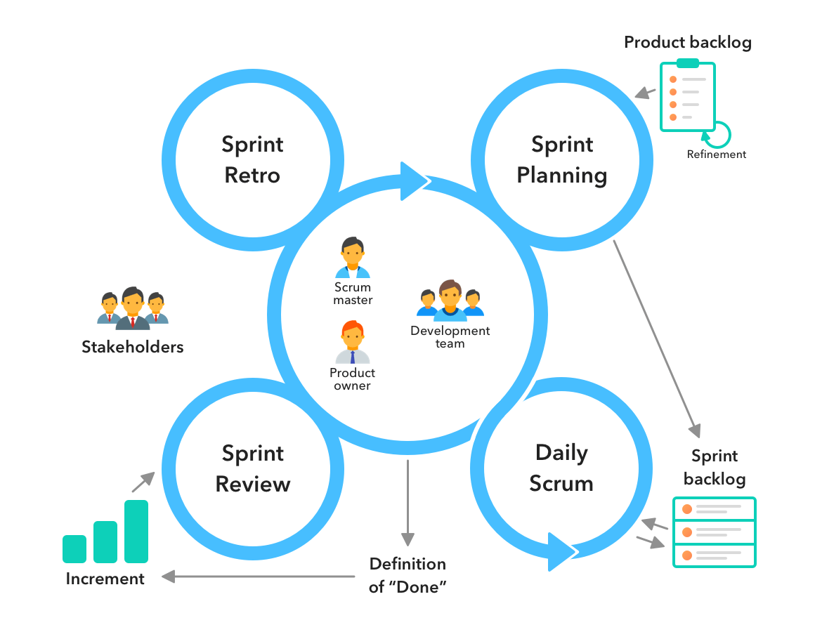
Factors to consider
When considering which approach, Agile makes the most sense on new projects. Consider Agile when its new and complex but waterfall could be okay when working with older projects that have time lines that are known and the situation surrounding the project are already inline. Project complexity
Requirments
Customer involvement
Delivery time
Risk tolerance
Compliance
Organization
Project size
Dependency
Client expense
Budget
These all have to be considered and if the majority of these apply, Agile will be the recommended approach.

Slide 6
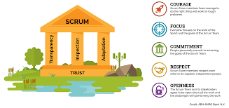
Reference
11, A., & Raza, M. (2020, August 11). Agile vs waterfall sdlcs: What’s the difference? BMC Blogs. https://www.bmc.com/blogs/agile-vs-waterfall/
Hoory, L. (2022, August 10). Agile vs. waterfall: Which project management methodology is best for you?. Forbes. https://www.forbes.com/advisor/business/agile-vs-waterfall-methodology/
The Scrum team: Scrum alliance. The Scrum Team | Scrum Alliance. (n.d.). https://resources.scrumalliance.org/Article/scrum-team

