Slide 1
Ben Postlethwaite
Masters Committee Meeting I
Supervisor: Michael Bostock
July 10th 2012
Thesis/Research Overview

Slide 2
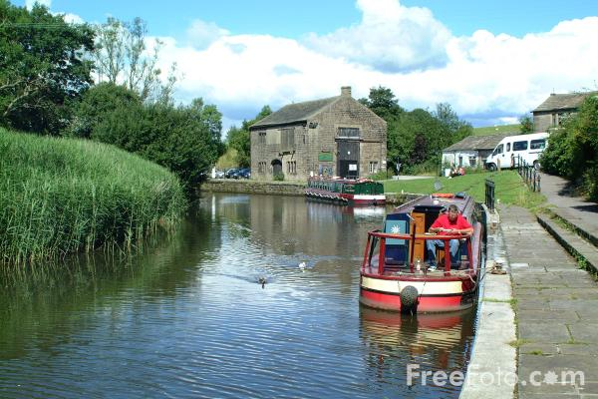
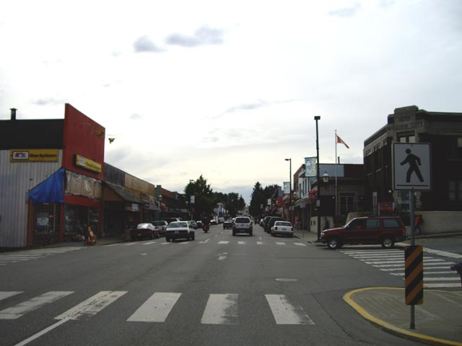

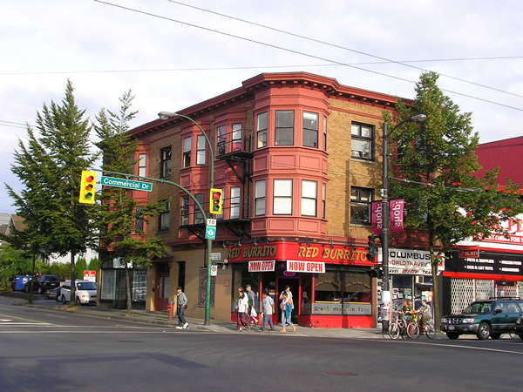
First, a little about me.
Foulridge, Lancashire. 1979
Mission, BC. 1981 - 1998
UBC. 2007 - Present.
Vancouver, BC. 2000 - Present

Slide 3
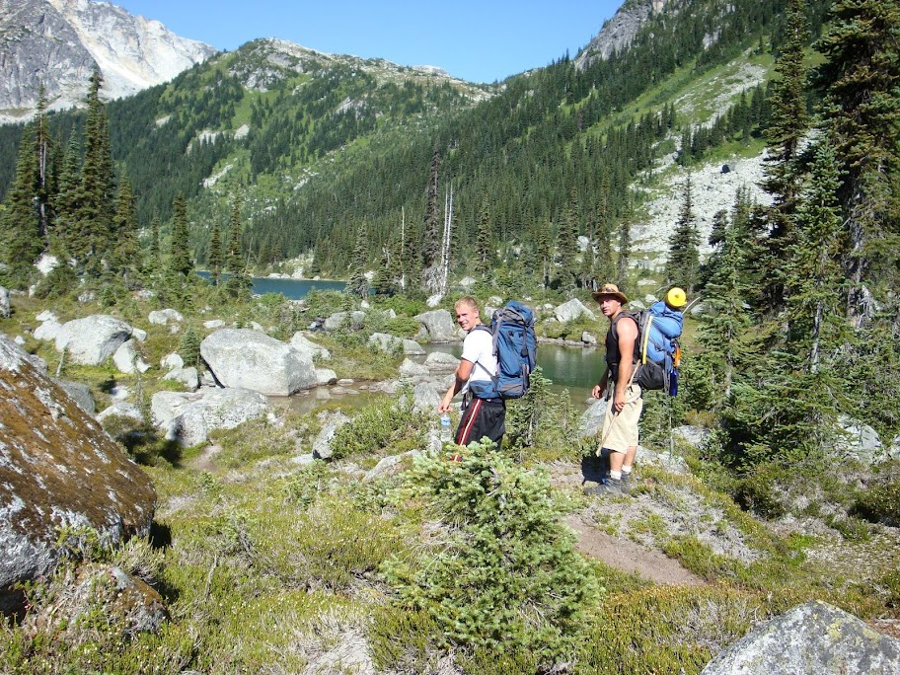
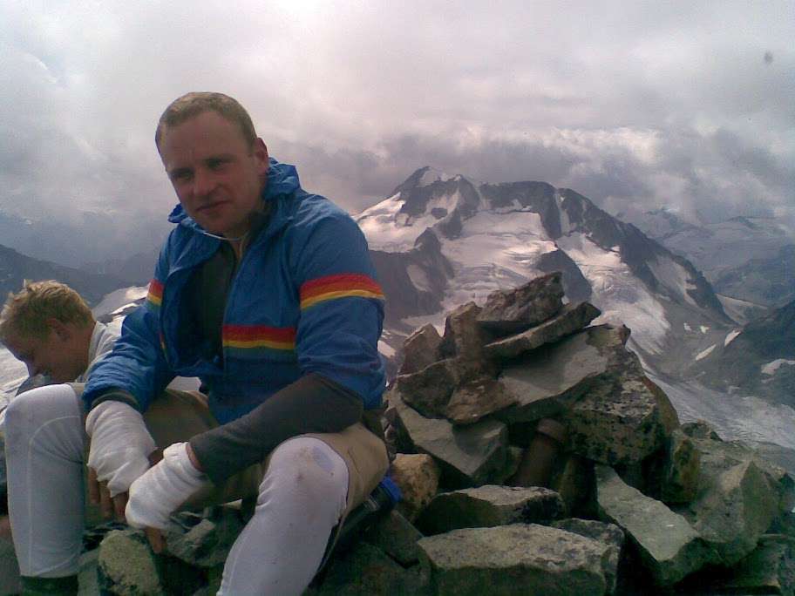
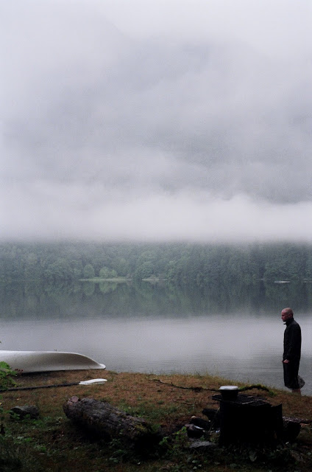
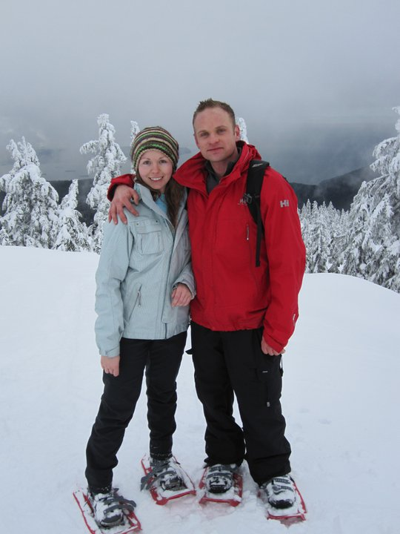


and a tiny bit more.
http://www.benpostlethwaite.ca

Slide 4
Research - Grant
Funding comes from NSERC grants established for the project “An Improved Model of the Canadian Lithosphere” which was initiated by Michael and A.W. Frederikson of the University of Manitoba.
UBC portion of grant is for research related to receiver function analysis and production of crustal depth and seismic property map (R = Vp/Vs) from all available Canadian seismic data.

Slide 5
Research - Thesis
Broadly speaking the research follows the requirements in the NSERC proposal with the added focus on a new method developed by Michael to unpack additional information from receiver function analysis.
Scope is still Canada wide but we hope the extra information will allow further constraints on the broad geologic picture.

Slide 6
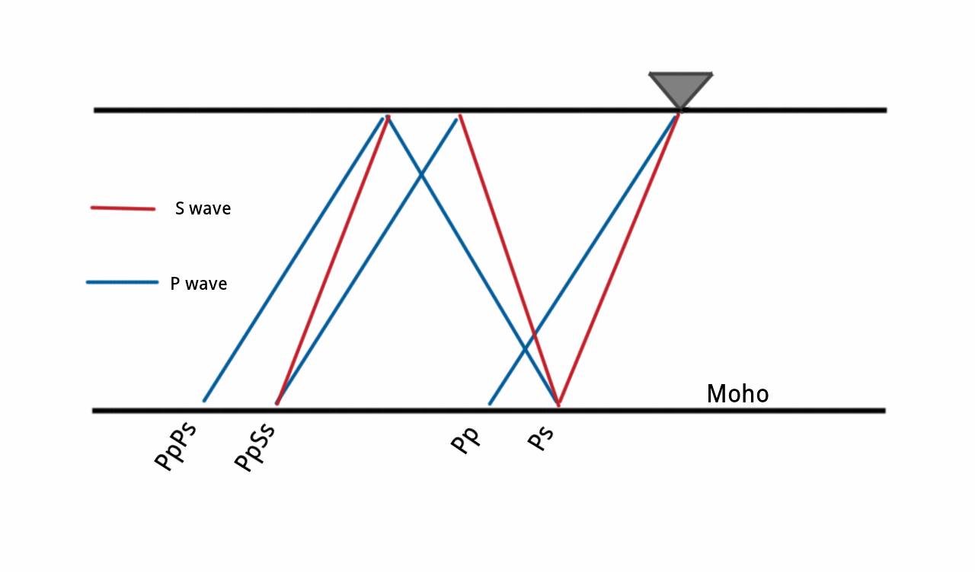
Research - Background
Kanamori (2000) put together machinery in use today.
Focused on reflected S-wave phases.

Slide 7
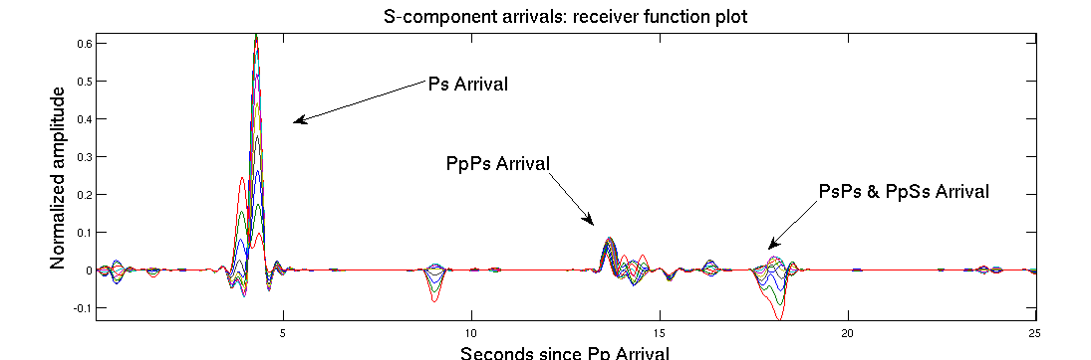
Research - Background
Rotate seismograms into S-component and P-component space.
Three events of interest contained in S-component seismogram.
P-component seismogram used as approximation to source function

Slide 8
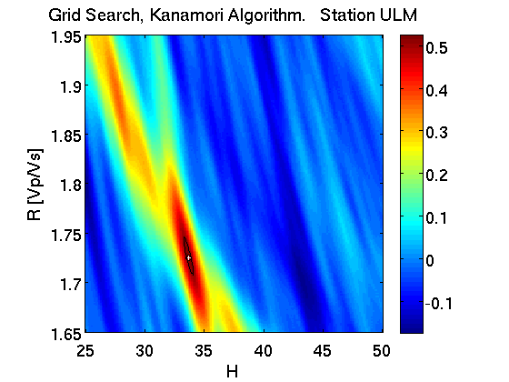
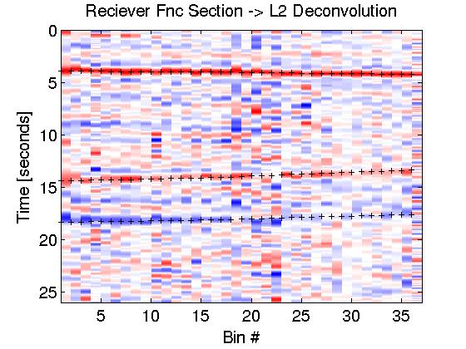
Research - Background
Perform deconvolution on all S-wave seismograms from particular angle -> produce 1 receiver function.
Do this for different angles, stack receiver function side by side.
These receiver functions become the data used to test models using different Vp/Vs and H values in a grid search.
Grid search is the process of solving the equations in the model for a range of Vp/Vs values.
The values that best predict the data = best estimates for the values of the material properties.

Slide 9
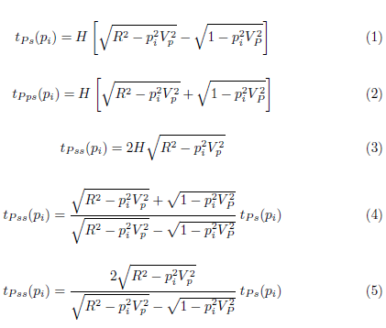
Research - Background
In 2010 in a paper “Bias in seismic estimates of crustal properties” by Michael Bostock and M. Ravi Kumar outlined a method to extract Vp, Vs and H from a receiver function grid search.
This is accomplished by breaking it down into two steps:
2) Then plug Vp_best and R_best into original Tps equation and do line search for H
1) Solve the divided equations for tpss and tpps to get best estimates for Vp_best and R_best

Slide 10
Research - Current
To date I have built out the program/tool-chain to preprocess, deconvolve and perform the grid search and have begun downloading 12 years of data from all the Canadian seismic stations.
I have all Eastern Canadian stations downloaded, preprocessed and picked.
Additionally I have some data from Dave Snyder of NRCAN that has come from Polaris which I am working on now. ( re-pre-processing )

Slide 11
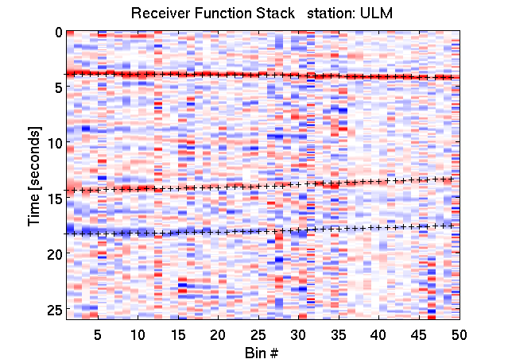
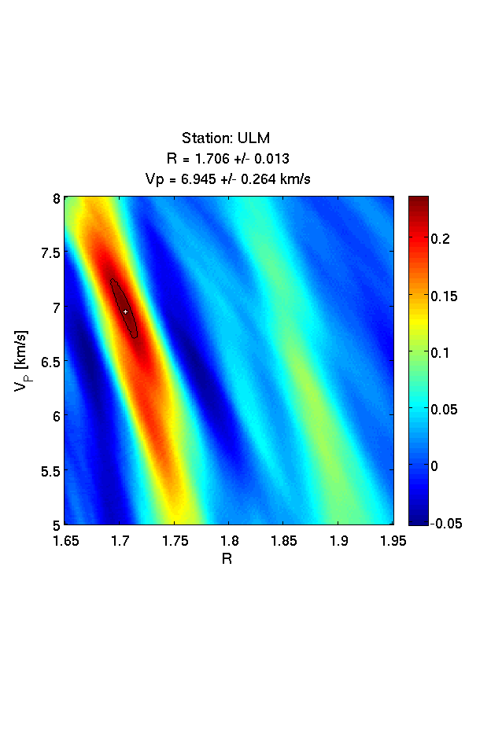
Research - Data - The Good
Receiver Function Stack -------------------> Grid Search for Vp & Vs

Slide 12
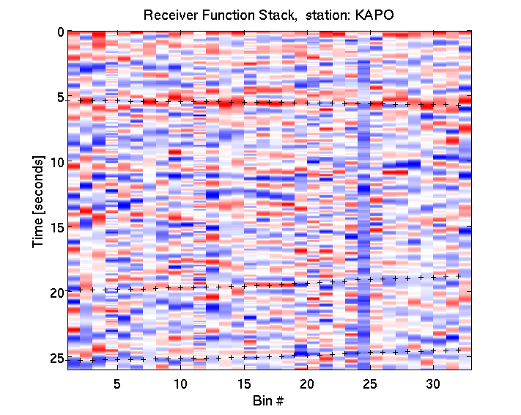
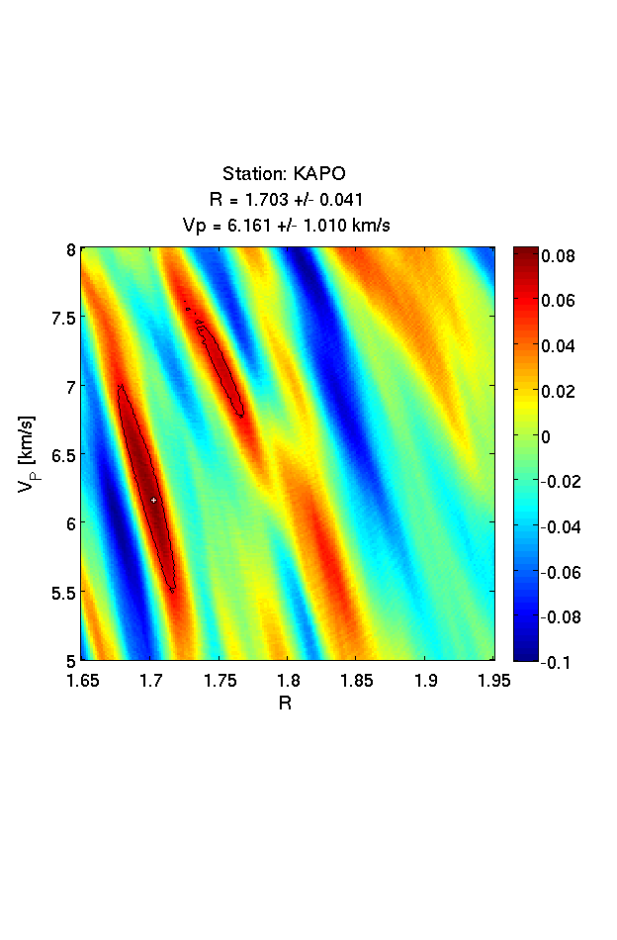
Research - Data - The Bad
Receiver Function Stack -------------------> Grid Search for Vp & Vs

Slide 13
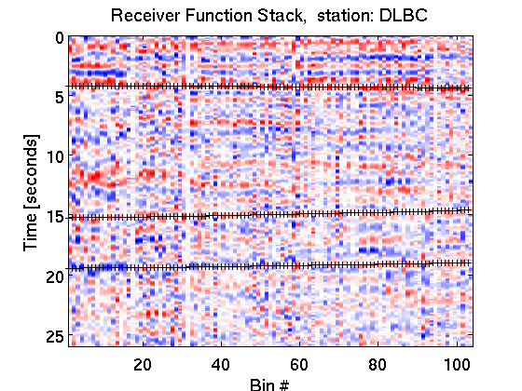
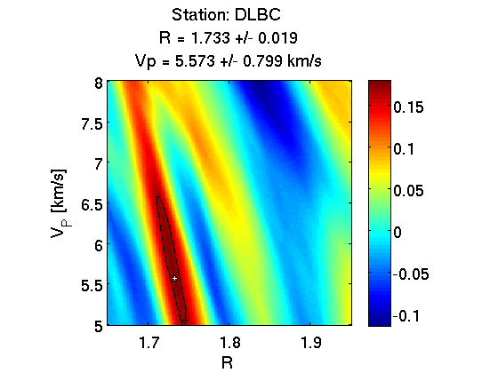
Research - Data - The Ugly
Receiver Function Stack -------------------> Grid Search for Vp & Vs

Slide 14
Research - next few months
Finish preprocessing Snyder's data.
Download and preprocess rest of Canadian data.
Try L1 minimization, Extended-Time Multitaper Frequency Domain Cross-Correlation methods. (including hybrid step approaches.)
Begin 2nd stage of project and get ready for AGU.

Slide 15
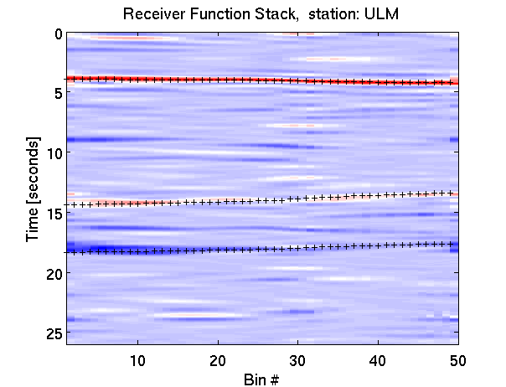
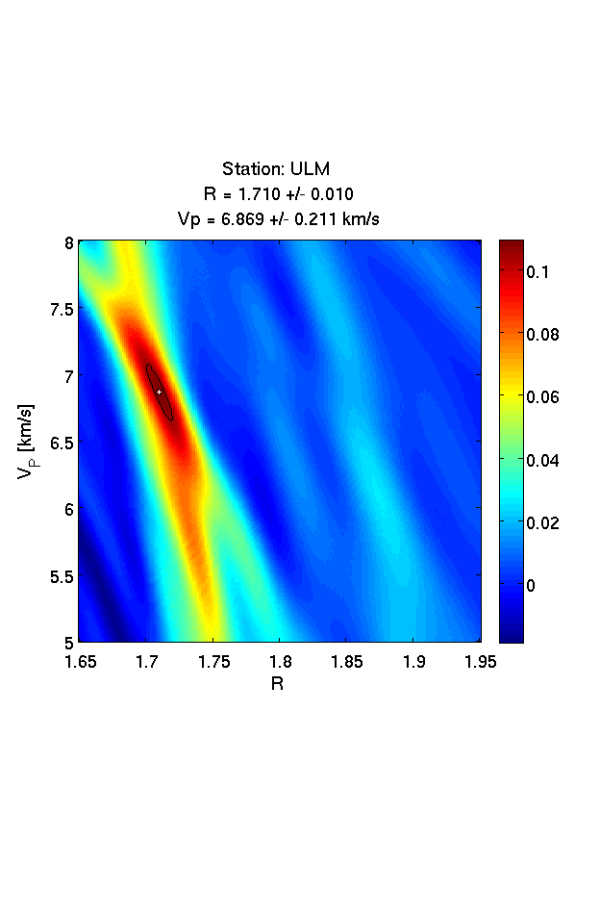
Research - next few months
Shift Invariant Curvelet Soft-Thresholding

Slide 16
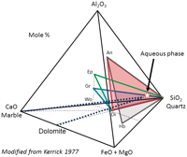
Research - after that...
2nd stage involves pairing the database of bulk seismic properties at each Canadian station with Nik Christensen's data on mineral seismic properties.
Going to require ternary or quaternary diagrams with well chosen end members.
David Snyder seemed to doubt the existence of a searchable geologic database at his institution at least. Follow-up required.
Thesis Defence. Journal Article.

Slide 17
References
Bostock, M. G., Kumar, R. M., (2010). Bias in Seismic Estimates of Crustal Properties. Geophysical Journal International, 182, 403-407.
Kanamori, H., Zhu, L., (2000). Moho Depth Variation in Southern California from Teleseismic Receiver Functions. Journal of Geophysical Research, 105, 2969-2980.

