Slide 1
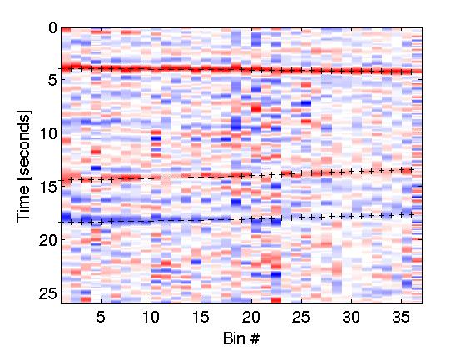
Improved Estimates of Key Seismic Properties of the Crust
Ben Postlethwaite
UBC

Slide 2
Overview
Background Science

Slide 3
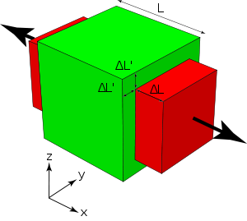
Motivation: The Problem
Extracting material properties from seismic data has a long history.
For bulk crustal composition under receivers the seismic velocity ratio
has been used.
This provides Poisson's ratio:
which is useful for constraining crustal composition.
Further use of seismic data to constrain crustal composition would require knowledge of explicit values of V_{p} or V_{s}.
Poisson's Ratio: It is the ratio of lengthening along one axis versus compression along the other two.

Slide 4
Motivation: The Problem
Many previous studies have used a grid search for the seismic velocity ratio R = V_{p}/V_{s} and crustal thickness H. Kanamori (2000)
Some a priori information is required, namely an estimate P-wave velocity V_{p}.
Here we attempt to recover V_{p} and seismic velocity ratio R, without any assumption on V_{p}.
For accurate resolution of V_{p} in solution we require sharp deconvolution (close to spike train as possible).
We try damped-L2 based deconvolution as well as sparsity promoting wavelet-based L1 minimization.

Slide 5
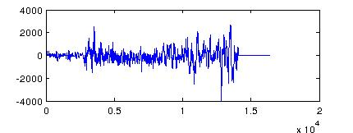
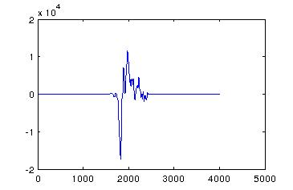
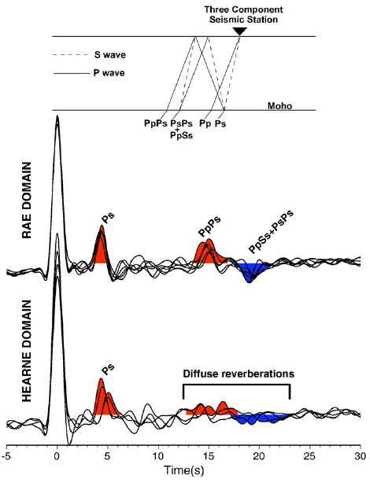
Motivation: The Problem
Pre-process Seismic Data
Select P-coda as source approx
Deconvolution
Non-Linear Newton + L1 fit for first arrival time
Grid Search for V_{p}, V_{s}.
Line search for H

Slide 6

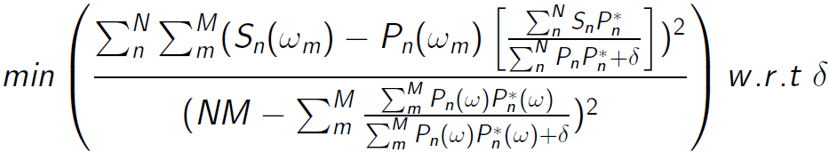
Motivation - The Problem
Pre-process Seismic Data
Currently using a Simultaneous Deconvolution with Generalized Cross Validation regularization.
where F is the Fourier transform matrix, G is the model, S is the S-wave seismogram , P is the P-wave source coda, * is the complex conjugate and δ is the regularization. δ is chosen by minimizing the Generalized Cross Validation function:
Select P-coda as source approx
Deconvolution
Non-Linear Newton + L1 fit for first arrival time
Misfit: more accurate with δ -> 0. Less stable.
Grid Search for V_{p}, V_{s}.
Line search for H
As δ increases denominator increases, promotes stability.

Slide 7
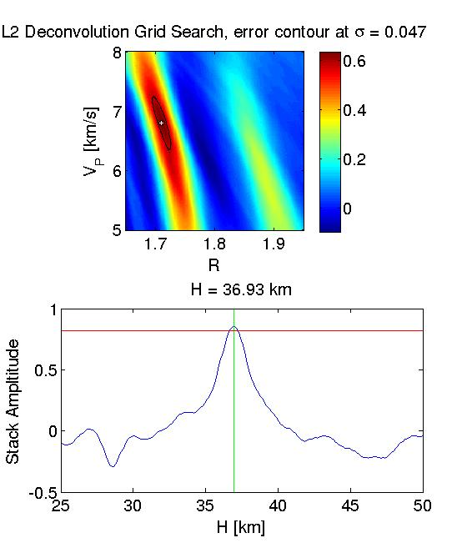
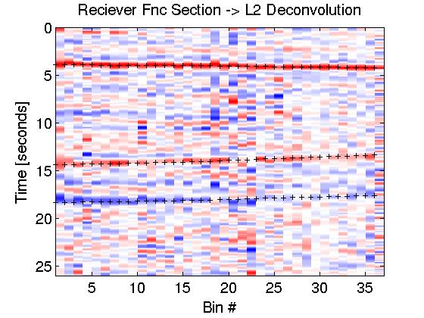
Motivation: The Problem
Pre-process Seismic Data
Select P-coda as source approx
Using ratios of
travel-time
equations for phases
tps, tpps & tpss
Deconvolution
Non-Linear Newton + L1 fit for first arrival time
Grid Search for V_{p}, V_{s}.
Line search for H

Slide 8
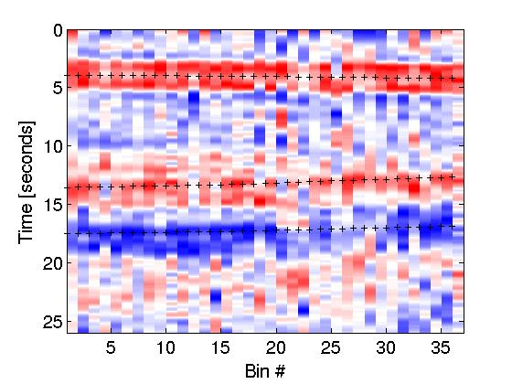
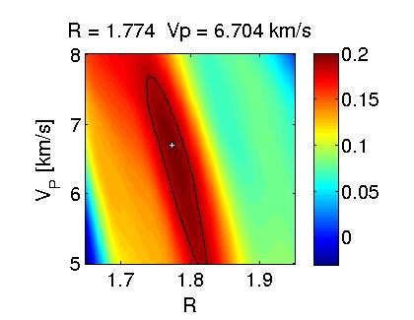
Motivation - The Problem
Confidence of final results highly dependent on sharpness of deconvolution.

Slide 9
Sparsity promoting L1 Deconvolution.
Take advantage of the fact that an optimal receiver function has sparse wavelet representation.
Design a deconvolution algorithm that leverages sparsity.
See if it can beat the tried and true L2 deconvolution.

