Slide 1
Improved Estimates of Key Seismic Properties of the Crust
Ben Postlethwaite (UBC)
Supervisor: Michael Bostock (UBC)
Notes:
Thank you David and thanks all for coming out to this discussion.
To get this going let's take a close look at the title of this talk, “ ... .“ -> NEXT

Slide 2
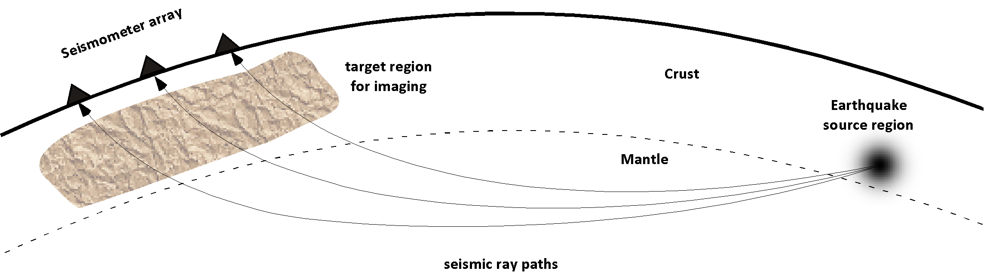
Seismic Properties
Geologic material properties which can be extracted from seismograms.
Seismograms are records of displacement from EQ energy.
We are concerned with ...
  P-wave velocity = Vp (around 6 km/s)
  S-wave velocity = Vs (around 3.5 km/s)
P-wave
S-wave
Notes:
When we are talking about seismic properties we are talking about geological material...
A seismogram is a record of earth shaking – displacement – which is physical response of earth to migrating energy from source, EQ.
Energy travels in different states, two interested are P-wave -> compressional and S-wave -> Shear.
Of importance here are that waves have unique displacements and travel at diff velocities.
Velocities are dependent on geology wave travels through
Thus seismic velocities diagnostic of geology.
Scale: domain investigation is Moho up.
Thus properties are of bulk crustal composition.

Slide 3
Seismic Properties & Scale
Seismic velocities are dependent on the material the seismic waves travel though.
Thus are diagnostic property of geology.
Project looks at the reflections within the crust.
All properties are then bulk averages, bulk crustal composition.
Notes:
When we are talking about seismic properties we are talking about geological material...
A seismogram is a record of earth shaking – displacement – which is physical response of earth to migrating energy from source, EQ.
Energy travels in different states, two interested are P-wave -> compressional and S-wave -> Shear.
Of importance here are that waves have unique displacements and travel at diff velocities.
Velocities are dependent on geology wave travels through
Thus seismic velocities diagnostic of geology.
Scale: domain investigation is Moho up.
Thus properties are of bulk crustal composition.

Slide 4
Why Improv[ed] Estimates?
Currently a clear method for extracting the seismic velocity ratio Vp/Vs.
This is extracted as a single value, useful in determing Poisson's Ratio.
Michael Bostock (2008) developed a means to determine Vp and Vs individually.
This project seeks to implement this idea and scale it out.
Allow for more accurate estimates of bulk crustal composition.
Useful to researchers and industry who require such data.
Better contraints = Better results
Notes:
When we are talking about seismic properties we are talking about geological material...
A seismogram is a record of earth shaking – displacement – which is physical response of earth to migrating energy from source, EQ.
Energy travels in different states, two interested are P-wave -> compressional and S-wave -> Shear.
Of importance here are that waves have unique displacements and travel at diff velocities.
Velocities are dependent on geology wave travels through
Thus seismic velocities diagnostic of geology.
Scale: domain investigation is Moho up.
Thus properties are of bulk crustal composition.

Slide 5
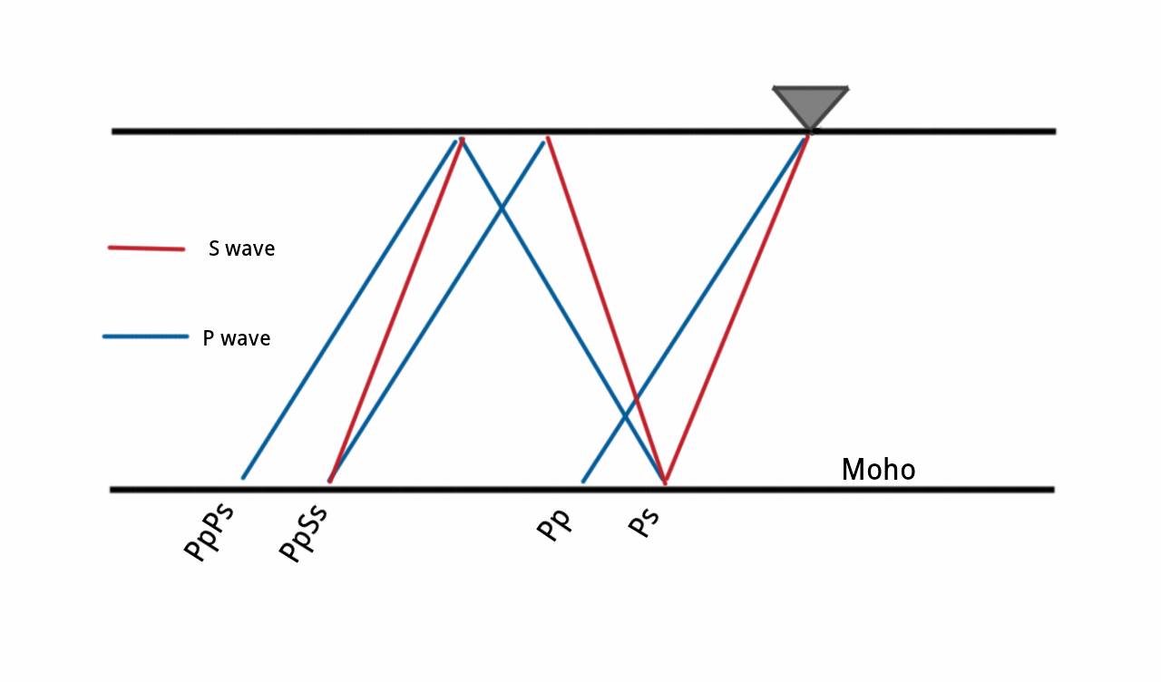
How: Reflected Phases
Kanamori (2000) put together machinery in use today.
Focused on reflected S-wave phases.

Slide 6
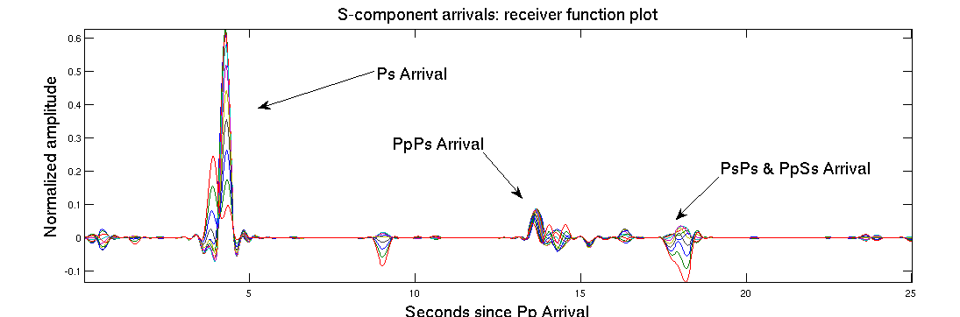
How: Reflected Phases
Rotate seismograms into S-component and P-component space.
Three events of interest contained in S-component seismogram.
P-component seismogram used as approximation to source function

Slide 7

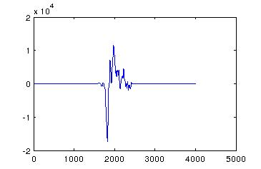
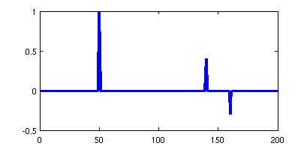
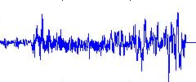
How: Convolution
Seismogram can be conceived as a convolution between source signature and a receiver function.
Convolution
Source: Wikipedia
*
=
Unfortunately the earth is not a 1D layered model, and the discontinuities are not perfect reflectors or spikes.
Noise & correlated error. Deconvolution = difficult.

Slide 8
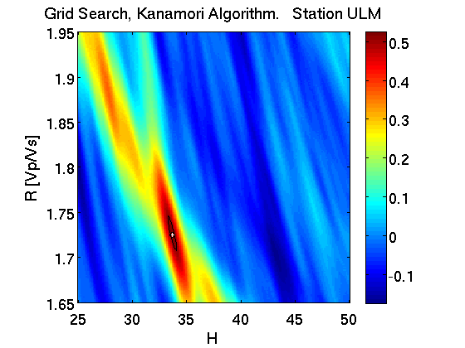
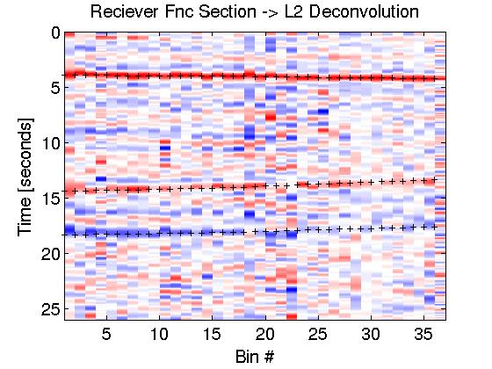
How: Receiver Functions
Perform deconvolution on all S-wave seismograms from particular angle -> produce 1 reciever function.
Do this for different angles, stack reciever function side by side.
These receiver functions become the data used to test models using different Vp/Vs and H values in a grid search.
Grid search is the process of solving the equations in the model for a range of Vp/Vs values.
The values that best predict the data = best estimates for the values of the material properties.

Slide 9
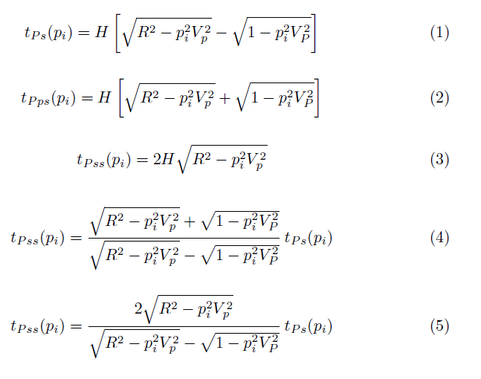
Today and forward
Travel time equations
Kanamori's method was employed recently in the 2010 paper “Precambrian crustal evolution: Seismic constraints from the Canadian Shield”.
Bostock in work from 2008 & 2010 show that it is possible to solve for Vp and Vs individually.

Slide 10
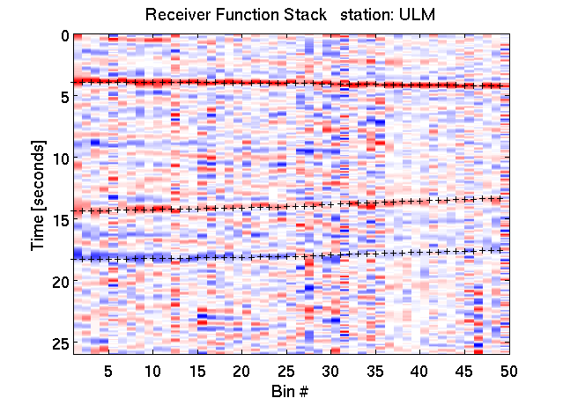
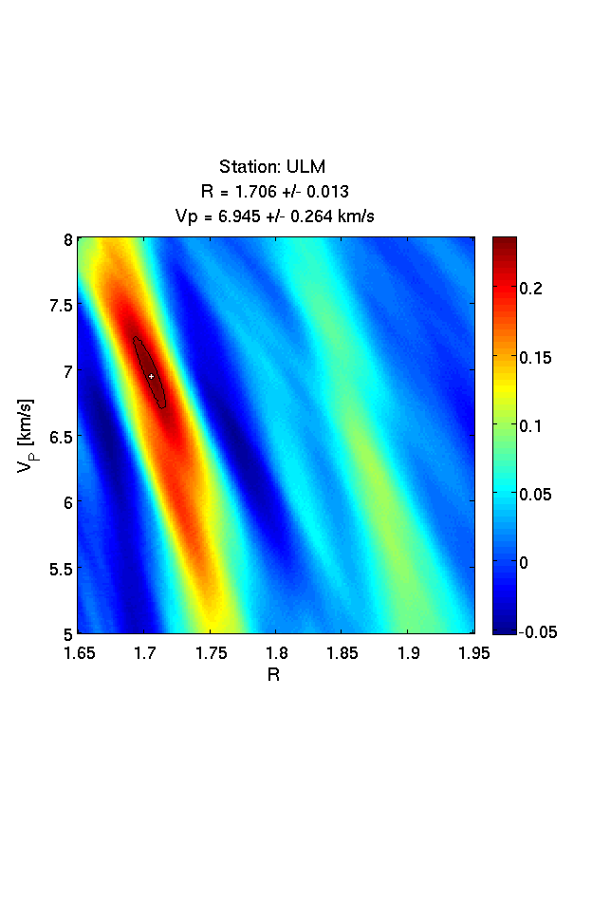
Results: The Good
Receiver Function Stack -------------------> Grid Search for Vp & Vs

Slide 11
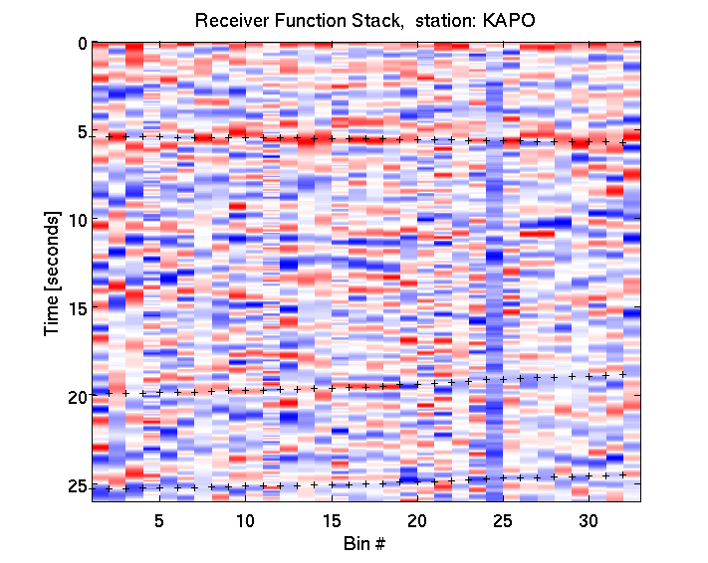
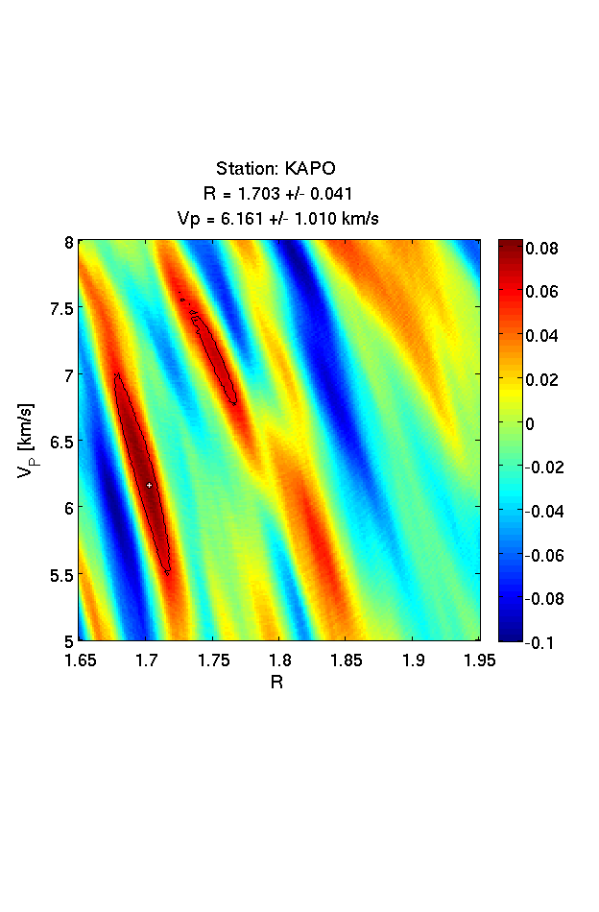
Results: The Bad
Receiver Function Stack -------------------> Grid Search for Vp & Vs

Slide 12
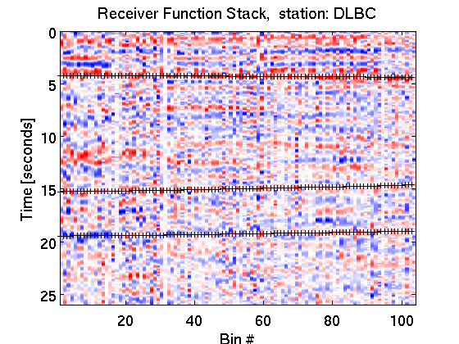
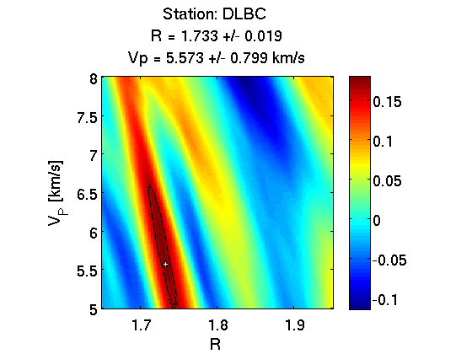
Results: The Ugly
Receiver Function Stack -------------------> Grid Search for Vp & Vs

Slide 13
Discussion & Future Direction
Around 30% of data fits into the good category.
30% into bad and 40% into the ugly.
High hopes for the ugly.
SLIM group at UBC:
  Sparsity promotion (Curvelets)
  Randomized sampling
  Compressive Sensing.

Slide 14
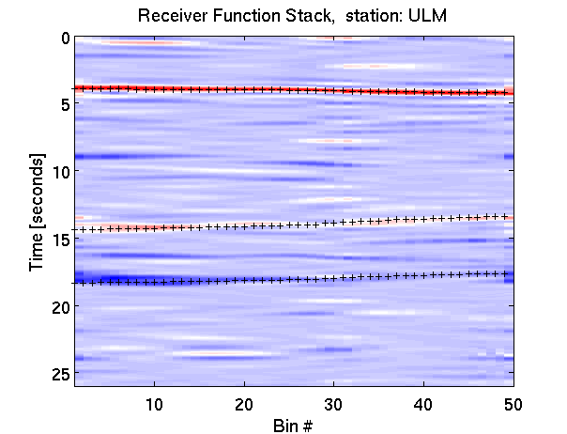
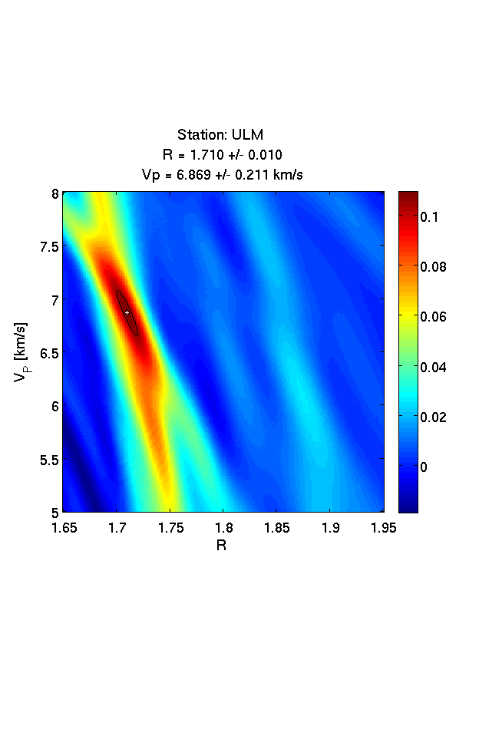
Discussion & Future Direction
Shift Invariant Curvelet Soft-Thresholding

Slide 15
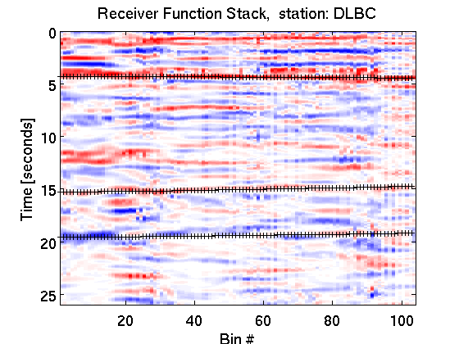
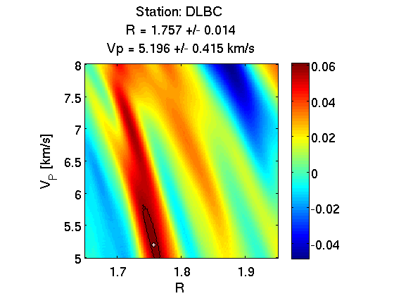
Discussion & Future Direction
Shift Invariant Curvelet Soft-Thresholding

Slide 16
Thank you!
References:
Bostock, M. G., (1998). Mantle Stratigraphy and Evolution of the Slave Province. Journal of Geophysical Research, 103, 21,183-21,200.
Bostock, M. G., Kumar, R. M., (2010). Bias in Seismic Estimates of Crustal Properties. Geophysical Journal International, 182, 403-407.
Thompson, D. A., Bastow, I. D., Helffrich, G., Kendall, J-M., Wookey, J., Snyder, D.B., Eaton, D.W., (2010). Precambrian Crustal Evolution: Seismic Constraints from the Canadian Shield.
Kanamori, H., Zhu, L., (2000). Moho Depth Variation in Southern California from Teleseismic Receiver Functions. Journal of Geophysical Research, 105, 2969-2980.

