Slide 1
Medicare Project
By
Bhavya Potineni

Slide 2
Problem Description
The professor is interested in the cost of “Cardiovascular stress test” (CPT code 93015) in various parts of US.
She is concerned that if the cost of the procedure is effected by the amount a pharmaceutical company is spending on a physician’s office.

Slide 3
Data Available
National Claims History (NCH) Standard Analytic Files (SAFs) which include Medicare claims as of 6/30/2013 (published on 4/07/2014 at www.cms.gov ).
Data to be considered are address of physician, procedure they are providing and amount they claimed from Medicare for that procedure.
Data set for identified General Payments made by pharmaceutical companies on physicians for the year 2013 (published 12/2014 at www.cms.gov).
Data to be considered are address of physician and amount spent on that address by the organization.

Slide 4
Data Normalization
Common fields between two data sets – address fields (street1,street2,city,state)
Problems with the address fields
Blvd -> boulevard
St -> street
Rd -> Road
Apt -> Apartment
Multiple spaces
‘#’, ‘.’, ‘,’, ’-’ special character
Required Normalization before grouping the data for analysis.

Slide 5
Procedure followed
Medicare Data
Pharmaceutical data
Load
Data wrangling/munging
Data wrangling/munging
Normalization
Filtering data wrt CPT code = 93015
Grouping
Group data wrt address fields
Group data wrt address fields
Joining
Join on address fields
Analysis
Finding correlation between data

Slide 6
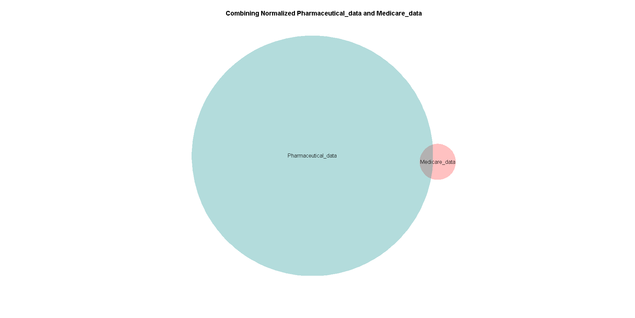
2803
409765
6435
CPT code 93015

Slide 7
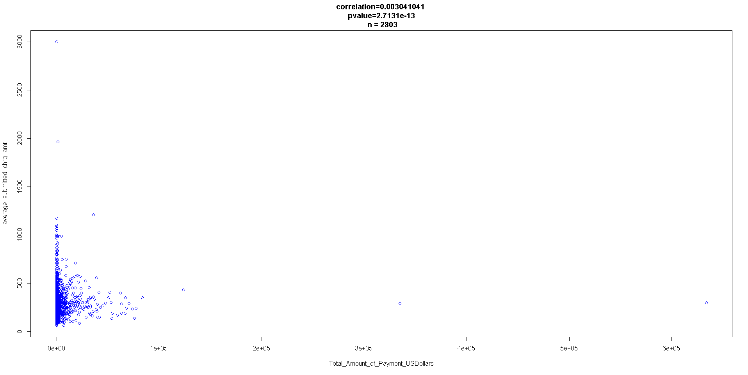
Plot for amount spent on physician vs amount claimed from Medicare from same address.

Slide 8
Tools and Statistical functions used
Pig – Data Normalization
Matlab – Computing correlation coefficient
Functions :
corrcoef() – to compute correlation coefficient
ttest() – to compute p values
R – Plotting the data
Functions:
Venneuler() - to plot Venn diagram
Plot() – to plot the scatter plot.

Slide 9
Thank you

