Slide 1
Getting Started with Remote Analysis
Ben Poulter
5.11.21

Slide 2
Logging in
Download NoMachine at: https://www.nomachine.com/download-enterprise#NoMachine-Enterprise-Client
https://confluence.slac.stanford.edu/display/PCDS/Remote+Visualization

Slide 3
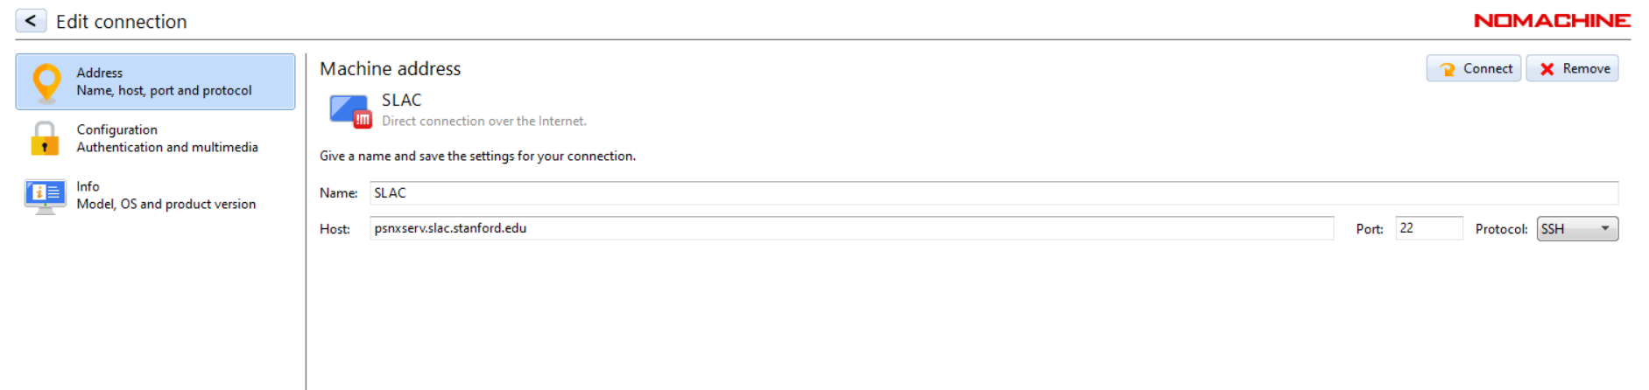
Enter this as your host server.
Be sure to change from NX to SSH

Slide 4
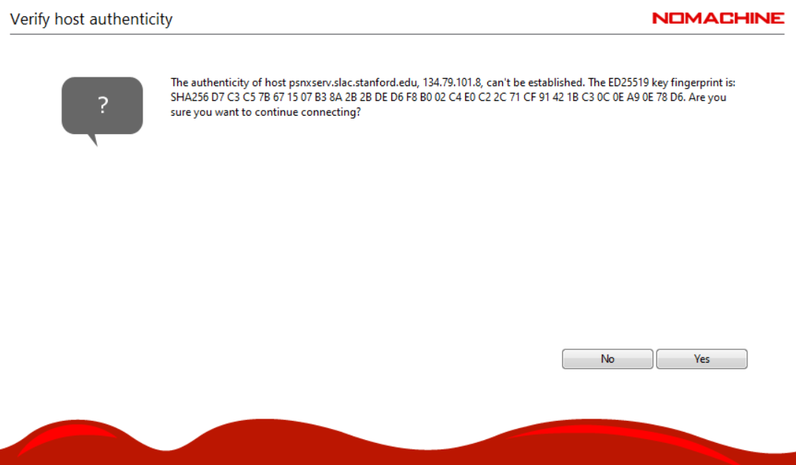
Hit yes

Slide 5
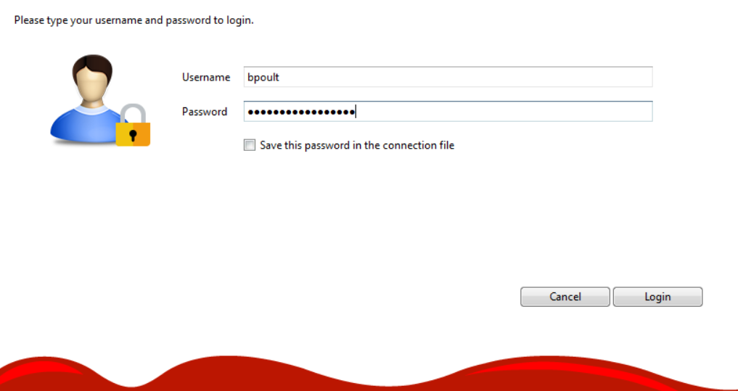
Login with your unix account information

Slide 6
Hit yes

Slide 7
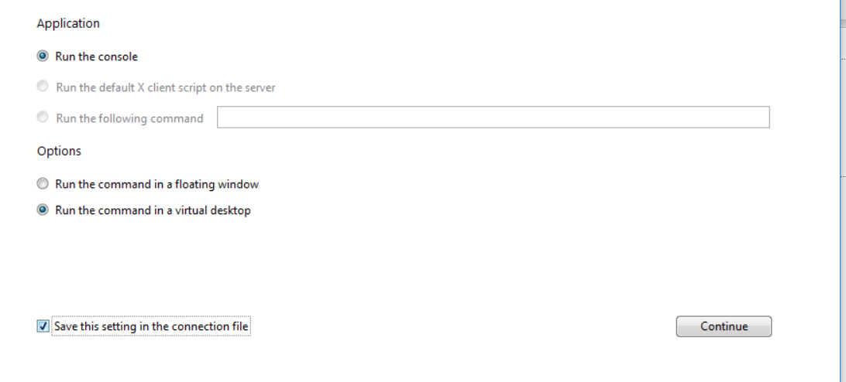
This is what I set mine up as, change resolution etc as you want on the following couple of prompts.

Slide 8
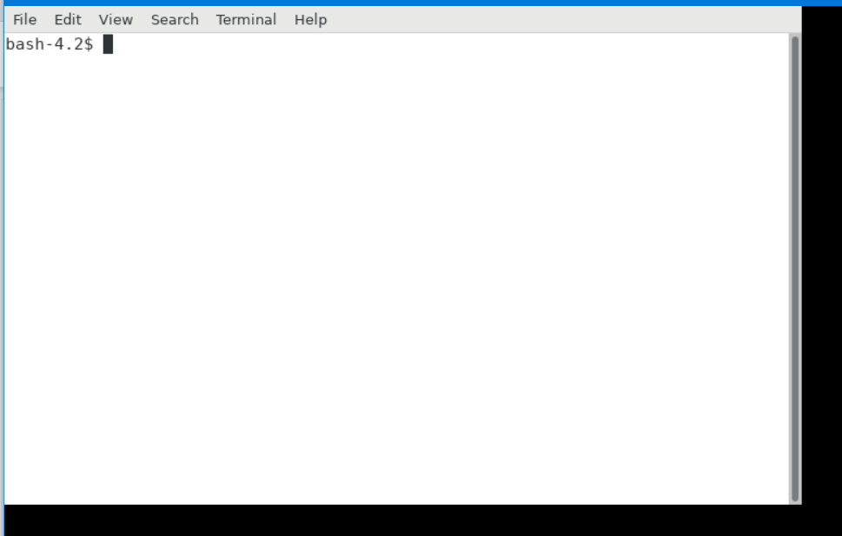
Should see something like this

Slide 9
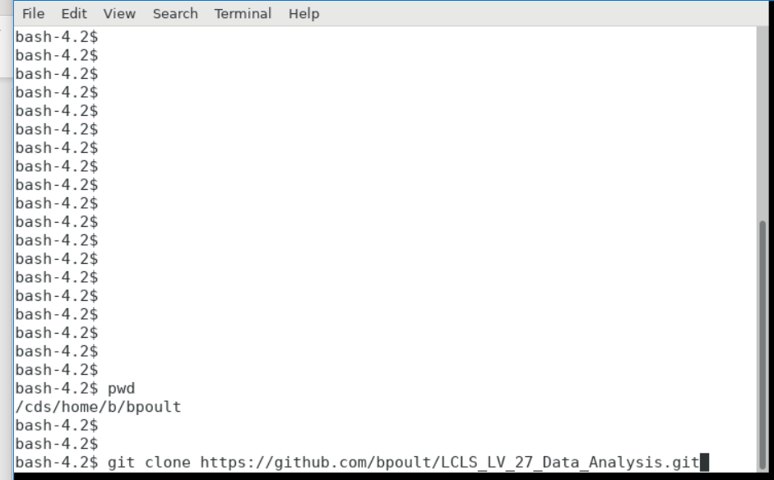
Type the following commands. Make sure you are in your directory, and then clone the github

Slide 10
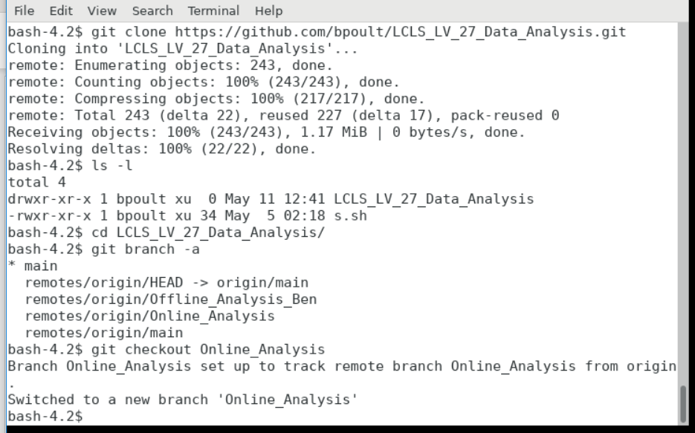
Change to the Online_Analysis branch. Go ahead and create your own folder

Slide 11
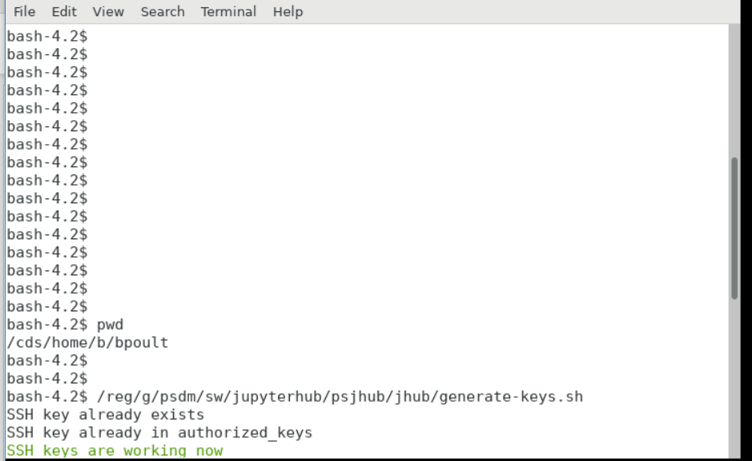

Slide 12
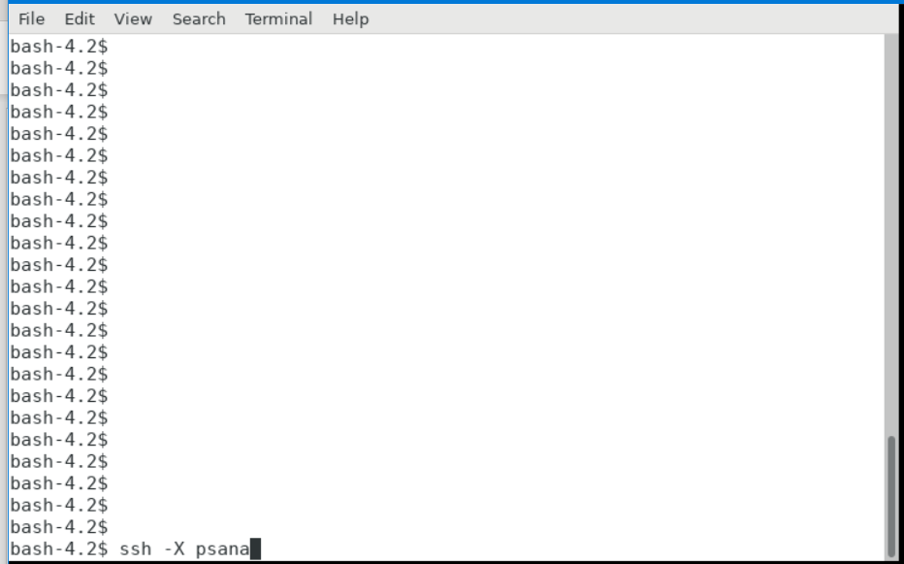
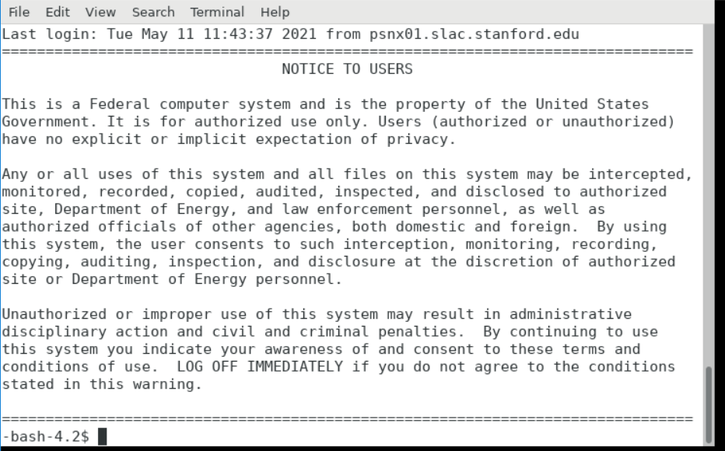
Which leads you to

Slide 13
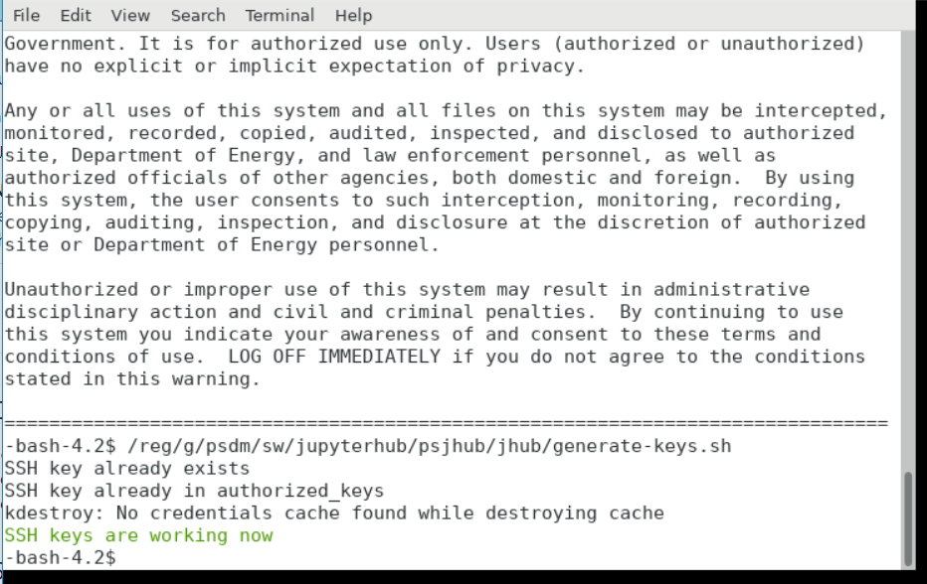
Not sure if you need to do this again, but just for safe measure.

Slide 14
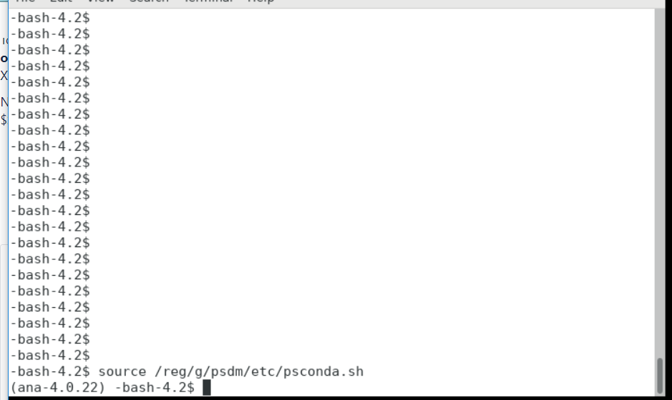
Now you should be good to run python code through this terminal, and jupyter notebooks should work as well.

Slide 15
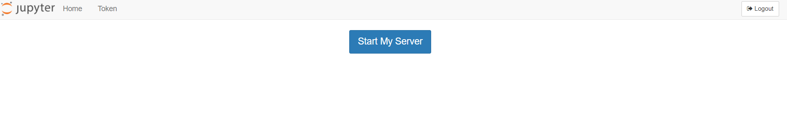
Accessing Jupyter Notebooks
https://pswww.slac.stanford.edu/jupyterhub/hub/home
Login with your Unix account information
Hit “start my server”

Slide 16
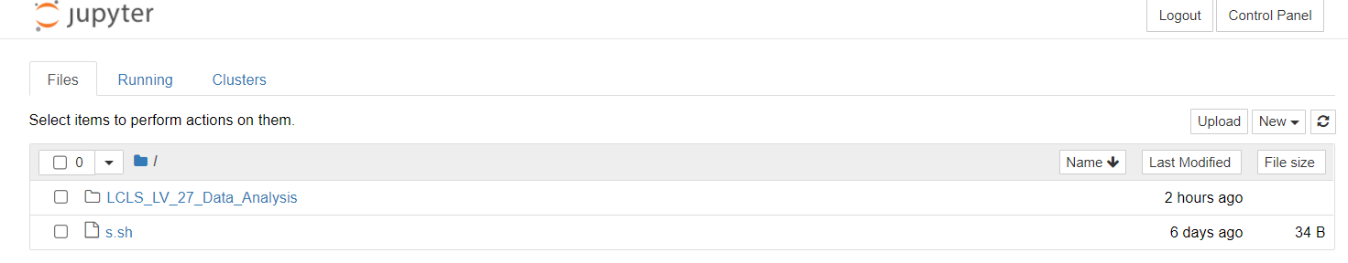
This should then show up where it is looking at your directory.
Enter the github repository you cloned “ LCLS_LV_27_Data_Analysis” folder.

