Slide 1
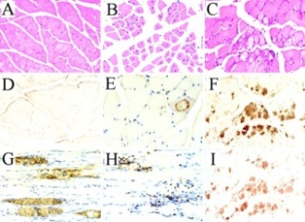
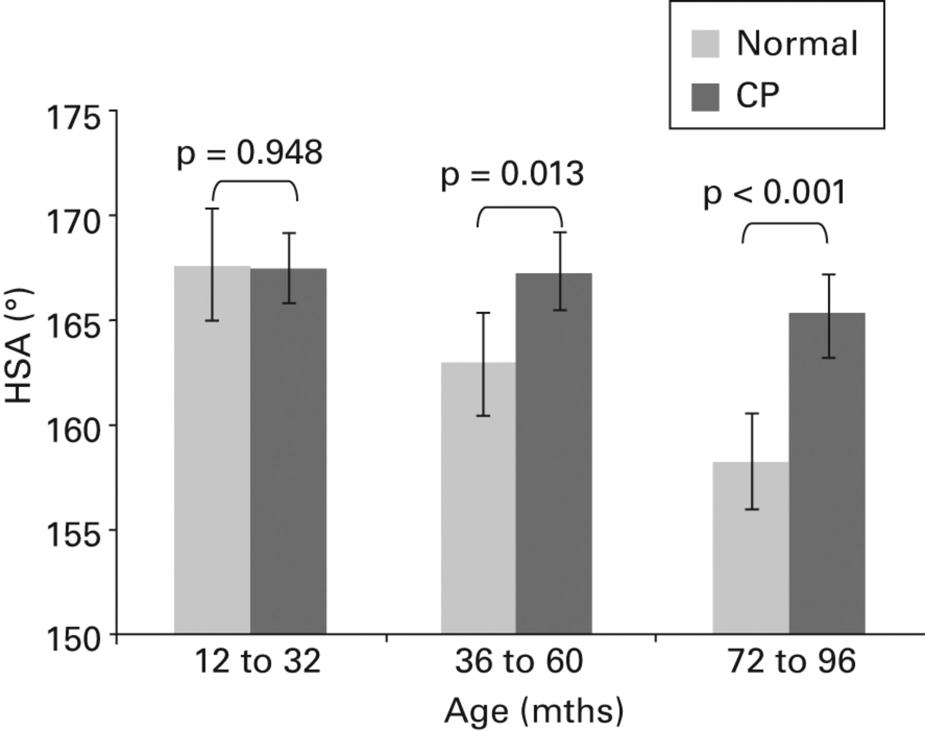

Evidence and Provenance
Explain why we believe a claim to be true (or not)
“BRCA1:2685T>A is pathogenic for
familial breast cancer””
Evidence is information used to evaluate the validity of an assertion (aka claim)
research data, prior claims, established facts
Provenance information describes the process history of a claim and its evidence
agents, methods, resources, date/location
The validity of claims ultimately rests on critical evaluation of all relevant evidence and provenance.
, http://www.pnas.org/content/99/9/6334/F3.large.jpg https://ghr.nlm.nih.gov/art/large/skeletal-muscle-anatomy.jpeg
Notes:
muscle image: https://ghr.nlm.nih.gov/art/large/skeletal-muscle-anatomy.jpeg
histo image: http://www.pnas.org/content/99/9/6334/F3.large.jpg
blot image: http://www.neurology.org/content/63/6/1114/F1.large.jpg
graph image: http://d2y3mehm86iyu9.cloudfront.net/content/jbjsbr/97-B/9/1291/F3.large.jpg
info: http://neuropathology-web.org/chapter13/chapter13eInflammatory.html

Slide 2
Evidence and Provenance Metadata for Curated Claims
Insufficient: most databases capture minimal metadata (e.g. publications, evidence types)
Inconsistent: systems and domains use diverse terms, conceptual models, and schema
Not Computable: missed opportunity to leverage this evidence metadata . . .
to support evaluate/compare validity of assertions
to resolve conflict between assertions or evidence
to identify ‘evidence gaps’ where a specific type of evidence is needed to validate a unsupported claims
to improve data curation and interpretation by presenting knowledge in context of related assertions and evidence

Slide 3
SEPIO: Scientific Evidence and Provenance Information Ontology
Generic ontological framework for representing detailed evidence and provenance information for scientific claims
Broadly applicable across domains and evidence types, but extensible for domain-specific use cases
Simple core structure linking assertions to foundational evidence information, and describing provenance of both
Organizes evidence information into ‘evidence lines’ that capture how it is combined, interpreted, and applied as evidence.
Allows modeling of ‘claim networks’ that trace evidence through prior assertions down to the level of foundational supporting data

Slide 4
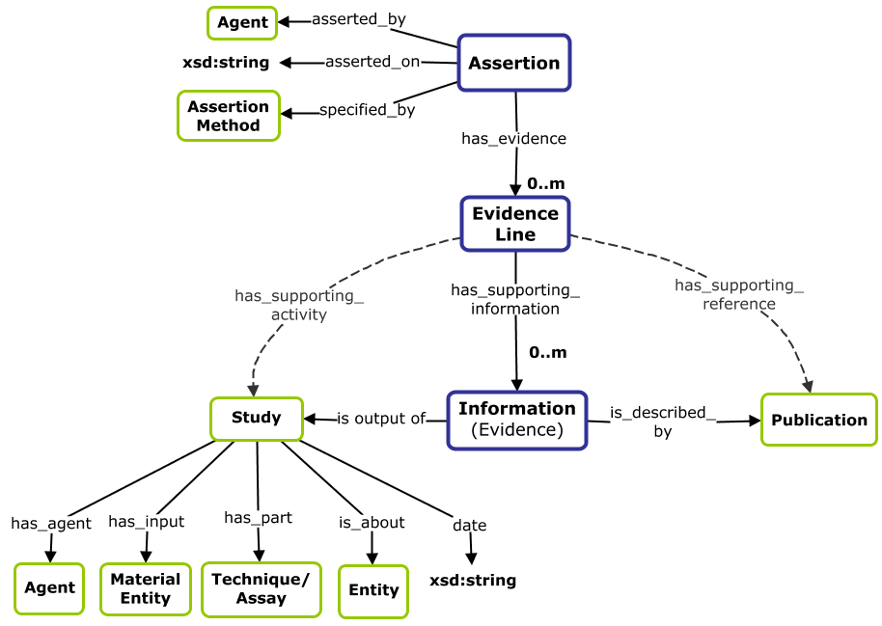
SEPIO Core Model
A statement of purported truth, as made by a particular agent on a particular occasion
A grouping of atomic evidence items that constitute an independent argument relevant to the validity of a target assertion.
A piece of information that is used to evaluate the validity of a target assertion. In doing so it plays the role of evidence.

Slide 5
SEPIO: Evidence Lines
Evidence lines organize evidence information into independent arguments relevant to establishing the validity of a claim.
Evidence Lines let us:
capture not only what evidence exists, but how it is interpreted and applied as evidence.
capture dependencies between pieces of supporting information that represent meaningful evidence only in combination
e.g. cases where fact 1 and fact 2 must both be true to establish meaningful evidence for a claim
describe attributes of evidence (e.g. the strength of support an agent believes an evidence line to provide for a particular claim)
determine and compute on four key dimensions of evidence (quantity, quality, diversity, and concordance)
Operate on these dimensions to computationally evaluate and compare claims based on their evidence
Notes:
Evidence lines are a unique and critical feature of the SEPIO model, which organize evidence information into independent arguments relevant to establishing the validity of a claim.

Slide 6


Modeling Evidence for Clinical Variant Interpretations
Variant interpretations are assertions about the pathogenicity of a genetic variant for a disease
These assertions rely on complex and diverse types of evidence, and are supported by sophisticated but siloed frameworks for evidence curation and interpretation [1]
Movement toward standardization of models and curation practices to identify and resolve conflicting interpretations [2, 3]
Pathogenic for?
Benign for?
Breast Cancer
BRCA1: 2685T>A
[1] ACMG 2015 Standards and Guidelines for the Interpretation of Sequence Variants (PMC4544753)
[2] GA4GH Variant Interpretation for Cancer Consortium (http://ga4gh.org/#/vicc)
[3] ClinGen Variant Interpretation Model (http://datamodel.clinicalgenome.org/interpretation/master/)
Notes:
These are the core concepts that underpin the SEPIO ontology
To demonstrate the features of the data model it supports, we will turn to the domain of clinical genetics and show how SEPIO represents variant classifications.
These are simply claims about the causative relationship between genetic variants and diseases – for example whether a variant like this is pathogenic or benign for Fabry Disease.
(Hundreds of thousands of human variants are classified by clinical genetics labs across the country (and these classifications get aggregated in a centralized databases such as ClinVar)
Variant classifications (are of particular interest to us because they):
- rely on complex and diverse types of evidence
- are generated through systematic curation pipelines (that capture detailed metadata about this E)
- often in conflict with each other (as labs evaluating the same variant may reach different conclusions about its pathogenicity)
- have direct clinical application (in diagnosis and treatment of disease)
These attributes make this a great area to demonstrate and ultimately apply our model.
-----
Evidence and provenance metadata for variant classifications are rich, well-documented, and widely utilized . . .
For these reasons, E and P metadata in this space are relatively rich, well-documented, and widely utilized- which makes this a promising area to demonstrate the SEPIO model and ultimately apply it in practice.

Slide 7
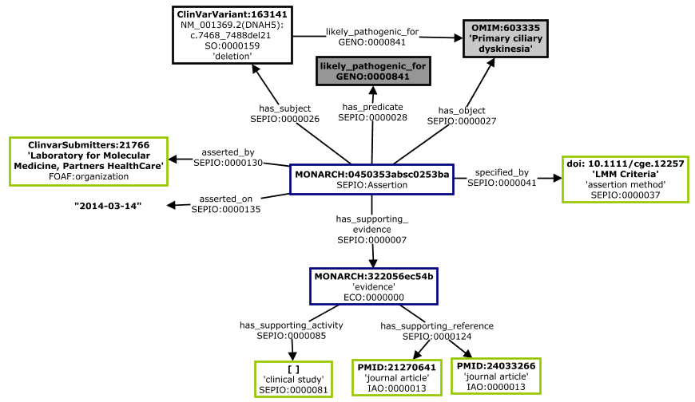
SEPIO Model of Sparse Variant Interpretation Metadata (ClinVar)
DNAH5:c.7468_7488del21 is likely pathogenic for Primary Ciliary Dyskinesia
Provides provenance for how the assertion was made, what type of study generated evidence for it, and references that might describe this evidence – but provides no actual evidence information.
Notes:
SEPIO supports sparse and rich models of the evidence and provenance - example of sparse metadata

Slide 8
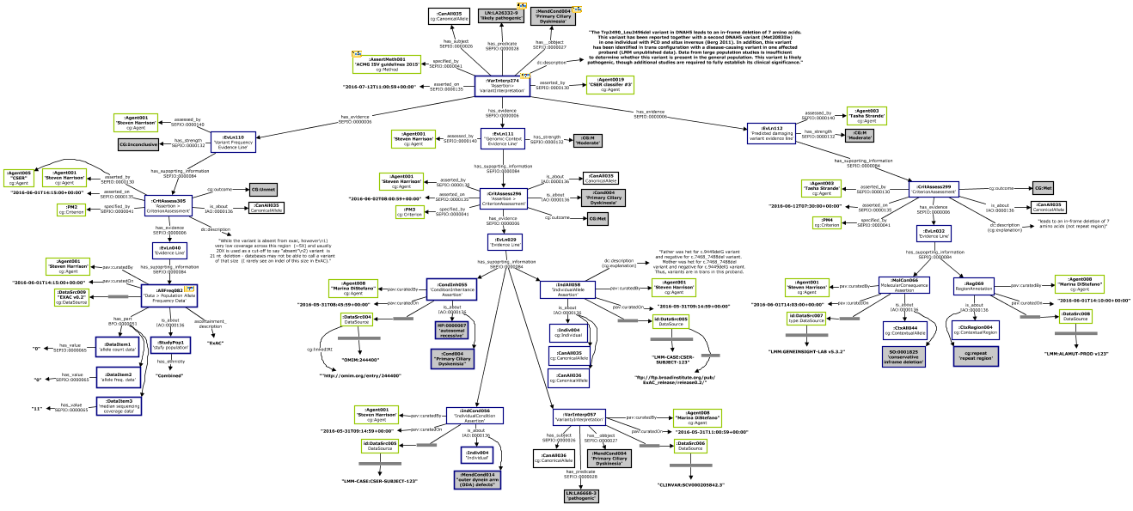
SEPIO Model of Rich Variant Interpretation Metadata (ACMG-ClinGen)
DNAH5:c.7468_7488del21 is likely pathogenic for Primary Ciliary Dyskinesia
Describes full complexity of ACMG workflow, with evidence lines that span multiple levels of interpretation, shows detailed supporting information, and rich provenance information across entire workflow.
Notes:
The goal with this slide is not to understand modeling detail, but to make points that:
We encounter cases where assertions such as this may be accompanied by very rich or very sparse evidence and provenance metadata
SEPIO accommodates consistent representation of both simple (ClinVar) and complex (ACMG-ClinGen) cases using same, extensible core design patterns
SEPIO structures evidence information from simple or complex workflows around the independent evidence lines it represents, which can span multiple levels of assertions and underlying evidence.
e.g. determination of whether a variant meets specific ACMG criterion represents an intermediate assertion that directly serves as evidence for the final variant interpretation, and which themselves have one more lines of supporting evidence)
Resources such as ClinVar are capturing but a fraction of the evidence and provenance information that is typically documented in variant interpretation workflows

Slide 9
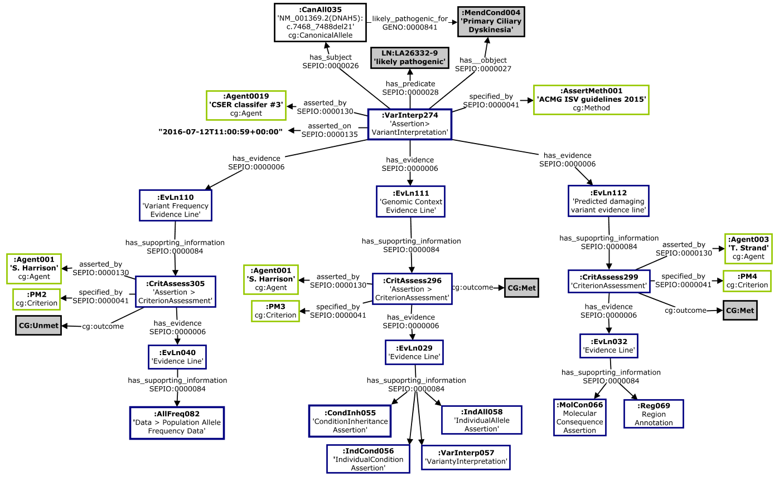
SEPIO Model of Rich Variant Interpretation Metadata (ACMG-ClinGen)
DNAH5:c.7468_7488del21 is likely pathogenic for Primary Ciliary Dyskinesia
Assertion
Evidence
Lines
Information
(Assertions)
Evidence
Lines
Information
Zoomed view of the previous diagram, highlighting the instantiation of two levels of the core assertion - evidence line - information axis
Notes:
A streamlined view of the previous diagram showing just the essential core structure of the model, and highlighting the fact that it describes multiple levels of assertions and evidence.
In the ACMG framework, assertions about whether a variant meets specific ‘evidence criteria’ are used directly as evidence by the agent making the final variant interpretation.
These assertions are used as evidence here, but as assertions themselves, they also have their own trails of evidence that is captured by curators and described in the model.
This illustrates how SEPIO supports

Slide 10
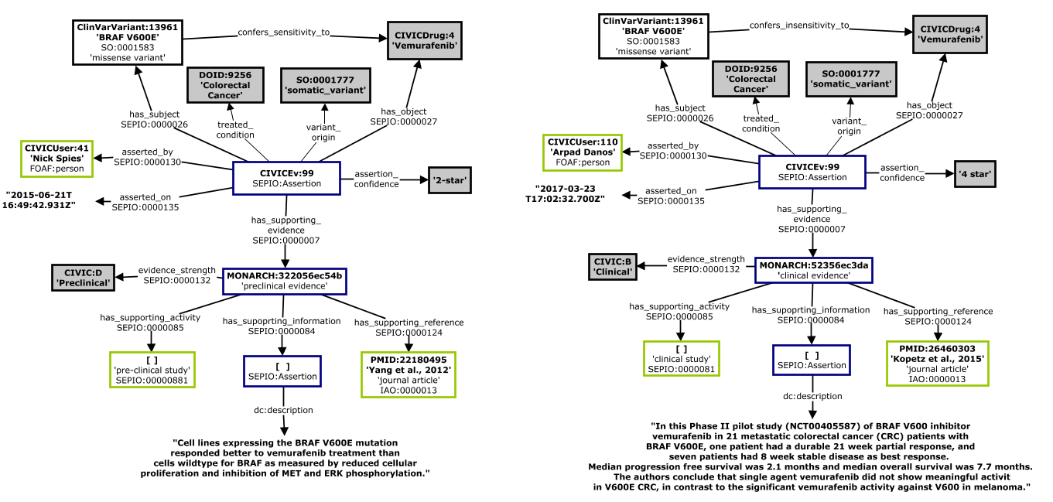
SEPIO Model of Evidence for Variant Effect on Therapeutic Response (CIViC)
'BRAF V600E‘ confers SENSITIVITY to Vemurafenib for treating Colorectal Cancer
'BRAF V600E‘ confers INSENSITIVITY to Vemurafenib for treating Colorectal Cancer
Evidence for other types of claims fit easily into the generic SEPIO Framework. Here we see modeling of two claims that put forth conflicting propositions. based on use of different evidence.

