Slide 1

App Development
Brett Powers
April 20, 2021

Slide 2

History
Apps have become an integral part of our lives.
Early apps such snake, calculator, alarm, etc…
1983 Steve Jobs envisioned an “app store” for specialized applications.
Itunes store was a first iteration of an app store. (2007)
Original App Store had 500 apps.
Then came Google Play, Amazon App Store, Blackberry’s App World.

Slide 3
Roughly 3.6 Billion people use smartphones daily and is only growing.
Apps are how we can utilize our devices to do unique things.
Calendar app
Games
Maps
Communication (twitter, facebook…)
News
Entertainment

Slide 4
App was voted ”word of the year” in 2010… (I was a sophmore in high school..)
This period has been coined “the app revolution”.
There is almost quite literally “an app for that” like that 2009 Apple commercial said. Check out iBeer and I Am Rich ($999.99)

Slide 5
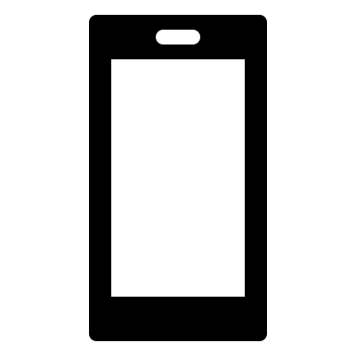
Basic Branches of App Development
Native Apps
Platform specific apps that use distinct frameworks and languages.
Swift/Xcode – Apple, Java/Android Studio – Android
Web Apps
Uses a browser to load the app and can be used cross-platform.
Chrome, Safari, Firefox, etc…
Take up no storage.
Hybrid Apps
Work across platforms and can behave like native apps.
Technically are web apps but are installed like a native app.
Examples are: Gmail, Twitter, Uber, etc…

Slide 6


Pros Cons
Native Apps
Pros
Best performance.
Complete Support
Full feature of OS.
Approval is needed.
Cons
Difficult to write.
More costly.
Not best for simple ideas.

Slide 7
Pros Cons
Web Apps
Pros
Relatively easy to maintain.
Built for all platforms if they can run on appropriate browser.
Less expensive.
Updates don’t need approval.
Cons
Smaller scope.
Can’t use all device features.
Slower and less responsive.

Slide 8
Pros Cons
Hybrid Apps
Pros
Don’t require browser.
Have access to features of devices internal API and hardware.
One codebase.
Cons
Slow.
Third-party dependencies.
Can be costly.

Slide 9

Frameworks
Software to aid and foster mobile app development.
Provides fundamental structure for a specific environment.
Some examples are:
React Native
Flutter
Xamarin
Django
Flask
Kivy

Slide 10

React Native
One of the most common mobile app frameworks.
Created by Facebook.
Open-source framework and allows for both iOS and Android platforms.
Based off Reactjs and JavaScript
Examples are: Instagram, Soundcloud, UberEats, and more.

Slide 11

Flutter
UI toolkit created by Google.
Like React Native it is cross-platform with Android and iOS.
Large range of widgets and helps build native applications.
Written in the language Dart.

Slide 12
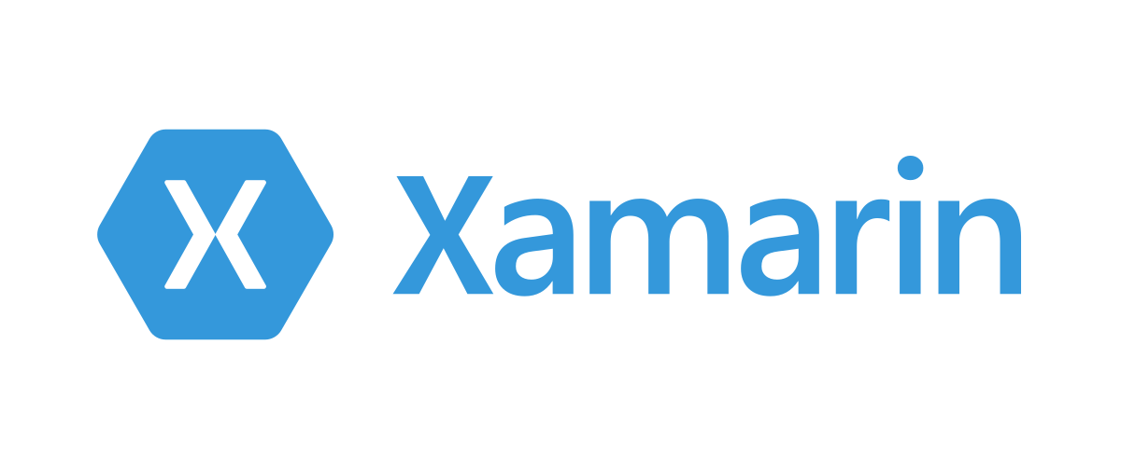
Xamerarin
Acquired by Microsoft in 2016
Based off of .Net.
Allows to build native apps for Android, iOS, and Windows.

Slide 13
Django
High level web framework to maintain and make writing app more focused.
Written in Python
Promotes ”pluggability”.
Known websites that use Django are: Instagram, Mozilla, The Washington Times, etc…

Slide 14

Flask
“micro” web framework for Python.
Does not require particular packages or tools/libraries.
Can get started quickly and easily using the documentation.
Very open-source and has lots of capabilities.

Slide 15

Kivy
Python based.
Free, open-source mobile app framework.
Can run on Android, iOS, Windows, Linux, macOS.
Easily create custom widgets.
Slow.
Can be tough to debug.

