Slide 1
Autoencoders
Brett Powers
Dec. 15, 2020

Slide 2
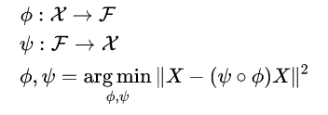
What are They?
Type of ANN that uses unsupervised method to learn some sort of “encoding” of a set of data given to it.
There is a deconstruct portion and a reconstruct portion to the model.
Main idea of setting target values to be equal to the inputs.
Approximating the input.

Slide 3
What are They used for?
Denoising images
Anomaly detection
Dimension Reduction

Slide 4
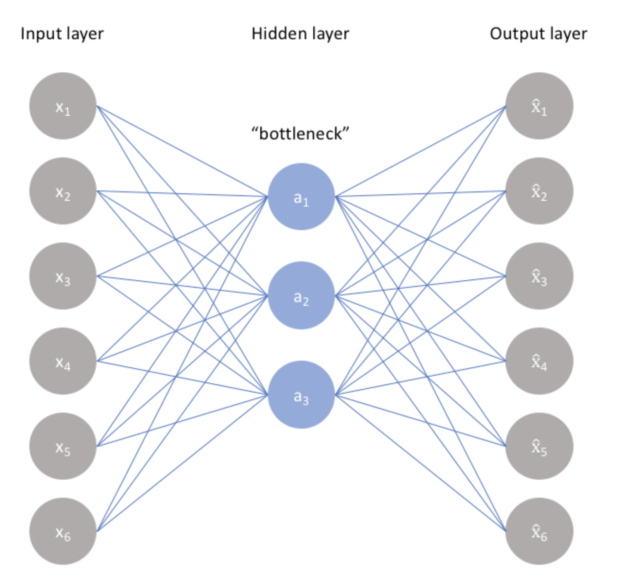
Main Idea Representation

Slide 5
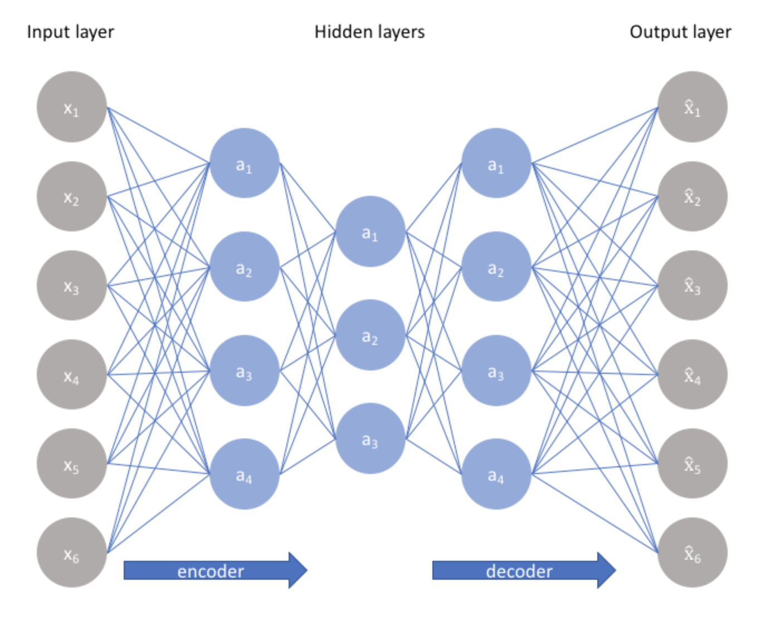
The amount of “depth” in the model is about
How many layers are used to encode and decode
To and from the latent representation or bottleneck .
More depth can help with computation cost.
Use less training data.
Experimentally are better at compression

Slide 6
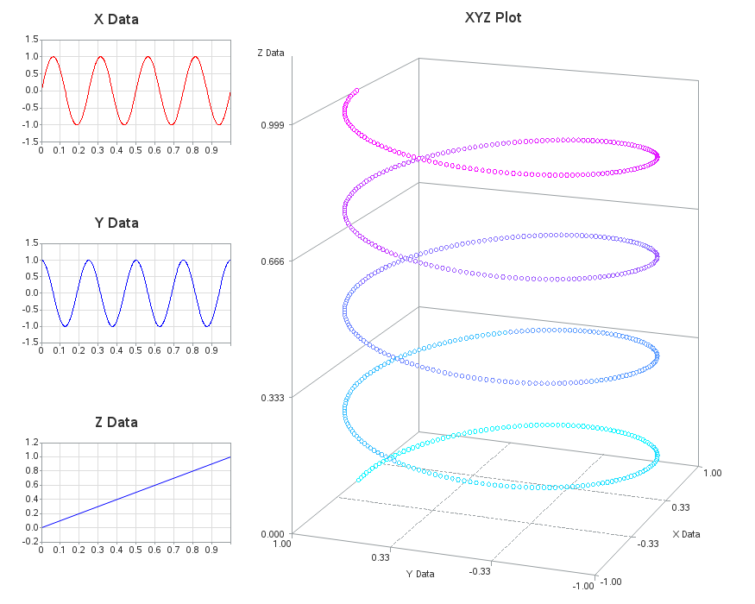
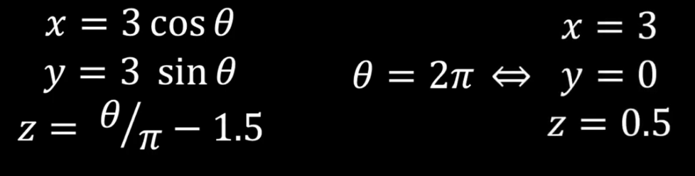
Underlying structure to the data.

Slide 7



Slide 8
Classic Autoencoders
Classic use cases for autoencoders are Sparse Autoencoder (SAE) and the Denoising Autoencoder (DAE).
SAE: Shown that we can get a lower dimensioned latent space by using a penalty in how many layers being used. This allows more sensitive attributes to come out of the input data.
DAE: Takes in a corrupted input and tries to output a undistorted version.

Slide 9
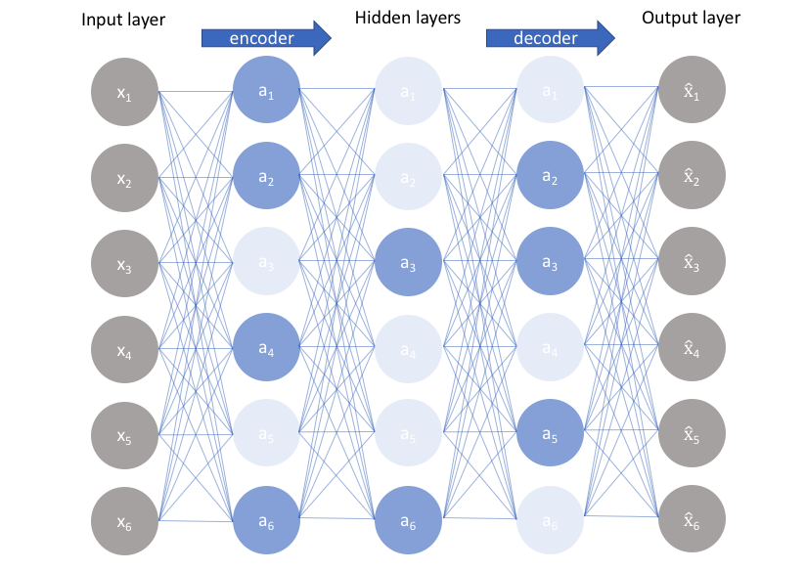
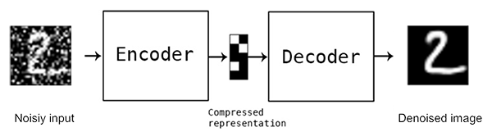
SAE
DAE

Slide 10
Variational Autoencoders
Similar to Generative Adversarial Networks (GANS) [Next talk!]
Generative model, using directed probabilistic graphical models.
Tries to simulate how the data is generated, in order to understand the causal relations.
Make very strong assumptions about the latent variables.

Slide 11
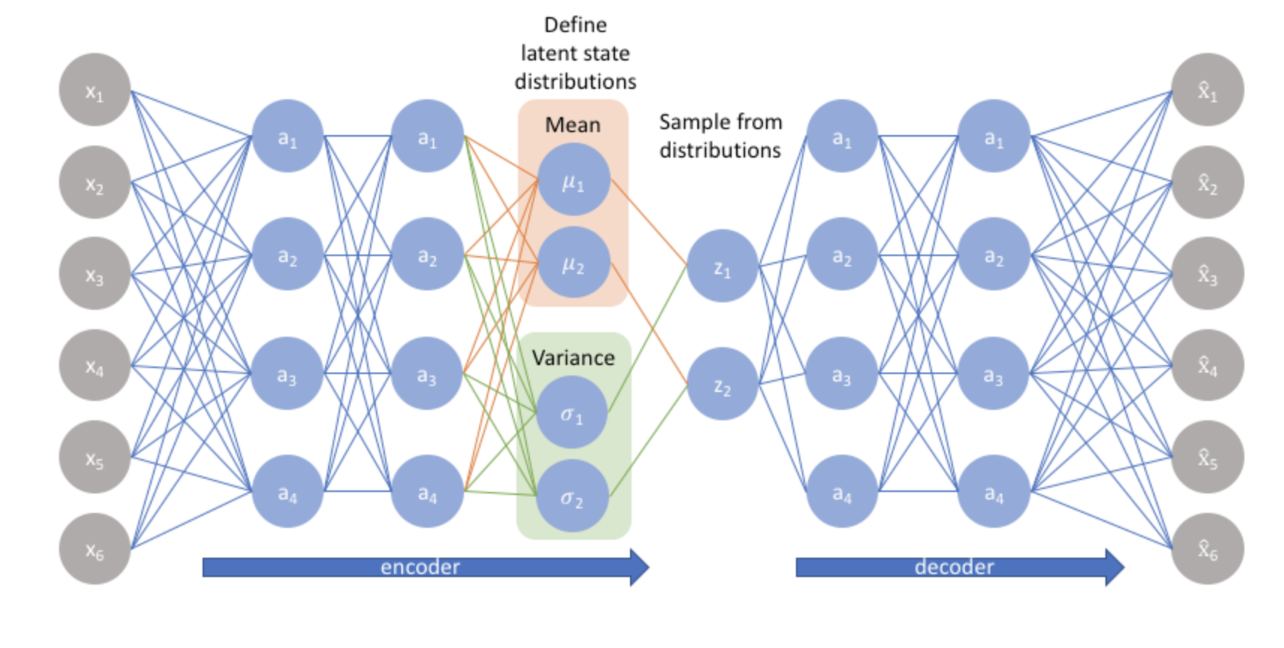
Variational Autoencoders

Slide 12
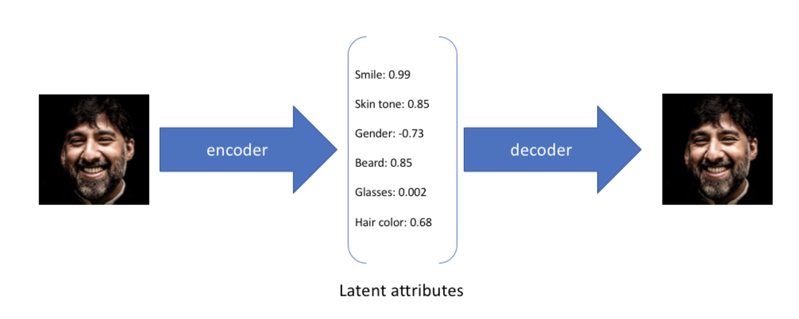
Variational Autoencoders

Slide 13
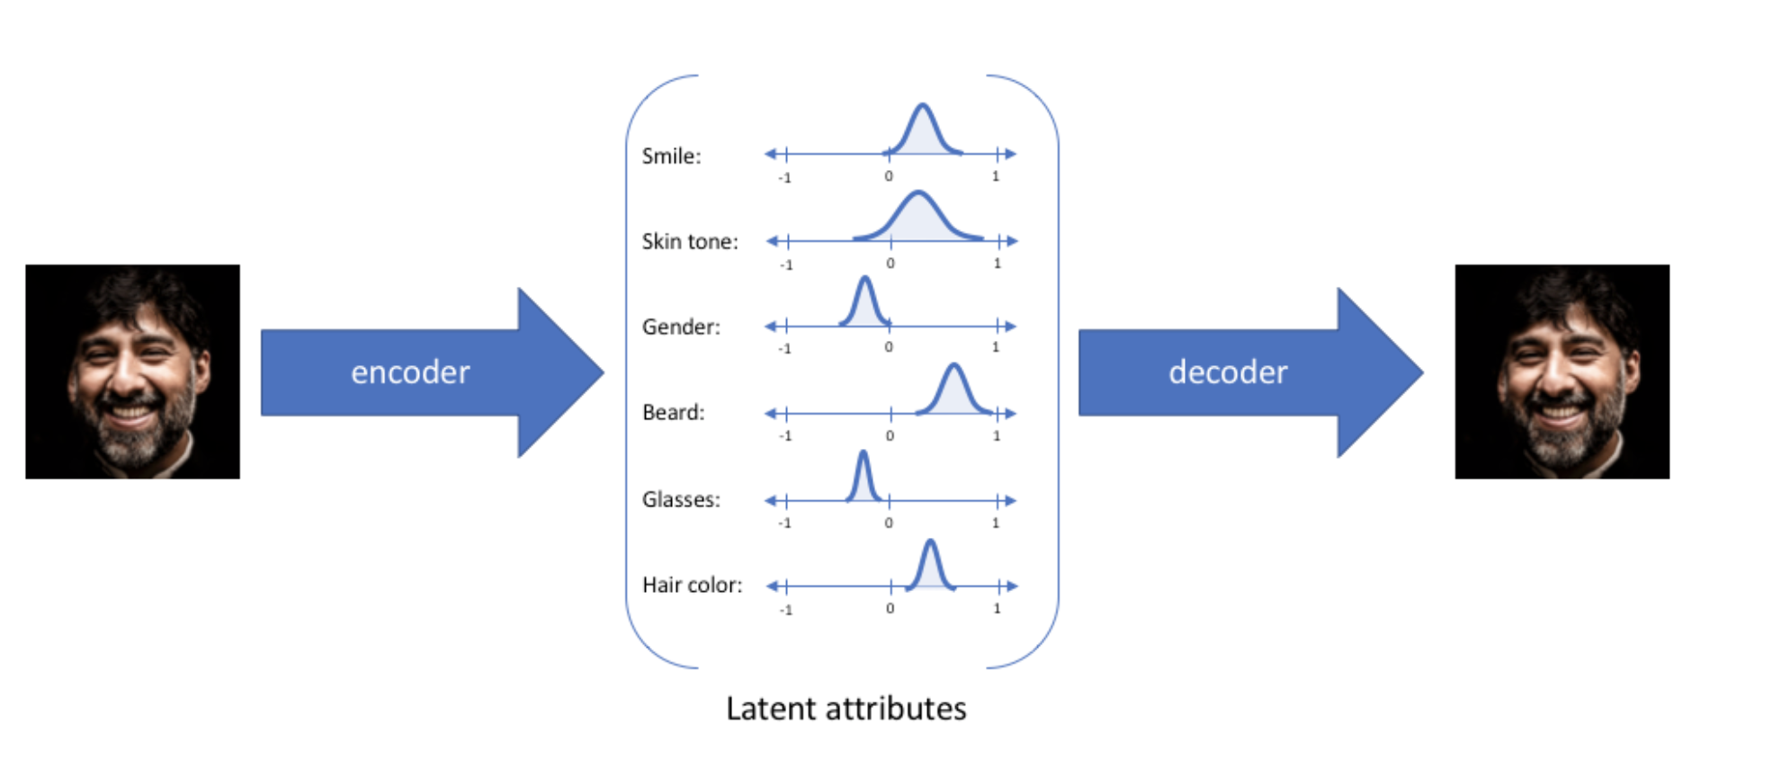
Variational Autoencoders

Slide 14
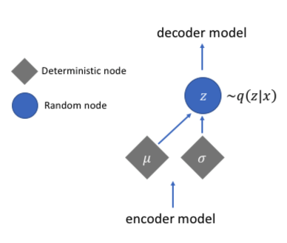
Variational Autoencoders

Slide 15
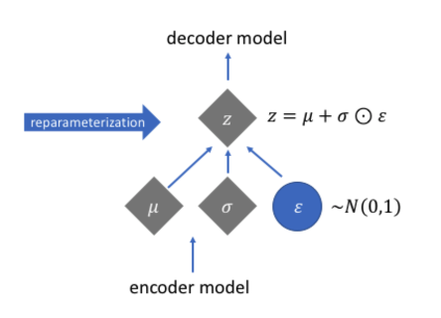
Variational Autoencoders

Slide 16
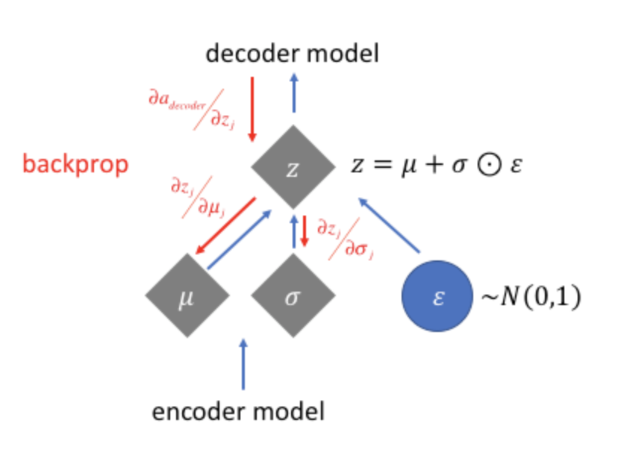
Variational Autoencoders

Slide 17
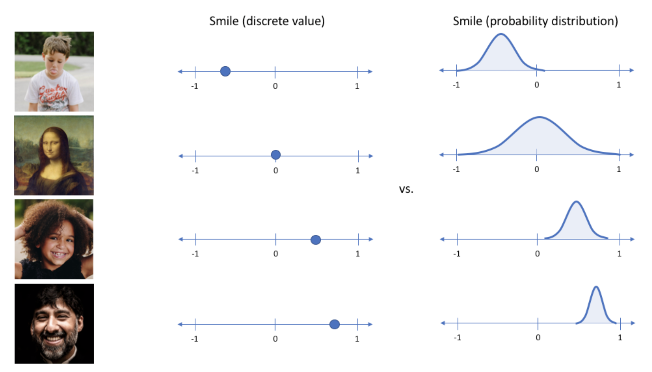
Variational Autoencoders

Slide 18
Comparing Autoencoder to PCA
PCA : Takes collection of the data reduces the number of vectors representing it into a smaller set of vectors (lower dimensions) that can then create the data set via linear combination.
Autoencoders: Can learn nonlinear dependencies and very useful for transfer learning. More computational expensive but can be alleviated using batches if data set is too large.

Slide 19
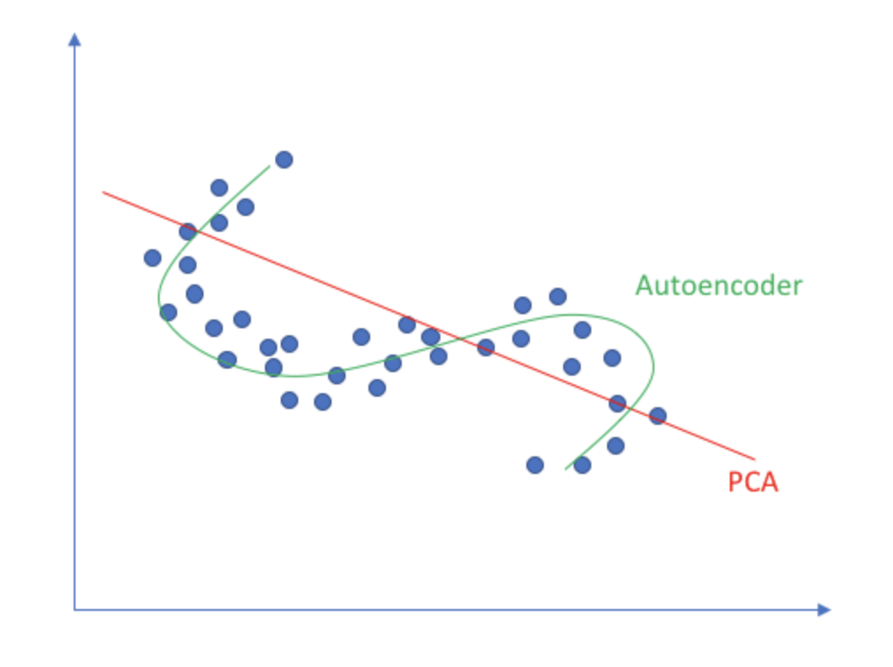
Comparing Autoencoder to PCA

