Slide 1
Unsupervised Learning Series
Brett Powers
December 2, 2020

Slide 2
What is it?
Unsupervised learning is a type of machine learning that looks for previously undetected patterns in a data set with no pre-existing labels and with a minimum of human supervision.
Clustering is when the training data is unlabeled and we want the algorithm to put data points into categories or clusters.
Useful for:
Segmentation problems
Data Analysis, splitting data up into compartments to further investigate.
Dimensionality Reduction
Anomaly Detection (Search for Outliers)

Slide 3
Cluster Algorithms
K-means
Hierarchical Clustering
Density-based spatial clustering of applications with noise (DBSCAN)

Slide 4
K-means
The main objective of the K-Means algorithm is to minimize the sum of distances between the points and their respective cluster centroid.
Pros | Cons
Simple | Non-optimal clusters
Flexible | Inconsistent
Efficient (computation complexity)

Slide 5
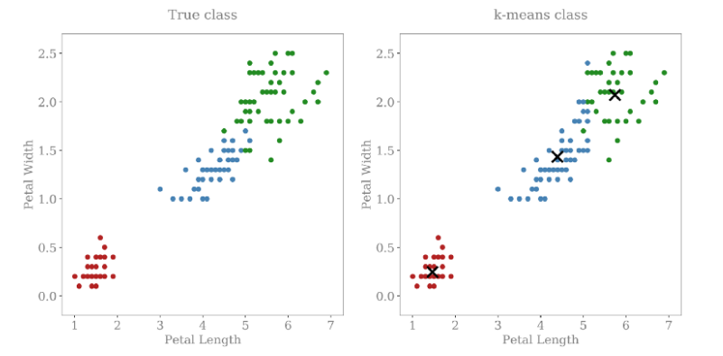
K-means
Famous Iris data set

Slide 6

K-means

Slide 7
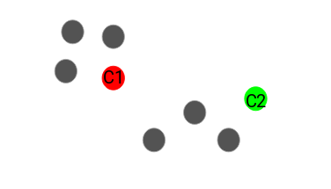
K-means

Slide 8
K-means

Slide 9
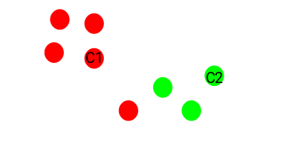
K-means

Slide 10
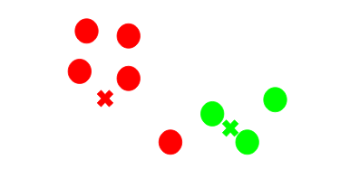
K-means

Slide 11
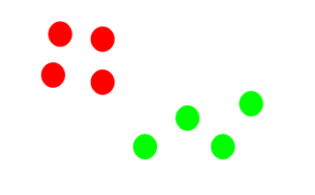
K-means

Slide 12
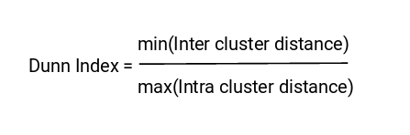
K-means
How do we know when we have a “good” clustering result?
We want tight clusters
We want very distinct clusters
Clusters are far apart!
Points within a cluster are close!
Also called Inertia

Slide 13
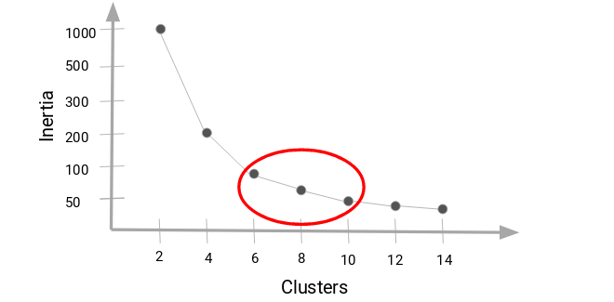

Slide 14
Hierarchical Clustering
Algorithm that starts with all data points starting out as their own “cluster”
Two nearest clusters are merged.
Repeat until only one cluster remains.
Cannot handle large amounts of data like K-means.
Results ARE reproducible, unlike K-means.

Slide 15
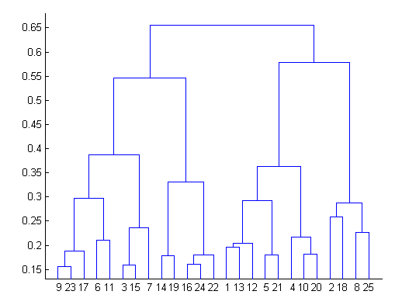
Hierarchical Clustering

Slide 16


Hierarchical Clustering
Using different types of Distance Metrics will alter your results using HCA.
Euclidean
Basically the Pythagoras theorem. ”As the crow flys”
Manhattan
AKA “Taxi Cab Distance”. Move around like driving on a grid.
Maximum
Simply take the largest distance between any of the points.

Slide 17
DBSCAN
Density based algorithm.
For each instance you measure how many samples are within an epsilon (𝛆).
If it has a required minimum amount of samples within the neighborhood, we set as a core instance.
Long sequences of neighboring core instances forms a cluster.
Any instance that is not a core instance, and does not have one in its neighborhood is considered an anomaly.

Slide 18
DBSCAN
Does not require to specify how many clusters.
Can find arbitrarily shaped clusters.
Very robust to outliers.
Requires only two parameters, epsilon (𝛆) and MinPts.
Need the clusters to be similarly dense for good results.

Slide 19
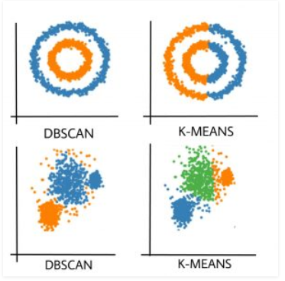
DBSCAN

Slide 20
Closing Remarks
Many other algorithms I haven’t mentioned. Mostly specialized cases.
Each algorithm comes with its pros and cons. Many people use a hybrid model.
Very powerful tool to use along with Supervised techniques.

