Slide 1
Dimensionality Reduction
Brett Powers
Dec. 9, 2020

Slide 2
“The Curse of Dimensionality”
This is a major reason why Dimension Reduction is so important.
Main idea:
Want to add more features for each instance you are classifying.
If you add too many it starts hurting your chances of getting good accuracy
Occurs because sample density decreases as features increases
As we keep adding in featuers and not increase the number of samples as well we will have a very sparse feature space and overfitting will occur.

Slide 3
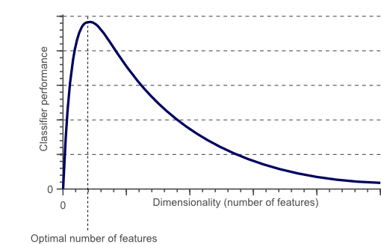

Slide 4
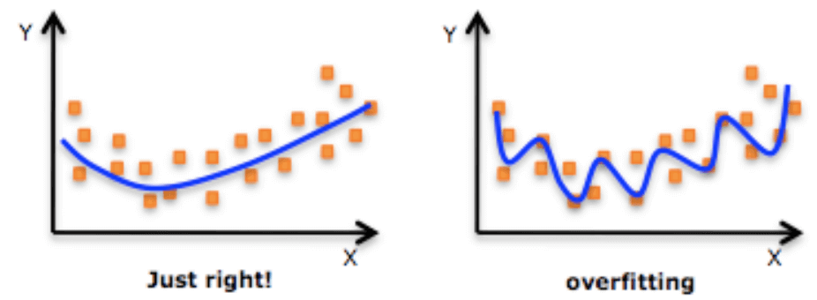
Overfitting
One of the big downsides of having way too many dimensions (features) is overfitting.
Over-generalizes the data you are trying to draw insight from.
Won’t do to well with new data you introduce to the model.

Slide 5
Dimensionality Reduction Techniques
PCA
Very popular and computationally friendlier than a lot of techniques
t-SNE
Used a lot within non-linear data at a global scale.

Slide 6
PCA
Principle Component Analysis
Break down data features into components which keeps the variance of the data intact. Maximize variance for each component.
Components are orthogonal to each other. (right angles in 2-D)
This means that each component is uncorrelated with each other.
Keep components that make up the majority of the variability to reduce the dimensions. Visualize this with a Scree Plot
Can use eigenvectors of Covariance Matrix to calculate components. (Very understood way of computation)

Slide 7
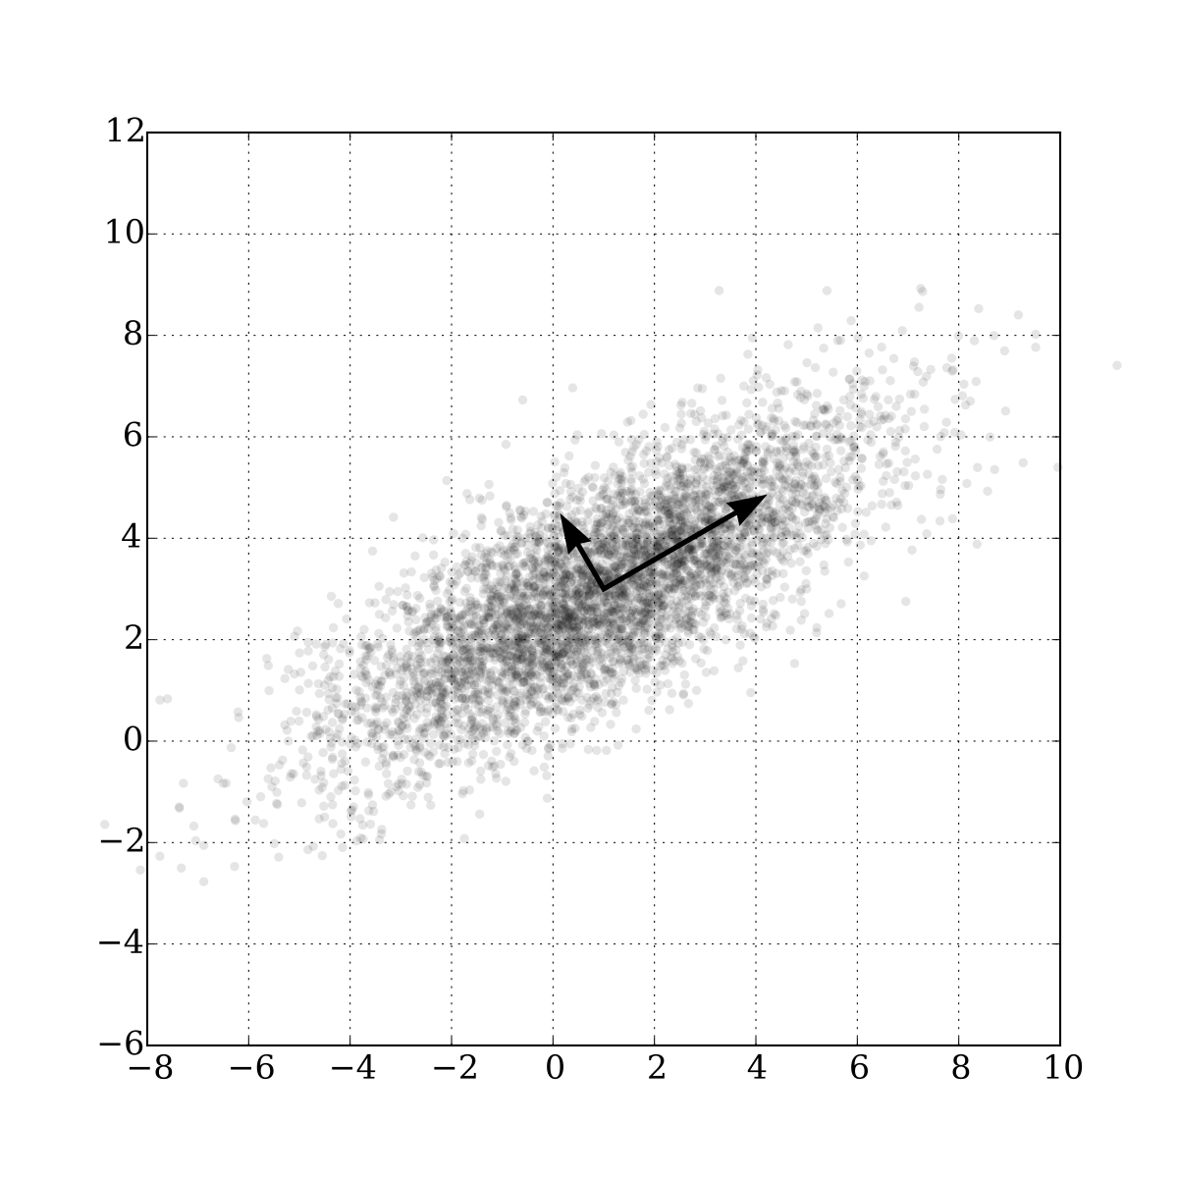

Slide 8
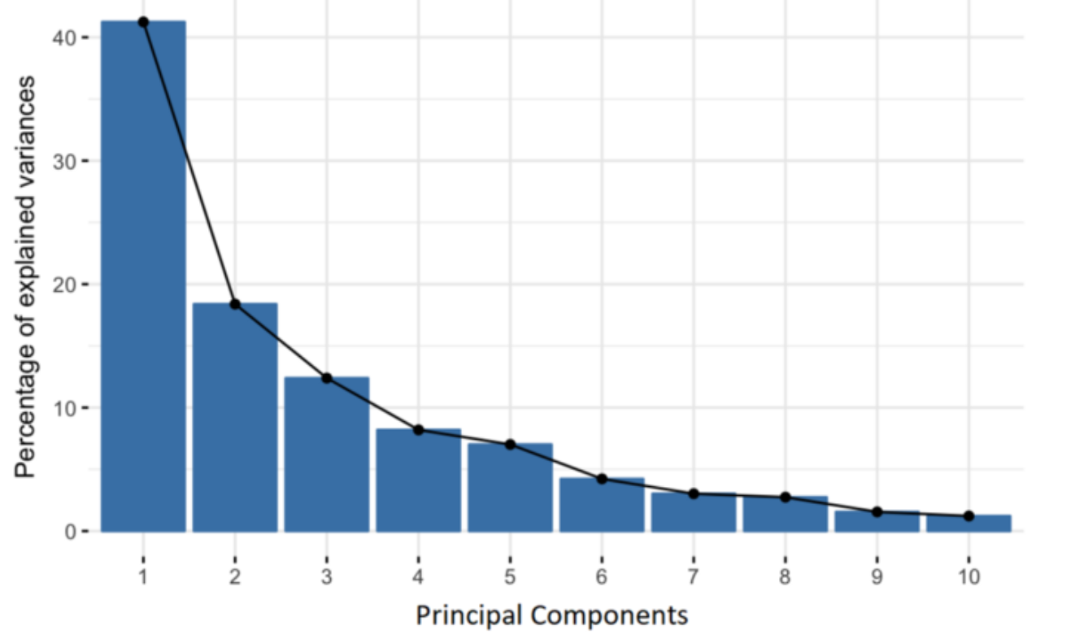
Scree Plot

Slide 9
PCA
Great for reducing number of features.
Keeps features independent from each other.
Lose interpretability of the feature set.

Slide 10
t-SNE
t-distributed stochastic neighbor embedding
Uses local relationships to create a new lower-dimensioned mapping
Allows for a global non-linear behavior within the data
Non-convexed – meaning there are possibly multiple minimum points and optimization could be an issue. Might get stuck within a local min.
Computationally expensive.

Slide 11
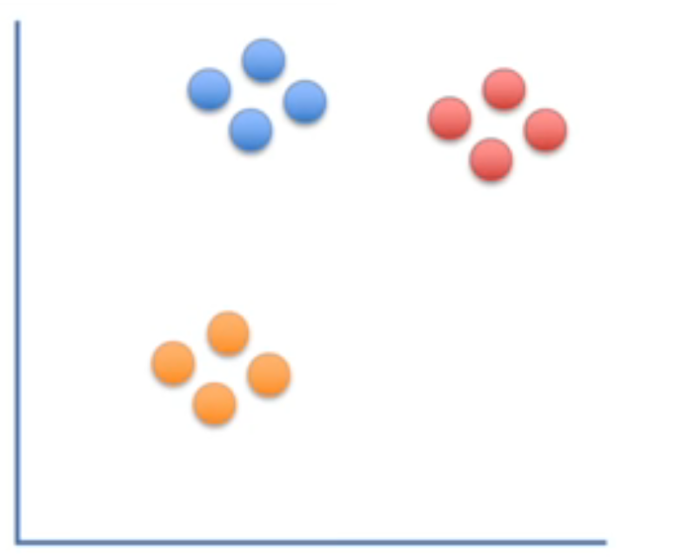

Slide 12
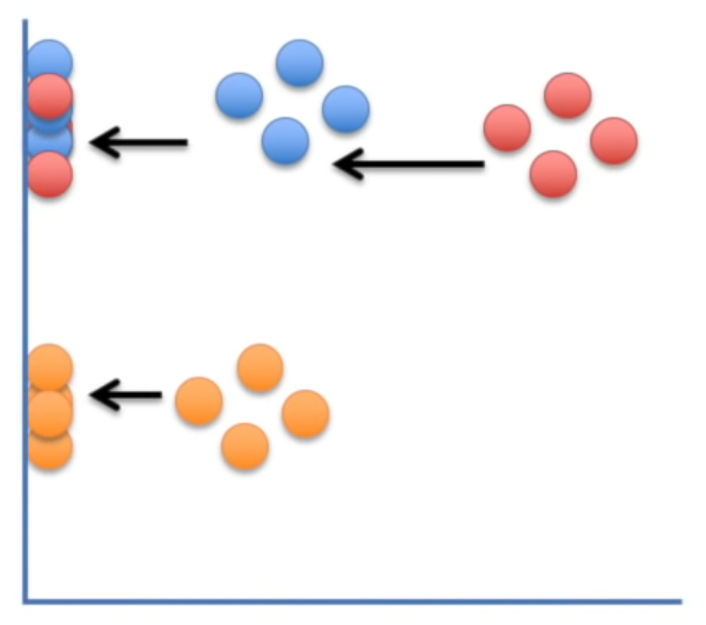
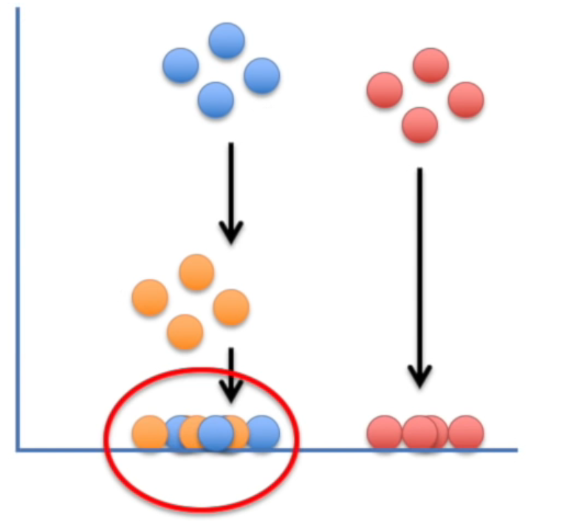
If we just project onto x or y axis…

Slide 13
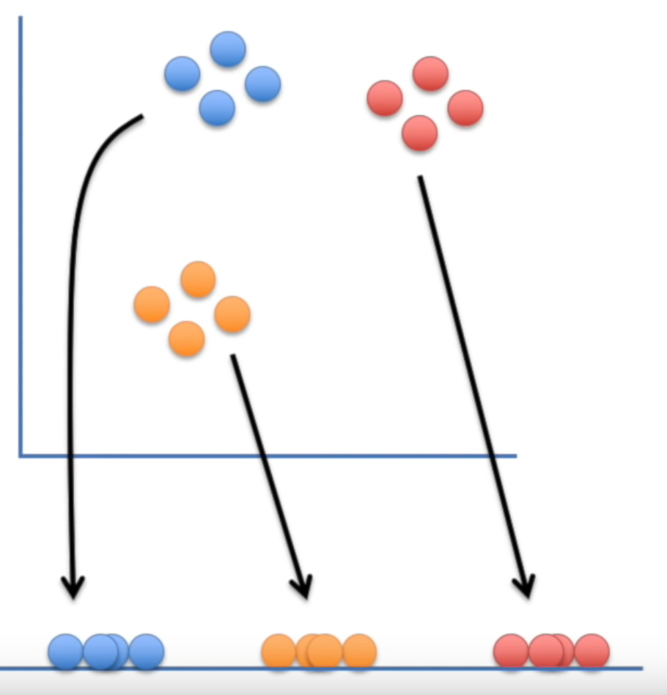
What we want!

Slide 14
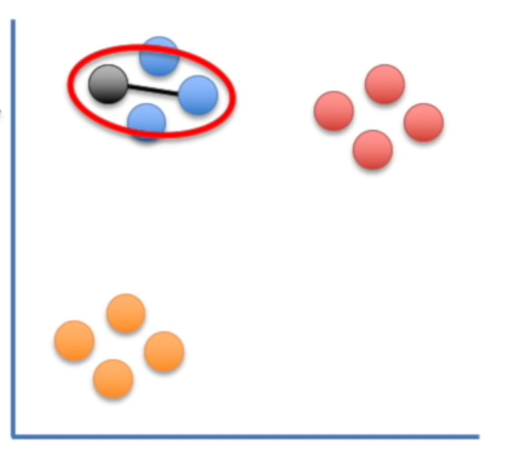
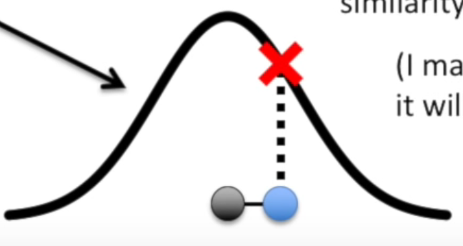

Slide 15
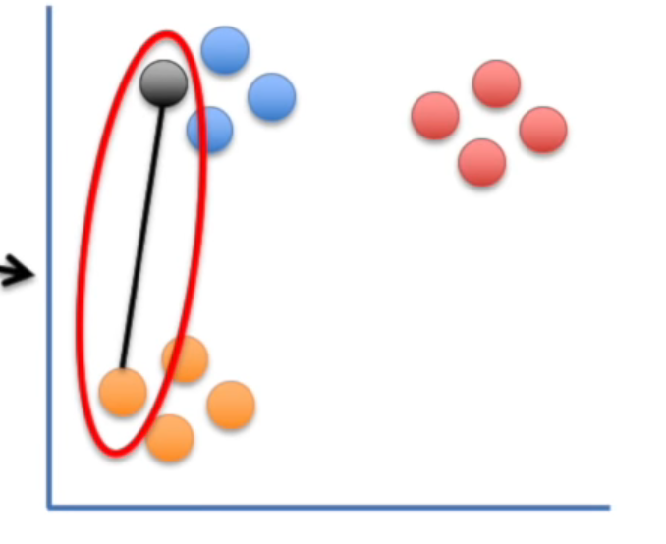
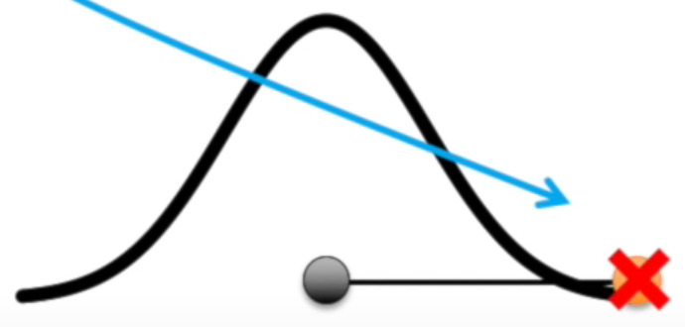

Slide 16
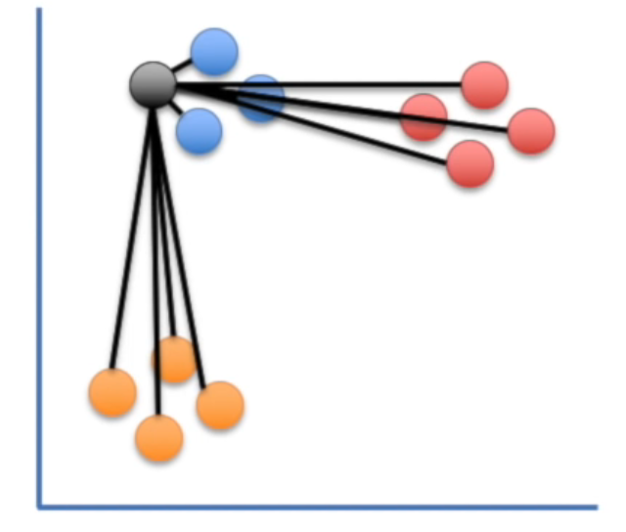
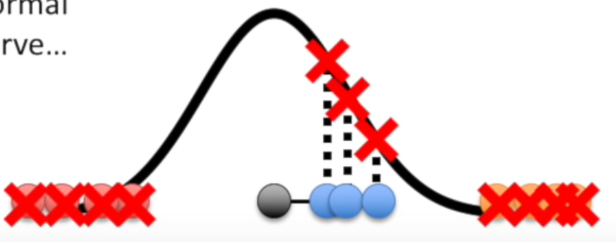

Slide 17
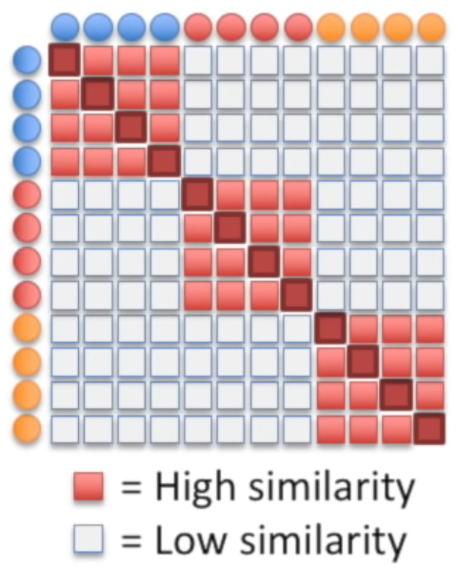
Distance Matrix

Slide 18
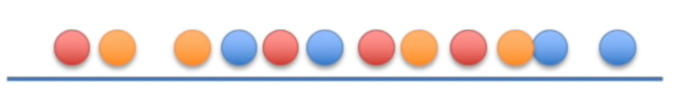
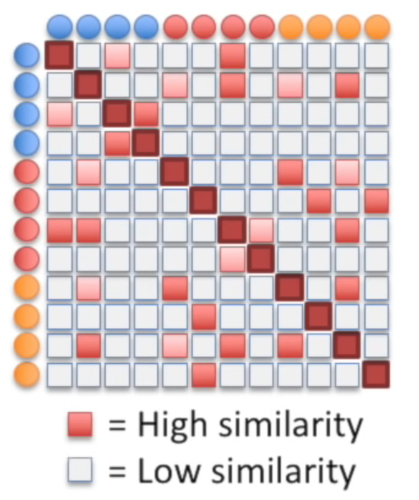
Randomly project onto ”lower dimensioned space”

Slide 19

Iterate

Slide 20
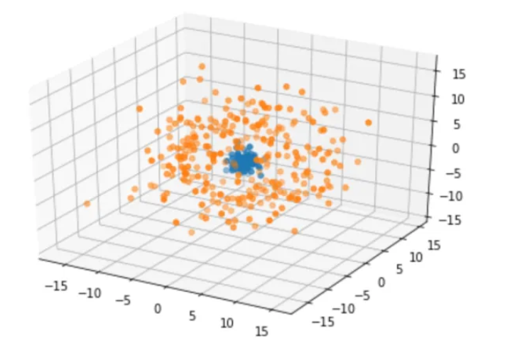
PCA vs. t-SNE with non-linear data

Slide 21
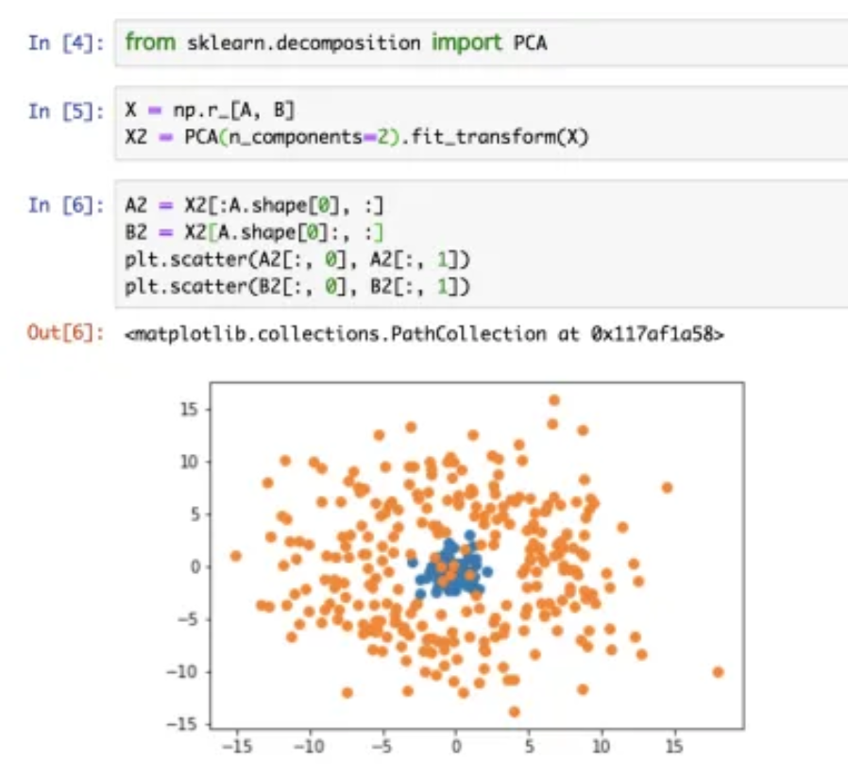

Slide 22
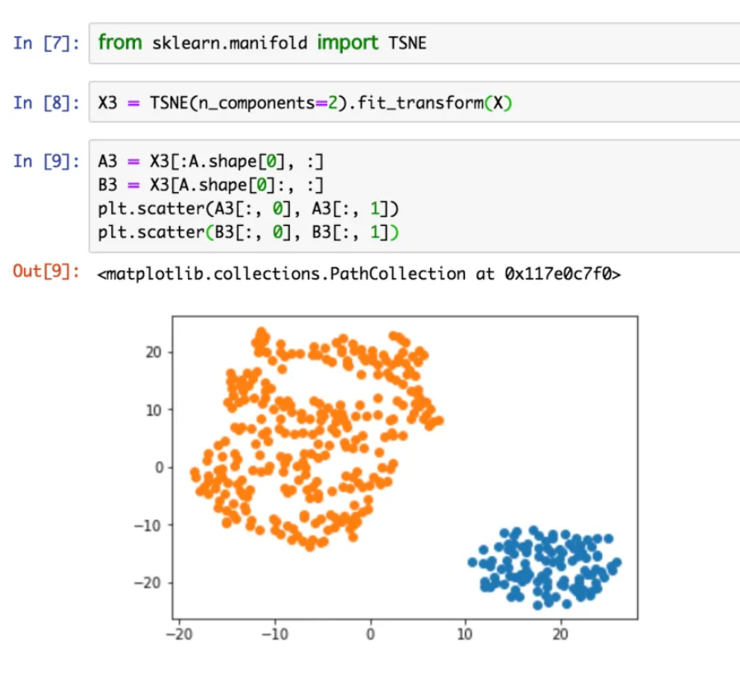

Slide 23
Conclusion
PCA can be used to take very high dimensional data and bring it down so that the computation and results can be more accurate. You lose meaning with the features however.
t-SNE is great for non-linear data but can be computationally expensive.
Many others I haven’t mentioned but this gets your feet wet. Such as using autoencoders instead of PCA. Next week.

