Slide 1
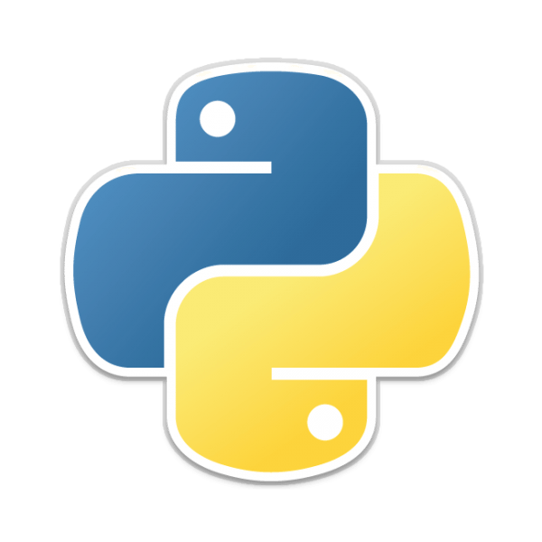
Intro to Python
Brett Powers
August 11, 2020

Slide 2
What is Python?
Released 1991.
General purpose open-source programming language.
Great language to learn if new to programming.

Slide 3
Pros
Emphasis on readability
Standard library + extensive libraries/packages
Very popular --> great online community
Big player in the ML space
Cons
Low speed
Not great for high memory tasks
Mobile Development
Don’t always play nice with other languages

Slide 4
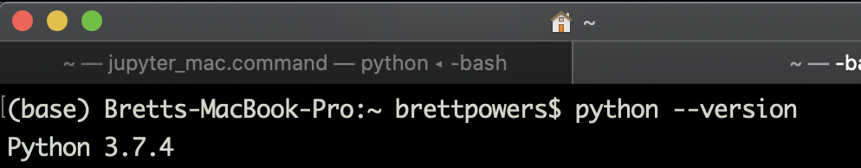
Installing Python
If you use a Mac you probably already have it installed!
Check what version with the following terminal command:
>> python --version
For a “relatively” easy installation system try Anaconda.
Python.org
Notes:
Go to python.org to show how easy it looks.

Slide 5
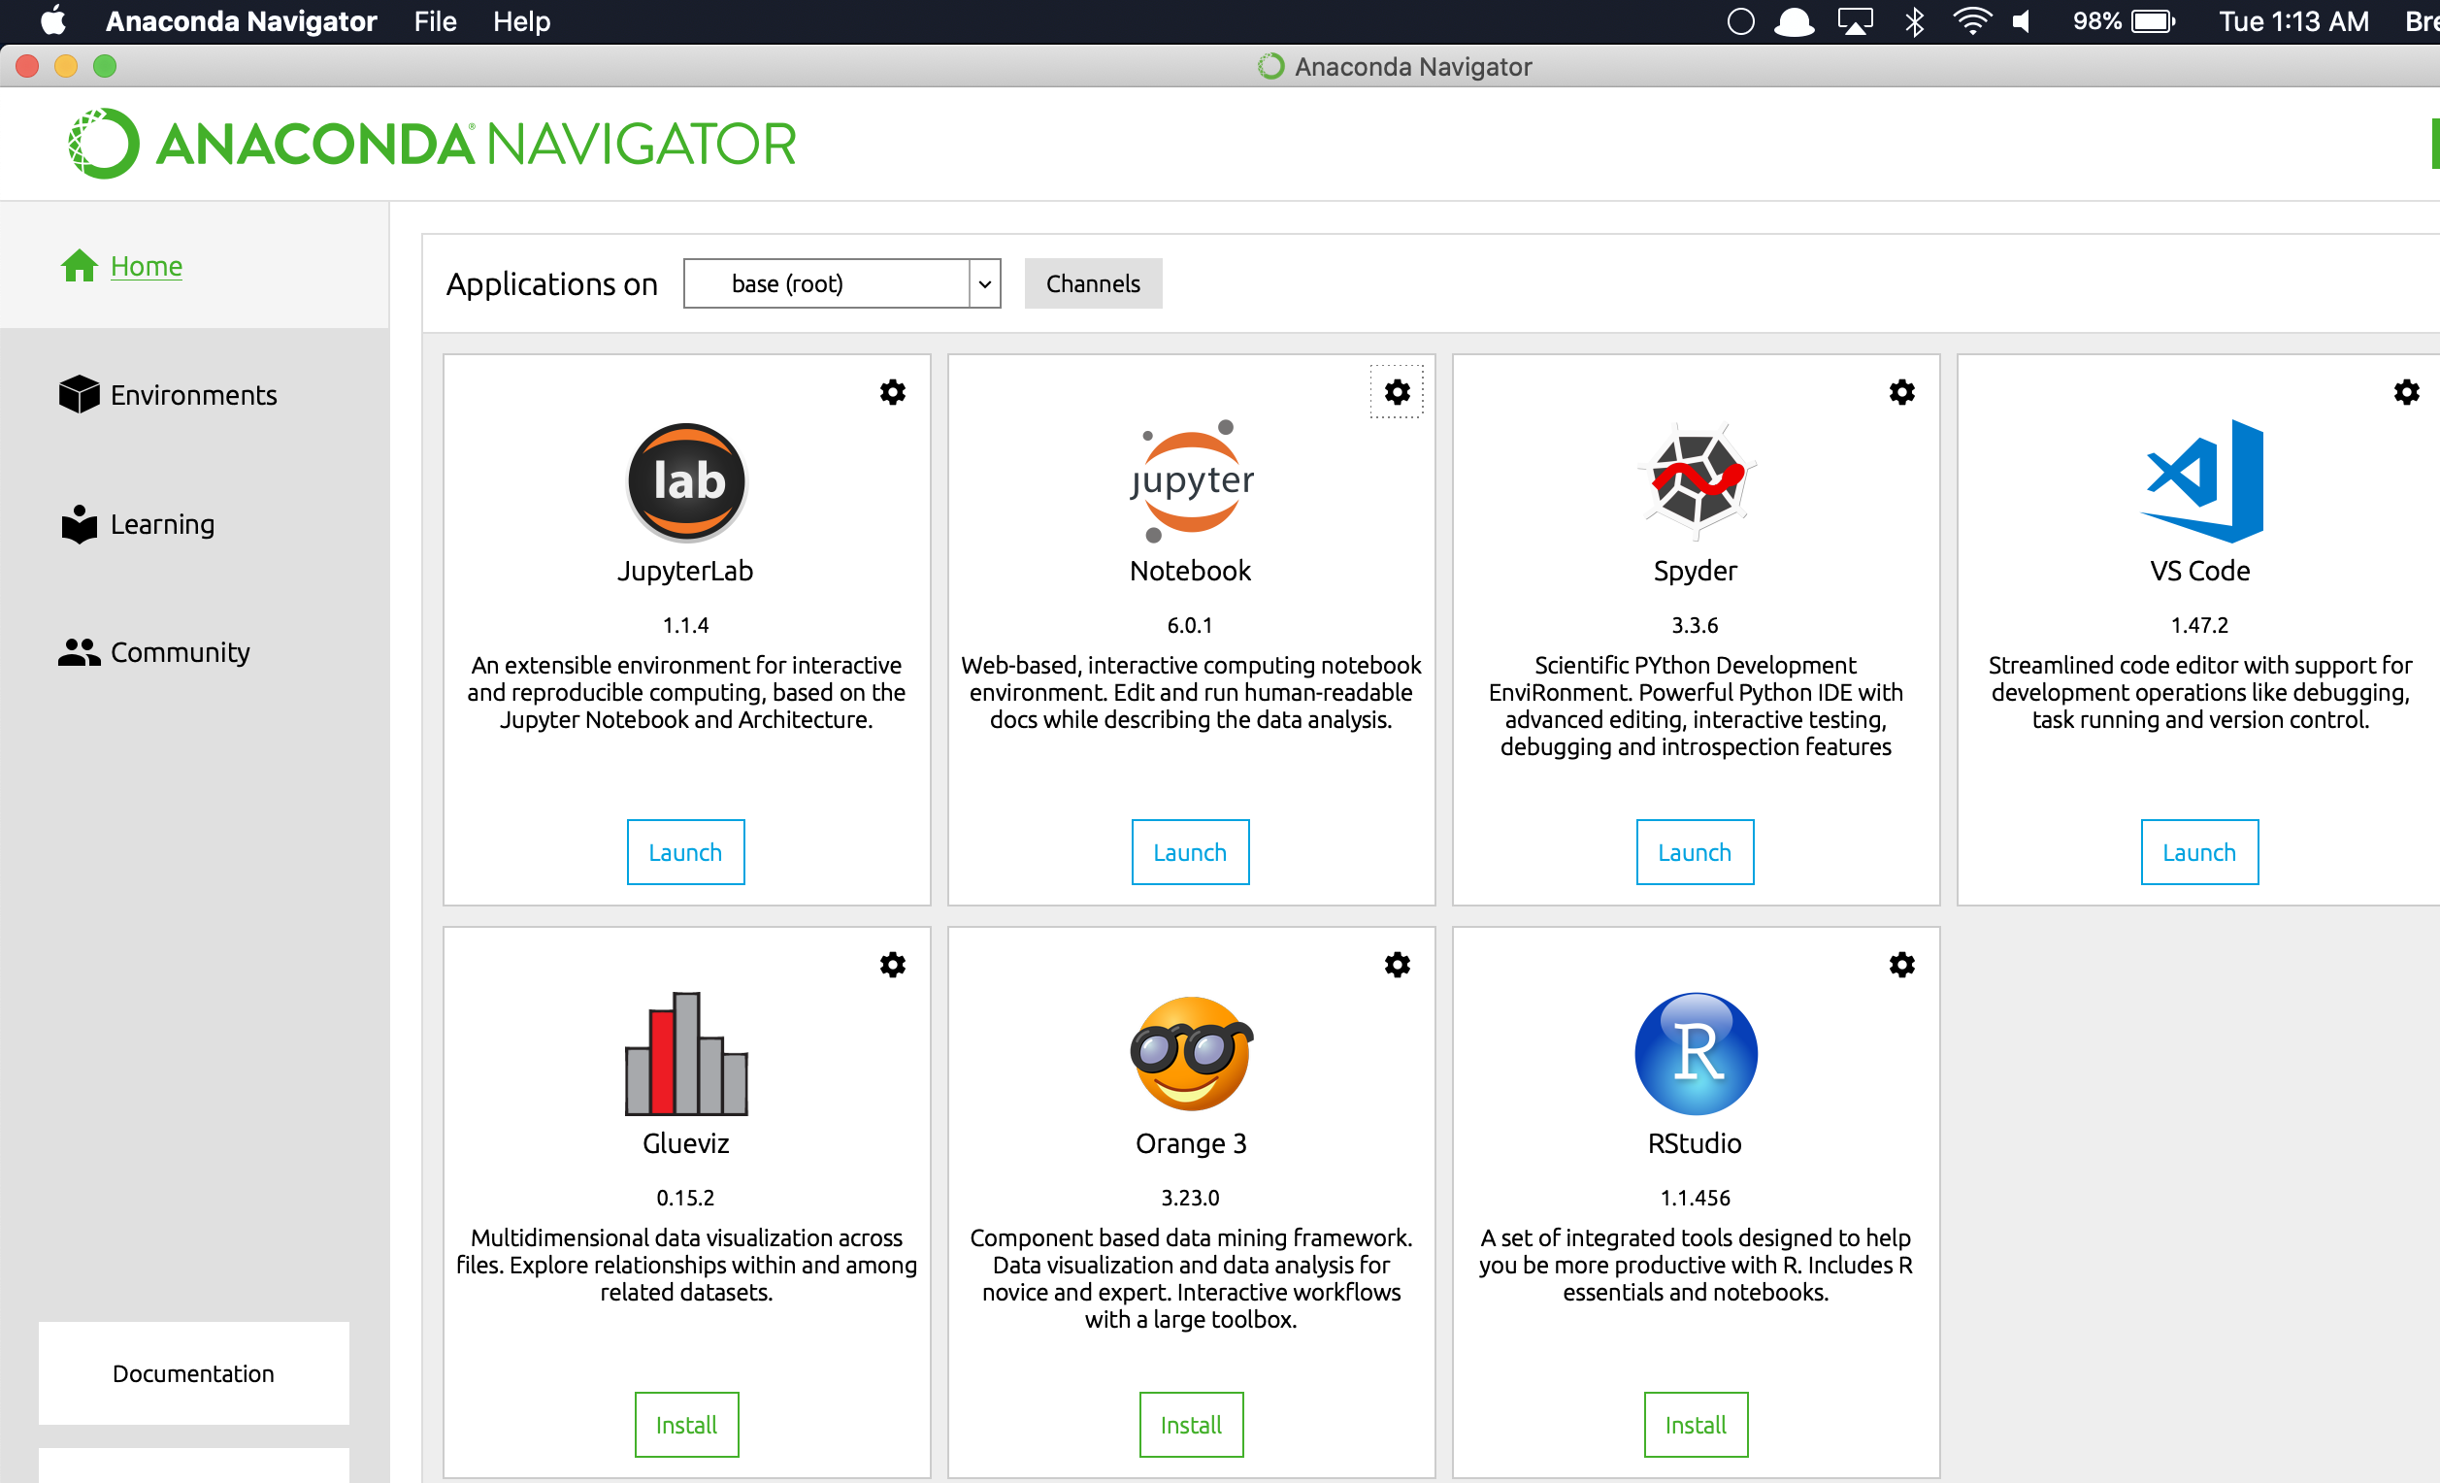
Anaconda

Slide 6
Versions of Python
Knowing what version of Python you are using is important.
Older modules/packages sometimes require the 2.* version of Python
They are “sunsetting” Python 2 (created in 2000)
Important take away is to make sure you have Python 3 installed and make sure it’s the version in use.
***Some older Macs may have Python 2 installed…***

Slide 7
Quick Peek at Python
Hello world.
Simple Math demo
Commenting
Notes:
Jupyter

Slide 8
Python Data Types
Data types are ways to categorize different objects that allow a certain functionality to be applied to them.
A lot of similarities to other languages.
Dynamic language so don’t need to indicate data type.
Standard Data Types:
String
Integer
Float
Boolean
List
Tuple
Dictionary

Slide 9
String: A string value is a collection of one or more characters put in quotes.
Integer: Positive or negative whole numbers.
Float: Any real number with floating point representation.
Boolean: A value representing TRUE or FALSE.
List: A list object is an ordered collection of one or more data items, not necessarily of the same type, put in square brackets.
Tuple: Ordered collection of one or more data items, not necessarily of the same type, put in parentheses.
Dictionary: unordered collection of data in a key:value pair form.
Notes:
Go to jupyter.

Slide 10
Simple Computer Science Practices
If-Else Statements
Equals: a == b
Not Equals: a != b
Less than: a < b
Less than or equal to: a <= b
Greater than: a > b
Greater than or equal to: a >= b
While Loops
For Loops

Slide 11
If-Else Statement
Python uses If Statements to compare objects and then proceed to an action if the logical statements are True or False.
White space indentation is a large syntax attribute within Python.
Can use other logic commands like AND, and OR.

Slide 12
While Loop
We can execute a set of statements as long as a condition is true.
Useful for completing an action indefinitely, until some condition is changed.

Slide 13
For Loop
Number of iterations is known.
Has a built in index counter (unlike the while loop)
Syntax is simple but need practice to get the hang of it.

Slide 14
Functions
Defining functions in python is similar to the previous examples.
Can be useful to break code into compartments and return computations or actions.
Very clear concept.

Slide 15
Modules/Packages
A code library with a specific purpose in mind.
Math module: mathematical objects like pi, computational tools (square root, log, trig functions)
Numpy
Pandas
Sklearn
Tensorflow/Keras

Slide 16
Numpy (Numerical Python)
Work with arrays, matrices, linear algebra techniques.
Much faster than ‘lists’ due to the memory usage.
C and C++ based.

Slide 17
Pandas
Data analysis manipulation tool
Use of a ‘DataFrame’ to store data.
Easy for reading and writing files.
Great for ”cleaning up” the data in the preprocessing stage.
Missing data
Splitting
Also written in C (much faster!)

Slide 18
SciPy
Scientific computing tools in Python
Builds upon Numpy and pandas, and matplotlib
Good for:
Signal processing
Interpolation
Fourier analysis

Slide 19
Matplotlib
Plotting library for Python
Designed to resemble MATLAB plotting
Types of plots:
Line plot
Histograms
Scatter
3D
Polar plots
Etc…

Slide 20
Sklearn
Simple and efficient tools for predictive data analysis
Built on Numpy, SciPy, and matplotlib
Few tools:
Classification
regression
Clustering
Preprocessing tools
Dimensionaliry reduction

Slide 21
Installing Packages
To use these modules you need to first install them onto your machine.
Python has a standard library but the best part of Python is to use other packages to customize functionality within your project.
PyPi.org (Python Package Index)
This is where your computer goes to extract packages.
Pip
Show example with pygame.

Slide 22
Importing Packages
After you have the packages you want installed you then can ‘import’ them.
Typically imports happen above the code.
Sometimes it is beneficial to use the ‘from’ feature
from import
*desired package*
*specific method within package*

Slide 23
Classes
Python is a great object-oriented programming language.
“Objects” within Python have within them properties and methods (a.k.a. functions)
Classes act like an “object constructor” or “blueprint” so you can create your own custom objects.
Notes:
note1

Slide 24
IDE’s
Stands for “Integrated Development Environment”
Provides a place to utilize coding languages and has extra features usually.
Syntax highlighting
Code completion
Debugging

Slide 25
Popular IDE’s
Important to find a solid IDE that works with your personal workflow.
Pycharm
Visual Studio (Microsoft)
Vim
Spyder (in Anaconda) *reminds me of MATLAB*
Atom *What I use*
Jupyter Notebooks
Ipython

Slide 26
Jupyter Notebooks
Fantastic for quick prototyping code.
Block code feature is extremely useful. (don’t need to run entire script)

Slide 27
Ipython
Showing the difference between Ipython vs. standard terminal

Slide 28
Conclusion
Python is a powerful programming language that has gained incredible popularity.
The open-source packages are very useful.
Readability makes it less daunting to learn.
Documentation is produced well.

