Slide 1
Non-parametric Statistical Tests
Brett Powers
May 12, 2021

Slide 2
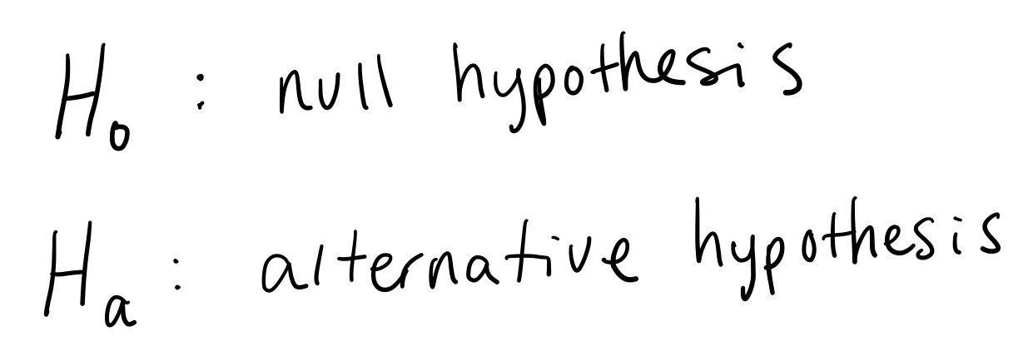
Statistical Tests
We perform statistical tests to make conclusions on data.
With said conclusions we can then make decisions based off quantitative analysis with some sort of confidence associated with it.
Depending on different assumptions that we can make will change what type of tests we should use.
Basic Structure:

Slide 3
Parametric vs. Non-parametric Tests
With a parametric test we are trying to conclude ideas about some sort of parameter/parameters.
Assumptions are made for these parameters and the data iteself.
Normally Distributed, Independent samples, best with lots of samples...
Non-parametric mostly means that we can’t assume the data is Normally Distributed. Also has good success when sample sizes are lower.
If possible, use parametric tests. They are more powerful statistically.

Slide 4
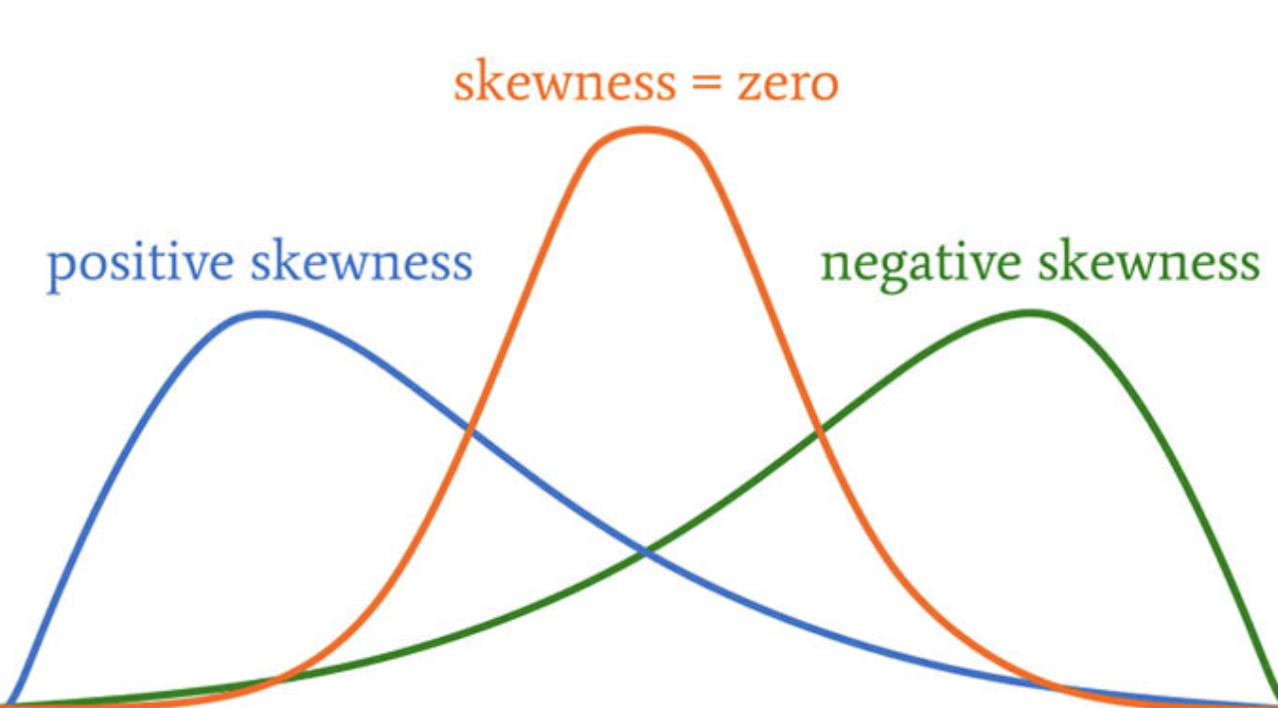
Skewness and Kurtosis

Slide 5
Skewness and Kurtosis
Distributions that are not symmetrical around their mean are said to have a non-zero skewness.
Normal Distribution (perfectly centered around mean) has 0 skewness.
Loose rule of skewness being between + and – 1 can be classified as approximately normal or “sufficiently normal” for parametric tests.

Slide 6
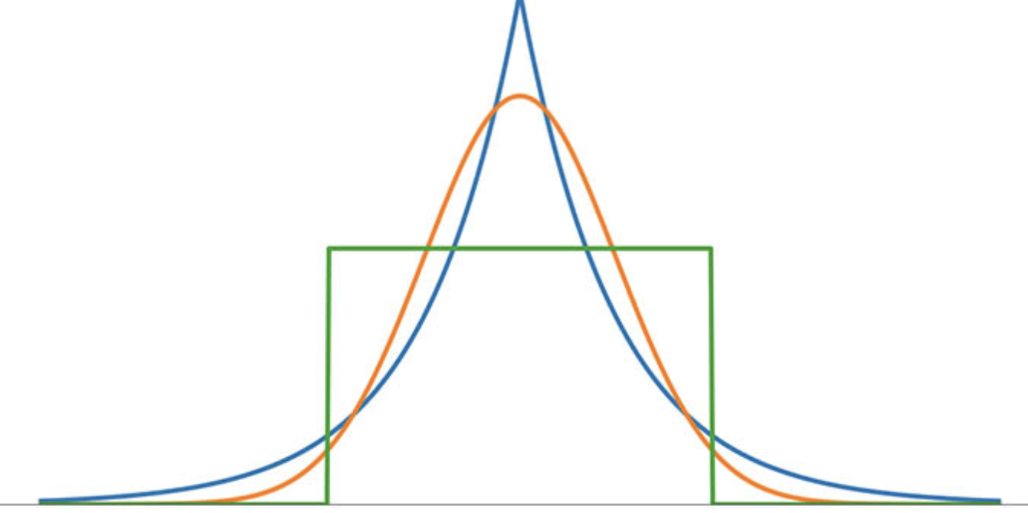
Skewness and Kurtosis
Normal distribution
Laplace distribution

Slide 7
Skewness and Kurtosis
Kurtosis is about measuring the data that is far away from the mean.
Tail-magnitudes or tail-weights are other terms for it.
Kurtosis of the normal distribution is 3 (orange curve).
Compared to lets say the Laplace Distribution which is 6 (blue curve).
Again similar to skewness we can use the idea of + or – 1 away from the normal distribution for kurtosis to be sufficiently normal for parametric tests.

Slide 8
Reasons to use Non-parametric Tests
Assumptions of data being Normally distributed are violated.
Sample size is not sufficiently large.
Data having known outliers.
Comes with the price of not being as robust compared to parametric tests that have the assumptions met.

Slide 9
Non-parametric tests Paired with Parametric
Non-Parametric Test | Parametric Counterpart
1-sample Signed Test | 1-sample t/Z Test
1-sample Wilcoxon Signed Ranked Test* | 1-sample paired t/Z Test
Friedman Test | Two-way ANOVA
Kruskal-Wallis Test | One-way ANOVA
Mann-Whitney Test | Independent Samples t-test
Moods Median Test | One-way ANOVA
Spearman Rank Correlation | Correlation Coefficient
* Code example coming.

Slide 10
Simple Non-parametric example
Lets look at the comparison of the Signed Test (non-parametric) with the t-test (parametric)

Slide 11
t test
Assumptions:
Data is independent
Randomly sampled
Normally distributed
Plain English Idea: We want to compare the mean of the sample to some pre-specified mean that we know and test for the deviation between them.

Slide 12
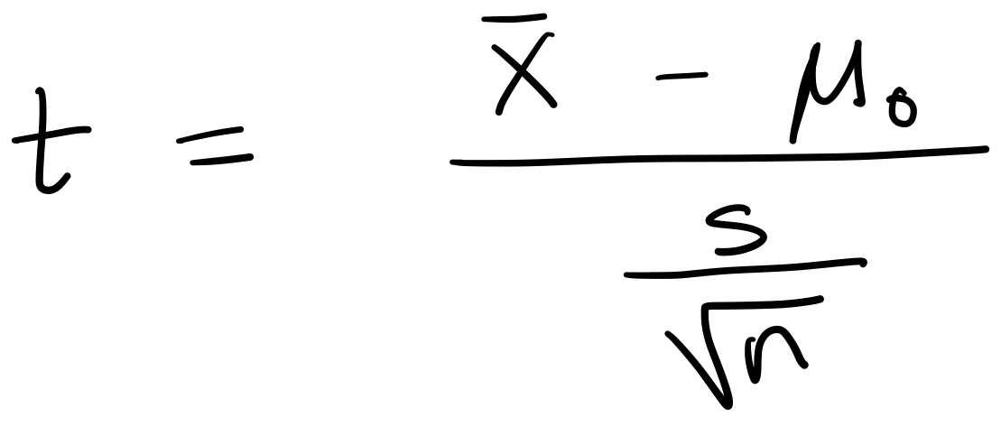
t test
Weight of babies from New York
Mean is 3,410 grams we can use this as our ”known” mean.
We can safely assume normal distribution with babies weights.
Steps:
Calculate sample mean
Set significance level (alpha = 0.05 is popular)
Calculate t score.
Compare t score calculated with t value from table.

Slide 13
Sign Test
Assumptions:
Samples are independent. Very easy to satisfy usually.
Plain English Idea: We want to take the data in front of us and use the notion of their medians to draw conclusion if they have similar common values.

Slide 14
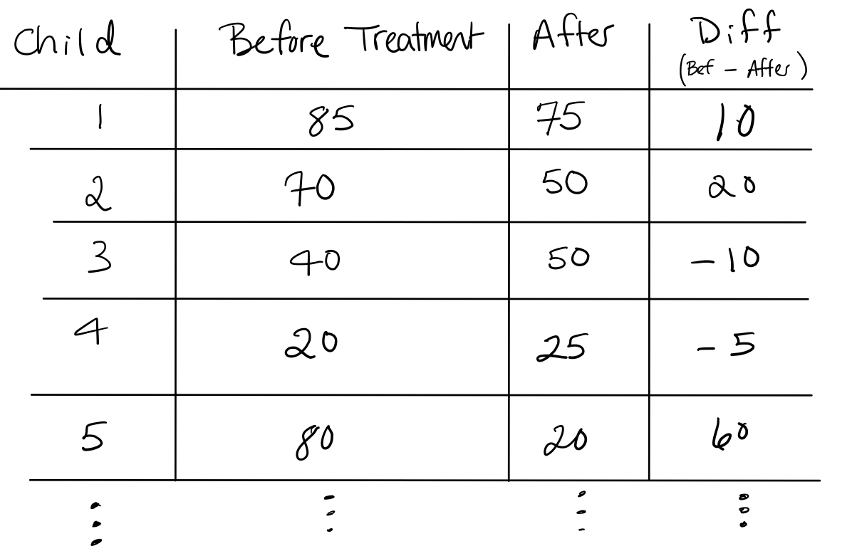
Sign Test

Slide 15
Sign Test
The null hypothesis is that the median differences is zero.
The alternative lets says is that median difference is positive.
We would expect a relatively equal number of (+) and (-) values of the differences if the null was TRUE.
We would expect more (+) values if the null was FALSE.

Slide 16
Sign Test
Steps:
Find the differences
Mark how many positive and negative values.
Take the smaller number and use it to compare to a table.
Similar to parametric however we are not assuming anything about the distribution. These values are known as Critical Values.

Slide 17
Wilcoxon Signed Rank Test
Similar to the Sign Test
Assumptions:
Paired data are from same distribution
Each pair is chosen independently.
This gives more weight to differences with larger magnitude.
Code example

