Slide 1
Parallelization GPU vs CPU
3/3/2021
Brett Powers

Slide 2
Parallel Computing
Taking larger problems and breaking it down into simpler steps/problems to then be run simultaneously.
If perfect and optimal, would lead to a linear speed-up in performance.
Requires careful setup of a program/algorithm to ensure dependencies are met to ensure parallel capabilities.
Virtually all computers today have some sort of hardware setup for parallel computing.
Can be used to speed-up, make cheaper, and do harder problems.

Slide 3
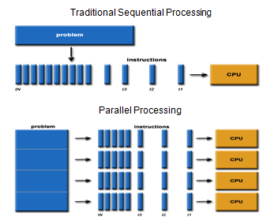

Slide 4
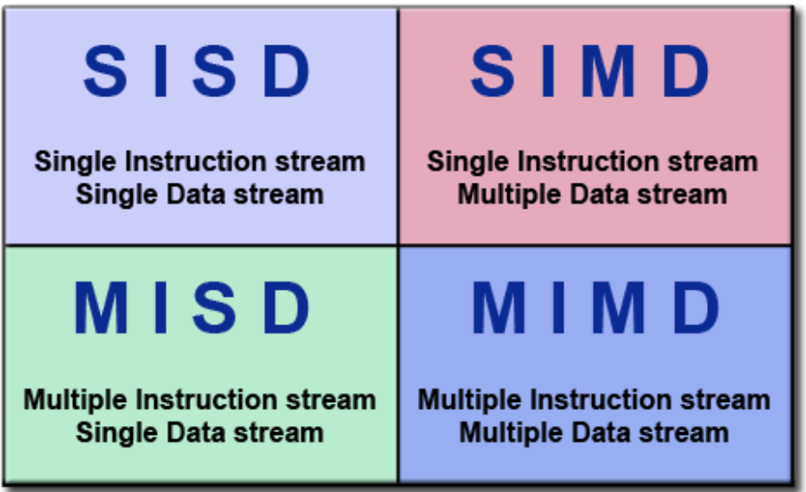

Slide 5
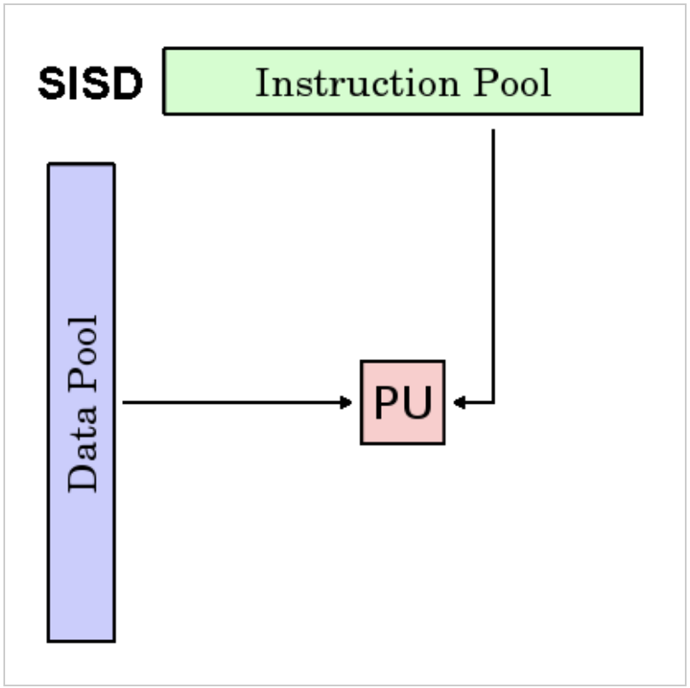
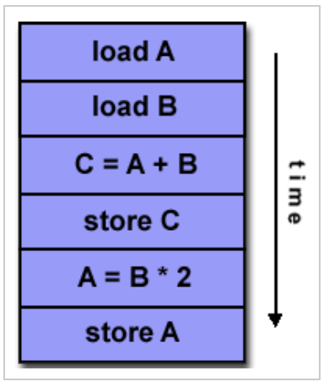
Deterministic execution
This is the oldest type of computer
Examples: older generation mainframes, minicomputers, workstations and single processor/core PCs.

Slide 6
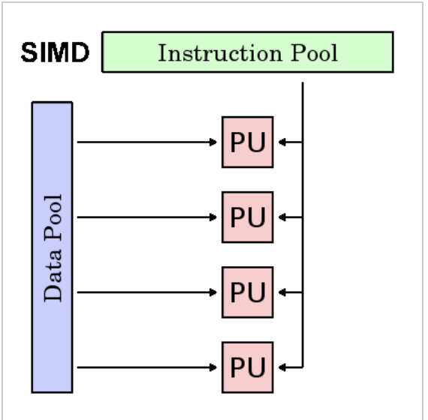
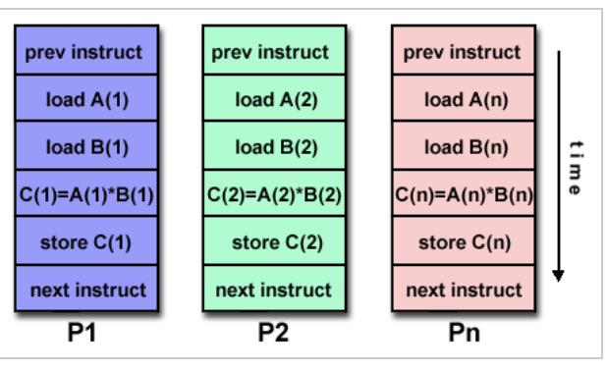
Best suited for specialized problems such as graphics/image processing.
Synchronous (lockstep) and deterministic execution

Slide 7
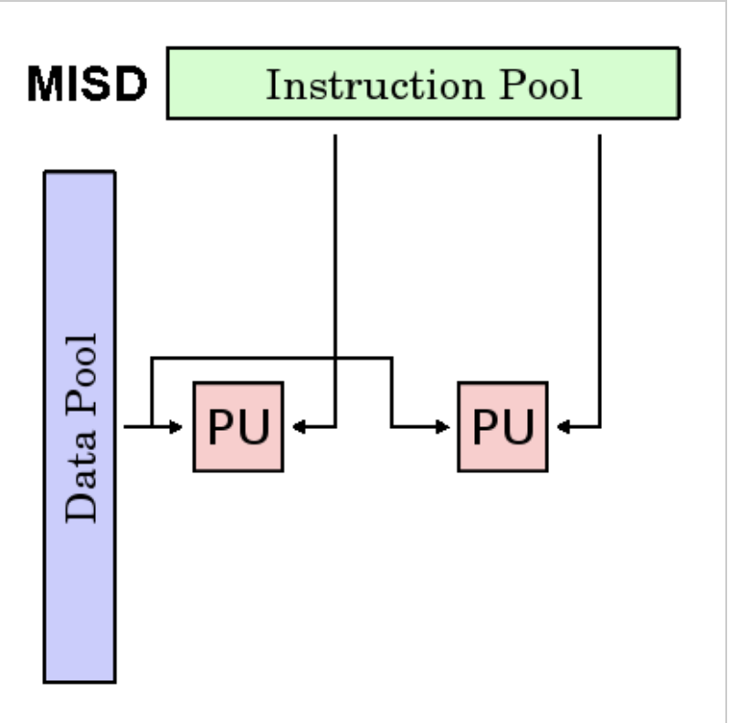
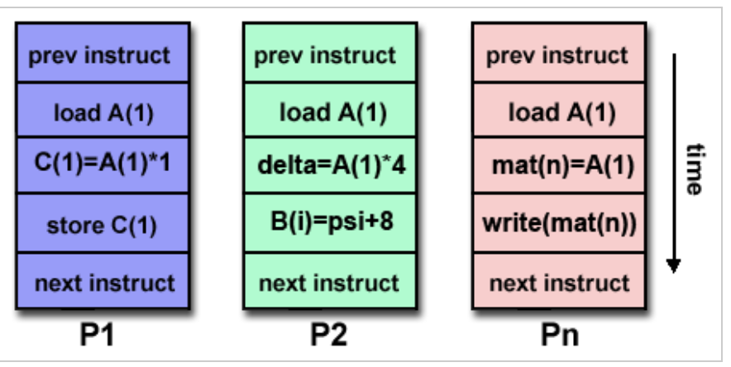
Few (if any) actual examples of this class of parallel computer have ever existed.
Some conceivable uses might be:
multiple frequency filters operating on a single signal stream
multiple cryptography algorithms attempting to crack a single coded message.

Slide 8
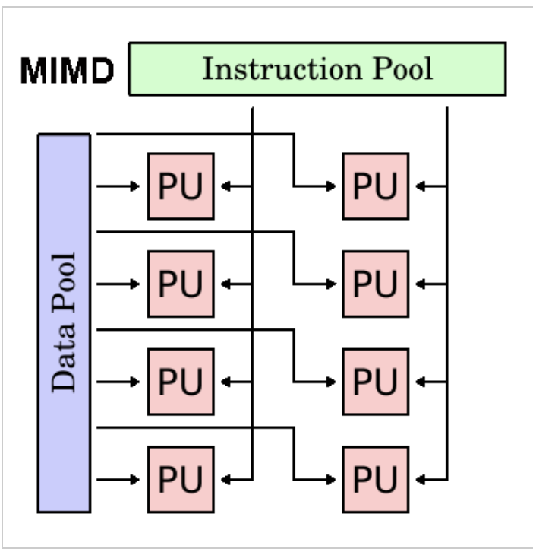
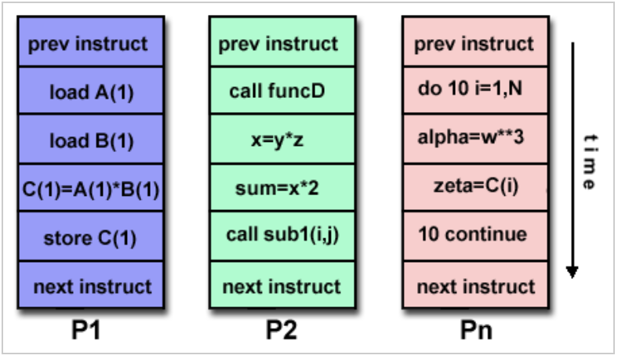
Execution can be synchronous or asynchronous, deterministic or non-deterministic
Currently, the most common type of parallel computer - most modern supercomputers fall into this category.
Examples: most current supercomputers, networked parallel computer clusters and "grids", multi-core PCs.
SIMD can be used as sub-components.

Slide 9
Terminology
HPC: High Performance Computing
Nodes: ”computer in a box” containing CPUs/memory networked together to create a supercomputer.
CPU/Socket/Core: Node can have multiple CPUs which in turn have multiple cores…
Task: logical discrete sections in a program.
Embarrassingly Parallel: Solving many similar, but independent tasks with little need for coordination between tasks.

Slide 10
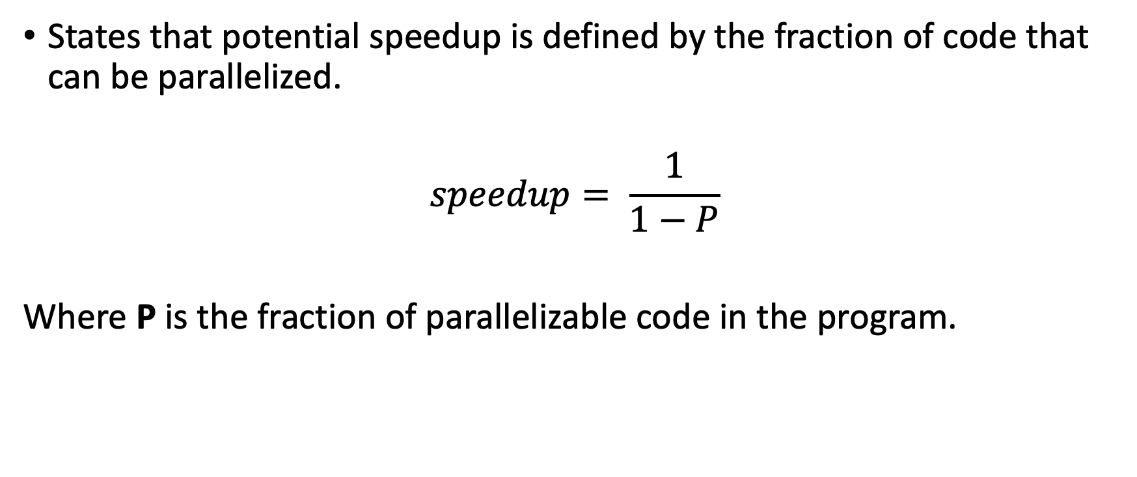
Amdahl’s Law
States that potential speedup is defined by the fraction of code that can be parallelized.
$$speedup= \frac{1}{1−P}$$
Where P is the fraction of parallelizable code in the program.

Slide 11
Amdahl’s Law Example
If none of code is parallelizable → P=0 → speedup = 1 (no speedup)
If all the code is parallelizable → P=1 → speedup = ∞
If 50% of the code can be parallelized → p=0.5 → speedup = 2

Slide 12
CPU vs. GPU
CPU:
central processing unit. Used for a variety of workloads. Does a fantastic job at doing individual tasks quickly. (loading data, creating files etc..)
GPU:
Graphical processing unit. Made up of many many many more smaller and specialized processing units that can do simple jobs in parallel and can do thousands of calculations at the same time. (any math being performed in the training process etc…)
Both are required for a solid machine learning system.

Slide 13
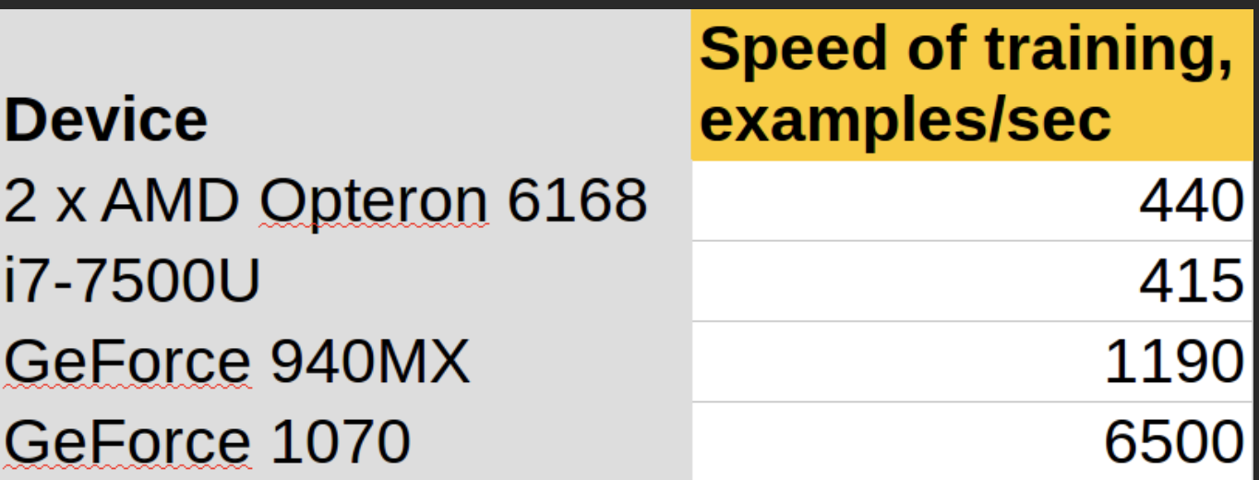
CUDA
Compute Unified Device Architecture (CUDA)
Created by NVIDIA in 2007.
Kind of created a monoploy/bottleneck in hardware one needs to use it…
Makes it easier to use GPU resources to ones parallel code.

Slide 14
TPUs
Tensor Processing Unit
Created by Google in 2015 and made commercially available in 2018.
Designed specifically for TensorFlow with neural networks in mind.
Best for:
Models dominated by matrix computations
Models with no custom TensorFlow operations inside the main training loop
Models that train for weeks or months
Larger and very large models with very large effective batch sizes

Slide 15
TPUs
Not Best for:
Workloads that access memory in a sparse manner might not be available on TPUs.
Workloads that require high-precision arithmetic. For example, double-precision arithmetic is not suitable for TPUs.
Neural network workloads that contain custom TensorFlow operations written in C++. Specifically, custom operations in the body of the main training loop are not suitable for TPUs.

