Slide 1
SQL vs. NoSQL Bonus Discussion: NEAT algorithm
Brett Powers
Feb. 3, 2021

Slide 2
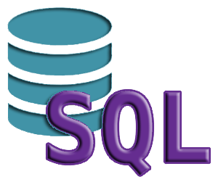
What is SQL
Structured Query Language (SQL)
Initially released in 1986
Uses relational database management system
Relational model devised by IBM researcher E.F. Codd
Eliminates the need to specify how to reach a certain record. (Index)
Widely used in the Business Intelligence toolbox.
Data Manipulation and data testing can be done using SQL.
Data Science tools such as Spark or Impala depend on SQL.

Slide 3
Pros of SQL
Efficient use of resources. Fast query processing.
Use of keywords like SELECT, INSERT, etc. make it more understandable.
Strong data integrity through ACID.
Generally more flexible query support.

Slide 4
ACID
Atomicity: Make sure ”transactions” are thought of as one unit.
Consistency: Makes sure a transaction brings the database from one valid state to another valid state. Valid state doesn’t necessarily mean correct however. Stops illegal transactions.
Isolation: Concurrent execution of transactions leaves database in same state as if they were executed sequentially.
Durability: Once a transaction has been committed, it will remain committed even after a system failure. Transactions are recorded on non-volatile memory (flash memory, ROM).

Slide 5
Cons of SQL
Rigid data models that when needs changing leads to downtime.
Horizontal scaling is challenging. Not supported, or supported in a immature manner.
High redundancy and repeated rows.

Slide 6
Examples of SQL Databases
PostgreSQL
Db2
MySQL
Oracle
SQL Server
CockroachDB
YugabyteDB

Slide 7
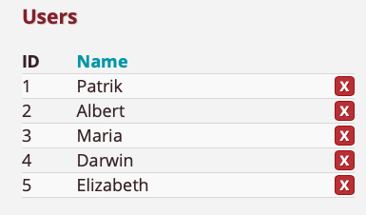
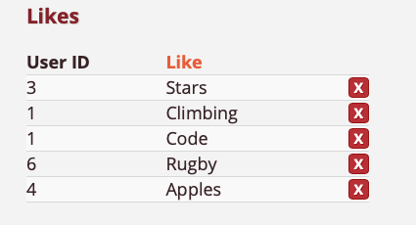
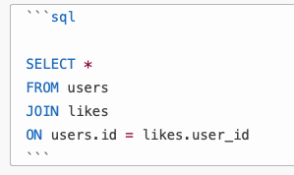
Example Using SQL (Joins!)

Slide 8
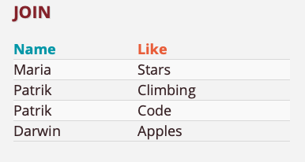

Slide 9
What is NoSQL?
Not that clear!
First thought as any database that didn’t support SQL.
Became popular in mid-2000’s.
Eventually transformed into “Not Only SQL”…
Wanted to solve big issues dealing with SQL database setup.
Lack of horizontal scaling.
Rigidity of table design with relational systems.

Slide 10
Pros of NoSQL Databases
No significant single points of failure and ability for easy scalability.
Changing data schemas on the fly and are much more flexible in terms of data models.
High levels of performance with the cost of some durability issues.

Slide 11
Cons of NoSQL Databases
Vague interpretation of ACID principles.
Lack of flexibility with querys. Lose the optimization that SQL databases can make with underlying data.

Slide 12
Examples of NoSQL Databases
Redis (Key-value databases)
CouchDB
MongoDB (Use of JSON format)
Elasticsearch
Cassandra (Not all rows require same columns.)

Slide 13
When to use Which one?
SQL
Relational data
Need data integrity
Better for ad-hoc queries
Swiss army knife approach (can be used with high structured data and unstructured data)
Potentially more reliable.

Slide 14
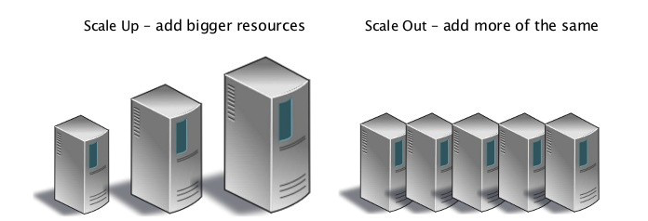
When to use Which one?
NoSQL
Specific needs and need of flexible schemas.
Unstructured data
Can meet high availability requirements and can react to failures to individual members.
Might be more useful for cloud computing (scaling)

Slide 15

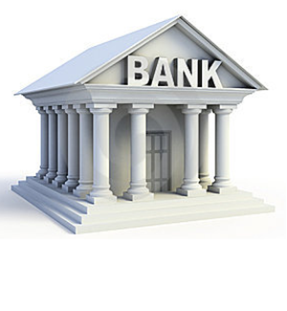
Social Media
Everyone doesn’t really need to see your post at the same exact moment. Availability is much more important → NoSQL Database.
Banks
Integrity of the data is extremely important and needs to be more secure → SQL

Slide 16
Bonus!
NEAT Algorithm
NeuroEvolution of Augmenting Topologies (NEAT)
Genetic algorithm for ANNs.
Ken Stanley, 2002 at Universtiy of Texas as Austin.
Alters both weighting parameters and structures of the networks.
Uses three main techniques.
Tracking genes
Speciation
Complexifying

Slide 17
Mechanics of the Algorithm
Usually human picks out network topology (hidden layers, number of nuerons, etc…) using empirical evidence and weights are learned through training process.
NEAT starts with simplest form. Input nodes, output nodes, series of connection genes. Ground up approach.
Uses a direct encoding scheme which means every connection and neuron is explicitly represented.
Complexity is obtained as the evolution progresses and neurons are inserted through discrete steps.

Slide 18
Extensions
rtNEAT: Allosws real time evolution instead of only discrete.
Phased pruning: adds periodic pruning. Help avoid unnecessary structure.
HyperNEAT: specialized in large scaled structures.
cgNEAT: Contant-generating NEAT, evolves custom video game content.
odNEAT: Designed for multi-robot systems. Online and decentralized.

Slide 19
Future
Can be used in complimentary fashion with standard approaches.
Paper published in 2020 uses a genetic algorithm to perform hyperparameter tuning.
Han, JH., Choi, DJ., Park, SU. et al. Hyperparameter Optimization Using a Genetic Algorithm Considering Verification Time in a Convolutional Neural Network.

