Slide 1
Workflow Management
Brett Powers
August 25, 2020

Slide 2
Basic Terminal Commands
Virtual Machines
Git
Google Cloud Platform
Eureka
Modular Workflow in Python
Discussion

Slide 3
Terminal Commands
Using the terminal can be a great way to navigate through files.
Performing tasks such as creating file directories and running scripts can be done.
Pwd, cd, ls, mkdir, mv, rm, man

Slide 4
Virtual Machines
What are they?
An emulation of a computer system.
Why use them?
Great to use for separate Python projects
No-fuss system to have the correct dependencies.

Slide 5
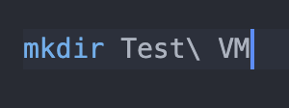
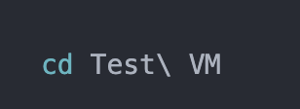
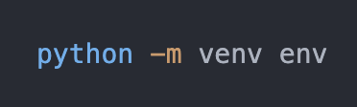
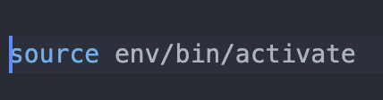
How to create a VM with Python

Slide 6
VM
Showing how packages in/out of VM
Deactivate

Slide 7
Git
What is it?
distributed version-control system for tracking changes in source code during software development.
Main Idea:
Be able to safely change code and always have the previous versions “saved” and readily available.
Great for a team working on one project that has lots of moving parts.
You don’t have to worry about mailing your files to each other and working with a ridiculous number of copies of the original file.

Slide 8
Git Commands
Git status
Git add
Git commit –m ‘commenting on changes’
Git push
Git pull
Example of changing a file.
Email me if you want a detailed outline of getting it going.
brett.powers@cuanschutz.edu

Slide 9
Google Cloud Platform
Suite of cloud computing services that runs on the same infrastructure that Google uses.
Able to pay for computing power with Google data centers.
BigQuery: data warehouse for analytics
Secure
Competitors
AWS (Amazon)
Azure (Microsoft)

Slide 10
Eureka
Eureka is an analytic infrastructure service provided by Health Data Compass to quickly provision virtual machines on Google Cloud Platform
HIPAA security and compliance standards
Scalability

Slide 11
Commands within Eureka
gcloud auth login
gsutil cp [source] [destination]
This is how you can move files to and from your local machine.
Secure way to transfer files onto a powerful machine.

Slide 12

Modular Python
Having a modular set up is better to keep work clear and purposeful.
Easier to debug usually.
Using the easy import feature of python.

