Slide 1
The Development of a Role-Playing Game for The Android Operating System

Slide 2
Game Overview
Dungeon crawler
Main and side quests
Hero will level up, gain new abilities and get access to better weapons to defeat his enemies.
New items will become available to the hero after completing quests.
Main quest will be saving the town's people that were captured by the antagonist.

Slide 3
Main Map Overview
Free roam area
Shops and town
Rescued towns people
Rebuilding of city
Entrance to dungeon

Slide 4















Sprites

Slide 5
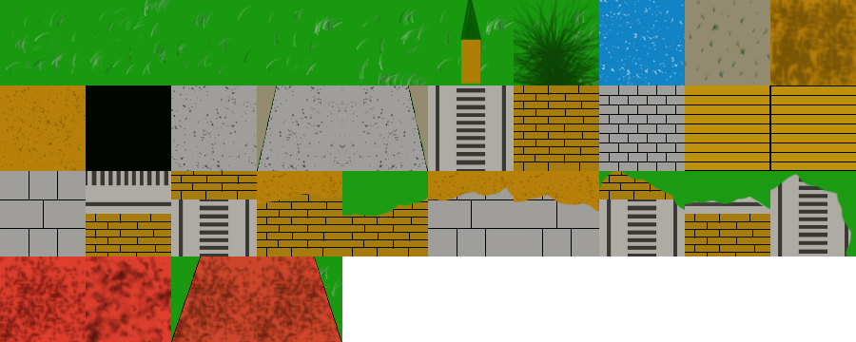
Sprite Sheet

Slide 6
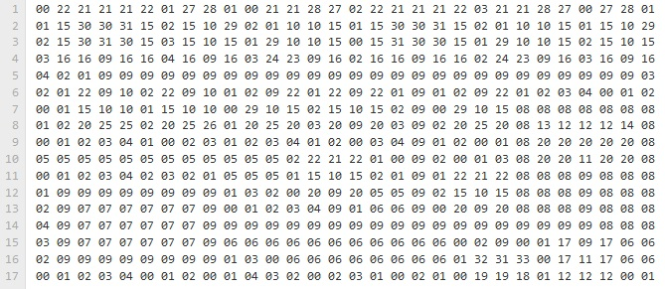
Sprite Coding

Slide 7
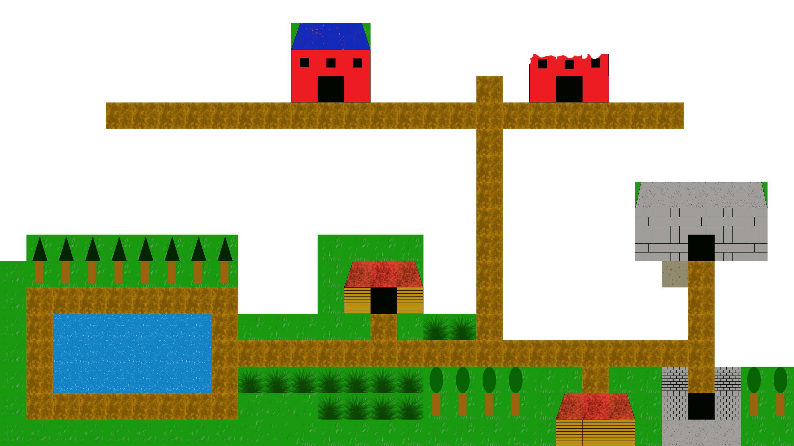

Slide 8
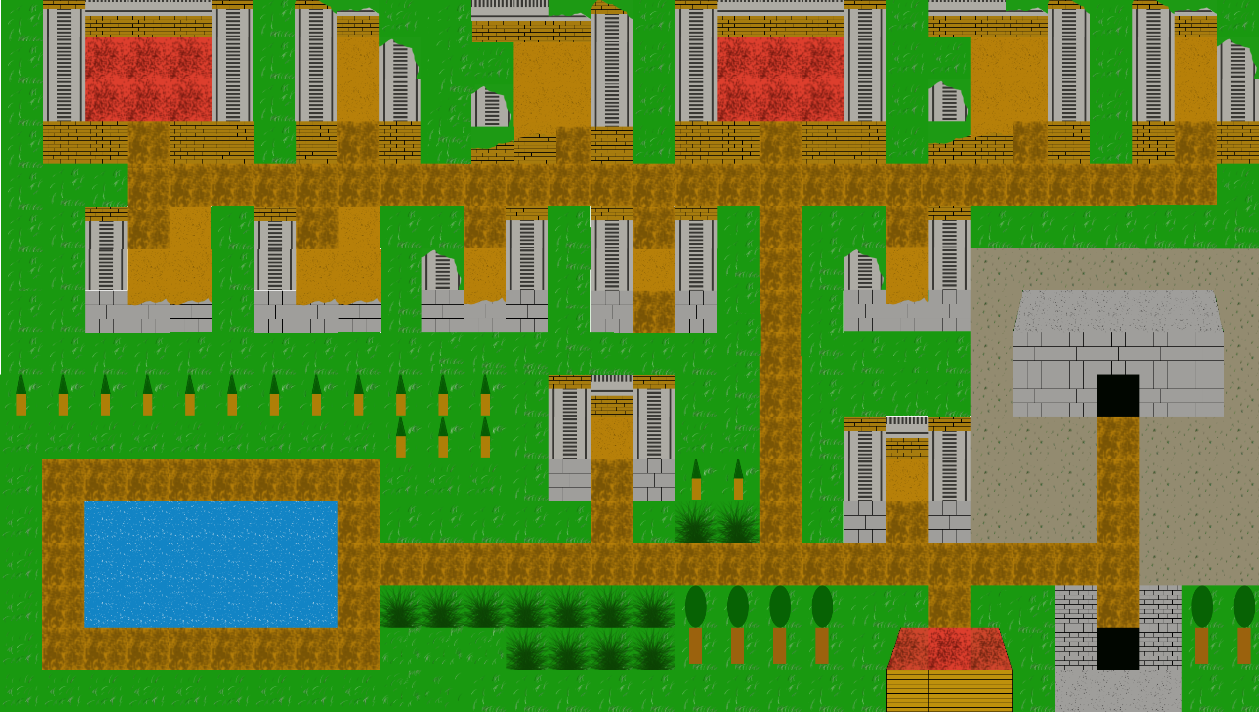

Slide 9
Dungeon
Level-based
Enemies (random encounter)
Items in chests
Bosses and mini-bosses
Towns-person rescue

Slide 10
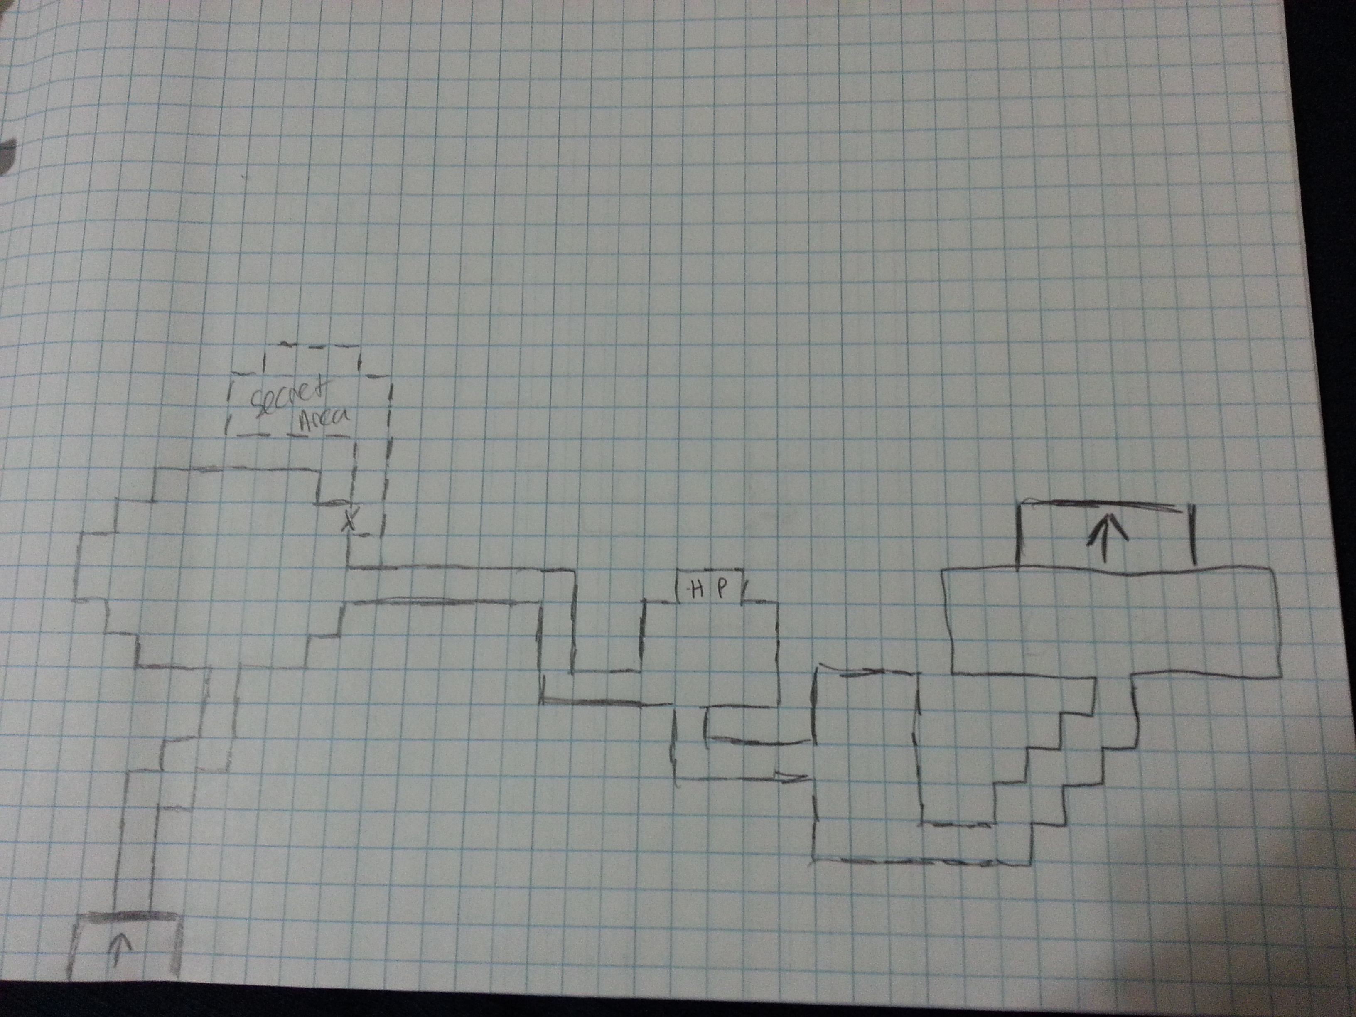

Slide 11
Systems/Engines

Slide 12
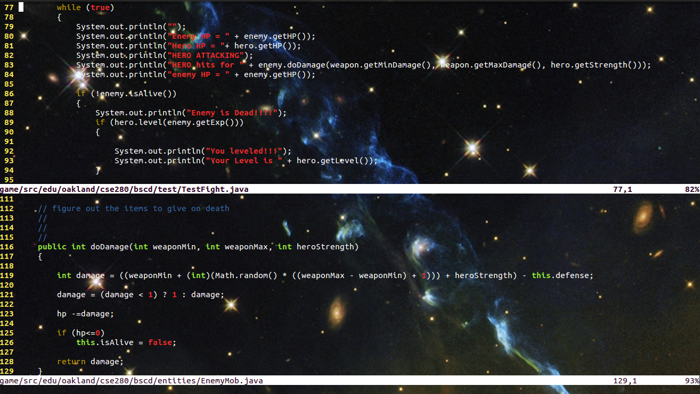
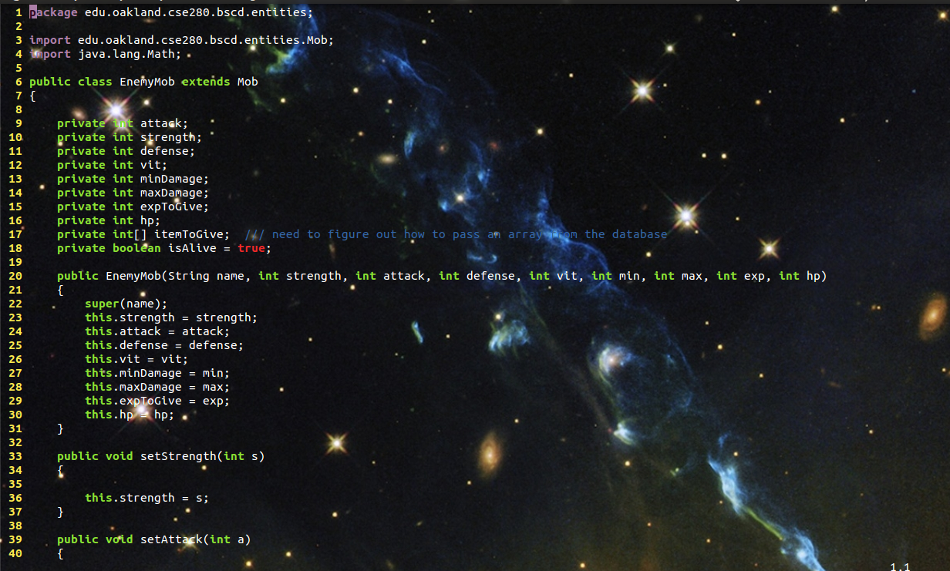
Combat System
(Damage Control / Enemy Mob

Slide 13
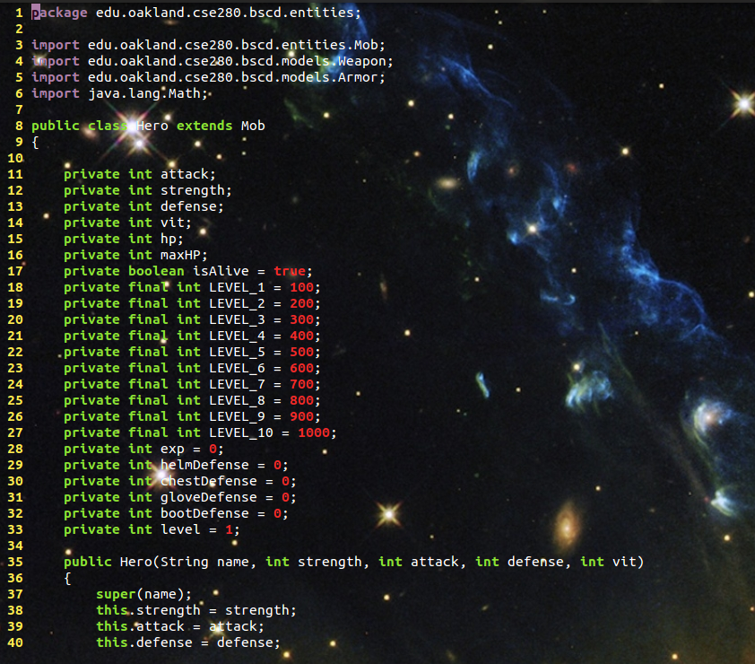
Hero System

Slide 14
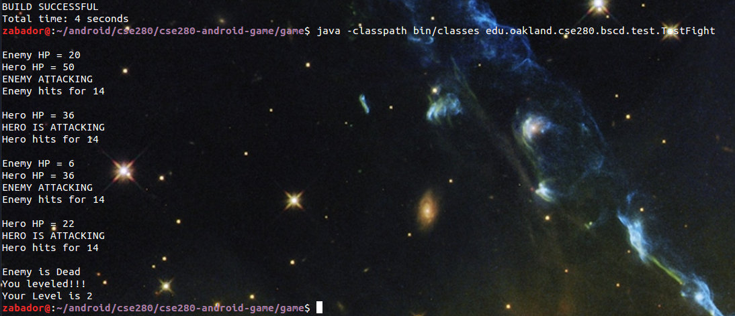
Running Fight Test

Slide 15
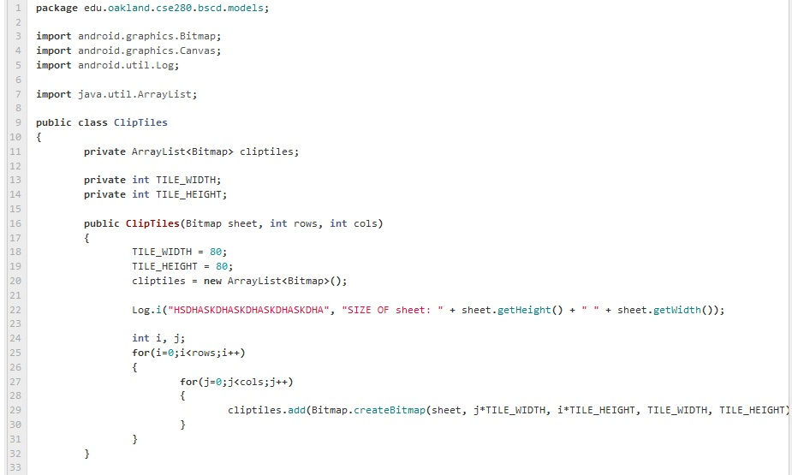
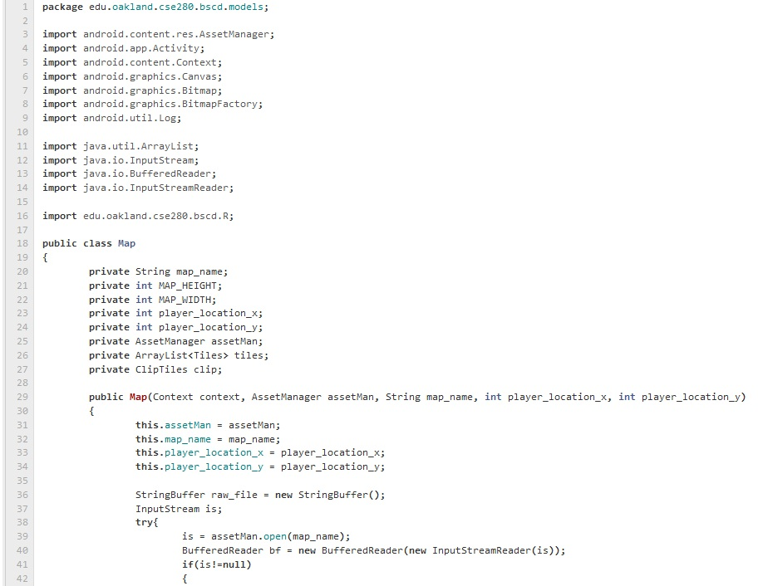
Mapping Engine

Slide 16
Project Time line
By October 2nd:
Main map designed
UI prototype
Quest & stories designed
By October 16th:
Map drawn out
UI finalized
List of items
Graphics engine prototype
By October 30th:
Loadable game
UI implemented
Coding
By November 13th:
Main quest finalized and runnable
Characters fully developed
Items implemented
Game runnable
By November 27th:
Game fully functional
Side quests added
Performance tweak
Finished

