Slide 1
Morphological Image Processing and Procedural Dungeon Generation
by Brandon Powell

Slide 2
Agenda
Procedural dunge-what?
How other games do it
The morphological way
The code
Live demo

Slide 3
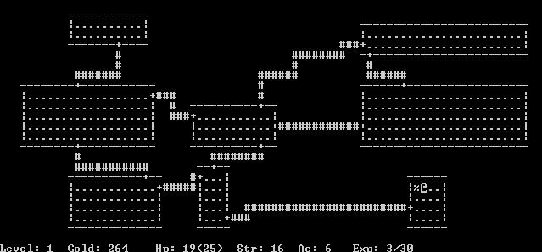
Procedural Dungeon Generation

Slide 4
Cool An Example, But What Is It?
Procedural dungeon generation is building a game area as the player goes through an already generated area

Slide 5
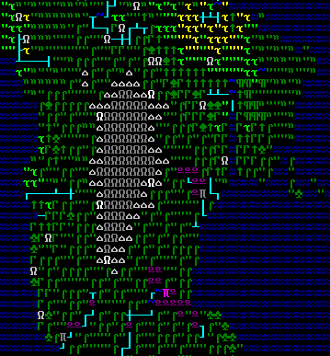
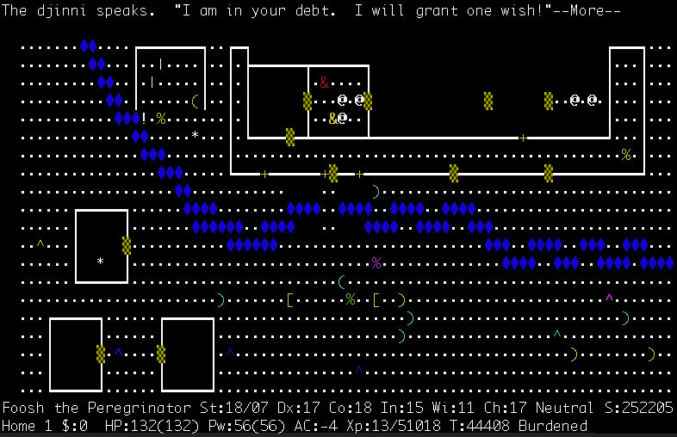
Some Example Games
Dwarf Fortress
NetHack

Slide 6
How Other Games Do It
Fill the whole map with solid earth
Dig out a single room in the centre of the map
Pick a wall of any room
Decide upon a new feature to build
See if there is room to add the new feature through the chosen wall
If yes, continue. If no, go back to step 3
Add the feature through the chosen wall
Go back to step 3, until the dungeon is complete

Slide 7
Morphological Way
Fill the whole map with solid earth
Dig out rooms randomly throughout the map
Use structuring element to do dilation
Use structuring element to do erosion on the dilated image

Slide 8
The Code
Tools used:
vim
clang++
cmake/make
tmux
git

Slide 9
The Code
Libraries used:
libSDL2 - https://www.libsdl.org/
libboost - http://www.boost.org/

Slide 10
The Code
https://github.com/bpowell/cse555

Slide 11
Demo
Live Demo!

