Slide 1
Detecting Memory Leaks Using Object Staleness Profiling
Gene Novark Emery Berger
UMass Amherst
Ben Zorn
Microsoft Research

Slide 2
Why Memory Leaks?
Common bug in shipped software
Hundreds of memory leaks in commercial applications
Demonstrated need for debugging tools
RADAR: leak diagnosis tool, ships with Vista
Integrated with Watson crash analysis system
More: SWAT, Bell, Cork, LeakDiag, UMDH, SafeMem, …
Existing tools have limitations

Slide 3
Reachability Leaks
“Lost” objects (classic memory leak)
Easy to find with existing tools or GC
Diagnostic tools
Purify, Valgrind (heavyweight instrumentation)
RADAR (postmortem heap analysis)
Report unreachable objects, outstanding allocs

Slide 4
Staleness Leaks
Reachable, but program will never use again (“Java”-style leak)
Harder to find: requires staleness information
“When did the application last use the object?”
Tools
Track memory accesses to determine object staleness
SWAT (lightweight, adaptive instrumentation)
Plug: this work

Slide 5
Existing Tool Problems
False positives/Too much information
False reports make the tool less useful
Objects not freed at end of program not necessarily leaks
Overestimating staleness due to sampling
Runtime Overhead
Tracking every access is expensive (Purify, Valgrind)
Memory overhead
Track extra metadata for every object

Slide 6
Plug: A Better Memory Leak Isolator
Aggregates objects from same allocation site
Reports last touch sites
Call stack of program
Exploits staleness information
Finds objects which really aren’t in use
Precise
Doesn’t overestimate object staleness, causing false positives
Low runtime, memory overhead
Can be on all the time, production runs

Slide 7
(Rest of the) Talk Outline
Tracking memory accesses in Plug
Using page protection
Reducing runtime overhead
Segregating objects by age
Reducing memory overhead
Segregating objects by allocation site
Results:
Performance overhead
Usability

Slide 8
Tracking Memory Accesses
Binary instrumentation
Instrument every read and write
Can be expensive
Can use sampling, but this is imprecise
Hardware/OS support
Using ECC memory (SafeMem)
Page protection?

Slide 9
Using Page Protection
Page-protect entire heap
On page fault:
Log object access
Advantage:
No instrumentation = no overhead unless faulting
Problems?
Lots of page faults: huge performance hit
Solution: age-ordered heaps
Notes:
Notes: One page fault, can track specific object but not currently implemented. Stats are maintained per page, so that if there are multiple objects on a page, they are considered together.
Last touch sites are currently maintained per page.

Slide 10
Age-ordered Heap Motivation
Generational hypothesis
Most objects die young
Young objects unlikely to be leaks
Need time to die
Most memory accesses
Focus leak detection on old objects
Only protect old objects
Existing allocators mix hot and cold, young and old
Plug allocator:
Segregate objects by age
Notes:
Need to verify that older pages end up with one object per page. Can measurethe density of older pages and determine if this hypothesis is correct.

Slide 11
Age-Ordered Heap (Ideal)
Bump-pointer allocator
Never reuses memory
Age order corresponds to address order
May have a “little” retention problem
1
2
3
4
5
6
Old
New
0x80000000
0x8FFFFFFF

Slide 12
AOH (Practical)
Metadata
Current allocation block
Old
New
Heap memory blocks
Protected
Unprotected
Age-ordered list of bump-pointer blocks
Free blocks when population = 0

Slide 13
Age-Ordered Heap Problems
Fragmentation
One small live object can retain a whole page
Different allocation sites have different lifetimes
Long-lived objects mixed with short-lived
Solution:
Segregate by allocation site
Selectively use age-ordered heaps for suspicious allocation sites

Slide 14
Allocation Site Segregation
Main Heap
(Standard Allocator)
Selected Alloc sites
(e.g. crosses 32 live object threshold)
0x14e99e32
0xc6b49a14
0xb629182b
0xcf3c2a95
0x9683a47a
Notes:
Crossing 32-object threshold is a simple heuristic that works pretty well (only 10% of sites ended up in AOH for FireFox)

Slide 15
Results
Overhead (time & space)
Plug sample output

Slide 16
Overhead: Espresso
Notes:
Need to break out CPU overheads by stack walk time & page protection/fault time
Need to break out memory overheads by AOH memory and standard heap memory

Slide 17
Memory Overhead: Firefox

Slide 18
Reporting Staleness
Summarize data per allocation site
Produce “Staleness CDF”
Fraction
Not stale
Very stale
Not stale
Very stale
Notes:
We both independently agreed that having the prob. Density function and the CDF would be better and easier to explain.

Slide 19
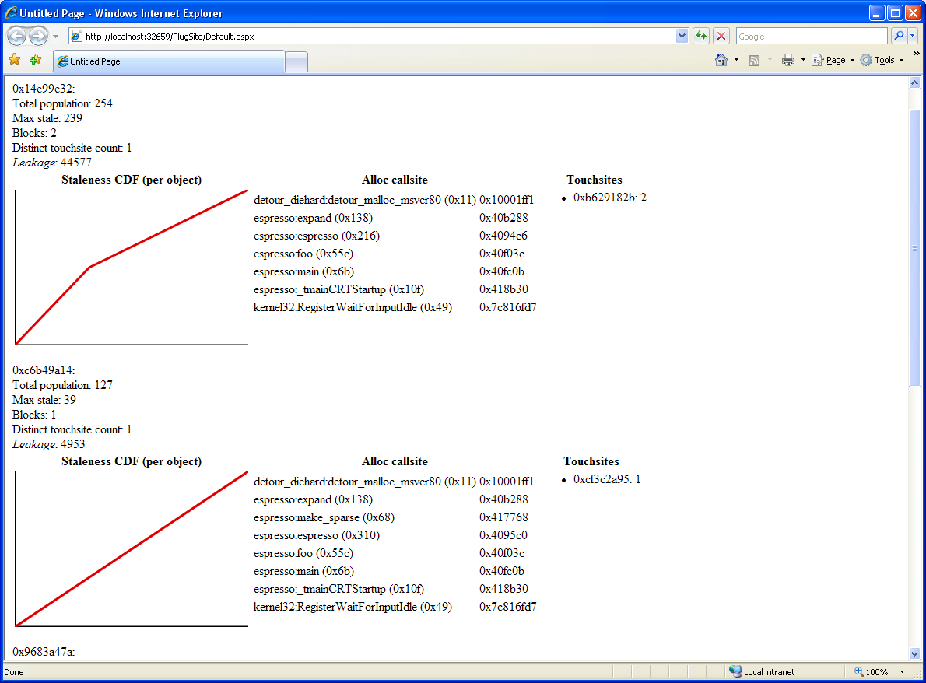
Demo: Plug Output

Slide 20
Summary
Plug: An efficient, precise heap profiler
Uses page protection to track staleness
Custom heap implementation reduces overheads
Sufficiently low overhead for everyday use
Notes:
Future work includes:
Tracking objects (not entire pages)
Decision algorithm for enabling AOH
Adaptive protection of pages within a single AOH (can we limit the overhead to a fixed %?)
Any way to make an allocation site not-suspicious (disable AOH) after its become suspicious?
Integrate OS support for trapping (to avoid passing protected pages to kernel)
Integrate callstack crawling that works even with FPO (need to time)

Slide 21
The End
http://www.cs.umass.edu/~gnovark/

Slide 22
SWAT Overview
MSR tool
Found many leaks in commercial apps
Uses Vulcan binary instrumentation to track reads and writes
Adaptive sampling reduces runtime overhead to ~5%
Misses most accesses in hot code blocks
Problem: Same code may not access same data

Slide 23
SWAT Coverage Example
Hash table (size N)
for(int i = 0; i < 10000; i++) {
…
hash.get(f(i));
…
}
Assume uniform
query distribution
Hot code, thus low sampling rate
Likelihood that reported staleness is correct, with 1% sampling rate?
E(samples for single entry) = iterations × 0.01 / N

Slide 24
Types of Memory Leaks
Reachability leaks: “Lost” objects (classic memory leak)
Easy to find with existing tools or GC
Staleness leaks: reachable, but program will never use again (“Java”-style leak)
Harder to find: requires staleness information
“When did the application last use the object?”
Plug: targets these memory bugs

Slide 25
Existing Memory Leak Tools
Reachability leaks
Purify, Valgrind (heavyweight instrumentation)
RADAR (postmortem heap analysis)
Report unreachable objects, outstanding allocs
Staleness leaks
E.g. SWAT (lightweight, adaptive instrumentation)
Track memory accesses to determine object staleness

