Slide 1
A Universal Cache Miss Equation
for the Memory Hierarchy
Y.C. Tay
National University of Singapore
in collaboration with:
Max Min Zou, Dinh Nguyen Tran, Phung Chinh Huynh, Xuanran Zong, Xi He,
Vimalraj Venkatesan, M. Rezazad

Slide 2
Outline:
universality
bottom-up vs top-down
applications
current work

Slide 3
#miss
M
Cache Miss Equation:
Prob(miss) = f (cache size)

Slide 4
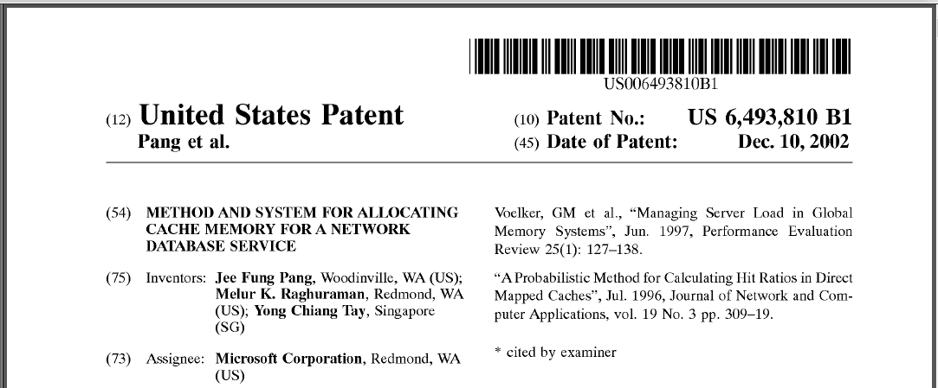
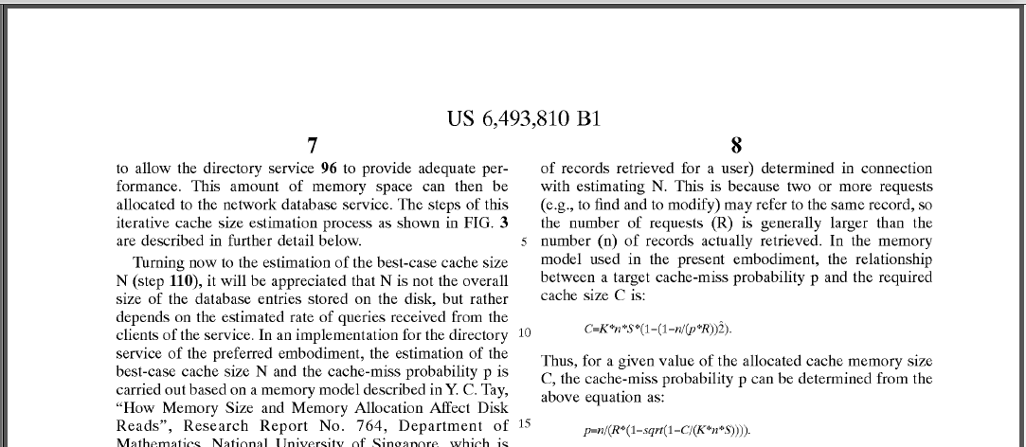
LDAP for
domain
controllers

Slide 5
P ^{miss}
accuracy?
P ^{miss}
reference
pattern
cache
size
management
policy
reference
pattern
cache
size
idealized
policy
data
layout
independence,
one application,
one process,
etc.
hardware
variation
application
mix
software
variation
LRU,
no prefetch,
etc.
data
instance
system
configuration
mathematically intractable
simplified
bottom-up analysis

Slide 6
Proposal
bottom-up analysis requires:
modeling expertise for accuracy
customization to suit variations
not scalable
tweaking as system evolves
different
top-down approach:
values
find one equation to rule them all
hopeless
same
P ^{miss} = f (cache size | parameters)
universal
equation
autonomic computing requres:
different
automatic configuration
values
dynamic adjustment

Slide 7
one equation to rule them all:
P ^{miss} = f (cache size | parameters)
minimum M
needed to run
cold miss
#miss = f (M | M*, M₀, n*, n₀)
dynamic allocation,
prefetch, etc.
1
= (K+ √K² – 4 )(n*+n₀) – n₀
ideal M
2
M* - M₀
where
K=
1 +
#miss
#miss
M - M₀
curvature
n₀
cache size
n*
n*
M₀
M*
M
M₀
M
our equation
previous equations
not working set size

Slide 8
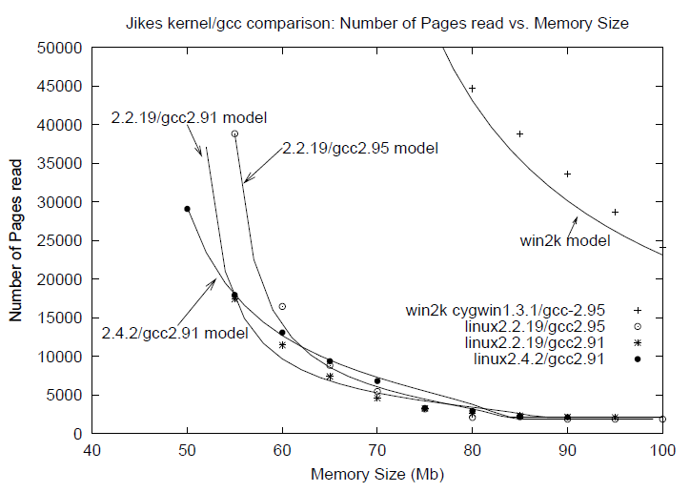
Equation applied to RAM
Tay and Zou, A page fault equation for modeling the effect of memory size, Perf. Eval. 2006

Slide 9
1
M* - M₀
#miss
= (K + √K² – 4 )(n*+n₀) – n₀
where
K=
1 +
2
M - M₀
intuition:
t_{RAM}
= average time between entry into RAM and eviction
t_{disk}
= average time between eviction and return to RAM
r = average #times a page is read from disk
1
t_{RAM}
References+Replacement Invariant:
(1 - )(1 + ) ~ 1
~
r
t_{disk}
+ Little’s Law
likely scenario: small r and large t_{RAM} / t_{disk}
likely scenario: large r and small t_{RAM} / t_{disk}
unlikely scenario: small r and small t_{RAM} / t_{disk}
unlikely scenario: large r and large t_{RAM} / t_{disk}
Tay and Zou, A page fault equation for modeling the effect of memory size, Perf. Eval. 2006

Slide 10
Equation applied to database buffer
D.N. Tran, P.C. Huynh, Y.C. Tay and A.K.H. Tung.
A new approach to dynamic self-tuning of database buffers. ACM Transactions. on Storage 2008

Slide 11
Equation applied to database buffer : dynamic adjustment of M_{i}
shortage of free memory
fair
memory reclamation
M₁
M₂
M₃
reclamation
_
₁
_
₂
_
₃
M₁
M₂
M₃
free
unfair
use equation
M’_{i}
_{i}
(Σ_{r} M_{r}
- )
=
M_{i}
-
Σ_{r} M’_{r}
before
reclamation
after
reclaim
reclamation
target total reclaim
amount
M’ = M* - M₀
D.N. Tran, P.C. Huynh, Y.C. Tay and A.K.H. Tung.
A new approach to dynamic self-tuning of database buffers. ACM Transactions. on Storage 2008

Slide 12
P ^{miss}
accuracy?
P ^{miss}
reference
pattern
cache
size
management
policy
reference
pattern
cache
size
idealized
policy
data
layout
independence,
one application,
one process,
etc.
hardware
variation
application
mix
software
variation
LRU,
no prefetch,
etc.
data
instance
system
configuration
mathematically intractable
simplified
bottom-up analysis

Slide 13
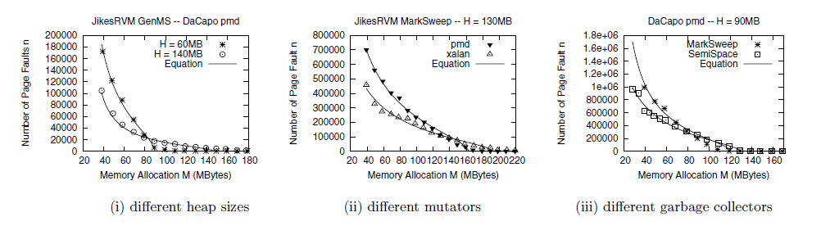
Equation applied to garbage-collected heap
reference pattern = mutator + garbage collector
depends on heap size H
Y.C. Tay and X.R. Zong.
A page fault equation for dynamic heap sizing. Proc. ICPE 2010

Slide 14
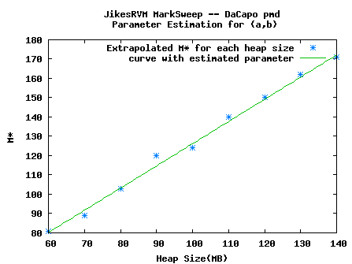
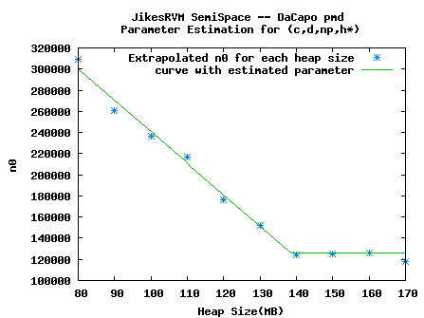
1
M* - M₀
#miss
= (K + √K ² – 4 )(n*+n₀) – n₀
where
K=
1 +
2
M - M₀
top-down modeling:
express parameters n*, n₀ , M*, M₀ in terms of
application-specific parameters
Example:
garbage-collected (GC) heap
H = heap size, M* = aH+b
H = heap size, M* = aH+b, n₀= cH+d
H = heap size
Y.C. Tay, X.R. Zong and X. He.
An equation-based heap sizing rule. Performance Evaluation 70, 11 (Nov. 2013).

Slide 15
1
M* - M₀
#miss
= (K + √K ² – 4 )(n*+n₀) – n₀
where
K=
1 +
2
M - M₀
top-down modeling:
express parameters n*, n₀ , M*, M₀ in terms of
application-specific parameters
Example:
garbage-collected (GC) heap
H = heap size, M* = aH+b, n₀= cH+d
GC type
#GC limit
GC space overhead
freelist usage
1
#miss
= (K + √K ² – 4 )(n*+ (cH+d)) – (cH+d )
2
(aH+b ) - M₀
where
K=
1 +
M - M₀
Y.C. Tay, X.R. Zong and X. He.
An equation-based heap sizing rule. Performance Evaluation 70, 11 (Nov. 2013).

Slide 16
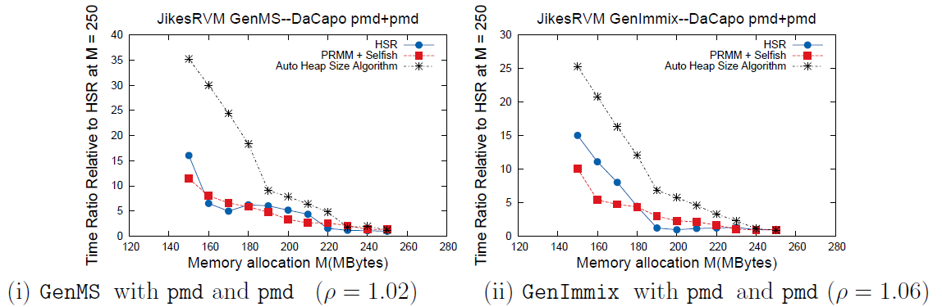
Equation applied to garbage-collected heap
JikesRVM’s dynamic heap sizing policy
Poor Richard’s Memory Manager
(paging-aware, process detects
memory pressure and initiates GC)
Heap Sizing Rule
(adjust heap size
only at GC)
HSR runtime
PRMM runtime

Slide 17
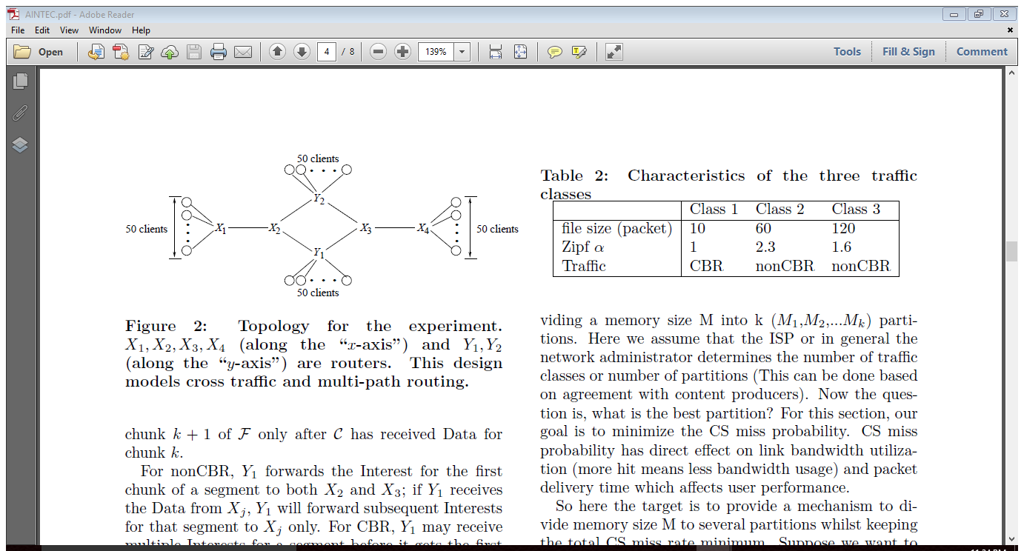
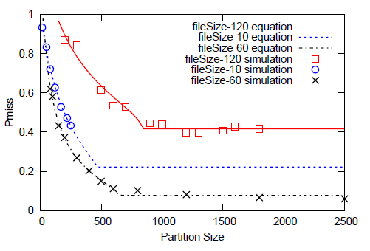
Equation applied to content-centric networking (NDN)
packets addressed by contents (not source location)
routers act as caches for packets
M. Rezazad and Y.C. Tay. A cache miss equation for partitioning an NDN content store.
Proc. Asian Internet Engineering Conference 2013.

Slide 18
1
M* - M₀
#miss
= (K + √K ² – 4 )(n*+n₀) – n₀
where
K=
1 +
2
M - M₀
one equation to rule them all:
references
equation1
Level1
misses
equation ?
equation2
Level2
misses
Level3

Slide 19








1
M* - M₀
#miss
= (K + √K ² – 4 )(n*+n₀) – n₀
where
K=
1 +
2
M - M₀
one equation to rule them all:
references
$$P_{1}=f\left(M_{1}\right|M_{1}^{∗}, M_{10},P_{1}^{∗},P_{10})$$
Level1
misses
$$P_{a}=f\left(M_{a}\right|M_{a}^{∗}, M_{a0},P_{a}^{∗},P_{a0})$$
$$P_{2}=f\left(M_{2}\right|M_{2}^{∗}, M_{20},P_{2}^{∗},P_{20})$$
Level2
misses
$$M_{a}=M_{1}^{}+M_{2}$$
Level3
$$M_{a}^{∗}={M_{1}+M}_{2}^{∗}$$
$$P_{a}^{∗}=P_{1}P_{2}^{∗}$$
$P_{a0}=P_{1}$ $P_{20}$
$$M_{a0}=M_{20}−M_{1}$$
Venkatesan, Tay, Zhang and Wei, A 3-level cache miss model for a nonvolatile extension to transcendent memory, Proc. CloudCom 2014

Slide 20
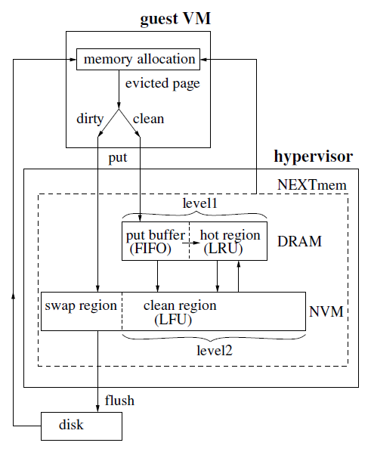





1
M* - M₀
#miss
= (K + √K ² – 4 )(n*+n₀) – n₀
where
K=
1 +
2
M - M₀
one equation to rule them all:
references
$$P_{1}=f\left(M_{1}\right|M_{1}^{∗}, M_{10},P_{1}^{∗},P_{10})$$
Level1
misses
$$P_{a}=f\left(M_{a}\right|M_{a}^{∗}, M_{a0},P_{a}^{∗},P_{a0})$$
$$P_{2}=f\left(M_{2}\right|M_{2}^{∗}, M_{20},P_{2}^{∗},P_{20})$$
Level2
misses
$$M_{a}=M_{1}^{}+M_{2}$$
Level3
$$M_{a}^{∗}={M_{1}+M}_{2}^{∗}$$
$$P_{a}^{∗}=P_{1}P_{2}^{∗}$$
transcendent memory
$P_{a0}=P_{1}$ $P_{20}$
cache shared by VMs,
managed by hypervisor
$$M_{a0}=M_{20}−M_{1}$$
Level1
Aggregated Level
Level2
Level3

Slide 21
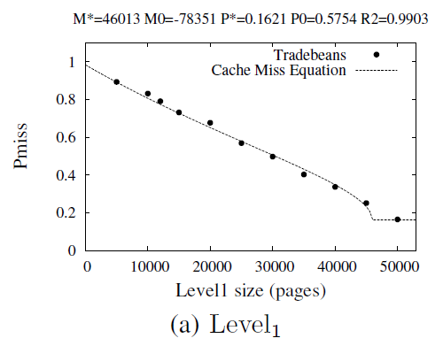
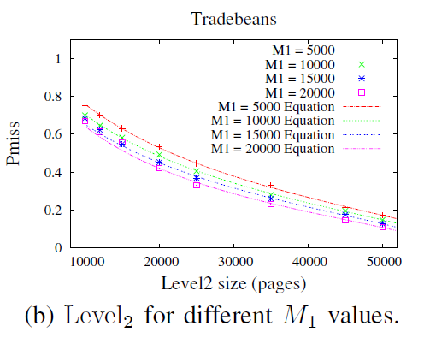
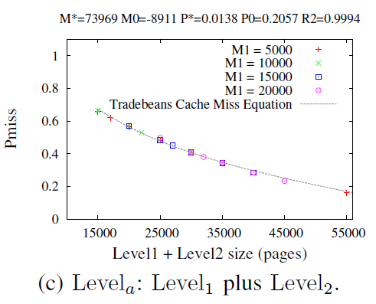




1
M* - M₀
#miss
= (K + √K ² – 4 )(n*+n₀) – n₀
where
K=
1 +
2
M - M₀
one equation to rule them all:
references
$$P_{1}=f\left(M_{1}\right|M_{1}^{∗}, M_{10},P_{1}^{∗},P_{10})$$
Level1
misses
$$P_{a}=f\left(M_{a}\right|M_{a}^{∗}, M_{a0},P_{a}^{∗},P_{a0})$$
$$P_{2}=f\left(M_{2}\right|M_{2}^{∗}, M_{20},P_{2}^{∗},P_{20})$$
Level2
$$M_{a}=M_{1}^{}+M_{2}$$
misses
$$M_{a}^{∗}={M_{1}+M}_{2}^{∗}$$
Level3
$$P_{a}^{∗}=P_{1}P_{2}^{∗}$$
transcendent memory
$P_{a0}=P_{1}$ $P_{20}$
$$M_{a0}=M_{20}−M_{1}$$

Slide 22
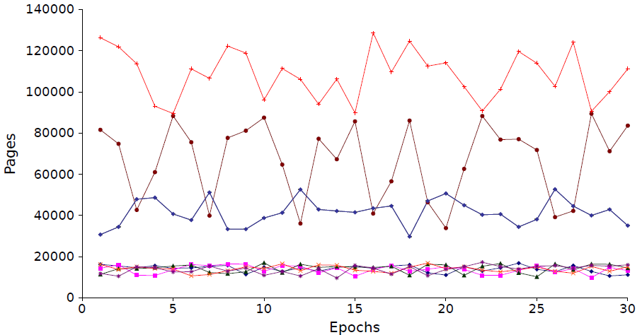
Application:
2-level dynamic allocation among VMs
Level1 (overcommitted): fair allocation for VM1, ..., VM5
Level1+ Level2 (SLO): Prob(latency > T_{max} ) < p_{max} for VM1, VM2
Level2 allocation for VM1
Level2 allocation for VM2
Level2 allocation for VM3,VM4,VM5
Level1 allocation for VM1,...,VM5
references
Level1
fair
misses
latency
Level2
misses
Level3

Slide 23
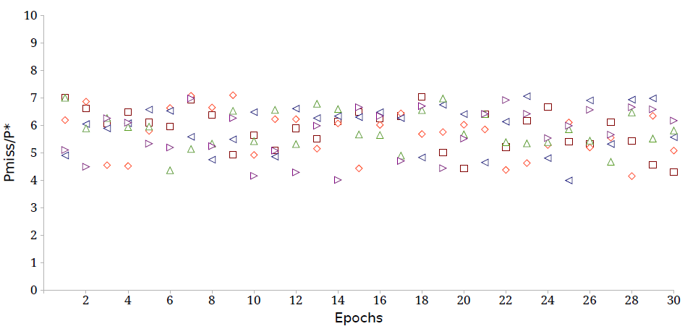
Application:
2-level dynamic allocation among VMs
Level1 (overcommitted): fair allocation for VM1, ..., VM5
Level1+ Level2 (SLO): Prob(latency > T_{max} ) < p_{max} for VM1, VM2
Level1 miss probabilities for VM1, ..., VM5
(Jain's fairness index: 0.96 to 0.99)
references
Level1
fair
misses
latency
Level2
misses
Level3

Slide 24
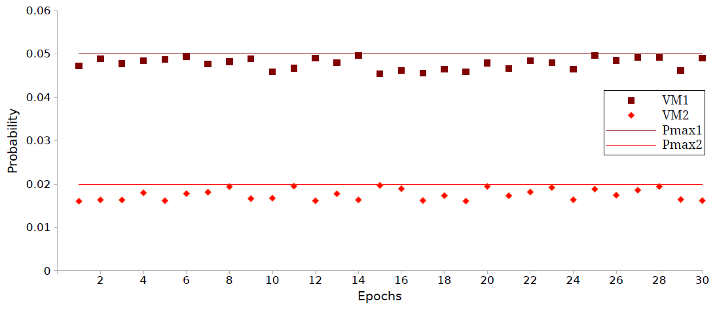
Application:
2-level dynamic allocation among VMs
Level1 (overcommitted): fair allocation for VM1, ..., VM5
Level1+ Level2 (SLO): Prob(latency > T_{max} ) < p_{max} for VM1, VM2
Level1 miss probabilities for VM1, ..., VM5
(Jain's fairness index: 0.96 to 0.99)
VM2 SLO
VM1 SLO

Slide 25
Current Work
(1) a tree of caches (content distribution, ISP router topology, ...)
use the equation to analyze relationship among miss rates
(2) replacement policies that balance recency and frequency
(ARC, LIRS, CAR, ...)
use the equation to analyze the balance
One Equation To Rule Them All!
1
M* - M₀
#miss
= (K + √K² – 4 )(n*+n₀) – n₀
where
K=
1 +
2
M - M₀

Slide 26
A Universal Cache Miss Equation
for the Memory Hierarchy
Y.C. Tay
National University of Singapore
in collaboration with:
Max Min Zou, Dinh Nguyen Tran, Phung Chinh Huynh, Xuanran Zong, Xi He,
Vimalraj Venkatesan, M. Rezazad

Slide 27
Case: processor cache
set-associative (2-dimensional)
SPEC CPU2000 benchmarks:
perlbmk
facerec
M.S. Haque and Q. Wei, Lachesis: Fast Endurance and Performance Evaluation Tool
for Non-Volatile Processor Cache Design Space Exploration, Design Automation Conf. 2014.

Slide 28
Current Work
a network of caches (Named Data Networking)
clients
C₅
source
C₁
C₆
P ^{miss}
C₃
= Prob(client retrieves from source)
C₂
C₄
= f (C₁, ... C₆ )
router
link
= ?

Slide 29
A Universal Cache Miss Equation
for the Memory Hierarchy
Y.C. Tay
National University of Singapore
in collaboration with:
Max Min Zou, Dinh Nguyen Tran, Phung Chinh Huynh, Xuanran Zong, Xi He,
Vimalraj Venkatesan, M. Rezazad

Slide 30
#miss
Cache Miss Equation:
M
Prob(miss) = f (cache size)
everywhere in the
memory hierarchy:
still an issue:
processor cache,
memory allocation,
RAM,
virtualization,
database buffer,
multicore,
SSD cache,
real estate,
content-centric networking,
energy consumption,
etc.
etc.

Slide 31
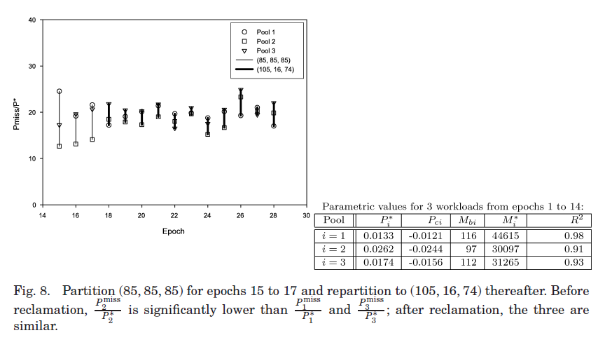
Equation applied to database buffer
D.N. Tran, P.C. Huynh, Y.C. Tay and A.K.H. Tung.
A new approach to dynamic self-tuning of database buffers. ACM Transactions. on Storage 2008

Slide 32
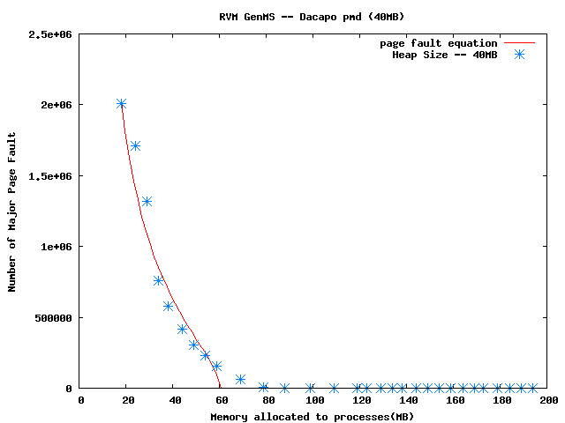
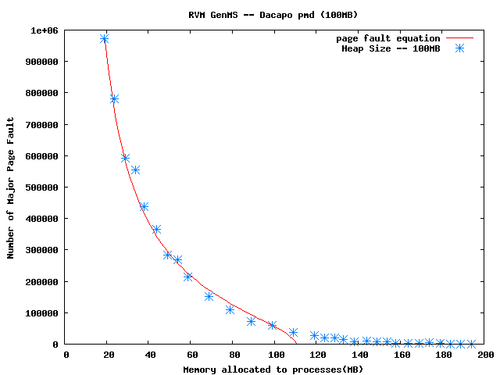
1
M* - M₀
#miss
= (K + √K ² – 4 )(n*+n₀) – n₀
where
K=
1 +
2
M - M₀
Research Program Proposal:
focus expertise on top-down modeling
to derive one
parameterized miss equation
for each cache type
Example:
type = garbage-collected heap
H = heap size, workload = RVM GenMS + Dacapo pmd
H = 40MB:
H = 100MB:

Slide 33
1
M* - M₀
#miss
= (K + √K ² – 4 )(n*+n₀) – n₀
where
K=
1 +
2
M - M₀
Research Program Proposal:
focus expertise on top-down modeling
to derive one
parameterized miss equation
for each cache type
Example:
type = garbage-collected heap
H = heap size, M* = aH+b, n₀= cH+d
1
#miss
= (K + √K ² – 4 )(n*+ (cH+d)) – (cH+d )
2
(aH+b ) - M₀
where
K=
1 +
M - M₀
Y.C. Tay, X.R. Zong and X. He.
An equation-based heap sizing rule. Performance Evaluation 70, 11 (Nov. 2013).

Slide 34
Application: memory sizing with M*
power down idle memory
to save battery (mobile devices) or
to save money (large data centers)
[Lefurgy et al., Energy management for commercial servers,
IEEE Computer (2003) ]
measure
P ^{miss}
fit with
equation
M > M*
excess memory
power down

Slide 35
Application: database buffer tuning
Oracle: Autonomic Database Diagnostic Monitor
[Dias et al., Autonomic performance diagnostic and tuning in Oracle,
CIDR (2005)]
SQL Server: Resource Advisor
[Narayanan et al., Continuous resource monitoring in self-predicting DBMS,
MASCOTS (2005)]
DB2: Self-Tuning Memory Manager
[Storm et al., Adaptive self-tuning memory in DB2,
VLDB (2006)]
all 3 tools use simulation to predict #IOs for bigger/smaller buffer
hard to change
if buffer in a black box,
simulation code
then no trace of hits,
so simulation not possible.
alternative: use equation to extrapolate #miss

Slide 36
Summary
Bottom-up analysis: not scalable
Universality: feasible
Research Program Proposal:
focus expertise on top-down modeling
to derive one
parameterized miss equation
for each cache type
One Equation To Rule Them All!
http://www.comp.nus.edu.sg/~tayyc/ResearchProgram.pptx

