Slide 1

Back-test for some trading strategies
Group Members:
YINRUI ZHAO YU YANG SHUANG LI WEIBO PENG
Website : https://github.com/bpp11144444/backtest

Slide 2
Outline
Three different trading strategies depend on technical analysis indicators
Some indicators to assess the quality of the strategy
Result and Analysis

Slide 3
Moving Average
Moving average is the average of the closing price of a security over a specified number of periods.
For instance，MA(20) is the average stock price of last 20 days
Moving averages smooth out short-term price fluctuations, giving the technician a clearer image of market trend.

Slide 4
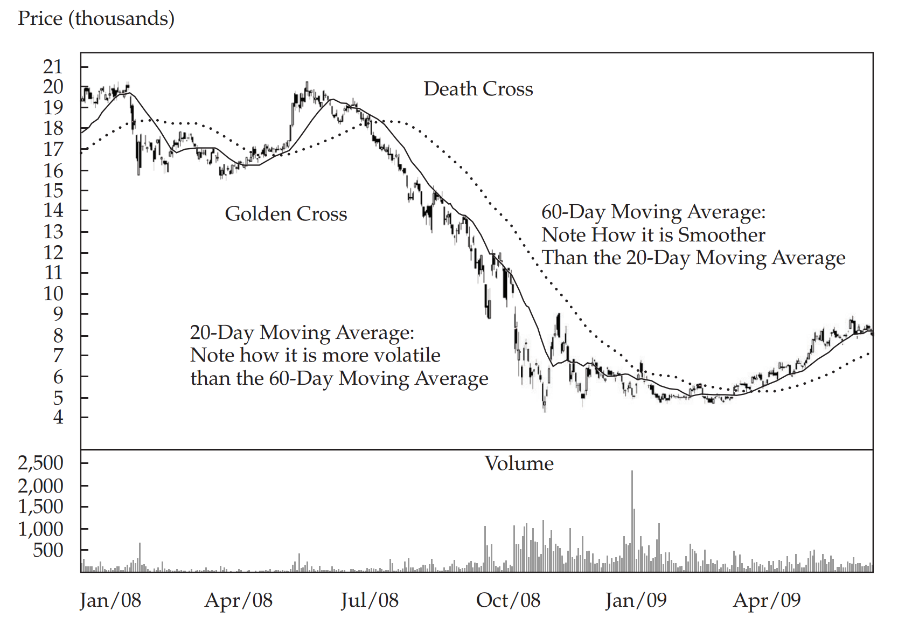
Moving Average
Investors often use moving- average crossovers as a buy or sell signal.
Golden cross : when a short- term moving average crosses from underneath a longer- term average, this movement is considered bullish
Death cross: when a short- term moving average crosses from above a longer- term moving average, this movement is considered bearish
We need TWO parameters :
fast period MA and slow period MA

Slide 5
Bollinger bands
Bollinger Bands consist of a moving average plus a higher line representing the moving average plus a set number of standard deviations from average price (for the same number of periods as used to calculate the moving average) and a lower line that is a moving average minus the same number of standard deviations.
Upper bands = Moving average (n) + 2σ
Middle line = Moving average (n)
Lower bands = Moving average (n) - 2σ

Slide 6
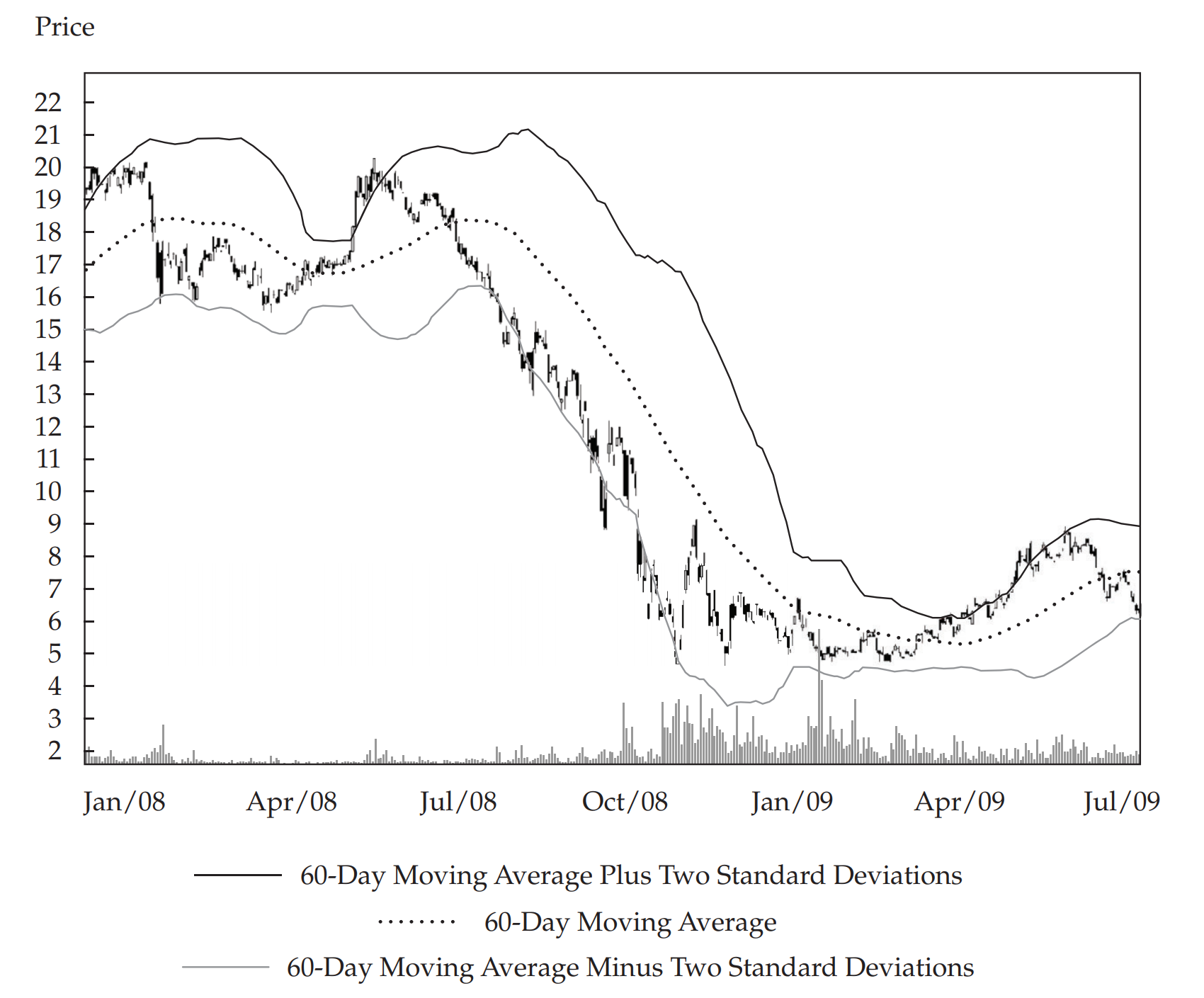
Bollinger bands
Investor sells when a security price reaches the upper band
Investor buys when a security price reaches the lower band.
This strategy assumes that the security price will stay within the bands
We need ONE parameter :
MA period

Slide 7
Moving Average Convergence / Divergence
The MACD is the difference between a short-term and a long-term moving average of the security’s price, and it is constructed by calculating two lines, the MACD line and the signal line:
MACD line: difference between two exponentially smoothed moving averages(EMA), generally 12 and 26 days.
Signal line: exponentially smoothed average of MACD line, generally 9 days.
DIFF=EMA(close,12)-EMA(close,26) | close for using close price
Signal line=EMA(DIFF,9)

Slide 8
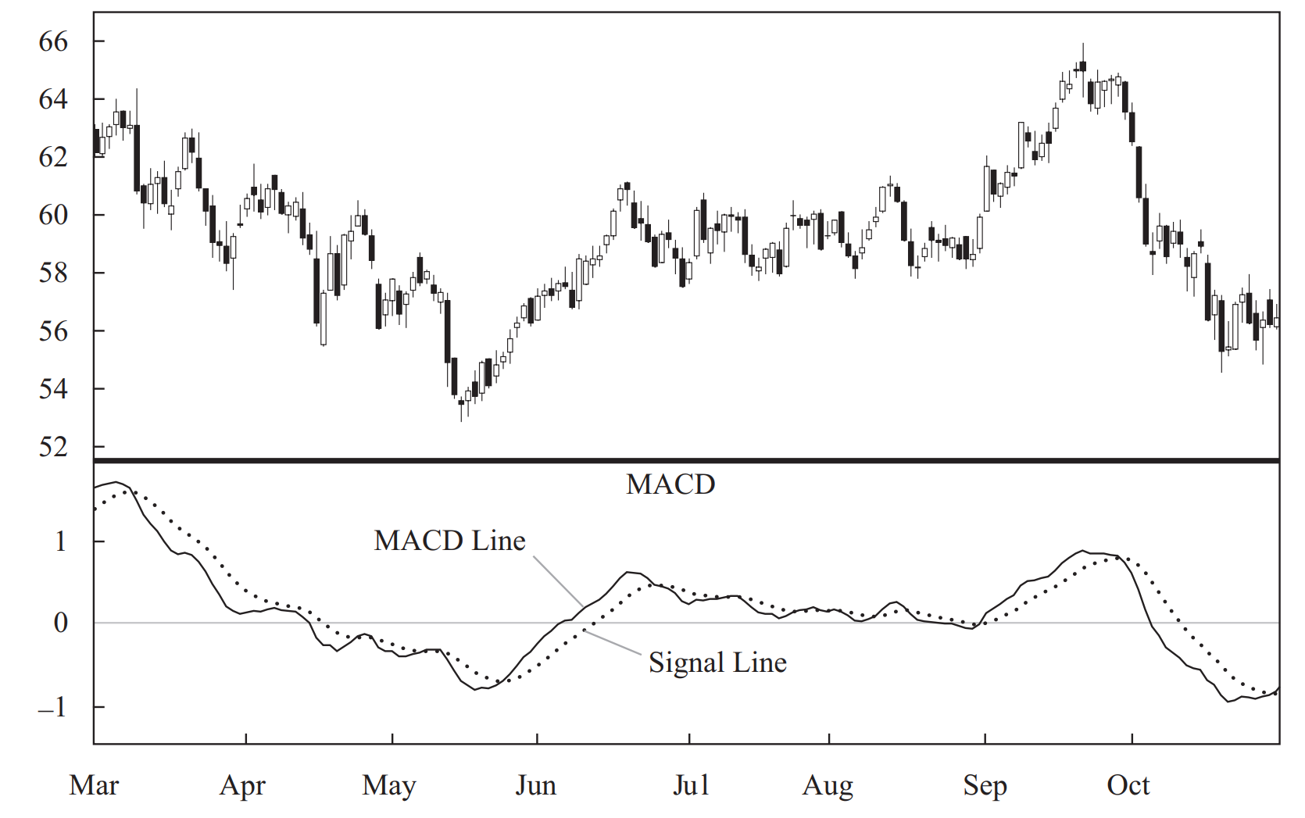
Moving Average Convergence / Divergence
MACD golden cross: DIFF breaks DEA from bottom to top, which is a buy signal.
MACD dead cross: DIFF breaks DEA from top to bottom, which is a sell signal.
We need THREE parameter :
Fast period EMA
Slow period EMA
Signal line period

Slide 9
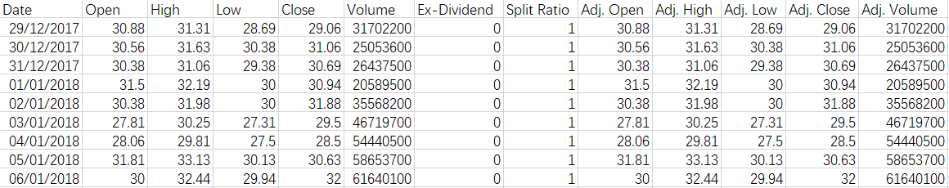
Data we use

Slide 10
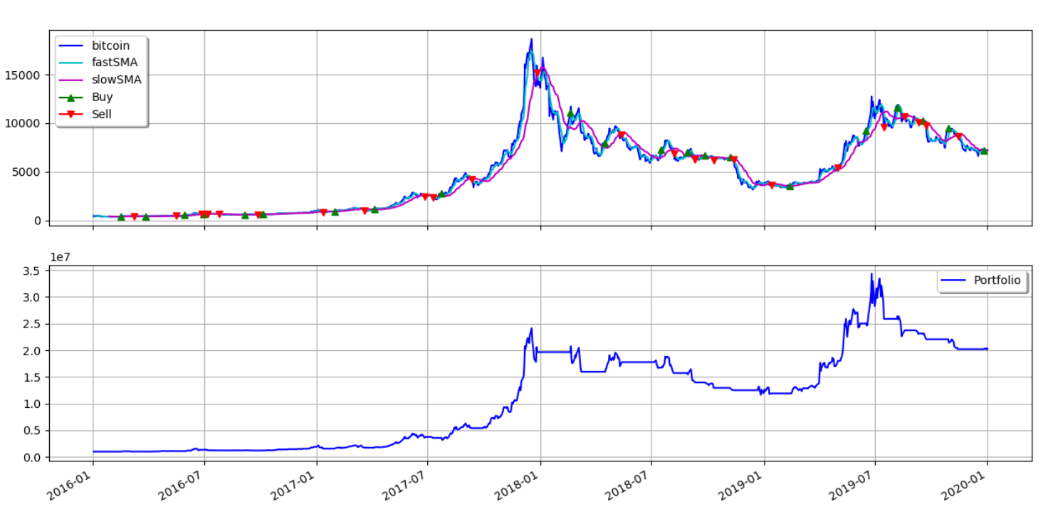
Some result for these strategies
Bitcoin-MA(5,20)

Slide 11
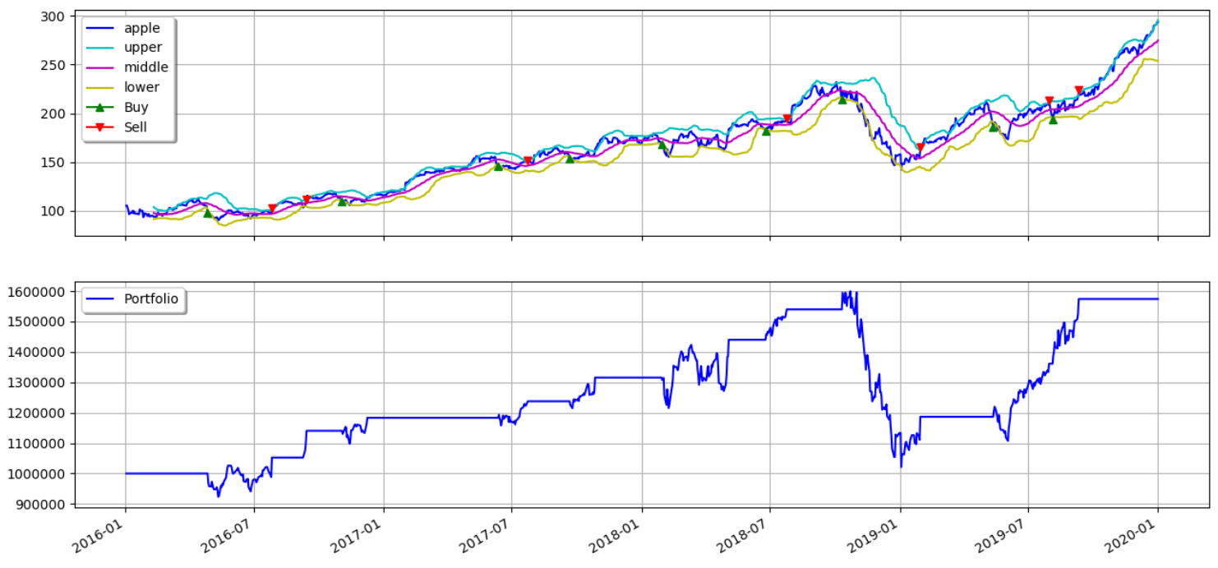
Some result for these strategies
Apple-Boll(30)

Slide 12
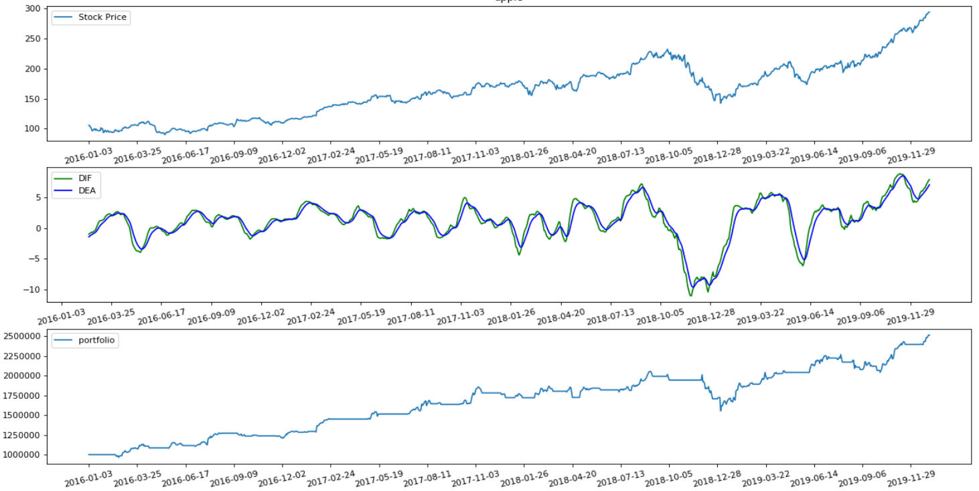
Some result for these strategies
Apple-MACD(12,26,9)

Slide 13
Outline
Three different trading strategies depend on technical analysis indicators
Some indicators to assess the quality of the strategy
Result and Analysis

Slide 14
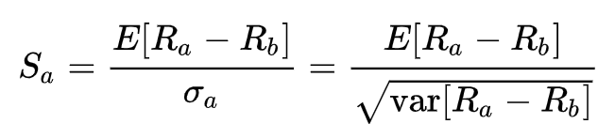
Sharpe Ratio
In finance, the Sharpe ratio measures the performance of an compared to a risk-free asset, after adjusting for its risk.
It is defined as the difference between the returns of the investment and the risk-free return, divided by the standard deviation of the investment (i.e., its volatility).
It represents the additional amount of return that an investor receives per unit of increase in risk.

Slide 15
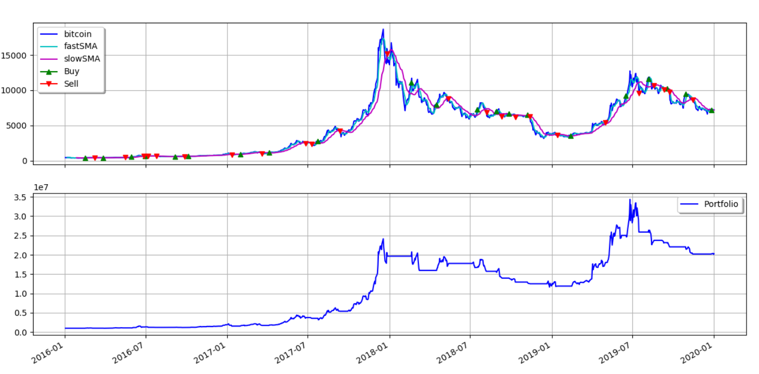
Deepest Drawdown
The drawdown is the measure of the decline from a historical peak in some variable (typically the cumulative profit or total open equity of a financial trading strategy). The largest drawdown is the largest one of these drawdowns.
Deepest drawdown

Slide 16
Longest Drawdown Duration
The longest drawdown duration is the length of any peak to peak period, or the time between new equity highs. The longest drawdown duration is the worst amount of time an investment has seen between peaks (equity highs).
Longest Drawdown Duration

Slide 17
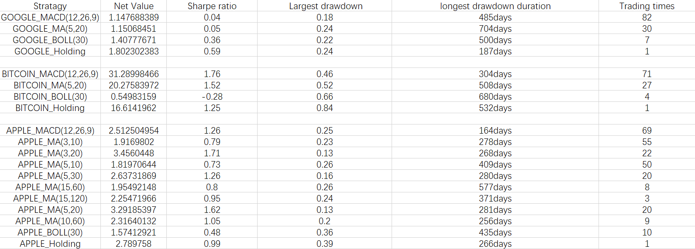
All indicators we need
Large
Large
Small
Small
Small

Slide 18
Outline
Three different trading strategies depend on technical analysis indicators
Some indicators to assess the quality of the strategy
Result and Analysis

Slide 19
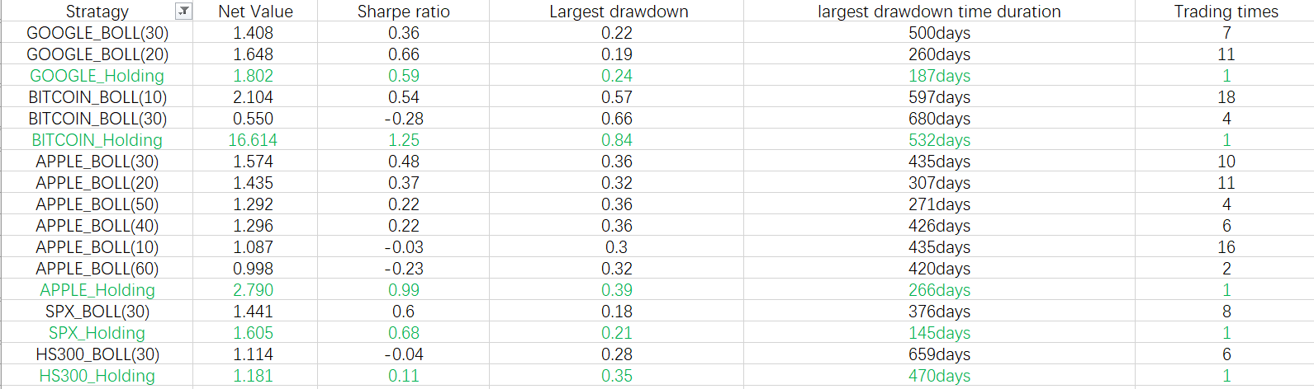
Result and Analysis
Our BOLL trading strategy is useless for all these stocks and Bitcoin.

Slide 20
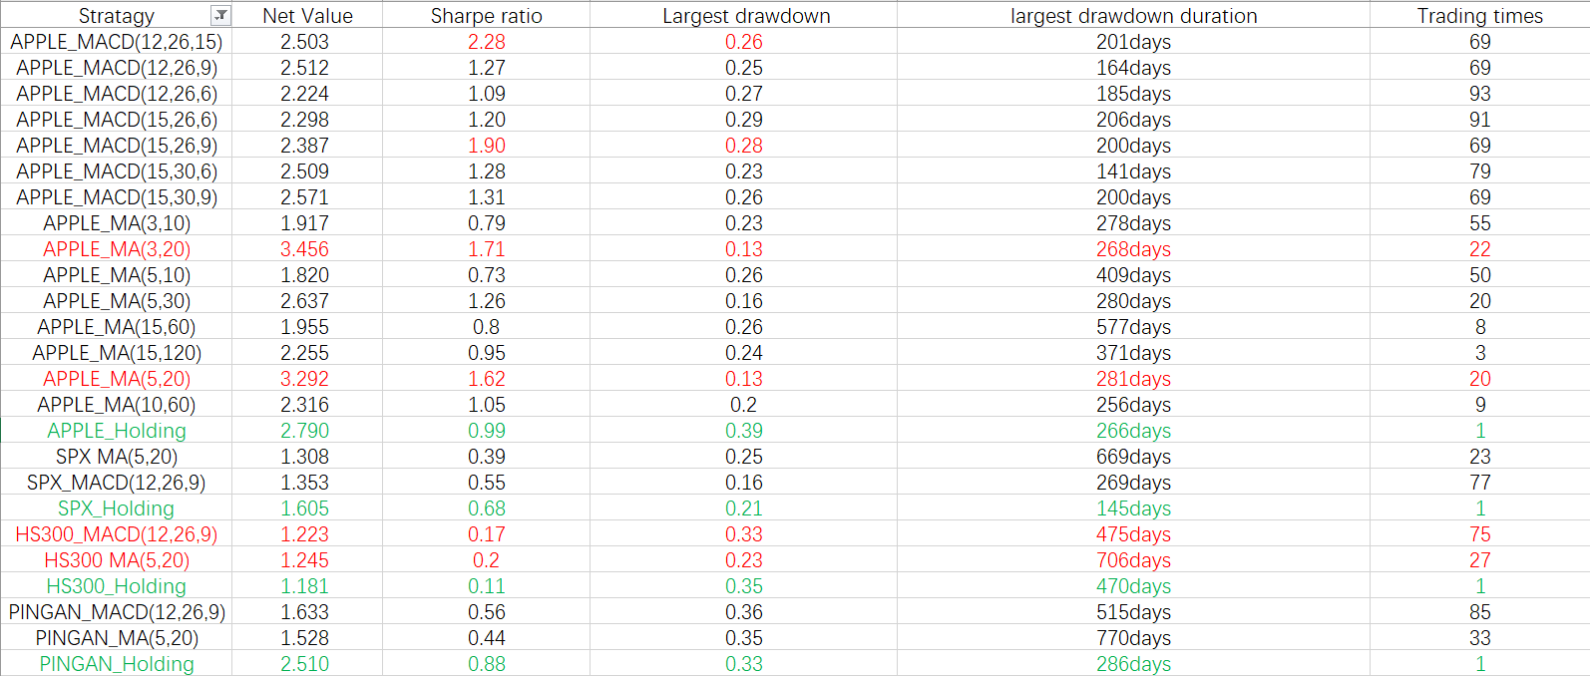
Result and Analysis
Our MA/MACD trading strategies are slightly useful for trading stocks

Slide 21
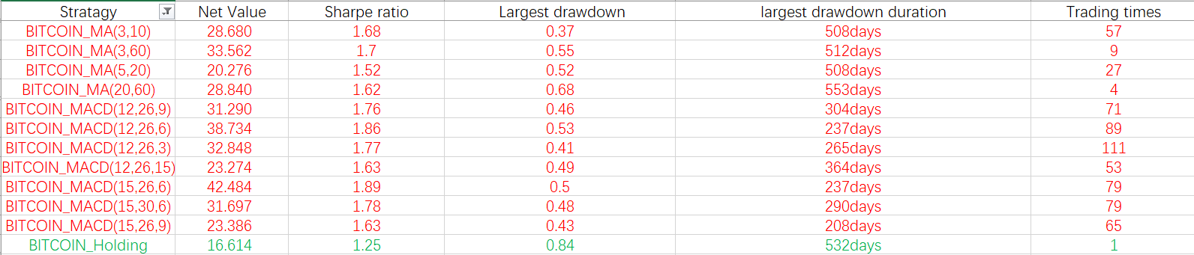
Result and Analysis
MA/MACD trading strategies performed vary well in trading Bitcoin!
Probably because Crypto-currency market is not yet a mature market

