Slide 1
Evolving Optimal Technical Stock Market Indicators Through Use of Multi-Objective Genetic Algorithms
Presentation by Farhan Hormasji and Bonnie Reiff CSE 848: Suvery of Evolutionary Computation
Fall 2015

Slide 2
Agenda
The Jigsaw Puzzle Problem and Applications
Previous work
State of solvers at the time of publishing
The Genetic Algorithm
Chromosome representation
Chromosome fitness
Crossover operation
Results and Critique
Results of the genetic algorithm-based solver
Limitations of the solution

Slide 3

The Problem
Determine the optimal parameters to buy/sell stock market indicators to maximize profit and minimize risk
Notes:
Image source: http://faganasset.com/wp-content/uploads/2015/04/stock-market-3.jpg

Slide 4
Multi-Objective Optimization Background

Slide 5
Terminology [1]
Pareto-optimal (non-dominated) solutions: “a set of solutions which are superior to the rest of the solutions in the search space when all objectives are considered but inferior to other solutions in the space in one or more objectives”
For p-dimensional vectors x₁ and x₂ (in a minimization problem), x₁ dominates x₂ when no value of x₁ is less than the corresponding dimension in x₂ and at least one value of x₁ is strictly less than its corresponding dimension in x₂

Slide 6
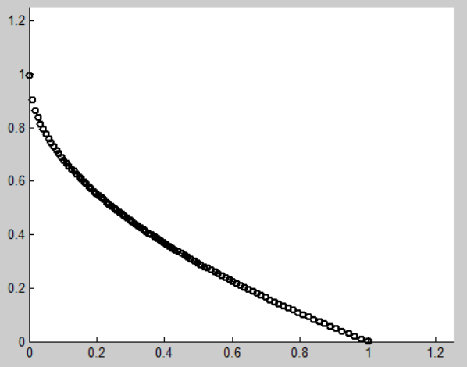
Why Use Multi-Objective Algorithms? [1]
Existence of conflicting objectives
Single-objective formulation of multiple constraints is very sensitive to weights
Single-point solution does not allow for different alternatives to give to expert decision makers
Notes:
If the objectives are not conflicting, then the multiple-objectives should be combined into a single objective (i.e. by summing them)

Slide 7
NSGA and NSGA-II
TODO

Slide 8
NSGA-III
TODO

Slide 9
U-NSGA-III
TODO

Slide 10
Indicators and Objectives

Slide 11
Indicators [2]
EMA: Exponential Moving Average
DEMAC (Double Exponential Moving Average Crossover)
MACD (Moving Average Convergence/Divergence)

Slide 12
Indicators (con’t)
RSI (Relative Strength Index)
MARSI (Moving Average Relative Strength Index)

Slide 13
Objective Functions
Maximizing Profit: Annual Return
Maximizing Return on Risk: Sharpe Ratio
Notes:
Mention that in the code, both of these had to be turned into minimizations by multiplying the objective by -1

Slide 14
Chromosome and Constraints
Indicator | Parameter | Minimum | Maximum | Standard Value
DEMAC | Short Lookback | 1 | 100 | 20
DEMAC | Long Lookback | 1 | 200 | 50
MACD | Short Lookback | 3 | 100 | 12
MACD | Long Lookback | 3 | 100 | 26
MACD | Signal Lookback | 1 | 100 | 9
RSI | Lookback | 3 | 100 | 14
RSI | Lower Boundary | 10 | 40 | 30
RSI | Upper Boundary | 60 | 90 | 70
MARSI | RSI Lookback | 3 | 100 | N/A
MARSI | Lower Boundary | 10 | 40 | N/A
MARSI | Upper Boundary | 60 | 90 | N/A
MARSI | Average Lookback | 1 | 100 | N/A
DEMAC | Voting Weight | 0 | 1 | -
MACD | Voting Weight | 0 | 1 | -
RSI | Voting Weight | 0 | 1 | -
MARSI | Voting Weight | 0 | 1 | -
Notes:
All parameters evolved as real-valued numbers (any parameters that need to be integers are rounded in the code)

Slide 15
Secondary Constraints
DEMAC: EMA_{short} < EMA_{long}
MACD: Signal < EMA_{short} < EMA_{long}
0 ≤ w_{DEMAC} + w_{MACD} + w_{RSI} + w_{MARSI} ≤ 1
Notes:
Implemented in the code in the form 0 ≤ Constraint

Slide 16
U-NSGA-III parameters
Parameter | Value
Number of Generations | 200
Population Size | 800
Number of Steps | 799
Real Crossover Probability | 0.80
Real Mutation Probability | 0.05

Slide 17
Results

Slide 18
Average Results over __ Runs
Objective | Avg. Minimum | Avg. Maximum | Avg. Average
Annual Return
Sharpe Ratio
Notes:
TODO Here: Average Fitness per Generation Graph
Other statistics: overall minimum and overall maximum of all runs

Slide 19
Average Final Population Values
Indicator | Parameter | Standard Value | Average Value | Minimum | Maximum
DEMAC | Short Lookback | 20
DEMAC | Long Lookback | 50
MACD | Short Lookback | 12
MACD | Long Lookback | 26
MACD | Signal Lookback | 9
RSI | Lookback | 14
RSI | Lower Boundary | 30
RSI | Upper Boundary | 70
MARSI | RSI Lookback | N/A
MARSI | Lower Boundary | N/A
MARSI | Upper Boundary | N/A
MARSI | Average Lookback | N/A
DEMAC | Voting Weight | -
MACD | Voting Weight | -
RSI | Voting Weight | -
MARSI | Voting Weight | -
Notes:
TODO Here: Average Fitness per Generation Graph
Other statistics: overall minimum and overall maximum of all runs

Slide 20
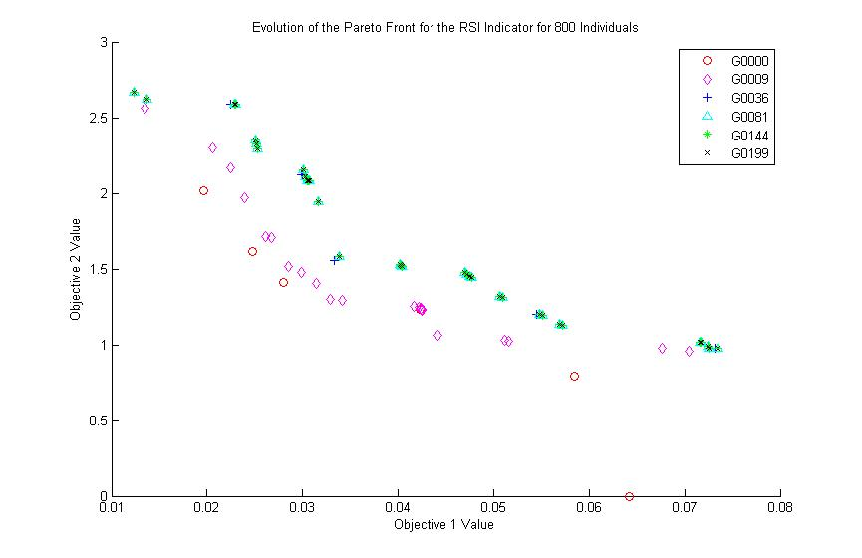
Search Space/Pareto Front Analysis
Notes:
TODO Here: Graphs of the evolution of the Pareto front for each of the individual objectives
Motivation: Pareto front graphs did not appear correct for a maximization problem

Slide 21
Comparison to Buy & Hold Strategy
TODO

Slide 22
Limitations of the Solution
Evolution of integer values using real-valued paramters

Slide 23
Future Work
Hypervolume calculations for run comparison (WHAT DOES THIS SHOW AGAIN??)
Requires ideal and reference points
Run with the GA on a second dataset to determine dependence of the results on the dataset
Answers the question of how broadly the results can be applied
Research alternative objective functions to use in place of Annual Return and Sharpe Ratio

Slide 24
Questions?

Slide 25
References
[1] N. Srinivas and K. Deb. Multiobjective Optimization Using Nondominated Sorting in Genetic Algorithms.
[2] M.B. Fayek, H.M. El-Boghdadi, and S.M. Omran. Multi-Objective Optimization of Technical Stock Market Indicators using GAs.

Slide 26
References (con’t)
[5]

