Slide 1
Evolving Optimal Technical Stock Market Indicators Through Use of Multi-Objective Genetic Algorithms
Presentation by Farhan Hormasji and Bonnie Reiff
7 December 2015 CSE 848 Fall 2015: Survey of Evolutionary Computation

Slide 2
Agenda
The Problem
Multi-Objective Optimization Background (evolution of U-NSGA-III)
Indicators and Objectives
U-NSGA-III Setup
Genetic Algorithm
Buy/Sell Simulation
Results
Discussion
Limitiations
Conclusions
Future Work

Slide 3

The Problem
Determine the optimal parameters to buy/sell stock market indicators to maximize profit and minimize risk
Notes:
Image source: http://faganasset.com/wp-content/uploads/2015/04/stock-market-3.jpg
Problem motivated by previous work in this area done using an outdated Multi-objective Genetic Algorithm (VEGA). Students tasked themselves with implementing the work done in U-NSGA-III, comparing to the results provided in the paper, and improving upon the work by performing more analysis and adding another objective function.

Slide 4
Multi-Objective Optimization Background

Slide 5
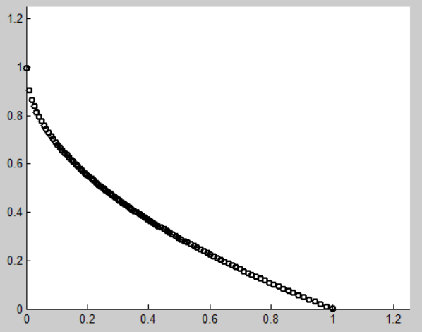
Why Use Multi-Objective Algorithms? [6]
Existence of conflicting objectives
Single-objective formulation of multiple constraints is very sensitive to weights
Single-point solution does not allow for different alternatives to give to expert decision makers
Notes:
If the objectives are not conflicting, then the multiple-objectives should be combined into a single objective (i.e. by summing them)

Slide 6
NSGA-II
NSGA-II is a multi-objective genetic algorithm based on non-dominated sorting that does not require maintaining solution diversity and can account for multiple constraints
One of the limitations of NSGA-II is its decreased performance in handling problems of 4 or more objectives
As the number of objectives go up, it becomes more likely that more solutions become non-dominated, which leads to less convergence to a Pareto front
Notes:
Pareto-optimal (non-dominated) solutions: “a set of solutions which are superior to the rest of the solutions in the search space when all objectives are considered but inferior to other solutions in the space in one or more objectives”
For p-dimensional vectors x₁ and x₂ (in a minimization problem), x₁ dominates x₂ when no value of x₁ is less than the corresponding dimension in x₂ and at least one value of x₁ is strictly less than its corresponding dimension in x₂
Two distinguishing features of the Diversity Preservation in the algorithm: (1) Density Estimation, (2) Crowded-Comparison Operator

Slide 7
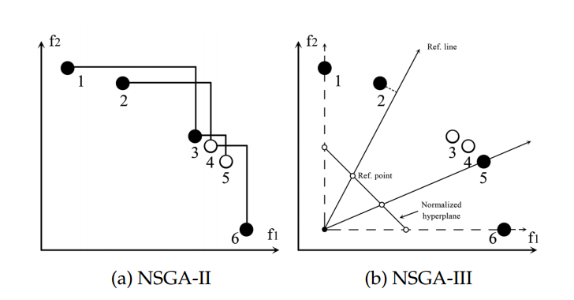
U-NSGA-III
Reference points throughout search space to maintain diversity
U-NSGA-III makes it easier to go from a mono- to many-objective problem by making the niching and normalization operators automatically defunct for mono- objective problems and active for multi- and many-objective problems
Notes:
Different selection operator (niching based)
Ideal points used to normalize search space
Extra selection operator details:
If the two solutions come from two different associated reference points, one is chosen at random
If they belong to the same niche/reference direction and same non-dominated front, the one closer to the reference direction is chosen

Slide 8
Indicators and Objectives

Slide 9

Indicators [5]
EMA: Exponential Moving Average
$$EMA\left(i\right)=weight_{current} ∗price\left(i\right)+weight_{MA}∗EMA(i−1)$$
$$weight_{current}=\frac{2}{n+1}; weight_{MA}=1.0 −weight_{current}$$
Notes:
Motivation behind EMA: assgins a larger weight to the most recent day of the calculation (versus a simple average which has equal weights)

Slide 10
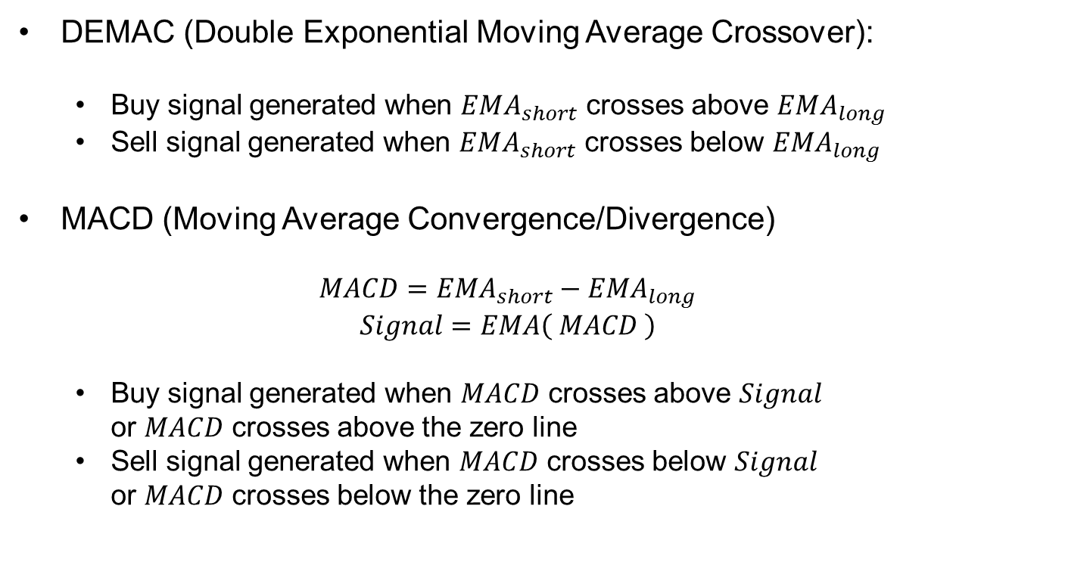
Indicators (con’t)
DEMAC (Double Exponential Moving Average Crossover):
Buy signal generated when $EMA_{short}$ crosses above $EMA_{long}$
Sell signal generated when $EMA_{short}$ crosses below $EMA_{long}$
MACD (Moving Average Convergence/Divergence)
$$MACD=EMA_{short}−EMA_{long}$$
$$Signal=EMA\left( MACD \right)$$
Buy signal generated when $MACD$ crosses above $Signal$ or $MACD$ crosses above the zero line
Sell signal generated when $MACD$ crosses below $Signal$ or $MACD$ crosses below the zero line

Slide 11
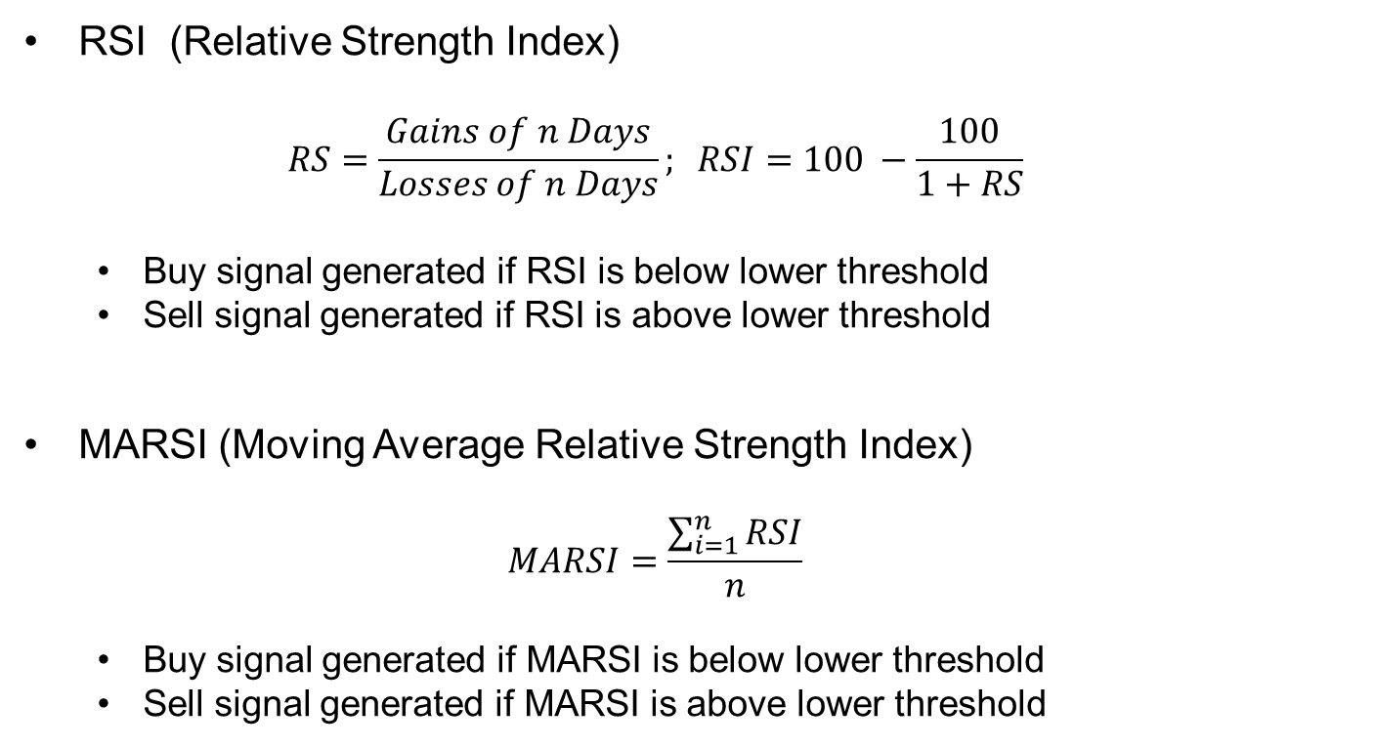
Indicators (con’t)
RSI (Relative Strength Index)
$$RS=\frac{Gains of n Days}{Losses of n Days}; RSI=100 −\frac{100}{1+RS}$$
Buy signal generated if RSI is below lower threshold
Sell signal generated if RSI is above lower threshold
MARSI (Moving Average Relative Strength Index)
$$MARSI=\frac{\sum_{i=1}^{n}{RSI}}{n}$$
Buy signal generated if MARSI is below lower threshold
Sell signal generated if MARSI is above lower threshold

Slide 12

Objective Functions
Maximizing Profit: Annual Return
$Annual Return=\left[{\left(\frac{return}{capital}\right)}^{\frac{1}{n}}−1\right]∗100$
Maximizing Return on Risk: Sharpe Ratio
$Sharpe Ratio=\frac{μ}{θ_{p}}$
Minimizing number of returns
Notes:
Mention that in the code, objectives 1 and 2 had to be turned into minimizations by multiplying the objective by -1

Slide 13
U-NSGA-III Setup
Notes:
Implementation details: using U-NSGA-III written in Java by Haitham Seada in collaboration with Professor Deb
Program allows anywhere between 1 and many objectives
Variables, constraints, parameters, and objective functions are all input via an XML file and an Evaluator class written for the specific problem
Data input done via the Apache Commons CSV Parser library

Slide 14
Chromosome and Constraints
Indicator | Parameter | Minimum | Maximum | Standard Value
DEMAC | Short Lookback | 1 | 100 | 20
DEMAC | Long Lookback | 1 | 200 | 50
MACD | Short Lookback | 3 | 100 | 12
MACD | Long Lookback | 3 | 100 | 26
MACD | Signal Lookback | 1 | 100 | 9
RSI | Lookback | 3 | 100 | 14
RSI | Lower Boundary | 10 | 40 | 30
RSI | Upper Boundary | 60 | 90 | 70
MARSI | RSI Lookback | 3 | 100 | 14
MARSI | Lower Boundary | 10 | 40 | 30
MARSI | Upper Boundary | 60 | 90 | 70
MARSI | Average Lookback | 1 | 100 | 14
Secondary Constraints:
DEMAC: EMA_{short} < EMA_{long}
MACD: Signal < EMA_{short} < EMA_{long}
Notes:
All parameters evolved as real-valued numbers (any parameters that need to be integers are rounded in the code)
Secondary constraints are implemented in the code in the form 0 ≤ Constraint

Slide 15
U-NSGA-III parameters
Parameter | Value
Number of Generations | 200
Population Size | 500
Number of Reference Points | 499
Real Crossover Probability | 0.80
Real Mutation Probability | 0.05
Number of Runs | 10
Notes:
These are the bi-objective parameters!
For three objective we tried:
25 structured reference points, population = 352
12 structured reference points, population = 92

Slide 16
Stock Data
Dow Jones Industrial Average data from Yahoo! Finance
Stock used: Apple Inc. (AAPL)
Dates: January 1, 1982 – January 1, 1985
Data contains Opening Price, High, Low, Closing Price, Volume, and Adjusted Closing Price for each trading day

Slide 17
Buy/Sell Implementation
Initial Wallet Size:
$20,000
Rules of the Buy/Sell simulation:
Cannot have consecutive buy or sell signals
Cannot buy stock unless wallet size > closing price
Indicators choose buy or sell based on majority rule
Store the return on each buy/sell transaction in an array

Slide 18
Results
Notes:
Implementation details: using U-NSGA-III written in Java by Haitham Seada in collaboration with Professor Deb
Program allows anywhere between 1 and many objectives
Variables, constraints, parameters, and objective functions are all input via an XML file and an Evaluator class written for the specific problem
Data input done via the Apache Commons CSV Parser library

Slide 19
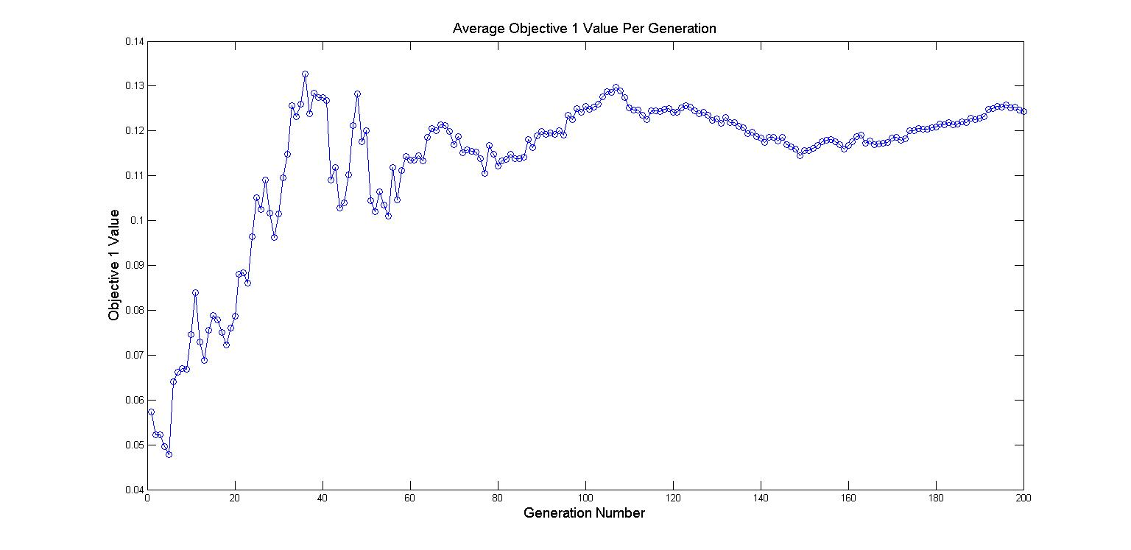
Bi-objective Results over 10 Runs
Notes:
Graph generated by taking the average objective value of all individuals in a particular generation over all runs

Slide 20
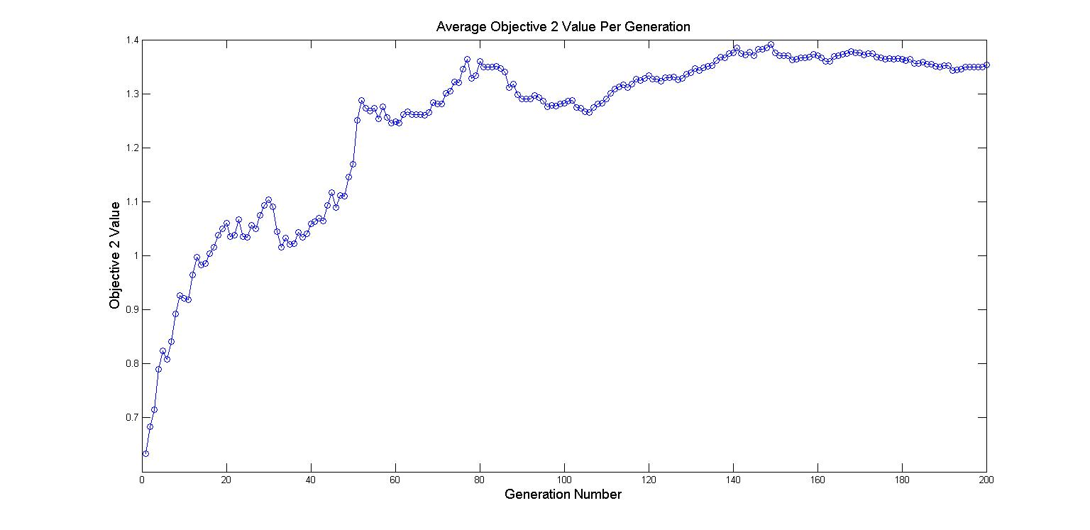
Bi-objective Results over 10 Runs
Notes:
Graph generated by taking the average objective value of all individuals in a particular generation over all runs

Slide 21
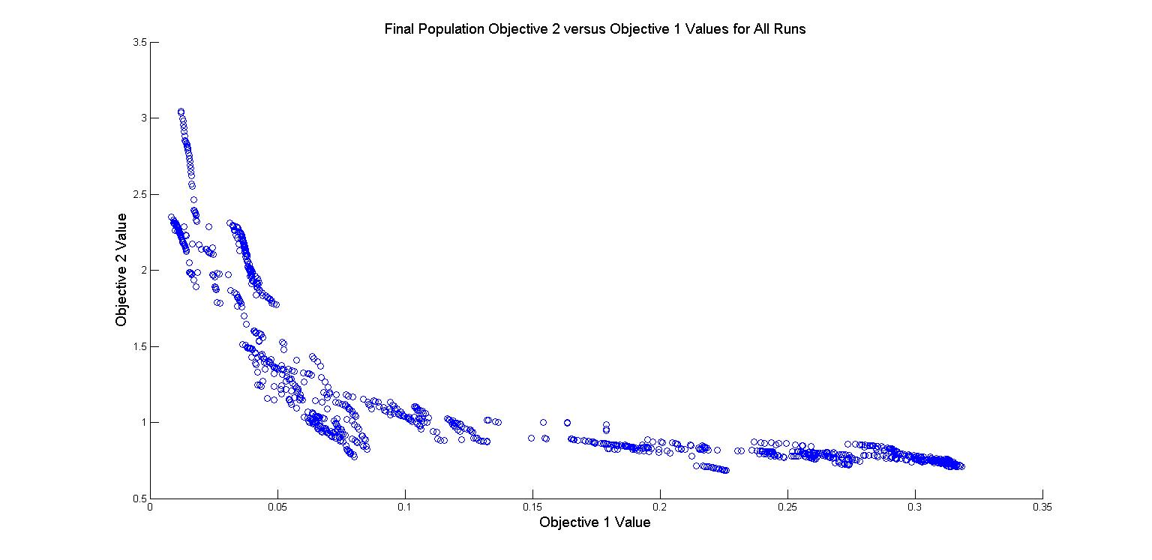
Bi-objective Results over 10 Runs
Objective | Average | Minimum | Maximum
Annual Return | 12.4389% | 0.8436% | 31.8321%
Sharpe Ratio | 1.3536 | 0.6838 | 3.0440
Notes:
Pareto Front: all individuals from every final population over 10 runs combined into one file and graphed (500 individuals * 10 runs = 5000 data points)
Question motivated by this graph: what does the search space look like and is the GA evolving towards a maximum for both objectives?

Slide 22
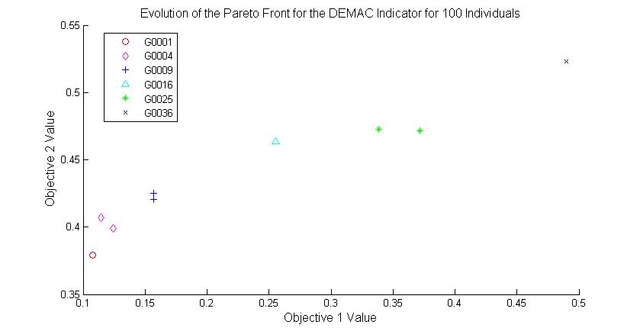
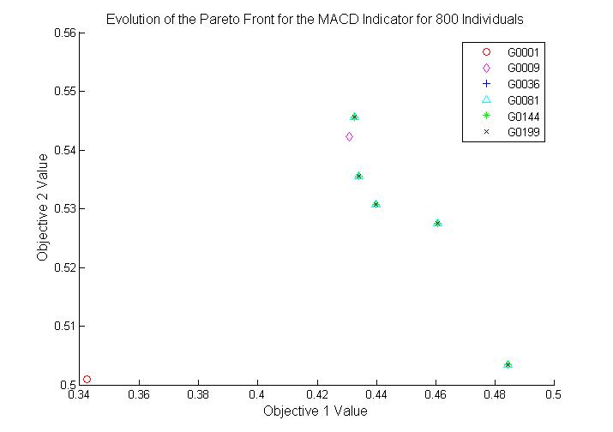
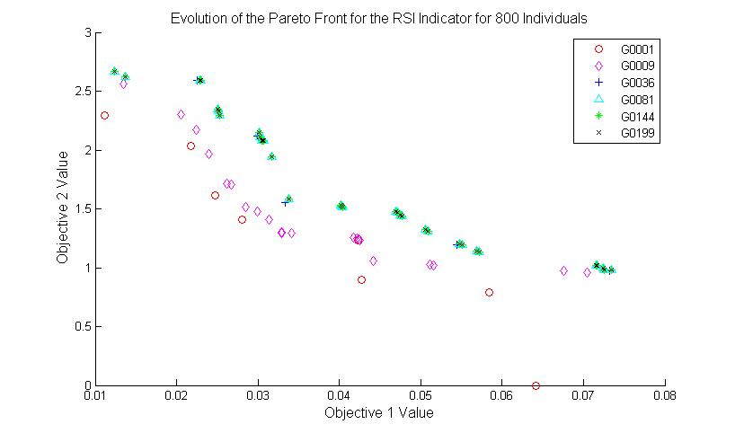
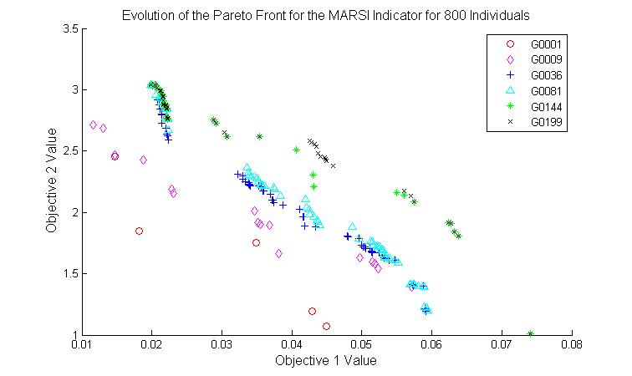
Search Space/Pareto Front Analysis
Notes:
Motivation: Pareto front graph did not appear correct for a maximization problem
For 800 individuals, there are 799 structured reference points on the front → should see these periodically structured along the front
Lack of this is evidence of irregular search space
Graphs convince us that the front is evolving towards a maximum despite the shape

Slide 23
Bi-objective Final Population Values
Indicator | Parameter | Standard Value | Average | Minimum | Maximum
DEMAC | Short Lookback | 20 | 13.7444 | 1.0001 | 75.7160
DEMAC | Long Lookback | 50 | 82.2916 | 1.5066 | 173.9992
MACD | Short Lookback | 12 | 42.7031 | 3.0026 | 72.4333
MACD | Long Lookback | 26 | 65.3110 | 3.5520 | 99.5999
MACD | Signal Lookback | 9 | 21.3089 | 1.2637 | 63.3186
RSI | Lookback | 14 | 45.7469 | 7.5367 | 94.0450
RSI | Lower Boundary | 30 | 19.3104 | 10.0120 | 32.8608
RSI | Upper Boundary | 70 | 73.3495 | 60.2513 | 89.9958
MARSI | RSI Lookback | 14 | 44.1298 | 3.2070 | 99.9951
MARSI | Lower Boundary | 30 | 28.8113 | 10.0300 | 39.9997
MARSI | Upper Boundary | 70 | 75.3322 | 60.1683 | 89.9218
MARSI | Average Lookback | 14 | 59.8648 | 1.0423 | 99.9886
Notes:
All individuals from every final population over 10 runs combined into one file and summary statistics taken on these 5000 data points
Diversity is evident in the Minimum and Maximum values → wide range of values contributing to the various objective function alternatives
Future possibility: relax the constraints to attempt to explore atypical values
Many averages not directly at the midpoint of the range, showing convergence of individuals to a value
Looking for a better way to summarize the data!

Slide 24
Comparison to Day Trading Strategy
 | Average | Minimum | Maximum | Day Trading
Annual Return | 12.4389% | 0.8436% | 31.8321% | 59.12%
Sharpe Ratio | 1.3536 | 0.6838 | 3.044 | 0.1494
Notes:
Day Trading Strategy: implemented a simple strategy in which the stock is bought when there is an increase in the stock value and sold when there is a decrease in the stock value (sensitive to changes in the market)
Shows the tradeoff/compromise of profit for less risk

Slide 25
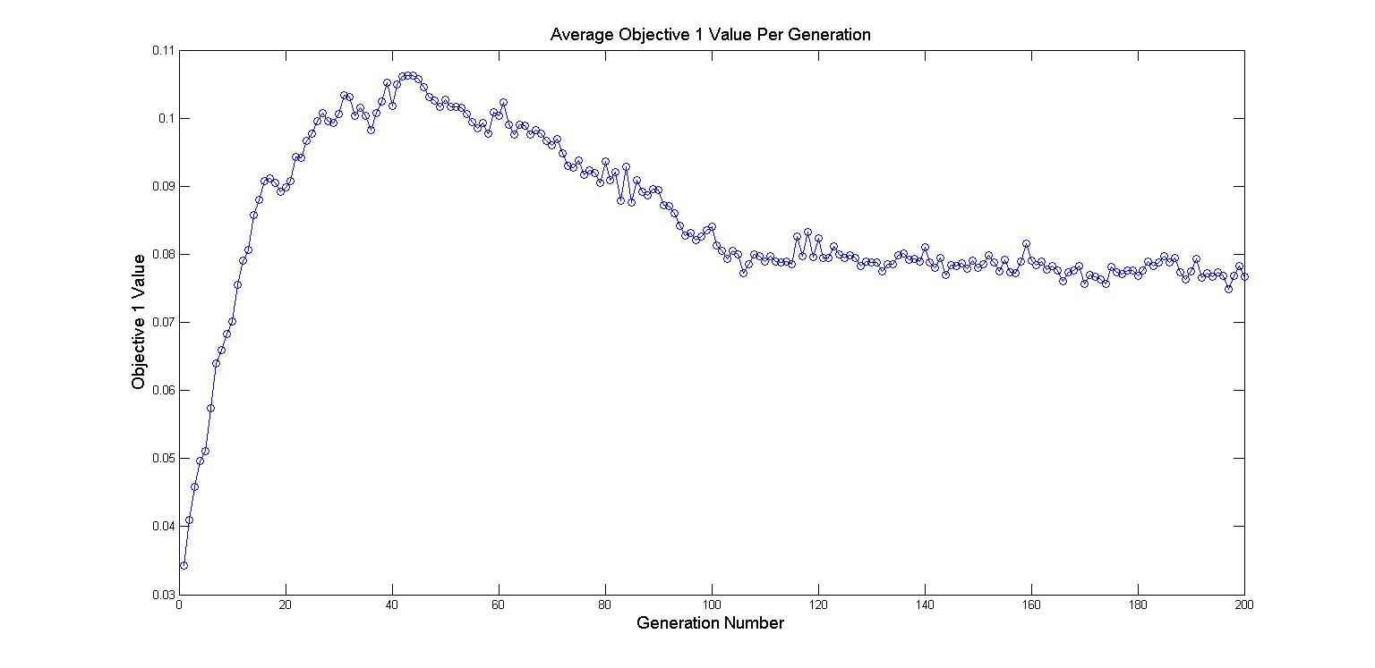
Three Objective Results over 10 Runs
Notes:
Introduction to the three objective problem: “Lazy Man’s Trading” → objective is to obtain the most profit for the least risk with the minimum number of buy/sell actions
Graph generated by taking the average objective value of all individuals in a particular generation over all runs

Slide 26
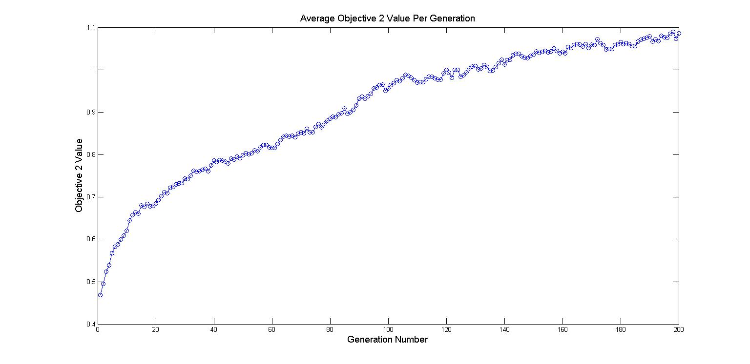
Three Objective Results over 10 Runs
Notes:
Graph generated by taking the average objective value of all individuals in a particular generation over all runs

Slide 27
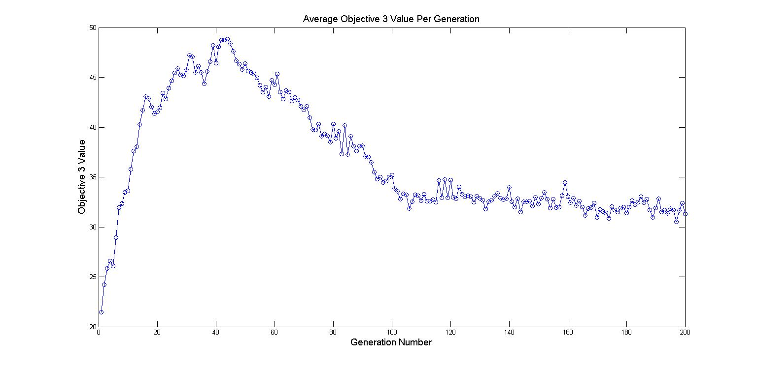
Three Objective Results over 10 Runs
Notes:
Graph generated by taking the average objective value of all individuals in a particular generation over all runs

Slide 28
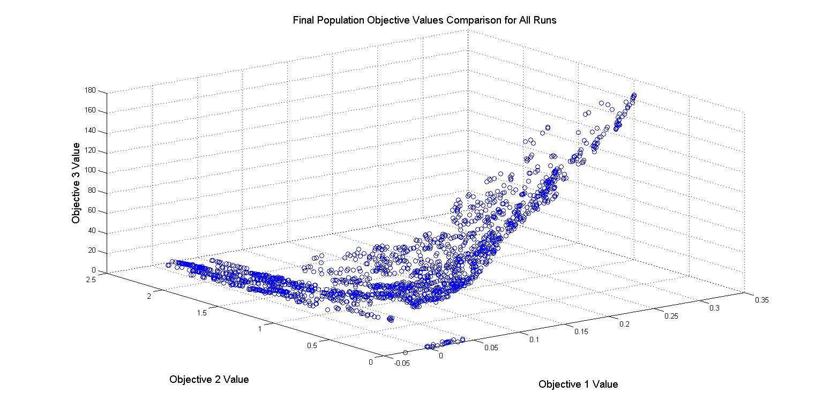
Three Objective Results over 10 Runs
Objective | Average | Minimum | Maximum
Annual Return | 7.6648% | -2.6417% | 31.3987%
Sharpe Ratio | 1.0857 | 0.0000 | 2.3780
Number of Returns | 31.2872 | 0.0000 | 180.0000
Notes:
Pareto Front: all individuals from every final population over 10 runs combined into one file and graphed (352 individuals * 10 runs = 3520 data points)
Same Pareto front curve seen for Objective 2 versus Objective 1 as seen in the bi-objective problem
Objective 1 and Objective 3 may be correlated because as one increases, so does the other (similar phenomenon not seen for Objective 2 and Objective 3)
Statistics versus: 12.4389%, 0.8436%, 31.8321%; 1.3536, 0.6838, 3.044

Slide 29
Limitations of the Solution
Financial Application Limitiations:
Potential affect of inflation and market value on the dataset
Not many clear tradeoff equations for conflicting objectives
Approach Limitations
Evolution of integer values using real-valued parameters
Probabilities of mutation and crossover have not been varied
No runs where algorithm could not afford to buy a stock

Slide 30
Conclusions
Findings from the data:
Search space for the problem is highly irregular
On average, many of the evolved parameters are different from the standard values used
General GA conclusions:
Multi-objective optimization methods are able to provide alternative solutions not offered by classical financial strategies
Many-objective optimization for this application is hard
Notes:
Bullet #1a: the search space produced an unexpected front of alternatives
Bullet #2a: (as showed in comparison to the Day Trading strategy)
Bullet #2b: …due to the correlation of many functions with either profit or risk

Slide 31
Future Work
Vary the probabilities of mutation and crossover and the initial wallet size
Add weights to the indicator voting scheme
Research alternative technical indicators and objective functions
Hypervolume calculations for run comparisons
Run with the GA on a second dataset to determine sensitivity of the results to the input data
Notes:
Bullet #2: Adding weights to the indicator can help to determine via evolutionary methods which indicator contributes most to obtaining both objectives
Bullet #4: Hypervolume compares the areas underneath the Pareto from curves
Requires the calculation or knowledge of ideal and reference points
Bullet #5: Answers the question of how broadly the results can be applied → We already did this a little bit with our current data (shortened the time period) and the results varied

Slide 32
Questions?

Slide 33
References
[1] H. Jain and K. Deb. An Evolutionary Many-Objective Optimization Algorithm Using Reference-point Based Non-dominated Sorting Approach, Part II: Handling Constraints and Extending to an Adaptive Approach. IEEE Trans. Evol. Comput., vol. 18, no. 4, pp.602-622 2014
[2] H. Seada and K. Deb. Effect of Selection Operator on NSGA-III in Single, Multi, and Many-Objective Optimization. 2015 IEEE Congress on Evolutionary Computation., pp.2915-2922 2015
[3] K. Deb and H. Jain. An Evolutionary Many-Objective Optimization Algorithm Using Reference-point Based Non-dominated Sorting Approach, Part I: Solving Problems with Box Constraints. IEEE Trans. Evol. Comput., vol. 18, no. 4, pp.577-601 2014

Slide 34
References (con’t)
[4] K. Deb, A. Pratap, S. Agarwal, and T. Meyarivan. A Fast and Elitist, Multiobjective Genetic Algorithm: NSGA-II. IEEE Trans. Evol. Comput., vol. 6, no. 2, pp.182-197 2002
[5] M.B. Fayek, H.M. El-Boghdadi, and S.M. Omran. Multi-Objective Optimization of Technical Stock Market Indicators using GAs. International Journal of Computer Applications., vol. 68, no. 20, pp.41-48 2013
[6] N. Srinivas and K. Deb. Multiobjective Optimization Using Nondominated Sorting in Genetic Algorithms. Evolutionary Computation., vol. 2, no. 3, pp.221-248 1994

