Slide 1
Evolving Optimal Technical Stock Market Indicators Through Use of Multi-Objective Genetic Algorithms
Presentation by Farhan Hormasji and Bonnie Reiff CSE 848: Suvery of Evolutionary Computation
Fall 2015

Slide 2
Agenda
The Problem
Multi-Objective Optimization Background (evolution of U-NSGA-III)
Indicators and Objectives
U-NSGA-III Setup
Genetic Algorithm
Buy/Sell Simulation
Results
Discussion
Limitiations
Conclusions
Future Work

Slide 3

The Problem
Determine the optimal parameters to buy/sell stock market indicators to maximize profit and minimize risk
Notes:
Image source: http://faganasset.com/wp-content/uploads/2015/04/stock-market-3.jpg
Problem motivated by previous work in this area done using an outdated Multi-objective Genetic Algorithm (VEGA). Students tasked themselves with implementing the work done in U-NSGA-III, comparing to the results provided in the paper, and improving upon the work by performing more analysis and adding another objective function.

Slide 4
Multi-Objective Optimization Background

Slide 5
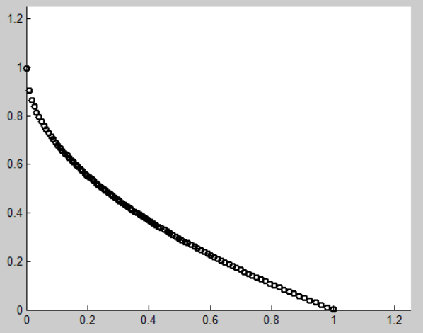
Why Use Multi-Objective Algorithms? [1]
Existence of conflicting objectives
Single-objective formulation of multiple constraints is very sensitive to weights
Single-point solution does not allow for different alternatives to give to expert decision makers
Notes:
If the objectives are not conflicting, then the multiple-objectives should be combined into a single objective (i.e. by summing them)

Slide 6
Terminology [1]
Pareto-optimal (non-dominated) solutions: “a set of solutions which are superior to the rest of the solutions in the search space when all objectives are considered but inferior to other solutions in the space in one or more objectives”
For p-dimensional vectors x₁ and x₂ (in a minimization problem), x₁ dominates x₂ when no value of x₁ is less than the corresponding dimension in x₂ and at least one value of x₁ is strictly less than its corresponding dimension in x₂

Slide 7
NSGA and NSGA-II
TODO

Slide 8
NSGA-III
TODO

Slide 9
U-NSGA-III
TODO

Slide 10
Indicators and Objectives

Slide 11
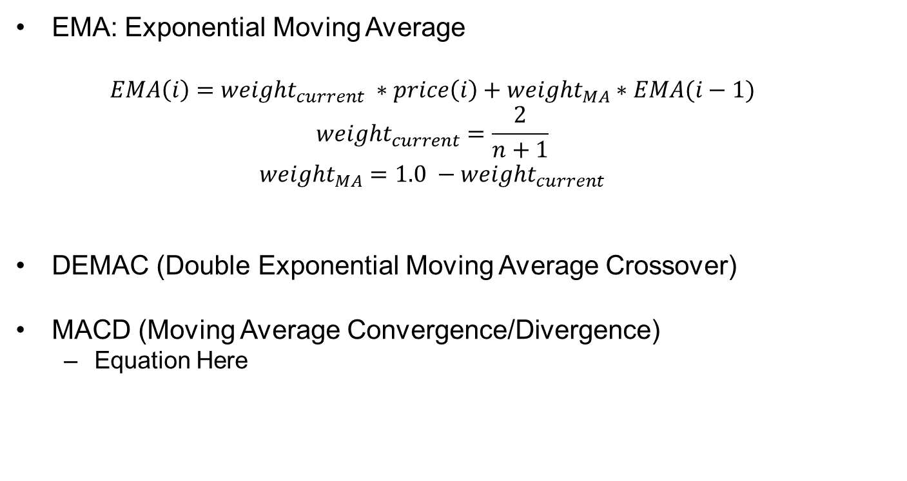
Indicators [2]
EMA: Exponential Moving Average
$$EMA\left(i\right)=weight_{current} ∗price\left(i\right)+weight_{MA}∗EMA(i−1)$$
$$weight_{current}=\frac{2}{n+1}$$
$$weight_{MA}=1.0 −weight_{current}$$
DEMAC (Double Exponential Moving Average Crossover)
MACD (Moving Average Convergence/Divergence)
Equation Here

Slide 12
Indicators (con’t)
RSI (Relative Strength Index)
Equation Here
MARSI (Moving Average Relative Strength Index)
Equation Here

Slide 13
Objective Functions
Maximizing Profit: Annual Return
Equation Here
Maximizing Return on Risk: Sharpe Ratio
Equation Here
Notes:
Mention that in the code, both of these had to be turned into minimizations by multiplying the objective by -1

Slide 14
U-NSGA-III Setup
Notes:
Implementation details: using U-NSGA-III written in Java by Haitham Seada in collaboration with Professor Deb
Program allows anywhere between 1 and many objectives
Variables, constraints, parameters, and objective functions are all input via an XML file and an Evaluator class written for the specific problem
Data input done via the Apache Commons CSV Parser library

Slide 15
Chromosome and Constraints
Indicator | Parameter | Minimum | Maximum | Standard Value
DEMAC | Short Lookback | 1 | 100 | 20
DEMAC | Long Lookback | 1 | 200 | 50
MACD | Short Lookback | 3 | 100 | 12
MACD | Long Lookback | 3 | 100 | 26
MACD | Signal Lookback | 1 | 100 | 9
RSI | Lookback | 3 | 100 | 14
RSI | Lower Boundary | 10 | 40 | 30
RSI | Upper Boundary | 60 | 90 | 70
MARSI | RSI Lookback | 3 | 100 | 14
MARSI | Lower Boundary | 10 | 40 | 30
MARSI | Upper Boundary | 60 | 90 | 70
MARSI | Average Lookback | 1 | 100 | 14
DEMAC | Voting Weight | 0 | 1 | -
MACD | Voting Weight | 0 | 1 | -
RSI | Voting Weight | 0 | 1 | -
MARSI | Voting Weight | 0 | 1 | -
Notes:
All parameters evolved as real-valued numbers (any parameters that need to be integers are rounded in the code)

Slide 16
Secondary Constraints
DEMAC: EMA_{short} < EMA_{long}
MACD: Signal < EMA_{short} < EMA_{long}
0 ≤ w_{DEMAC} + w_{MACD} + w_{RSI} + w_{MARSI} ≤ 1
Notes:
Implemented in the code in the form 0 ≤ Constraint

Slide 17
U-NSGA-III parameters
Parameter | Value
Number of Generations | 200
Population Size | 800
Number of Steps | 799
Real Crossover Probability | 0.80
Real Mutation Probability | 0.05

Slide 18
Stock Data
Dow Jones Industrial Average data from Yahoo! Finance
Stock used: Apple Inc. (AAPL)
Dates: January 1, 1982 – January 1, 2012
Data contains Opening Price, High, Low, Closing Price, Volume, and Adjusted Closing Price for each trading day

Slide 19
Buy/Sell Implementation
Initial Wallet Size:
Rules of the Buy/Sell simulation:

Slide 20
Results

Slide 21
Pareto Front Results
Objective | Avg. Minimum | Avg. Maximum | Avg. Average
Annual Return
Sharpe Ratio
Notes:
TODO Here: Pareto front graph (Objective-2 versus Objective-1 for the final population)
Other statistics: overall minimum and overall maximum of all runs

Slide 22
Average Fitness Results over __ Runs
Notes:
TODO Here: Average Fitness per Generation graph for both objectives
Other statistics: overall minimum and overall maximum of all runs

Slide 23
Average Final Population Values
Indicator | Parameter | Standard Value | Average Value | Minimum | Maximum
DEMAC | Short Lookback | 20
DEMAC | Long Lookback | 50
MACD | Short Lookback | 12
MACD | Long Lookback | 26
MACD | Signal Lookback | 9
RSI | Lookback | 14
RSI | Lower Boundary | 30
RSI | Upper Boundary | 70
MARSI | RSI Lookback | 14
MARSI | Lower Boundary | 30
MARSI | Upper Boundary | 70
MARSI | Average Lookback | 14
DEMAC | Voting Weight | -
MACD | Voting Weight | -
RSI | Voting Weight | -
MARSI | Voting Weight | -

Slide 24
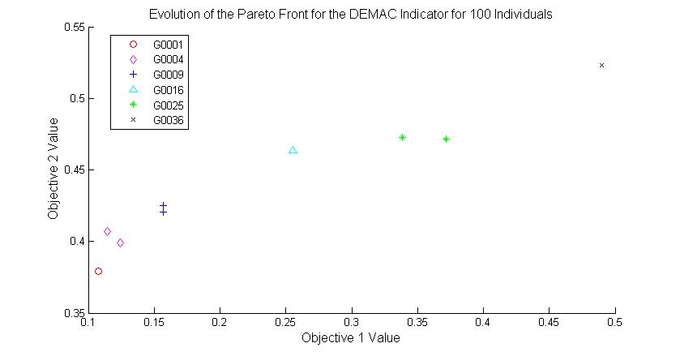
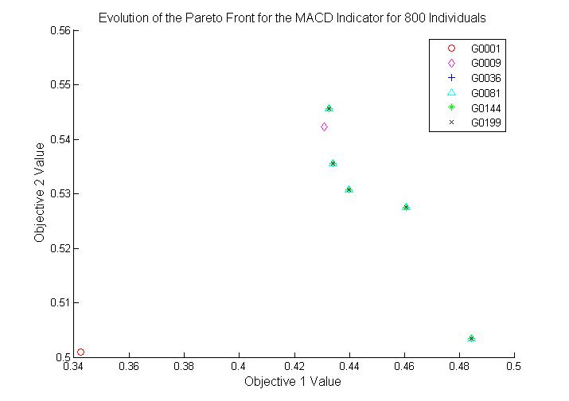
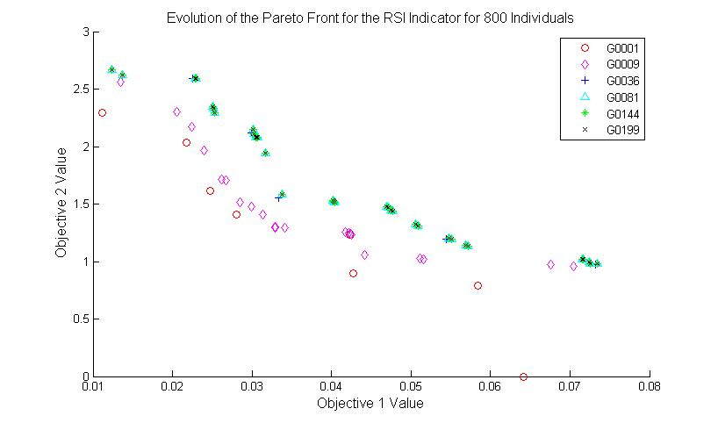
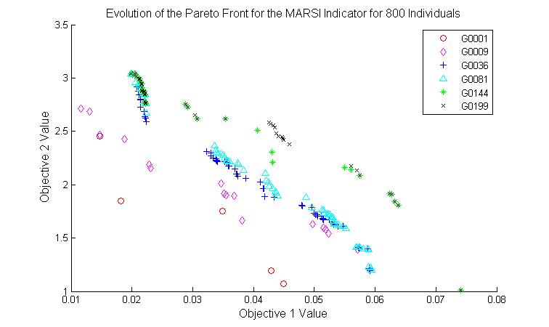
Search Space/Pareto Front Analysis
Notes:
Motivation: Pareto front graphs did not appear correct for a maximization problem

Slide 25
Comparison to Buy & Hold Strategy
TODO

Slide 26
Limitations of the Solution
Evolution of integer values using real-valued paramters
Potential affect of inflation on the values of the dataset

Slide 27
Conclusions
TODO

Slide 28
Future Work
Add weights to the indicator voting scheme to determine via evolutionary methods which indicator contributes the most to obtaining the objectives
Hypervolume calculations for run comparison (WHAT DOES THIS SHOW AGAIN??)
Requires ideal and reference points
Run with the GA on a second dataset to determine dependence of the results on the dataset
Answers the question of how broadly the results can be applied
Research alternative objective functions to use in place of Annual Return and Sharpe Ratio

Slide 29
Questions?

Slide 30
References
[1] N. Srinivas and K. Deb. Multiobjective Optimization Using Nondominated Sorting in Genetic Algorithms.
[2] M.B. Fayek, H.M. El-Boghdadi, and S.M. Omran. Multi-Objective Optimization of Technical Stock Market Indicators using GAs.

Slide 31
References (con’t)
[5]

