Slide 1
Evolving Optimal Technical Stock Market Indicators Through Use of Multi-Objective Genetic Algorithms
Presentation by Farhan Hormasji and Bonnie Reiff CSE 848: Suvery of Evolutionary Computation
Fall 2015

Slide 2
Agenda
The Problem
Multi-Objective Optimization Background (evolution of U-NSGA-III)
Indicators and Objectives
U-NSGA-III Setup
Genetic Algorithm
Buy/Sell Simulation
Results
Discussion
Limitiations
Conclusions
Future Work

Slide 3

The Problem
Determine the optimal parameters to buy/sell stock market indicators to maximize profit and minimize risk
Notes:
Image source: http://faganasset.com/wp-content/uploads/2015/04/stock-market-3.jpg
Problem motivated by previous work in this area done using an outdated Multi-objective Genetic Algorithm (VEGA). Students tasked themselves with implementing the work done in U-NSGA-III, comparing to the results provided in the paper, and improving upon the work by performing more analysis and adding another objective function.

Slide 4
Multi-Objective Optimization Background

Slide 5
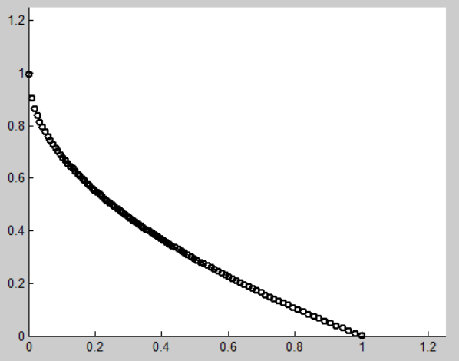
Why Use Multi-Objective Algorithms? [6]
Existence of conflicting objectives
Single-objective formulation of multiple constraints is very sensitive to weights
Single-point solution does not allow for different alternatives to give to expert decision makers
Notes:
If the objectives are not conflicting, then the multiple-objectives should be combined into a single objective (i.e. by summing them)

Slide 6
Terminology [6]
Pareto-optimal (non-dominated) solutions: “a set of solutions which are superior to the rest of the solutions in the search space when all objectives are considered but inferior to other solutions in the space in one or more objectives”
For p-dimensional vectors x₁ and x₂ (in a minimization problem), x₁ dominates x₂ when no value of x₁ is less than the corresponding dimension in x₂ and at least one value of x₁ is strictly less than its corresponding dimension in x₂

Slide 7
NSGA and NSGA-II
TODO

Slide 8
NSGA-III
TODO

Slide 9
U-NSGA-III
TODO

Slide 10
Indicators and Objectives

Slide 11

Indicators [5]
EMA: Exponential Moving Average
$$EMA\left(i\right)=weight_{current} ∗price\left(i\right)+weight_{MA}∗EMA(i−1)$$
$$weight_{current}=\frac{2}{n+1}; weight_{MA}=1.0 −weight_{current}$$
Notes:
Motivation behind EMA: assgins a largver weight to the most recent day of the calculation (versus a simple average which has equal weights)

Slide 12
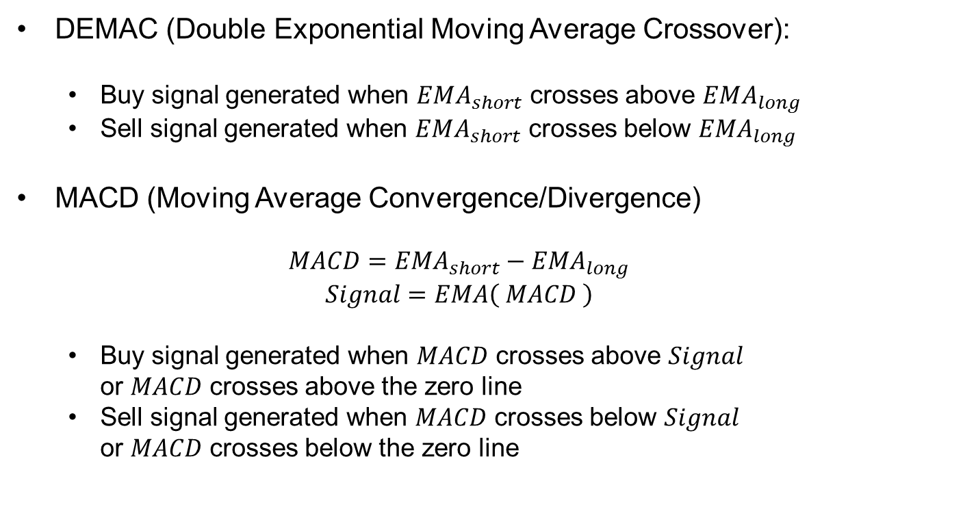
Indicators (con’t)
DEMAC (Double Exponential Moving Average Crossover):
Buy signal generated when $EMA_{short}$ crosses above $EMA_{long}$
Sell signal generated when $EMA_{short}$ crosses below $EMA_{long}$
MACD (Moving Average Convergence/Divergence)
$$MACD=EMA_{short}−EMA_{long}$$
$$Signal=EMA\left( MACD \right)$$
Buy signal generated when $MACD$ crosses above $Signal$ or $MACD$ crosses above the zero line
Sell signal generated when $MACD$ crosses below $Signal$ or $MACD$ crosses below the zero line

Slide 13
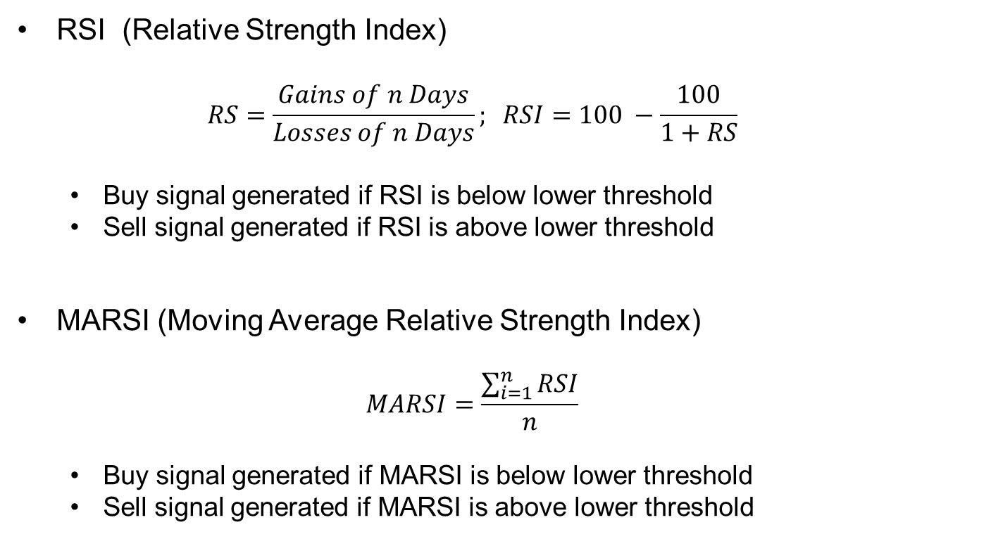
Indicators (con’t)
RSI (Relative Strength Index)
$$RS=\frac{Gains of n Days}{Losses of n Days}; RSI=100 −\frac{100}{1+RS}$$
Buy signal generated if RSI is below lower threshold
Sell signal generated if RSI is above lower threshold
MARSI (Moving Average Relative Strength Index)
$$MARSI=\frac{\sum_{i=1}^{n}{RSI}}{n}$$
Buy signal generated if MARSI is below lower threshold
Sell signal generated if MARSI is above lower threshold

Slide 14
Objective Functions
Maximizing Profit: Annual Return
Equation Here
Maximizing Return on Risk: Sharpe Ratio
Equation Here
Notes:
Mention that in the code, both of these had to be turned into minimizations by multiplying the objective by -1

Slide 15
U-NSGA-III Setup
Notes:
Implementation details: using U-NSGA-III written in Java by Haitham Seada in collaboration with Professor Deb
Program allows anywhere between 1 and many objectives
Variables, constraints, parameters, and objective functions are all input via an XML file and an Evaluator class written for the specific problem
Data input done via the Apache Commons CSV Parser library

Slide 16
Chromosome and Constraints
Indicator | Parameter | Minimum | Maximum | Standard Value
DEMAC | Short Lookback | 1 | 100 | 20
DEMAC | Long Lookback | 1 | 200 | 50
MACD | Short Lookback | 3 | 100 | 12
MACD | Long Lookback | 3 | 100 | 26
MACD | Signal Lookback | 1 | 100 | 9
RSI | Lookback | 3 | 100 | 14
RSI | Lower Boundary | 10 | 40 | 30
RSI | Upper Boundary | 60 | 90 | 70
MARSI | RSI Lookback | 3 | 100 | 14
MARSI | Lower Boundary | 10 | 40 | 30
MARSI | Upper Boundary | 60 | 90 | 70
MARSI | Average Lookback | 1 | 100 | 14
DEMAC | Voting Weight | 0 | 1 | -
MACD | Voting Weight | 0 | 1 | -
RSI | Voting Weight | 0 | 1 | -
MARSI | Voting Weight | 0 | 1 | -
Notes:
All parameters evolved as real-valued numbers (any parameters that need to be integers are rounded in the code)

Slide 17
Secondary Constraints
DEMAC: EMA_{short} < EMA_{long}
MACD: Signal < EMA_{short} < EMA_{long}
0 ≤ w_{DEMAC} + w_{MACD} + w_{RSI} + w_{MARSI} ≤ 1
Notes:
Implemented in the code in the form 0 ≤ Constraint

Slide 18
U-NSGA-III parameters
Parameter | Value
Number of Generations | 200
Population Size | 500
Number of Steps | 499
Real Crossover Probability | 0.80
Real Mutation Probability | 0.05
Number of Runs | 20

Slide 19
Stock Data
Dow Jones Industrial Average data from Yahoo! Finance
Stock used: Apple Inc. (AAPL)
Dates: January 1, 1982 – January 1, 2012
Data contains Opening Price, High, Low, Closing Price, Volume, and Adjusted Closing Price for each trading day

Slide 20
Buy/Sell Implementation
Initial Wallet Size:
Rules of the Buy/Sell simulation:

Slide 21
Results

Slide 22
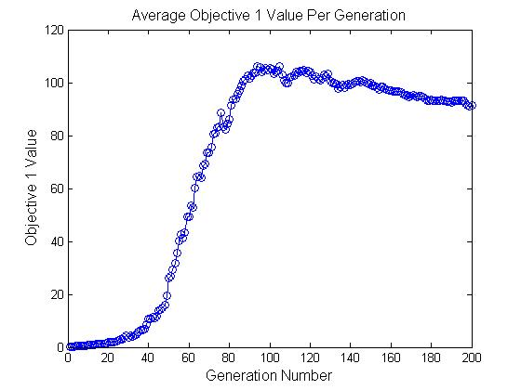
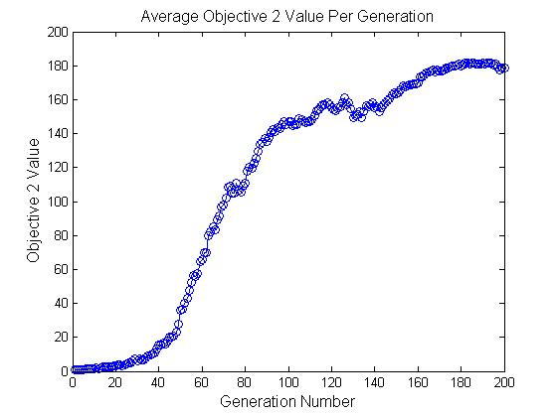
Avg. Fitness Results over 20 Runs

Slide 23
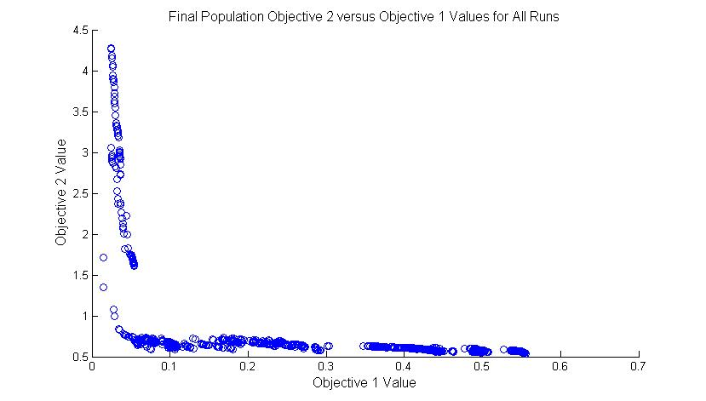
Pareto Front Results over 20 Runs
Objective | Minimum | Maximum | Average
Annual Return | 1.4253% | 55.5305% | 37.0288%
Sharpe Ratio | 0.5414 | 4.2747 | 0.7237

Slide 24
Final Population Values
Indicator | Parameter | Standard Value | Average Value | Minimum | Maximum
DEMAC | Short Lookback | 20 | 24.1937 | 1.0001 | 97.4881
DEMAC | Long Lookback | 50 | 64.3938 | 1.3960 | 199.9010
MACD | Short Lookback | 12 | 22.2128 | 3.0000 | 94.1425
MACD | Long Lookback | 26 | 41.8160 | 3.0047 | 99.9341
MACD | Signal Lookback | 9 | 8.2883 | 1.0235 | 76.7809
RSI | Lookback | 14 | 47.2368 | 14.9687 | 99.9863
RSI | Lower Boundary | 30 | 20.5126 | 10.0003 | 39.5512
RSI | Upper Boundary | 70 | 79.9924 | 61.0704 | 89.9979
MARSI | RSI Lookback | 14 | 53.1958 | 3.0022 | 99.9992
MARSI | Lower Boundary | 30 | 26.0290 | 10.0004 | 39.9746
MARSI | Upper Boundary | 70 | 76.4269 | 60.1836 | 89.9966
MARSI | Average Lookback | 14 | 49.6752 | 1.0916 | 99.9997
Notes:
Diversity is evident in the Minimum and Maximum values
Future possibility: relax the constraints to attempt to explore atypical values
Many averages not directly at the midpoint of the range, showing convergence of individuals to a value

Slide 25
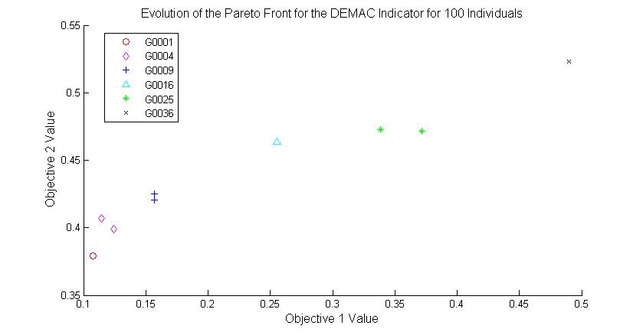
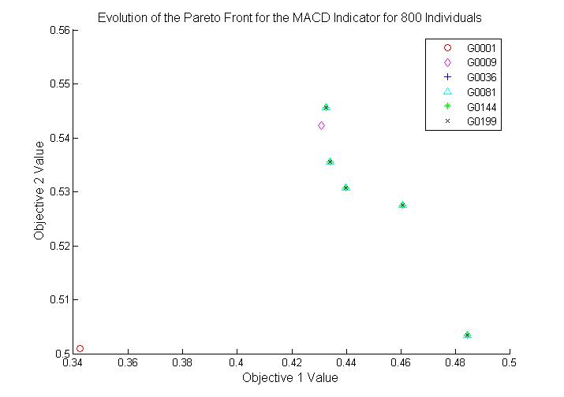
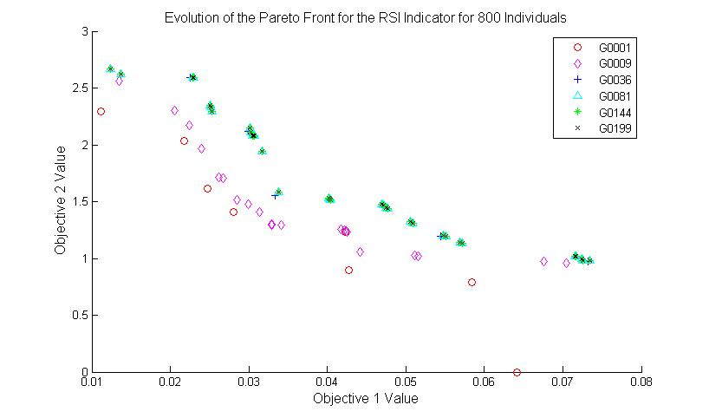
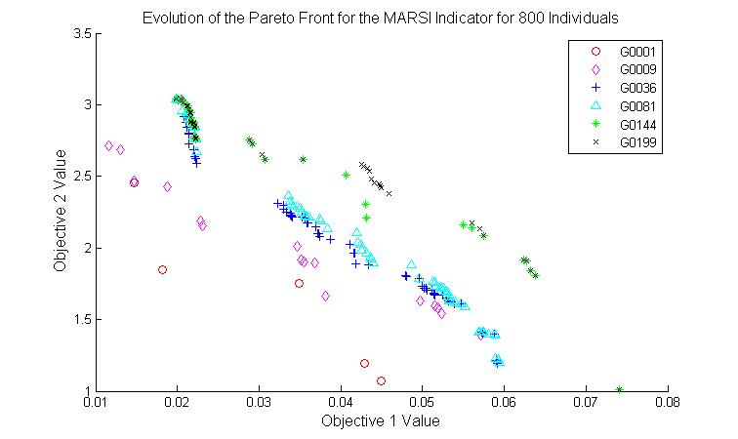
Search Space/Pareto Front Analysis
Notes:
Motivation: Pareto front graphs did not appear correct for a maximization problem

Slide 26
Comparison to Buy & Hold Strategy
TODO

Slide 27
Limitations of the Solution
Data Limitiations:
Potential affect of inflation on the values of the dataset
Approach Limitations:
Evolution of integer values using real-valued paramters

Slide 28
Conclusions
TODO

Slide 29
Future Work
Vary the probabilities of mutation and crossover and the initial wallet size
Add third objective for the “Lazy Investor” problem
Add weights to the indicator voting scheme
Research alternative technical indicators and objective functions
Hypervolume calculations for run comparisons
Run with the GA on a second dataset to determine dependence of the results on the dataset
Answers the question of how broadly the results can be applied
Notes:
Bullet #3: Adding weights to the indicator can help to determine via evolutionary methods which indicator contributes most to obtaining both objectives
Bullet #5: Hypervolume compares the areas underneath the Pareto from curves
Requires the calculation or knowledge of ideal and reference points

Slide 30
Questions?

Slide 31
References
[1] H. Jain and K. Deb. An Evolutionary Many-Objective Optimization Algorithm Using Reference-point Based Non-dominated Sorting Approach, Part II: Handling Constraints and Extending to an Adaptive Approach.
[2] H. Seada and K. Deb. Effect of Selection Operator on NSGA-III in Single, Multi, and Many-Objective Optimization.
[3] K. Deb. An Evolutionary Many-Objective Optimization Algorithm Using Reference-point Based Non-dominated Sorting Approach, Part I: Solving Problems with Box Constraints.

Slide 32
References (con’t)
[4] K. Deb. A Fast and Elitist, Multiobjective Genetic Algorithm: NSGA-II.
[5] M.B. Fayek, H.M. El-Boghdadi, and S.M. Omran. Multi-Objective Optimization of Technical Stock Market Indicators using GAs.
[6] N. Srinivas and K. Deb. Multiobjective Optimization Using Nondominated Sorting in Genetic Algorithms.

