Slide 1
A Model for Determining Tweet Popularity via Prediction Methods
Presentation by Farhan Hormasji and Bonnie Reiff CSE 881: Data Mining
7 December 2015

Slide 2
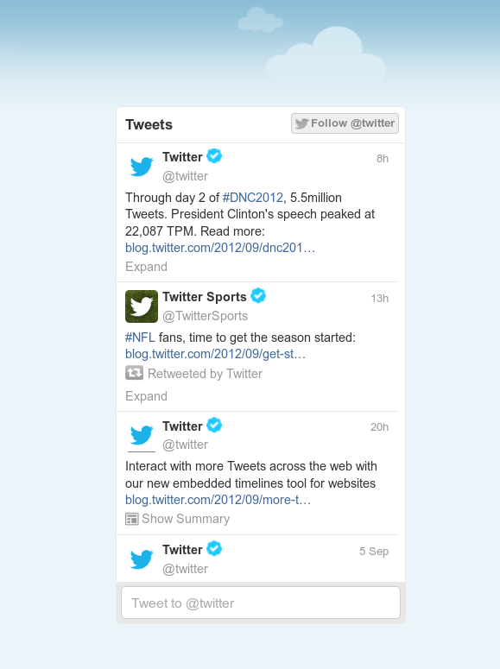
The Question
What features of a Tweet contribute most to its popularity?
Notes:
Image source: http://i1-news.softpedia-static.com/images/news2/Twitter-Debuts-Embeddable-Streams-so-You-Can-Take-Twitter-Anywhere-You-Go-2.png
Popularity defined in terms of retweet count and favorite count
Motivation behind the research question:
Interesting problem
Opportunity to work with social media data mining
Knowing the determining factors can help a user to understand how to get more people to see his or her Tweet → could be important for application such as political domain where a candidate wants to reach a larger user base

Slide 3
Data Collection and Preprocessing
Creation of 2 PHP Programs for interaction with the Public Stream and Search APIs
Streaming program:
Outputs a CSV file with the chosen attributes for each Tweet
Preprocessing:
Creation of an array of the most popular hashtags for additional (manual) feature analysis
Removal of commas (in order to use a CSV file output format)
Generation of Binary or Integer Count attributes from String features
Searches at 10 minutes, 30 minutes, 1 hour, and 20 hours after every data collection to collect Retweet and Favorite count information
Notes:
PHP programs are based loosely on the getTwitter.php program provided for reference by the professor
Uses Twitter libraries developed by Matt Harris (located on Github)
Public Stream API: returns a current stream of public statuses filtered by options such as language, keywords, and locations
Search API: allows queries for recent Tweets by ID
Constraints on the stream: >500 followers for user and Tweet is not already a Retweet

Slide 4
The Dataset
Total number of Tweets used:
Size of training data:
Size of validation data:
Target Attribute:
Features/Predictors:
Notes:
Chosen attributes include information about the text of the Tweet, meta-information (i.e. retweeted or quoted status), information about the user who posted the Tweet

Slide 5
SVM Classification
Potential slide information:
Data labeling (binary classification as “popular” or “not popular”)
Matlab implementation of SVM
Notes:
Limitation of the classification: limited number of “popular” tweets in the data stream → many of the Tweets did not show a high retweet or favorite count in any of the searches

Slide 6
Results
TODO
Conclusions
TODO

