Slide 1
A Model for Determining Tweet Popularity via Prediction Methods
Presentation by Farhan Hormasji and Bonnie Reiff CSE 881: Data Mining
Fall 2015

Slide 2
Agenda
Research Question
Data Acquisition and Dataset Statistics
PHP Programs and Manual Preprocessing
Data Labeling
Predictive Model and Test
Predictand Feature
Implementation
Results
Conclusion

Slide 3
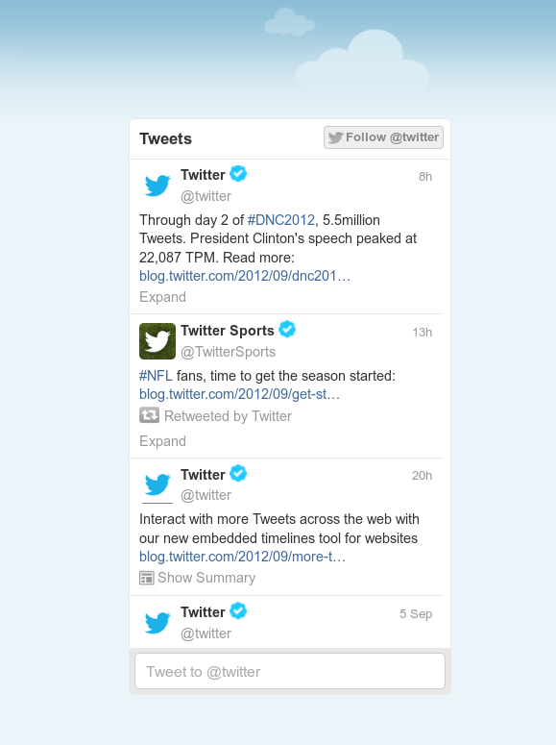
The Question
What features of a Tweet contribute most to its popularity in terms of number of retweets and number of favorites?
Notes:
Image source: http://i1-news.softpedia-static.com/images/news2/Twitter-Debuts-Embeddable-Streams-so-You-Can-Take-Twitter-Anywhere-You-Go-2.png
Motivation behind the research question:
Interesting problem
Opportunity to work with social media data mining
Knowing the important factors can help a user to understand how to get more people to see his or her Tweet

Slide 4
Data Acquisition and Dataset Statistics

Slide 5
PHP Program: streamTweets
Interaction with the Public Stream API
Data collection run for 15 minutes at a time for ___ runs for a total of ___ tweets
Program creates a CSV file and writes the chosen attributes for each Tweet to the file
Preprocessing in the program:
Creation of an array of the most popular hashtags for additional feature analysis
Removal of commas (in order to use a CSV file output format)
Change of String type attributes to Binary or Integer Count attributes
Manual processing: addition of 10 features for binary presence of the 10 most popular hashtags in each Tweet
Notes:
PHP program is based loosely on the getTwitter.php program provided for reference by the professor
Uses Twitter libraries developed by Matt Harris (located on Github)
Public Stream API: returns a current stream of public statuses filtered by options such as language, keywords, and locations
Chosen attributes include information about the text of the Tweet, meta-information (i.e. retweeted or quoted status), information about the user who posted the Tweet

Slide 6
PHP Program: searchTwitter
Interaction with the Search API
Runs 10 minutes, 30 minutes, 1 hour, and 20 hours after every data collection
Returns the retweet count and favorite count of each Tweet
Manual processing: addition of the counts from the 10 minute, 30 minute, and 1 hour searches to the data from the streaming
20 hour search data used as the predictand for training
Notes:
PHP program is based loosely on the getTwitter.php program provided for reference by the professor
Uses Twitter libraries developed by Matt Harris (located on Github)
Search API: allows queries for recent Tweets by ID

Slide 7
Manual Data Labeling
TODO

Slide 8
Predictive Modeling and Test

Slide 9
SVM Classification in Matlab
TODO

Slide 10
Results

Slide 11
Limitations/Challenges
Data acquisition timing
Amount of time between the stream and subsequent search of Tweet had to be approximated for efficiency reasons
Search limited by the Twitter API Rate Limit (180 searches in 15 minutes)
Notes:
Data acquisition timing: goal was to have the same time difference between stream and search for each tweet → infeasible due to API Rate Limits

Slide 12
Conclusions
TODO
Notes:
Data acquisition timing: goal was to

Slide 13
Questions?

