Slide 1
Sentiment Analysis on Social Media
Team:
1. Pavan Reddy Boyapally
2. Jagadeesh Chandra Bose Mende
3. Kavitha Madiraju
Guided By: Khaled Sayed, Assistant Professor

Slide 2
Introduction & Objectives
What is Sentiment Analysis?
Identifies opinions/emotions (positive, negative, neutral) in text.
Used in NLP for insights from online reviews, tweets, and blogs.
Applications:
Business: Improve products/services.
Entertainment: Analyze audience reviews.
Politics: Track public sentiment.
Objectives:
Build ML and DL models for sentiment classification.
Evaluate performance using accuracy, precision, recall, and computational efficiency.

Slide 3
Challenges & Relevance
Challenges:
1. Linguistic Variations: Slang, emojis, abbreviations.
2. Sarcasm: "Great movie... not!"
3. Context Dependency: "Cool" (positive or temperature?).
4. Class Imbalance: Datasets often skew toward positive sentiment.
5. Multilingual Input: Mixing languages.
Relevance to Project:
- Real-time analysis of movie reviews and tweets.
- Benchmark traditional ML (e.g., Logistic Regression, SVM) vs. DL (LSTM, BERT).

Slide 4
Methodology: From Data to Insights
1. Workflow:
Data Collection → Preprocessing → Feature Extraction → Model Training → Evaluation.
2. Data Collection:
IMDB (50K reviews): Formal, structured reviews.
Sentiment140 (1.6M tweets): Informal, noisy text.
Amazon Reviews (100K): Mixed-length e-commerce reviews.
3. Preprocessing:
Clean text: Remove punctuation, emojis, URLs.
Tokenize & Lemmatize: Break into words; reduce to root forms.
Normalize: Lowercase text; handle abbreviations.

Slide 5
4. Feature Extraction:
TF-IDF: For ML models.
Word Embeddings: Dense vectors (Word2Vec, GloVe).
BERT Tokenizer: Handles subword context.
5. Model Training:
Classical ML: Logistic Regression, SVM.
DL Models: LSTM, BERT.
Data Augmentation: Synonym replacement, back translation.
6. Evaluation:
Metrics: Accuracy, Precision, Recall, F1-Score

Slide 6
Models & Techniques
Classical ML Models:
Logistic Regression: Simple, interpretable.
SVM: Effective for high-dimensional data.
Naive Bayes: Fast but assumes feature independence.
Deep Learning Models:
LSTM: Captures sequential dependencies.
BERT: State-of-the-art, contextual understanding.
Feature Extraction:
TF-IDF: Importance of words across documents.
Word Embeddings: Dense vectors capturing word relationships.

Slide 7
Results & Analysis
Best Performer: Support Vector Machine (SVM)
Accuracy: 91.69%.
High recall for positive sentiments; struggles with negatives.
Summary of Results:
Model | Accuracy | Precision (Positive) | Recall (Positive) | F1-Score (Positive)
Logistic Regression | 87.42% | 0.88 | 0.89 | 0.88
SVM | 91.69% | 0.94 | 0.96 | 0.95
Naive Bayes | 84.78% | 0.85 | 1.00 | 0.92
LSTM | 88.78% | 0.90 | 0.90 | 0.90
BERT | 81.25% | 0.84 | 0.83 | 0.83

Slide 8
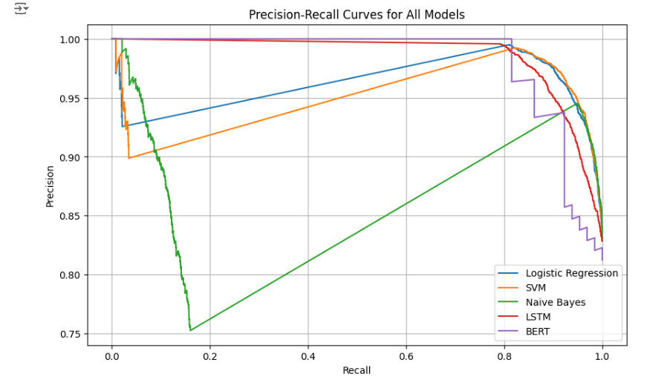
Precision-Recall Curves
SVM maintained consistently high precision and recall for positive sentiments.
Naive Bayes exhibited steep precision-recall drops for negative sentiments.
LSTM and BERT achieved smoother curves due to their advanced architectures.

Slide 9
Conclusion & Recommendations
Key Insights:
SVM: Best for structured datasets.
LSTM: Balanced performance and computational cost.
BERT: Superior context understanding but computationally expensive.
Future Work:
Multilingual sentiment analysis.
Improve sarcasm detection.
Deploy real-time sentiment systems for movie reviews.

Slide 10
References
1. Mikolov, T., et al. "Efficient Estimation of Word Representations in Vector Space."
2. Devlin, J., et al. "BERT: Pre-training of Deep Bidirectional Transformers for Language Understanding."
3. Hochreiter, S., and Schmidhuber, J. "Long Short-Term Memory."
4. Maas, A. L., et al. "Learning Word Vectors for Sentiment Analysis."
5. Sentiment140 Dataset Documentation.

