Slide 1
Postman
A quick intro to testing with Postman

Slide 2
NeedS being solved
Easy
  GUI based
  Content assists throughout
Notes:
Postman is one of many GUI based web service clients. While there are other options, this client has a significant marketshare, making the file format somewhat portable among other utilities.
Postman goes through appreciable links to be friendly. Content assist features are present throughout and done intelligently. For example, Content-Type headers have appropriate selections. There’s code assist for testing the validity of a response.

Slide 3
NeedS being solved
Documentation
  APIs defined, both in English and inputs and outputs fully documented
  Can define both happy and sad paths
  Grouping of services into collections
  Sharable
Notes:
In any project good communication is key. Postman allows an always active, always current documentation of the backend interface. Changes to the Postman files can be immediately uploaded to a workspace and coded against. They can also be saved in a Git repository and later imported upon checkout, making it versioned.
Postman in particular, and for a fee, provides a team interface. People on your team can be invited to join a workspace and get the latest version, sparing people a download from a browser, Git synchronization, email, etc.
The expected behavior is actively defined, especially the happy paths. The project errors, as best as they’re tested, are also defined here. Little things like HTTP status codes get clearly deliniated—an important thing because not every project is consistent.

Slide 4
NeedS being solved
Execution
  Can do quick one-offs, or run collections. For example, add all the APIs for your project to have full, repeatable, regression testing.
  Run the same service in any environment at the change of a drop-down.
  Easily see full parameters, authorization, headers, body and the full response body, cookies and headers. Easily “lint” the results into indented JSON. Save the response to separate file.
  Set up a mock server for UI development.
  Regularly monitor results.
Notes:
With only a few clicks, a request can be created and tested and see the full results. It’s possible to define a request via curl command (or export a request to curl from Postman).
More commonly, a single request can be executed, or a full collection can be executed. This allows a manual regression test, or it could be inserted into your CI/CD pipeline.
Postman is aware of your environments. Each environments can be defined as needed, such as local, test/qa, production, etc, and environment specific variables can be included in your request. For example, define HOST as https://test.somecompany.com for your TEST environment. Authorization can be set up to be fetched, either through a standard OATH2 sequence or via a user’s browser capture. So after a deployment to test, you could select the TEST environment, then run the services for a TEST regression.
Additionally, a mock server can be defined so that the UI people have a server to target while the back-end people are still working on the implementation. Finally, it can be set up for routine monitoring.

Slide 5
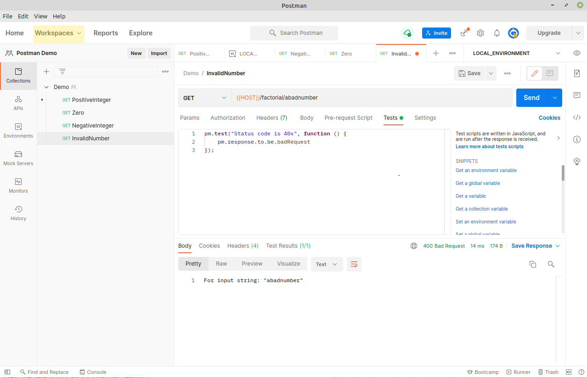
postman layout
Notes:
A workspace is akin to a project in an IDE like Eclipse or IntelliJ.

Slide 6
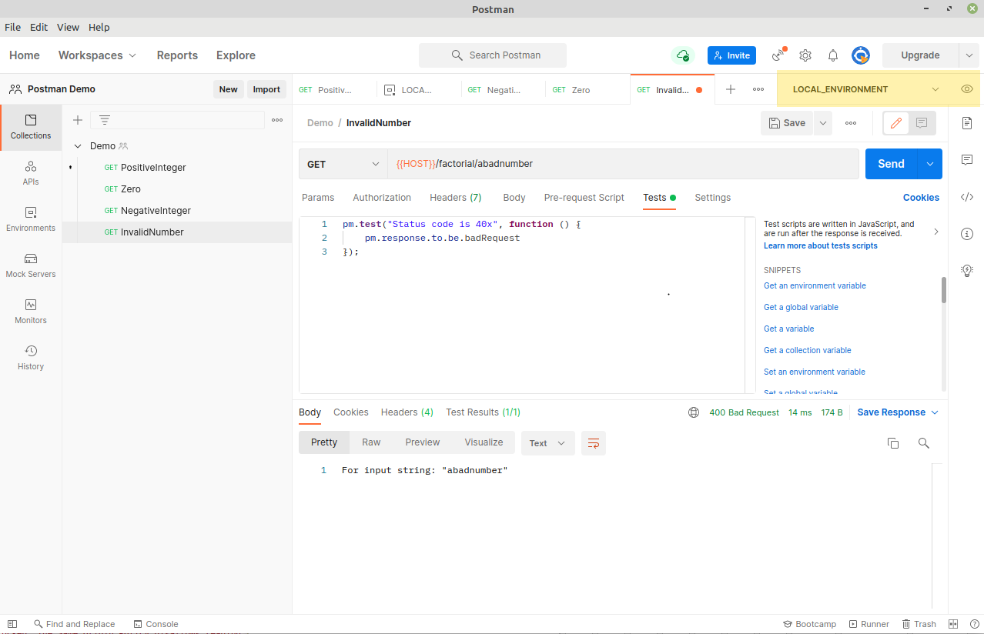
postman layout
Notes:
This is the environment selector drop down and the place to change specific environment settings.

Slide 7
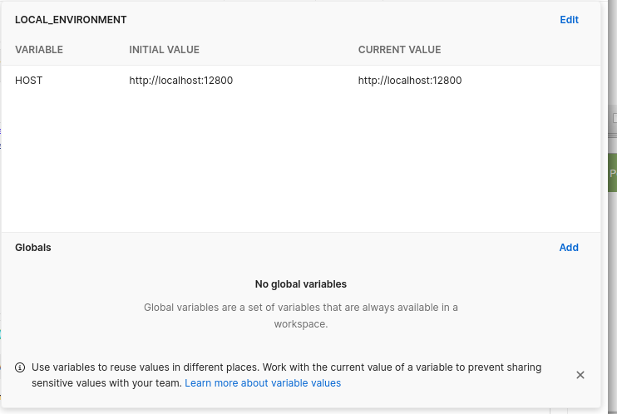
postman layout
Notes:
This is the environment selector drop down and the place to change specific environment settings. Surround the variable with {{ and }}, eg. use {{VARIABLE_NAME}} anywhere in your request. Global and system variables are usable as well.

Slide 8
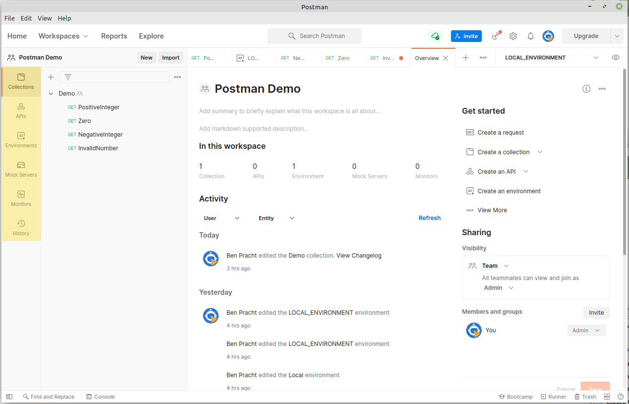
postman layout
Notes:
This is the environment selector drop down and the place to change specific environment settings. Surround the variable with {{ and }}, eg. use {{VARIABLE_NAME}} anywhere in your request. Global and system variables are usable as well.

Slide 9
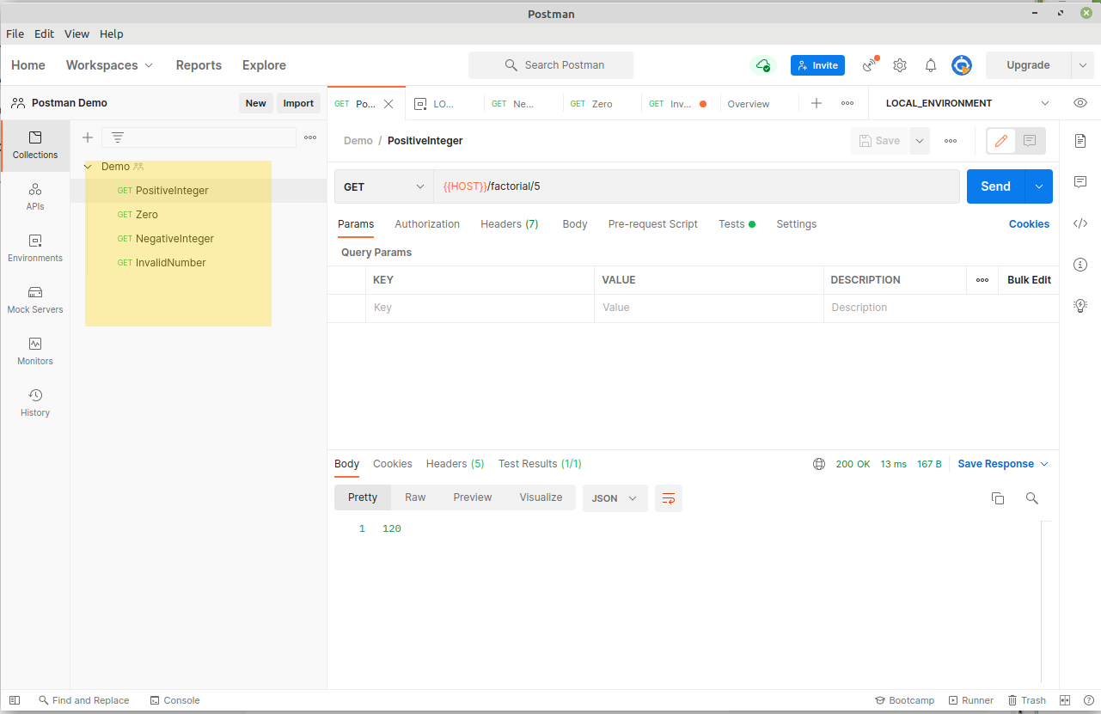
postman layout
Notes:
This is the environment selector drop down and the place to change specific environment settings. Surround the variable with {{ and }}, eg. use {{VARIABLE_NAME}} anywhere in your request. Global and system variables are usable as well.

Slide 10
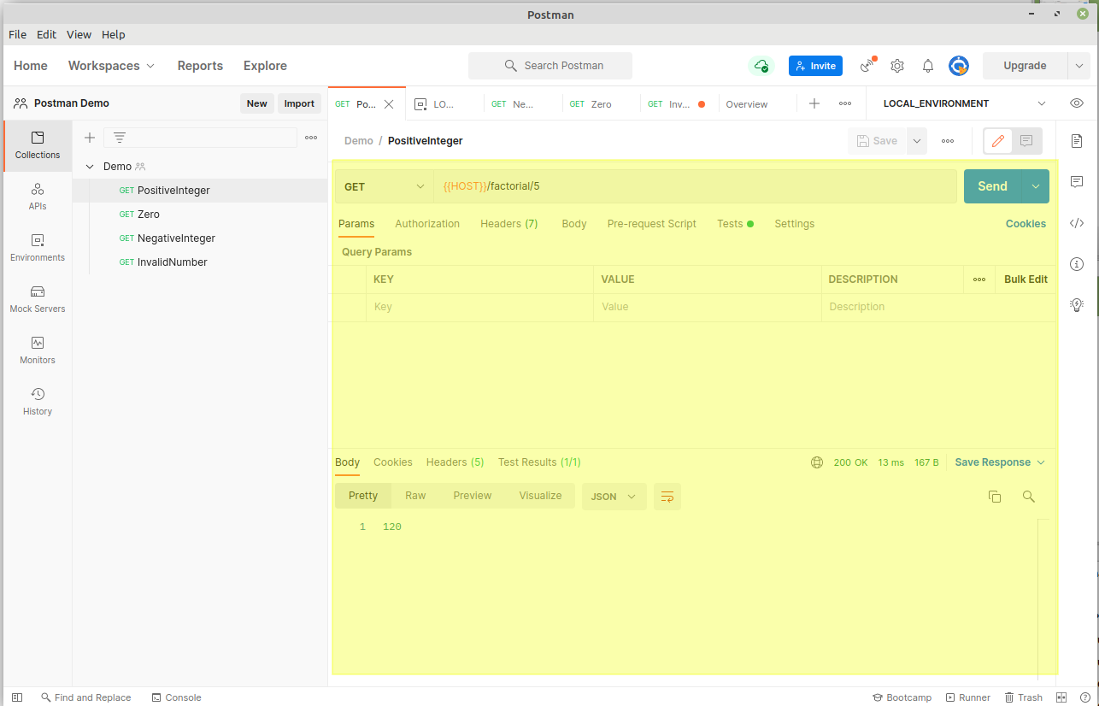
postman layout
Notes:
This is the environment selector drop down and the place to change specific environment settings. Surround the variable with {{ and }}, eg. use {{VARIABLE_NAME}} anywhere in your request. Global and system variables are usable as well.

Slide 11
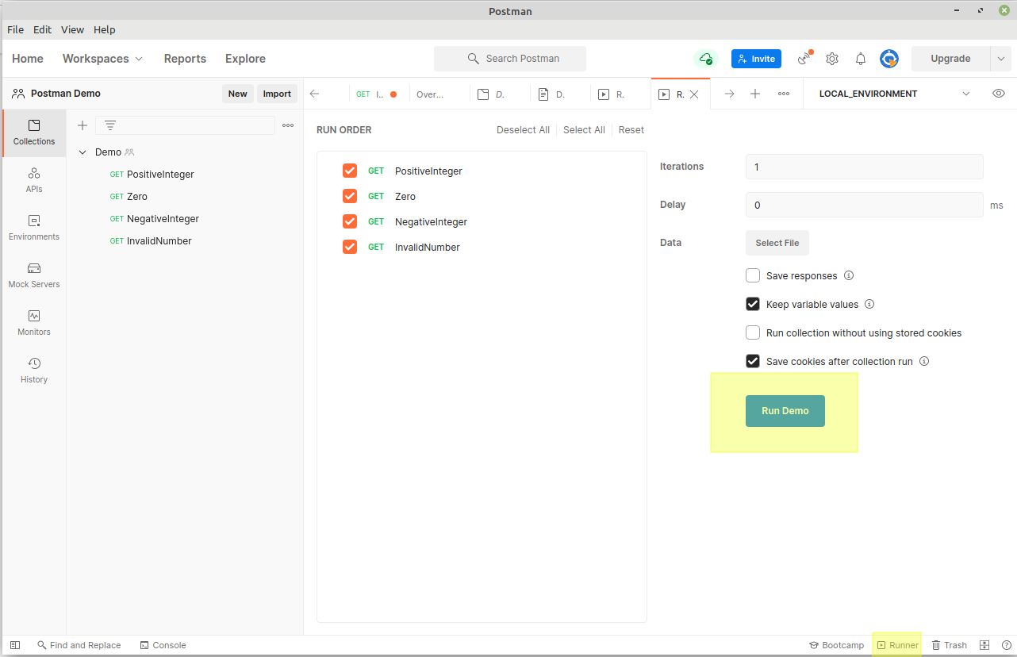
postman layout
Notes:
This is the environment selector drop down and the place to change specific environment settings. Surround the variable with {{ and }}, eg. use {{VARIABLE_NAME}} anywhere in your request. Global and system variables are usable as well.

Slide 12
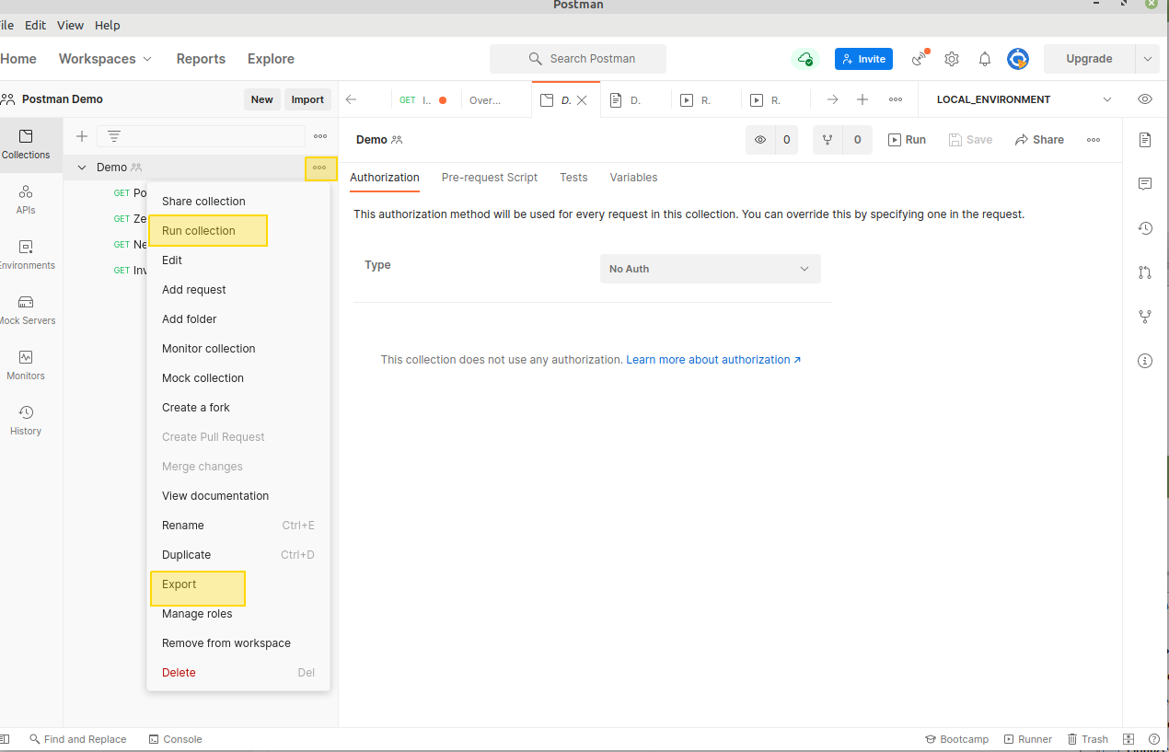
postman layout
Notes:
This is the environment selector drop down and the place to change specific environment settings. Surround the variable with {{ and }}, eg. use {{VARIABLE_NAME}} anywhere in your request. Global and system variables are usable as well.

Slide 13
Do’s and dont’s
Do define every service in your collection. At least define the expected normal path.
Do not assume the service follows standard RESTful API conventions, especially regarding returned status codes. Many shops do not, while some mostly follow them but deviate slightly.
Do document the purpose of the service.
Do persist the collection. Postman offers Git sync capability. Please see https://blog.postman.com/better-practices-for-git-version-control-in-postman/ for more information.

Slide 14
HAPPY TESTING!

