Slide 1
Postman and Crimes of Testing
RESTful Testing and Gating with Postman

Slide 2
Value for your time
Make, facilitate communication and testing
Measurement of coverage
Reduce quantity of bad code getting out
  Gated Checkins
  Sonar
Notes:
Justify the use of your time listening to me ramble by sharing benefits of specific usage of a specific tool and on preventing bad code from getting out into the wild

Slide 3
NeedS being solved by postman
Easy
  GUI based
  Content assists throughout
Notes:
Postman is one of many GUI based web service clients. While there are other options, this client has a significant marketshare, making the file format somewhat portable among other utilities.
Postman goes through appreciable links to be friendly. Content assist features are present throughout and done intelligently. For example, Content-Type headers have appropriate selections. There’s code assist for testing the validity of a response.

Slide 4
NeedS being solved by postman
Documentation
  APIs defined, both in English and inputs and outputs fully documented
  Can define both happy and sad paths
  Grouping of services into collections
  Sharable
Notes:
In any project good communication is key. Postman allows an always active, always current documentation of the backend interface. Changes to the Postman files can be immediately uploaded to a workspace and coded against. They can also be saved in a Git repository and later imported upon checkout, making it versioned.
Postman in particular, and for a fee, provides a team interface. People on your team can be invited to join a workspace and get the latest version, sparing people a download from a browser, Git synchronization, email, etc.
The expected behavior is actively defined, especially the happy paths. The project errors, as best as they’re tested, are also defined here. Little things like HTTP status codes get clearly deliniated—an important thing because not every project is consistent.

Slide 5
NeedS being solved BY POSTMAN
Execution
  Can do quick one-offs, or run collections. For example, add all the APIs for your project to have full, repeatable, regression testing.
  Run the same service in any environment at the change of a drop-down.
  Easily see full parameters, authorization, headers, body and the full response body, cookies and headers. Easily “lint” the results into indented JSON. Save the response to separate file.
  Set up a mock server for UI development.
  Regularly monitor results.
Notes:
With only a few clicks, a request can be created and tested and see the full results. It’s possible to define a request via curl command (or export a request to curl from Postman).
More commonly, a single request can be executed, or a full collection can be executed. This allows a manual regression test, or it could be inserted into your CI/CD pipeline.
Postman is aware of your environments. Each environments can be defined as needed, such as local, test/qa, production, etc, and environment specific variables can be included in your request. For example, define HOST as https://test.somecompany.com for your TEST environment. Authorization can be set up to be fetched, either through a standard OATH2 sequence or via a user’s browser capture. So after a deployment to test, you could select the TEST environment, then run the services for a TEST regression.
Additionally, a mock server can be defined so that the UI people have a server to target while the back-end people are still working on the implementation. Finally, it can be set up for routine monitoring.

Slide 6

Testing Tool Landscape
Notes:
Before we get too deep, I wanted to clarify the scope of the testing. Here I’m showing a heavily and drastically simplified corporate stack that’s somewhat commonly found. Reading from left to right, we start with whatever the user sees, be it an actual person or some other client application, and whatever form the UI takes. If there is a visual UI such as a React, Angular or other SPA application, One or more testing frameworks could be used to assure quality at the UI level. Focusing on the Java side, we’re gladly avoiding these things

Slide 7
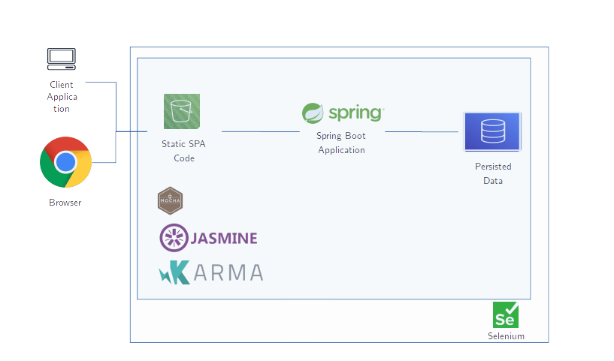
Testing Tool Landscape
Notes:
Before we get too deep, I wanted to clarify the scope of the testing. Here I’m showing a heavily and drastically simplified corporate stack that’s somewhat commonly found. Reading from left to right, we start with whatever the user sees, be it an actual person or some other client application, and whatever form the UI takes. If there is a visual UI such as a React, Angular or other SPA application, One or more testing frameworks could be used to assure quality at the UI level. Focusing on the Java side, we’re gladly avoiding these things

Slide 8
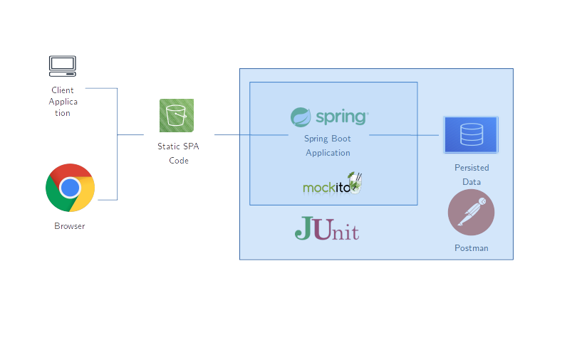
Testing Tool Landscape
Notes:
Again from left to right, many of us Java people will be more focused on the backend. As such, we typically focus on quality unit testing as done by Junit. To help isolate the testing, we’ll also be mocking things not in test using a mocking framework such as Mockito or maybe PowerMock. However, much of our RESTful testing can begin with Postman.

Slide 9
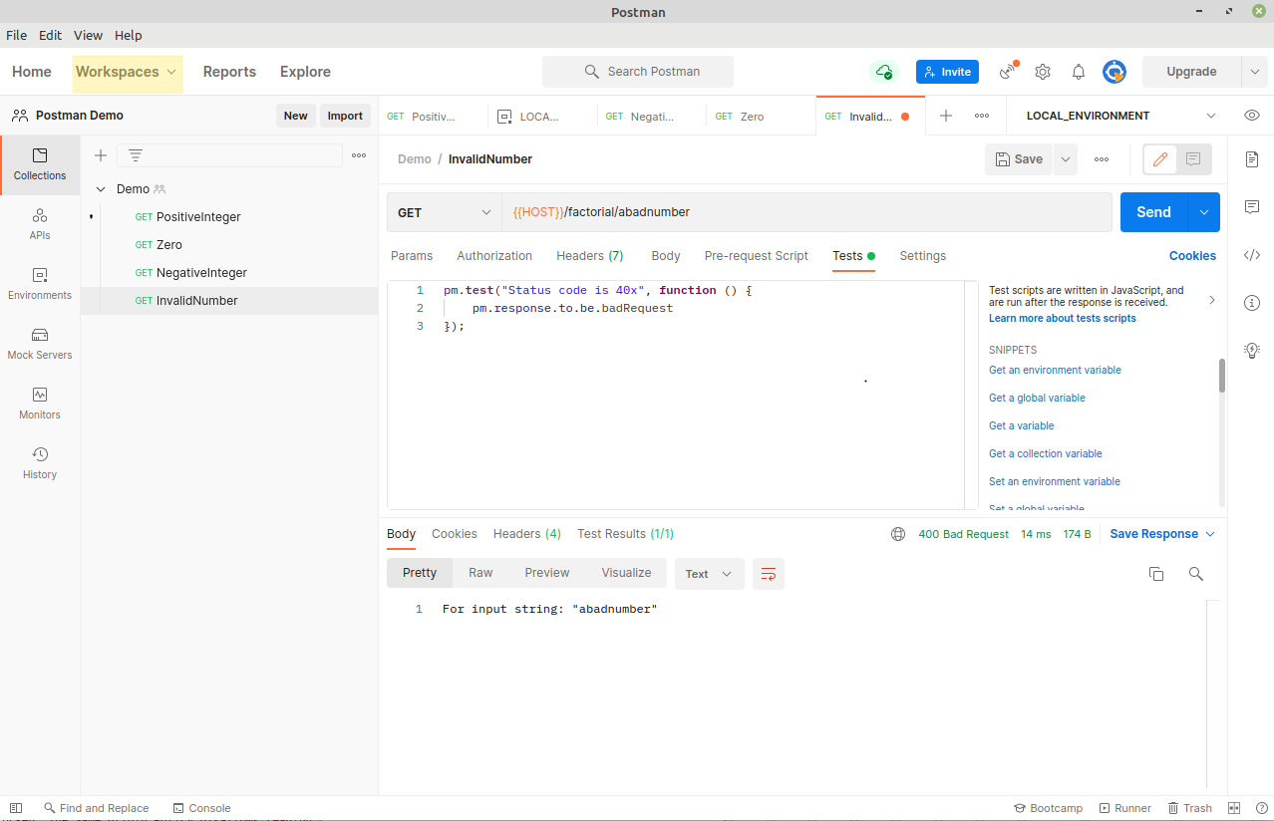
postman layout
Notes:
A workspace is akin to a project in an IDE like Eclipse or IntelliJ.

Slide 10
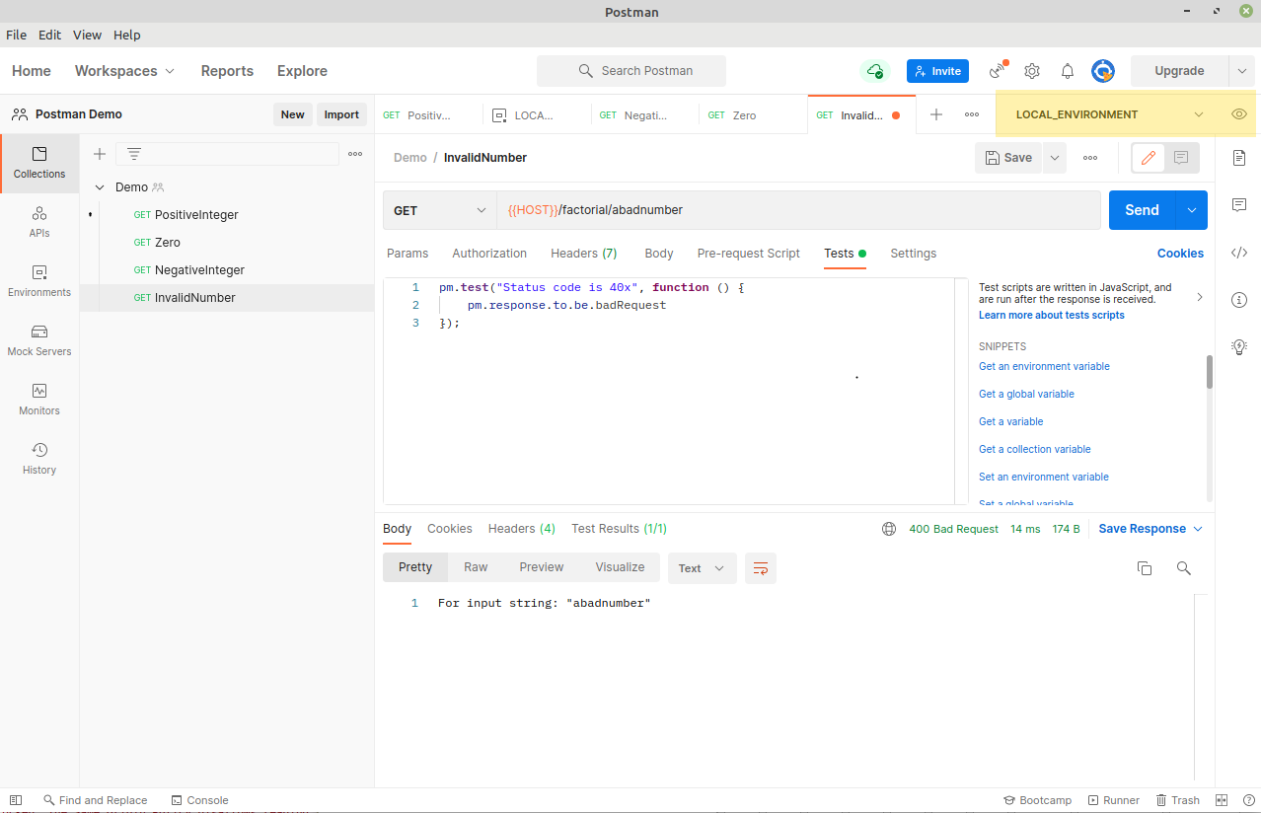
postman layout
Notes:
This is the environment selector drop down and the place to change specific environment settings.

Slide 11
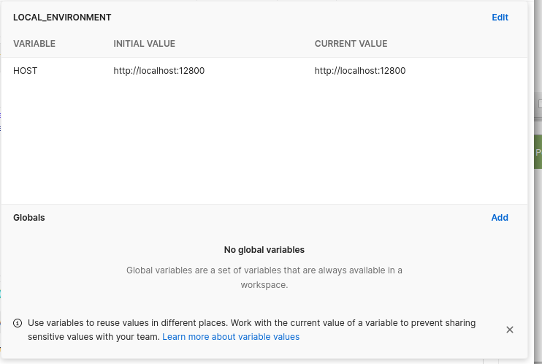
postman layout
Notes:
This is the environment selector drop down and the place to change specific environment settings. Surround the variable with {{ and }}, eg. use {{VARIABLE_NAME}} anywhere in your request. Global and system variables are usable as well.

Slide 12
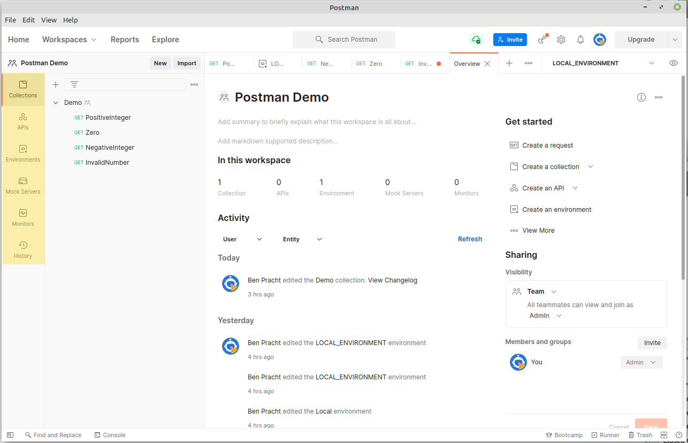
postman layout
Notes:
This is the environment selector drop down and the place to change specific environment settings. Surround the variable with {{ and }}, eg. use {{VARIABLE_NAME}} anywhere in your request. Global and system variables are usable as well.

Slide 13
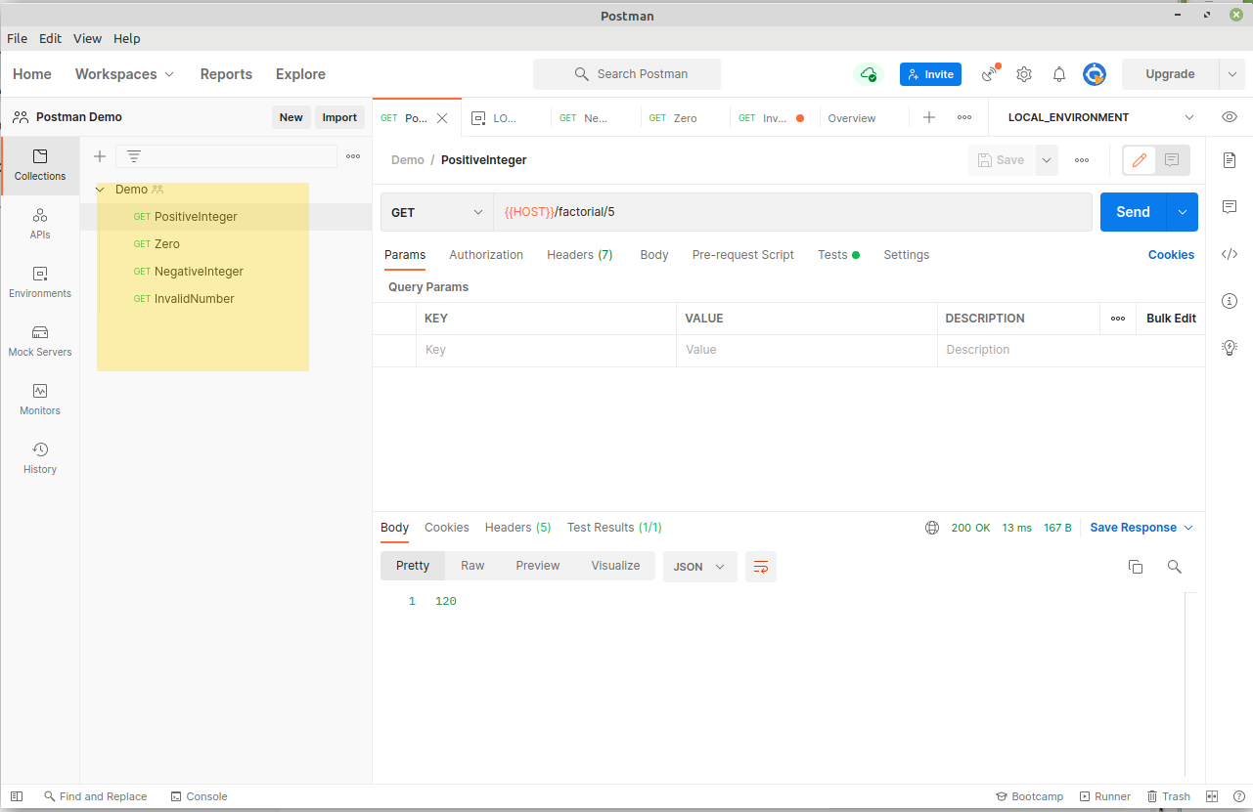
postman layout
Notes:
This is the environment selector drop down and the place to change specific environment settings. Surround the variable with {{ and }}, eg. use {{VARIABLE_NAME}} anywhere in your request. Global and system variables are usable as well.

Slide 14
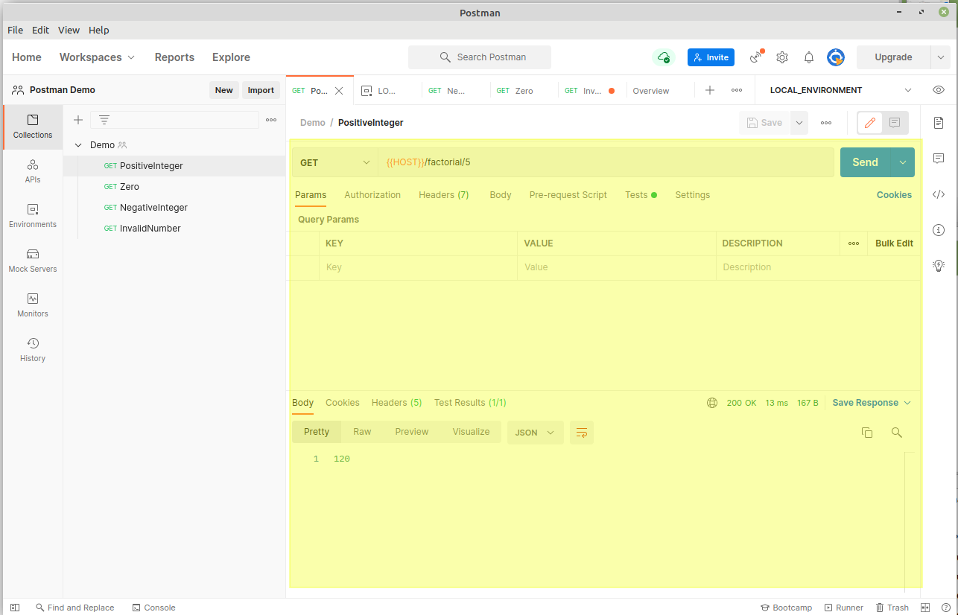
postman layout
Notes:
This is the environment selector drop down and the place to change specific environment settings. Surround the variable with {{ and }}, eg. use {{VARIABLE_NAME}} anywhere in your request. Global and system variables are usable as well.

Slide 15
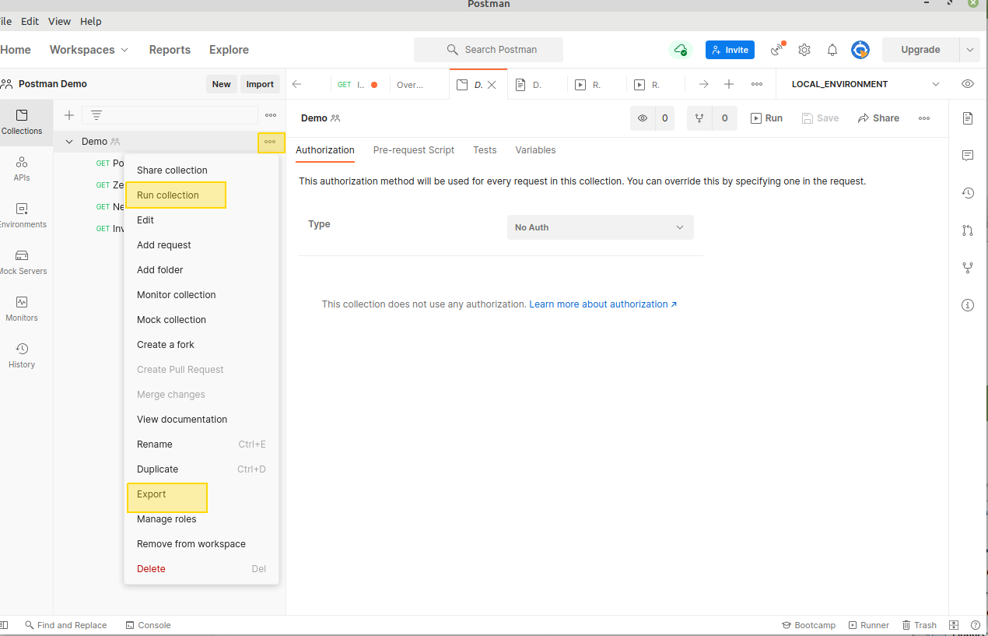
postman layout
Notes:
This is the environment selector drop down and the place to change specific environment settings. Surround the variable with {{ and }}, eg. use {{VARIABLE_NAME}} anywhere in your request. Global and system variables are usable as well.

Slide 16
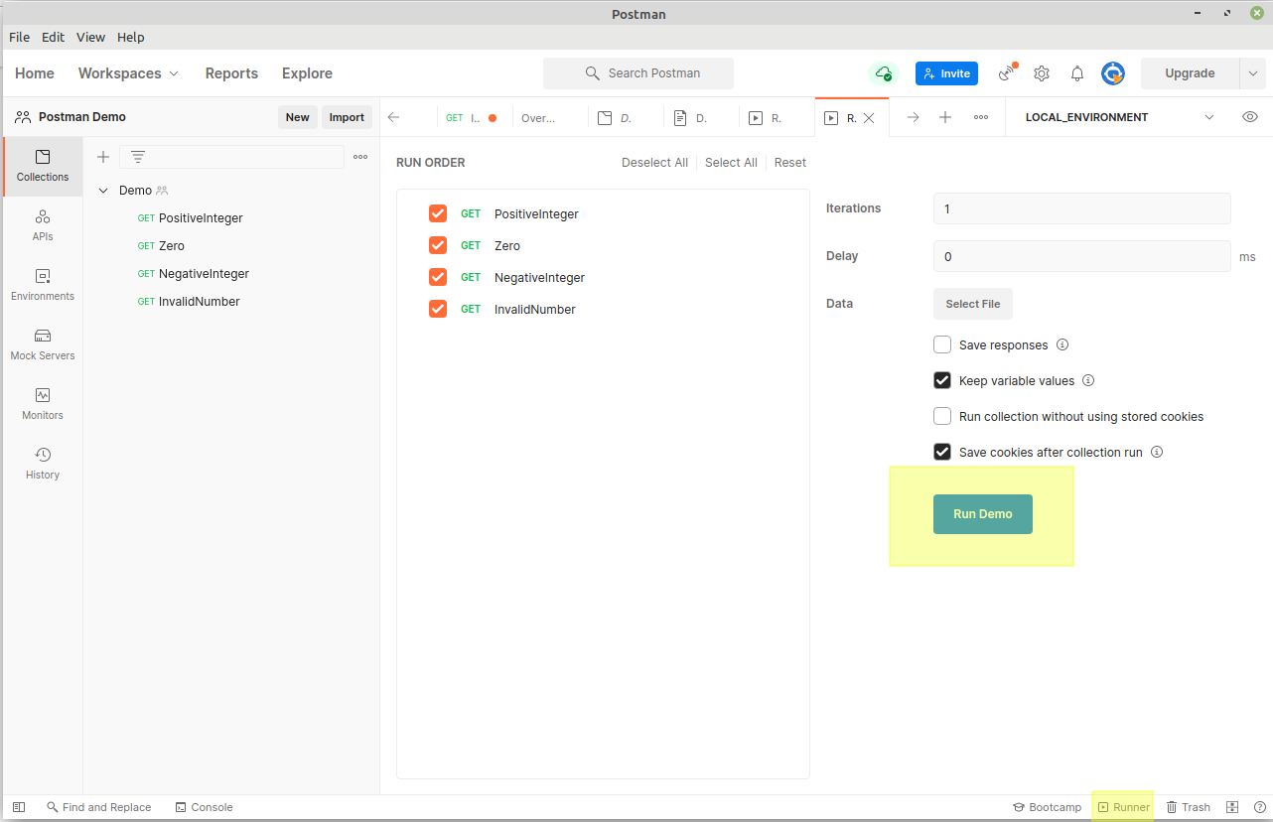
postman layout
Notes:
This is the environment selector drop down and the place to change specific environment settings. Surround the variable with {{ and }}, eg. use {{VARIABLE_NAME}} anywhere in your request. Global and system variables are usable as well.

Slide 17
POSTMAN Do’s and dont’s
Do define every service in your collection. At least define the expected normal path.
Do use variables to “genericize” the service. Don’t make one request for dev and another for test. Instead, shift the differences to an environment variable.
Do not assume the service follows standard RESTful API conventions, especially regarding returned status codes. Many shops do not, while some mostly follow them but deviate slightly.
Do document the purpose of the service.
Do persist the collection. Postman offers Git sync capability. Please see https://blog.postman.com/better-practices-for-git-version-control-in-postman/for more information.

Slide 18
BRIEF INCANTATION FOR QUALITY GATING
Using open source Github repository. You’ll likely have a different Git host, but the ideas will be similar. This was easier and quicker than standing up a Jenkins server, a SonarCube server and a git repository.
Created a repository with my Java code
Add Github workflow actions to automate my Maven build and Sonar Scan
Block bad test results from merge
Notes:
Here, I created a demo project which provides a factorial service as a RESTful endpoint. It’s built using Maven .
However for ease and convenience, I put this on a private Github repository and set up GitHub workflow actions. If you’re using GHE or Bitbucket, there are parallel workflow capabilities you could use.

Slide 19
HAPPY TESTING!

