Slide 1

METAL SEGMENTATION FOR ARTIFACT REDUCTION
Projection-Domain vs Image-Domain Segmentation
A comparative study of two deep-learning approaches to segmenting metal
implants in CT / CBCT scans, with a hands-on U-Net implementation.
Presentation • Monday Review

Slide 2






Agenda
What we'll cover today
The Problem
Two Domains
Why metal implants corrupt CT/CBCT images and why segmentation matters
Image-domain vs projection-domain metal segmentation
Paper 1 — CBCT Projection Domain
Paper 2 — CT Image Domain
Synthetic-data U-Net for projection-domain segmentation (Agrawal et al.)
Diffusion-based segmentation, DiffSeg (Xie et al.)
Head-to-Head Comparison
My Implementation
Which domain segments metal better, and why
U-Net based metal mask segmentation notebook — approach & results
2

Slide 3
The Problem: Metal Artifacts in CT / CBCT
Why accurate metal segmentation matters
Metal implants (screws, plates, dental fillings, hip prostheses) are
high-density and cause severe artifacts:
Typical MAR Pipeline
Blooming, streaking and shading around metal regions
1. Acquire CT / CBCT scan
Obscured boundaries hinder diagnosis & dose planning
Metal Artifact Reduction (MAR) inpaints the metal trace —
but this requires accurate metal segmentation first
2. Segment metal
(image domain or projection domain)
Manual segmentation is slow, subjective, and impractical
for thousands of CT/CBCT projections
3. Mask / inpaint metal trace
in projections or sinogram
4. Reconstruct corrected image
Step 2 — metal segmentation — is the focus of both papers reviewed.
3

Slide 4

Two Segmentation Domains
Where in the imaging pipeline does segmentation happen?
Image Domain
Projection Domain
Segmentation is performed on the reconstructed 3D CT volume (axial slices), typically using HU-based thresholds or learned models on reconstructed images.
Segmentation is performed directly on the raw 2D X-ray projections (sinogram for CT, projections for CBCT) before reconstruction.
Operates on reconstructed slices (e.g. 512x512 HU volumes)
Operates directly on raw 2D projections / sinograms
Simple thresholds (2500/3000 HU) are common baselines
No forward-projection step needed for MAR
Must be forward-projected back to sinogram/projection
space for projection-based MAR
Handles motion blur and out-of-FOV metal naturally
4

Slide 5

Paper 1 — Projection-Domain Metal Segmentation (CBCT)
Agrawal, Hietanen & Sarkka, IEEE Access 2023
Key Results (10 clinical test scans)
Synthetic Training via Monte Carlo Simulation
94.8%
90.2%
Real ground-truth metal labels are hard to obtain — boundaries
are unclear and there are hundreds of projections per scan
Mean DSC
Best model: Noisy (full+crops)
Mean IOU
Noisy (full+crops)
Solution: simulate metal-corrupted CBCT projections + ground
truth from 10 real metal-affected clinical scans (knee, wrist,
foot, ankle, palm, forearm)
90.5%
0.51e-3
Compares noisy (300-1400 photons/pixel) vs clean (5000
photons/pixel) simulations — noisy is cheaper & more realistic
Mean DSC — CMAR
(threshold-based baseline)
False positive rate
on 6 metal-free scans
Trains a modified U-Net (4 down/up blocks, instance norm) on
full-size projections + crops together for robustness
Best result: Noisy simulation + full-size & cropped projections trained together significantly outperformed CMAR, MMAR, and consistency-check methods, especially for motion-affected and out-of-FOV metals.
5

Slide 6



Paper 1 — Model & Training Pipeline
Modified U-Net trained purely on simulated CBCT projections
1
2
3
4
Reconstruct & Threshold
Monte Carlo Simulation
Modified U-Net Training
Binary Metal Trace Output
FDK reconstruction of real CBCT scans; metal segmented via global HU threshold (>=3400 HU), refined with median filter + dilation
Photon-transport simulation generates metal-only & metal-inserted projections (PENELOPE/Badal-style), with realistic noise
4 encoder + 4 decoder blocks, instance norm, trained on simulated full-size + cropped (474x370) projections; BCE loss
Sigmoid + 0.5 threshold gives the binary metal mask directly in the projection, ready for inpainting-based MAR
Network: U-Net variant — 16 to 256 channels, 3x3 conv + ReLU + instance norm, bilinear upsampling, skip connections, 1x1 output conv + sigmoid. Trained on a single RTX 2080 Ti, Adam optimizer, BCE loss, with stacked augmentations (flips, elastic deformation, noise, dropout).
6

Slide 7
Paper 2 — Image-Domain Metal Segmentation (CT)
Xie et al., DiffSeg — BMC Medical Imaging 2024
Key Results (2,820 test slices)
Diffusion Probabilistic Model for Metal Masks
95.45%
97.89%
Operates on reconstructed axial CT slices (512x512), not raw
projections
Mean DSC — DiffSeg
(best among all models)
Accuracy — DiffSeg
DiffSeg = ResU-Net diffusion model + Conditional Dynamic
Coding (fuses mask + prior image) + GFParser (removes
high-frequency noise via learnable Fourier filter)
84.19%
93.52%
Trained on 100 patients (11,280 slices) with simulated metal
artifacts inserted into real artifact-free CT images
Mean DSC — T3000
threshold baseline
Mean DSC — U-Net
(traditional baseline)
Validated on clinical artifact CT, CTPelvic1K, and physical
phantoms with known titanium rod geometry
DiffSeg outperformed U-Net, Attention U-Net, R2U-Net & DeepLabV3+ on simulated, clinical, and phantom data (statistically significant, p<0.05 vs most models). Its smaller, tighter masks better preserve surrounding bone detail during MAR.
7

Slide 8
Paper 2 — DiffSeg Architecture
Conditional dynamic coding + global frequency parser on a ResU-Net backbone
1
2
3
4
Artifact Simulation
Diffusion Process
Dynamic Conditional Coding
GFParser
Metal masks (dental fillings, screws, hip implants, coils) inserted into clean CT; beam hardening + Poisson noise simulated for realism
Forward process adds Gaussian noise to the segment label over T=1000 steps; ResU-Net learns to reverse it conditioned on the CT image
Fuses current segmentation mask features with the original-image prior at multiple scales to focus on the metal region
FFT-based learnable frequency filter removes high-frequency noise introduced by the conditional fusion, sharpening mask edges
Ablation impact: Removing both modules drops DSC to 93.56% (DiffSeg_1). Dynamic conditional coding alone gives 94.35% (+0.79%). Adding GFParser reaches the full 95.45% (+1.1% total) — each component contributes measurably.
8

Slide 9
Head-to-Head Comparison
Projection-domain (CBCT) vs Image-domain (CT) metal segmentation
Aspect | Projection Domain (Paper 1) | Image Domain (Paper 2)
Modality / Data | CBCT, extremity scans (knee, wrist, ankle, foot) | CT, head/neck, chest, abdomen + phantoms
Model | Modified U-Net (CNN, supervised) | DiffSeg — diffusion model + ResU-Net
Training data | Purely synthetic (Monte Carlo simulation) | Simulated artifacts on 100 real patient CTs
Best DSC | 94.8% | 95.45%
Best Accuracy / IOU | IOU = 90.2% | ACC = 97.89%
vs Threshold baseline | CMAR (region-growing): DSC 90.5% | T3000 threshold: DSC 84.19%
Key strength | No forward projection needed; robust to motion, out-of-FOV metal, and voxel-size changes | Sharper, smaller masks; better detail near metal in NMAR correction
Inference cost | Single forward pass (fast, ~ms) | Diffusion sampling (~3 s/batch, DPM-Solver)
9

Slide 10


VERDICT
Which Domain Segments Metal Better?
It depends on the goal — but projection-domain segmentation is the stronger choice for CBCT-based MAR pipelines, while image-domain (DiffSeg) wins on raw segmentation accuracy for reconstructed CT.
Projection Domain wins when...
Image Domain (DiffSeg) wins when...
Metal is out-of-FOV or scan has heavy motion artifact
(image-domain cannot segment what isn't reconstructed)
Highest raw DSC/Accuracy on reconstructed slices is
the priority (95.45% vs 94.8%)
Pipeline needs direct integration into existing
projection-based MAR (no forward-projection step)
Fine boundary detail and noise suppression matter
(GFParser removes high-frequency artifacts)
Real-time / single-pass inference is required
Sufficient compute is available for diffusion sampling
(~3s per batch)
10

Slide 11
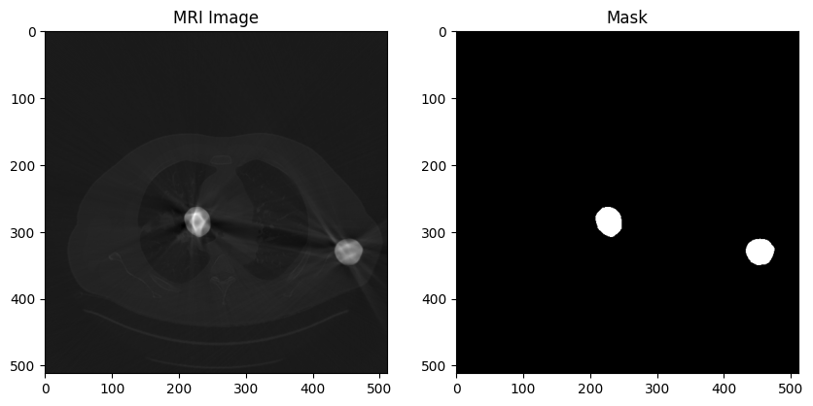
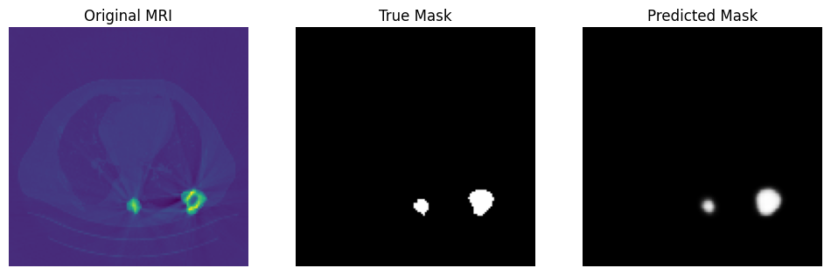
My Implementation — U-Net Metal Mask Segmentation
Task: build & train a U-Net to segment metal regions in CT slices
Training Results
Approach
99.86%
99.89%
0.0040
0.0033
Dataset: 500 CT slices (512x512) with paired binary metal
masks, loaded as raw float32 arrays
Train accuracy
(epoch 15)
Val accuracy
(epoch 15)
Train loss (BCE)
(epoch 15)
Val loss (BCE)
(epoch 15)
Preprocessing: min-max normalization, resized to 128x128
(image: bilinear, mask: nearest-neighbour to keep it binary)
Sample input slice & ground-truth metal mask
Model: lightweight U-Net — 2 encoder blocks (16->32 ch),
bottleneck (64 ch), 2 decoder blocks with skip
concatenation, 1x1 conv + sigmoid output
Training: 80/20 train-test split, Adam optimizer, binary
cross-entropy loss, 15 epochs
Predicted mask vs ground truth (test sample)
Image-domain task — directly comparable to DiffSeg
approach in Paper 2
11

Slide 12


Implementation — Observations & Next Steps
Where this fits relative to the reviewed papers
Observations
Suggested Next Steps
Validation accuracy (99.89%) is very high but driven mainly
by background pixels — DSC/IOU on the metal class would
give a fairer picture (as both papers report)
Report DSC / IOU / sensitivity / specificity per the metrics
used in both papers for direct comparability
Compare against a fixed-threshold baseline (2500/3000 HU)
as done in Paper 2
Predicted mask is smoother / slightly larger than ground
truth — similar to over-segmentation seen with simple
threshold methods in Paper 2
Apply data augmentation (flips, elastic deformation) following
U-Net (Ronneberger et al.) and Paper 1's strategy
128x128 downsampling may blur small or thin metal
structures; both papers avoid downsampling near metal
boundaries for this reason
Evaluate on full-resolution slices / crops to preserve fine
metal boundaries, as recommended in Paper 1
A compact 2-level U-Net was sufficient for this dataset's
large, well-separated metal regions
Long term: extend to the projection domain (CBCT) using
simulated data, mirroring Paper 1's pipeline
12

Slide 13

Summary
Both domains push U-Net beyond simple HU thresholds — DSC improved from ~84% (threshold) to ~95% (deep learning)
Projection-domain (Paper 1) is best suited to CBCT pipelines: motion-robust, handles out-of-FOV metal, single fast pass
Image-domain DiffSeg (Paper 2) achieves the highest raw segmentation accuracy via diffusion + frequency-domain refinement
My U-Net notebook implements the image-domain approach — a strong foundation to extend toward Paper 2's evaluation rigor
Thank you — questions welcome

