Slide 1


Project Presentation presented by Bablu Prasad

Slide 2
TABLE OF CONTENTS
1. Introduction 2. Objective & Scope Of the Project 3. Application Tools 4. Project Design 5. Flowchart 6. Testing And Validation 7. Conclusion 8. Limitations 9. References

Slide 3
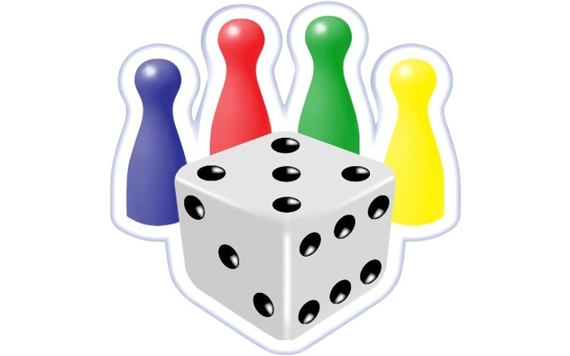
Introduction
This project is a Ludo game developed using Python's library. The primary purpose of this game is to recreate the classic board game experience in a digital format, offering players an interactive and visually appealing platform to enjoy Ludo. The game focuses on implementing core gameplay mechanics, including dice rolling, token movement, home pathways, and player interactions. It also emphasizes learning key concepts in game development such as object-oriented programming, event handling, collision detection, and user interface design. This project serves as both a fun gaming application and a hands-on approach to deepening programming skills.

Slide 4
Objective of the Project
Developed Core Game Mechanics:
Implement essential gameplay mechanics, including dice rolling, token movement, and adherence to traditional Ludo rules.
Create logic for special moves like safe zones, capturing opponent tokens, and navigating home pathways.
Created an Interactive Game Board:
Design and develop a visually appealing 2D Ludo game board that accurately reflects the layout of a physical Ludo board.
Implement real-time updates on token positions and player progress on the board.
Integrate Multiplayer Functionality:
Allow for up to four players, three players, two players.
Enhance Gameplay with Visual Feedback:
Include animations for dice rolls, token movement, and token captures to enhance player engagement.
Incorporate sound effects for key events like dice rolls, token movements, and winning milestones.
Ensure Smooth User Experience and Interface:
Design an intuitive user interface with clear instructions, player turn indicators, and resourceful visual aids.
Optimize game performance for smooth gameplay, ensuring accurate rule implementation and responsiveness.

Slide 5
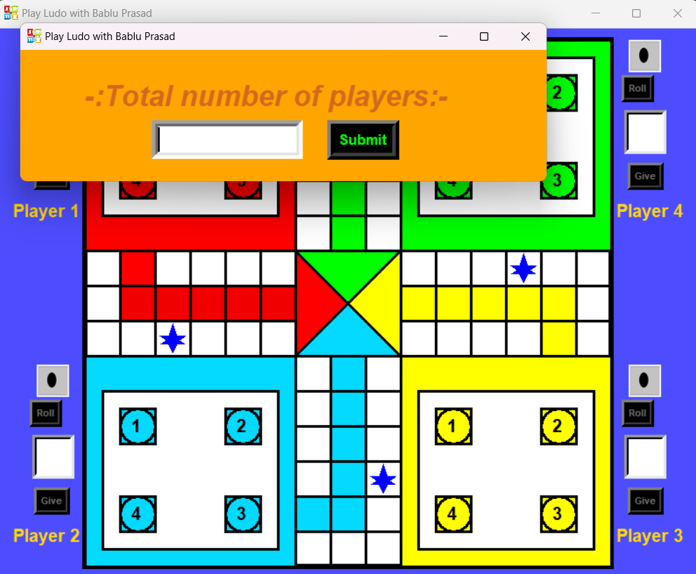
Scope of the project
The classic Ludo gameplay focuses on faithfully replicating traditional rules, where players roll dice, move tokens, and aim to navigate all their tokens to the home zone. The game supports multiplayer mode for up to four players on the same device, providing versatile gaming options. It features an interactive, visually detailed 2D Ludo board enhanced with animations for dice rolls, token movement, and capturing opponent tokens, ensuring an engaging visual experience. A robust turn-based logic system automates turn handling, cycling through players in a fair and sequential manner to maintain smooth and balanced gameplay.

Slide 6
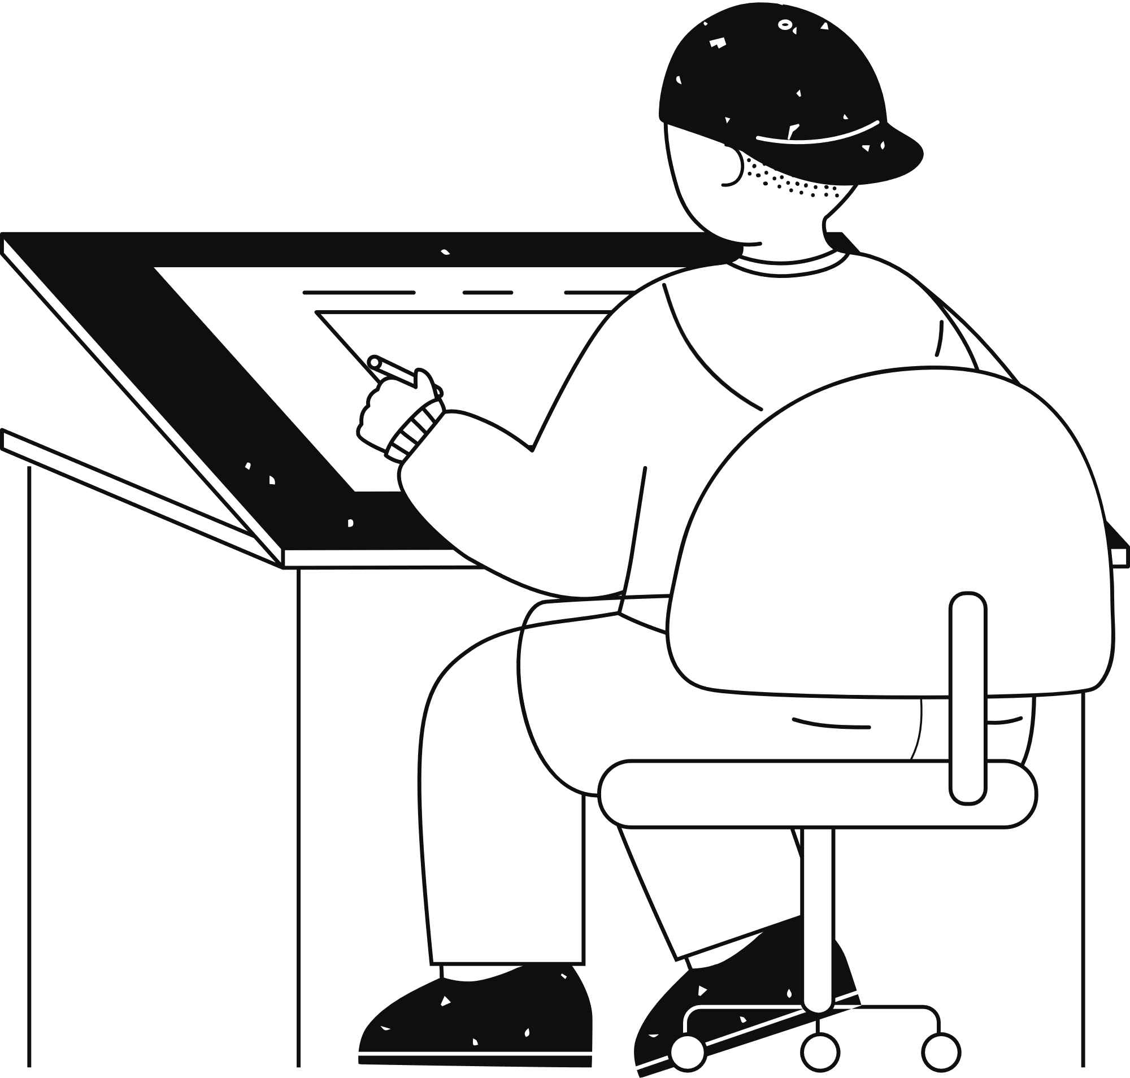


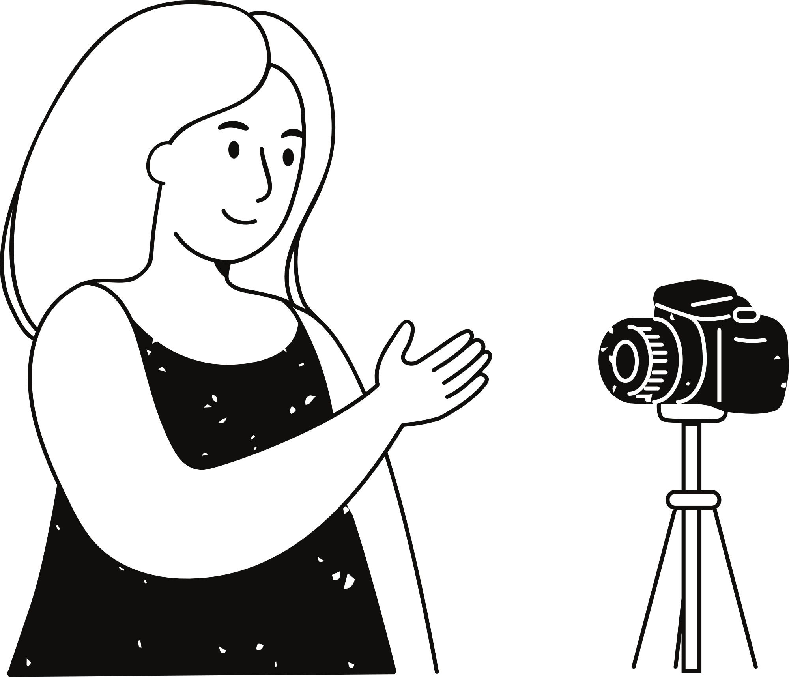

Programming Language
Python:
Used for implementing the game's logic, handling animations, and managing game mechanics.
Testing Tools
Pygame Debugging Features:
For monitoring game states, detecting errors, and fine-tuning gameplay elements.
Application
Tools
Libraries
Pygame, Tkinter, Pillow, Random:
Core library for game development, enabling sprite management, event handling, and rendering of graphics.
Additional tools
Level Editor or Graphics Tools: External software such as Photoshop,
GIMP, or Canva to design the Ludo board and tokens, ensuring a polished
visual experience.
Development Tools
IDEs:
PyCharm: For coding, debugging, and managing project files.
Visual Studio Code: An alternative IDE for quick editing and testing.

Slide 7
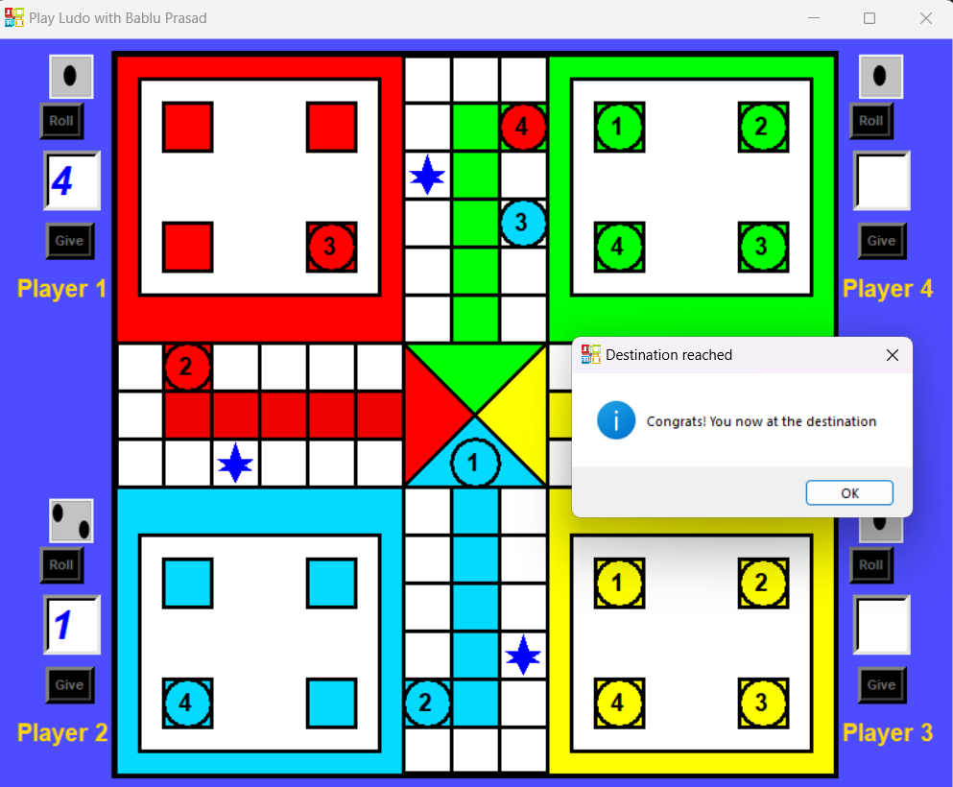
Project Design
Dice Class:
Represents the dice used for rolling and determining token movement.
Attributes:
value: The numeric result of the dice roll, ranging from 1 to 6.
image: The visual representation of the dice face corresponding to the rolled value.
Methods:
roll(): Generates a random number between 1 and 6, updating the dice value and corresponding image.
draw(): Displays the dice face on the screen at a specified position.
Token Class:
Represents an individual game piece that belongs to a player.
Attributes:
position: The current position of the token on the board.
is_in_home: A Boolean indicating if the token has reached its home zone.
color: The color of the token, matching its player.
Methods:
move(steps): Moves the token by the specified number of steps, ensuring the
movement is valid based on game rules.
can_move(dice_value): Checks if the token can legally move based on its
current position and dice roll.
is_safe_position(): Verifies if the token is in a safe position on the board.
Board Class:
Represents the game board, including the layout, safe zones, and home zones.
Attributes:
layout: A structured representation of the board, specifying paths, safe zones, and home zones.
safe_positions: A list of positions on the board where tokens are immune fromcapture.
home_zones: Specific areas where tokens move to complete the game.
Methods:
is_safe(position): Checks if a given position on the board is part of a safe zone.
validate_move(token, steps): Validates the movement of a token based on its position, the dice roll, and the rules of the game.
check_collision(token): Detects and resolves conflicts when two tokens land on the same position.
Player Class:
Choosing number of player in the game(4 players).
Attributes:
tokens: A list of Token objects controlled by the player.
color: The player’s unique color for identification and token representation.
Methods:
take_turn(dice_value): Handles the player’s turn, allowing them to roll the
dice and move a token based on the dice value.
has_won(): Checks if all the player’s tokens have reached the home zone,
signaling victory.

Slide 8
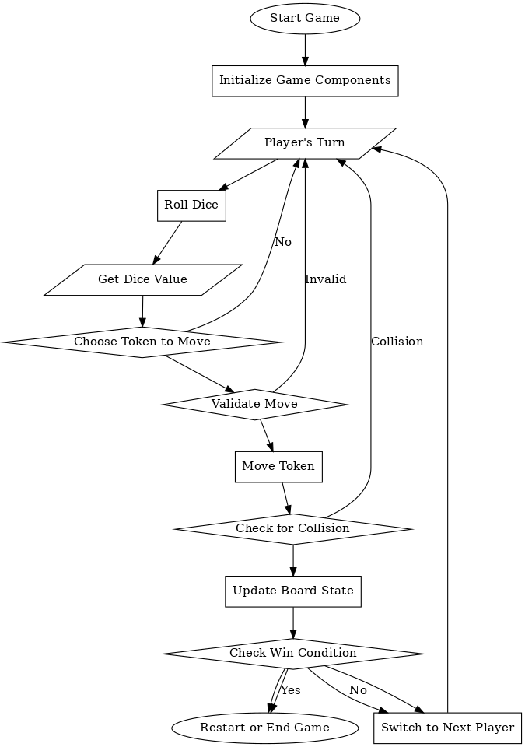
Flow chart

Slide 9
Testing and Validation
Unit Testing | Integration Testing | System Testing | Manual Testing | Performance Testing
Verifies the functionality of individual components or methods. | Checks how well different components interact with each other. | Validates the entire game workflow to ensure it meets requirements. | Game was manually played under various scenarios to identify issues. | Ensures the game runs smoothly across different environments.
Key Areas Tested: | Key Areas Tested: | Key Areas Tested: | Key Areas Tested: | Key Areas Tested:
- Dice rolling functionality. | - Interaction between dice rolling and token movement. | - Smooth game board rendering. | - Accurate token movements. | - Stable frame rate (60 FPS target).
- Token movement logic. | - Player turn transitions. | - Turn-based logic execution. | - Dice animations and sound effects. | - Resource loading times (board, tokens).
- Safe zone rules implementation. | - Handling special moves like token captures. | - Accurate tracking of token positions. | - Capture mechanics under various scenarios. | - Compatibility across different screen sizes.

Slide 10
Conclusion
The Ludo game was successfully developed with interactive gameplay, a graphical board, and token movements. Core mechanics like dice rolling, token movement, collision detection, and winning conditions were implemented. A modular, object-oriented design ensured scalability for adding players, themes, or advanced features, with reusable classes for tokens, dice, and the board. Engaging elements such as dynamic token movements, dice animations, and real-time updates were incorporated, along with features like safe zones and collision rules to adhere to classic Ludo rules. Rigorous testing ensured smooth performance and a polished user experience across various scenarios.

Slide 11
Limitations
Limited Features and Gameplay Depth: The game focuses on core Ludo mechanics but lacks advanced features like AI difficulty levels, customizable game modes, or varied themes to enhance gameplay variety.
No Restart Option: Once a game session ends, players cannot restart directly, requiring them to relaunch the game to play again.
Minimal Sound Effects: The game does not include sound effects for events like dice rolls, token movements, or captures, reducing audio immersion.
Basic Animations: While functional, the animations for dice rolls and token movements are minimal and could be enhanced for a more dynamic visual experience.
Single-Session Gameplay: The game is designed for single-session play without features like saving progress or resuming previous games.
Static Game Setup: Token movements and gameplay interactions follow fixed rules without dynamic variations, limiting replayability and surprise elements.

Slide 12
Reference
Pygame Documentation:
Comprehensive reference for Pygame features like sprite handling, collision detection, and sound integration.
https://www.pygame.org/docs/
Python Official Documentation:
Standard library references for os, random, and csv modules.
https://docs.python.org/
OpenGameArt.org:
Source for free and royalty-free 2D game assets.
https://opengameart.org/
Freesound.org:
Repository for free sound effects and audio clips.
https://freesound.org/
Clear Code YouTube Channel:
Tutorials on Pygame game development.
https://www.youtube.com/@CodingWithRuss
Project Git hub repository :
https://github.com/bprasad03/ludo_game

Slide 13
Thank you !

