Slide 1
Diagram1 dataset pipeline = slide2
Diagram2 L1 = slide3
Diagram3 L2 = slide4

Slide 2
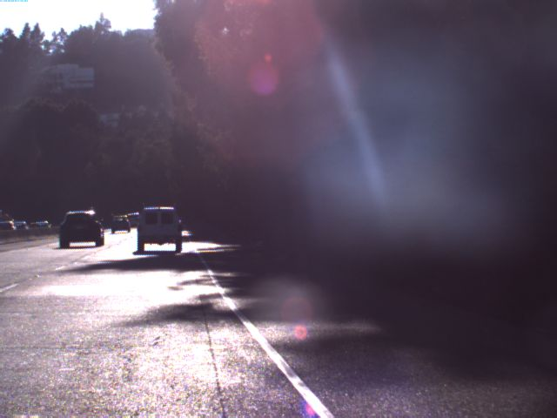
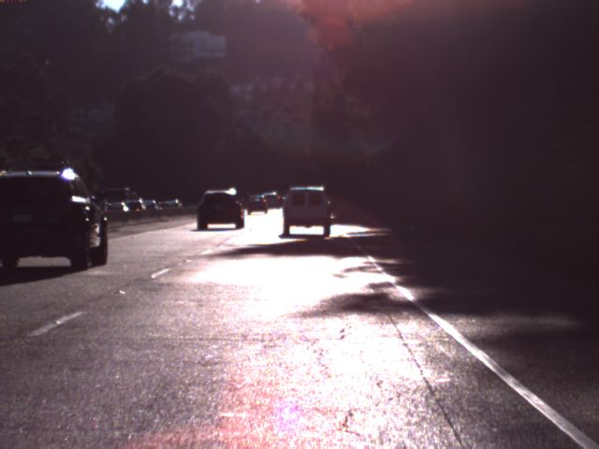
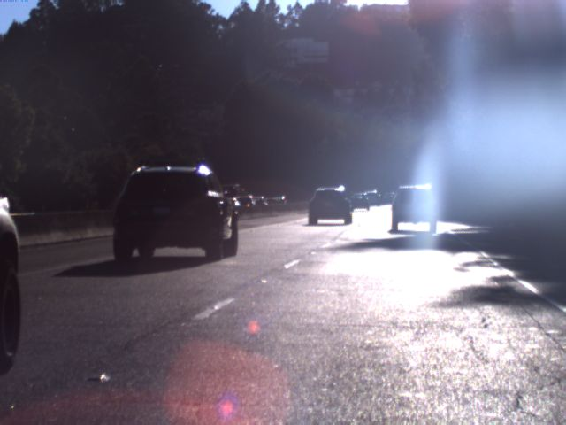
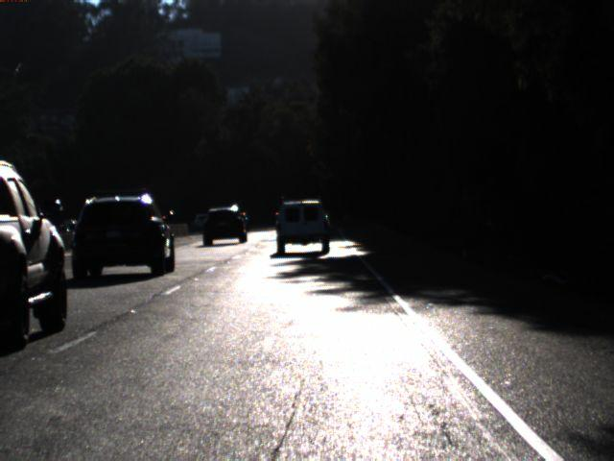
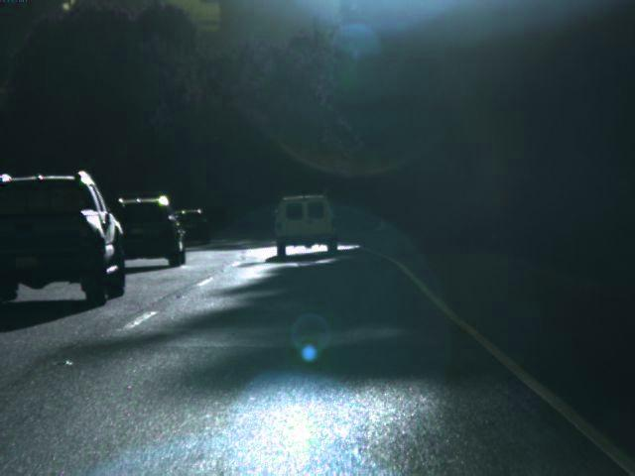
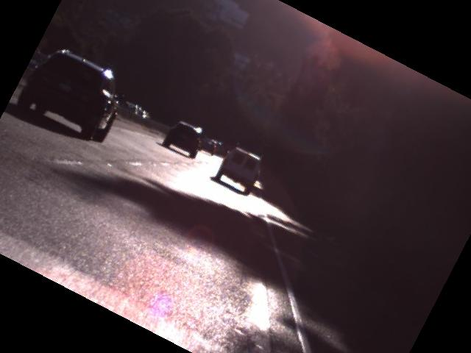
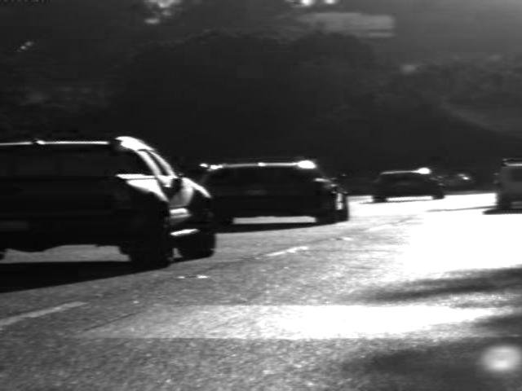
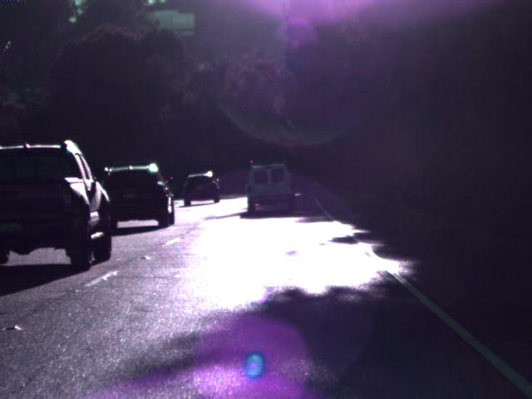
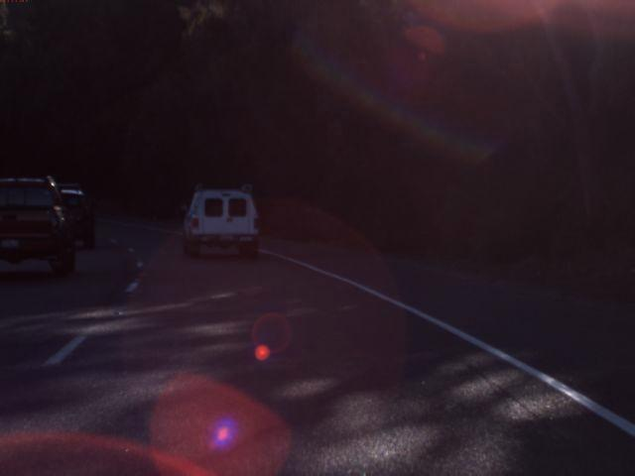
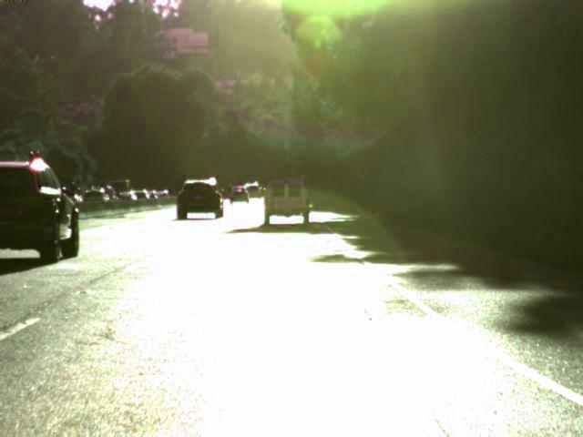
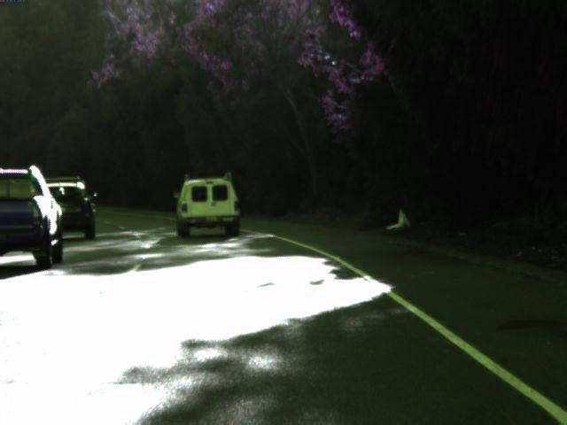
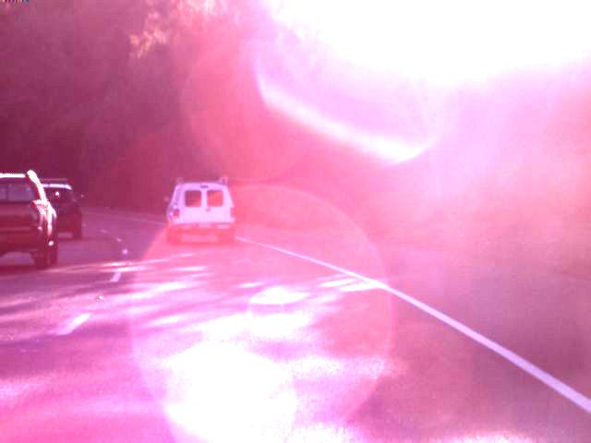
Terminology: source_augmentation_probability
hmb1_L2_6 -> hmb1 dataset augmented with Level 2 and augmentation probability p=0.6
Right Camera
Center Camera
HMB1
Left Camera
L1
L2
L3
hmb1_L1_4
hmb1_L1_5
hmb1_L1_6
hmb1_L2_4
hmb1_L2_5
hmb1_L2_6
hmb1_L3_05
hmb1_L3_1
hmb1_L1_25

Slide 3
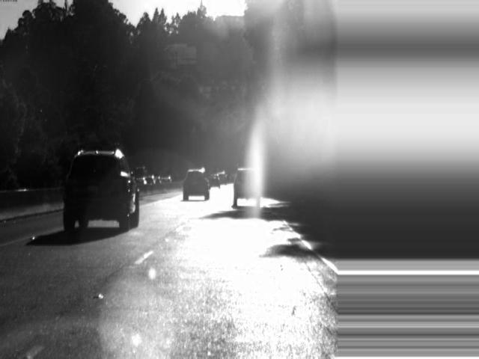
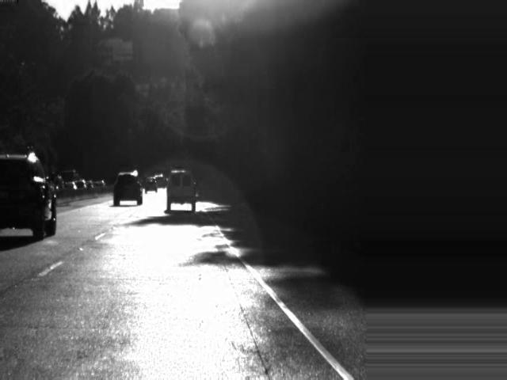
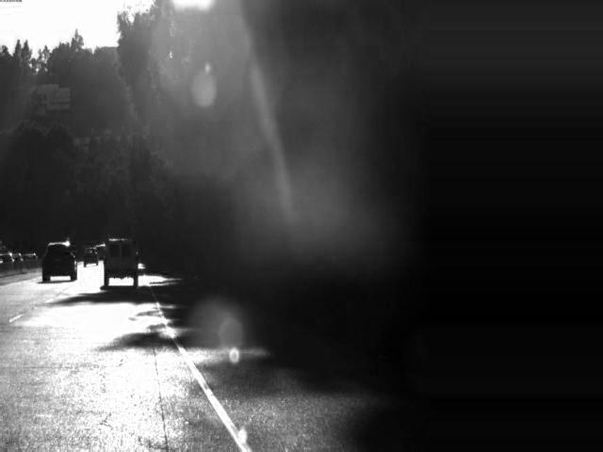
HMB1
13,203 images
3
images
Random Augmentation
p = {0.4, 0.5, 0.6}
3
augmented images
hmb1_L1_{p}
13,203
augmented + un-augmented images

Slide 4
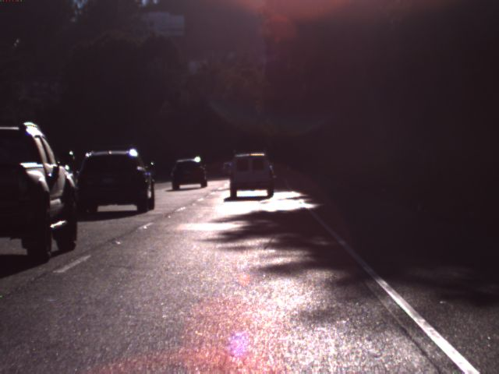
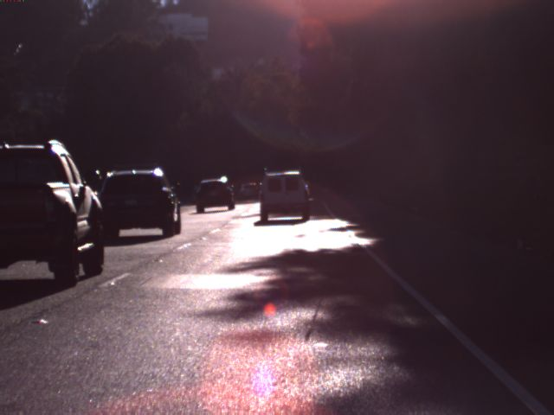
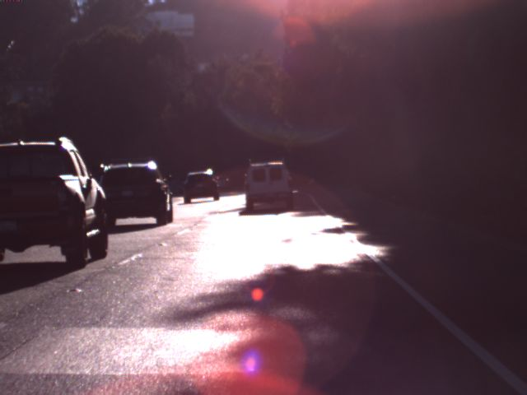
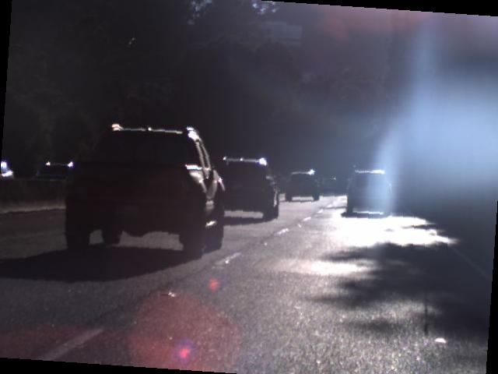
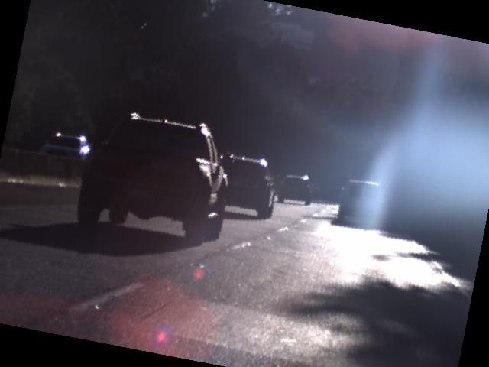
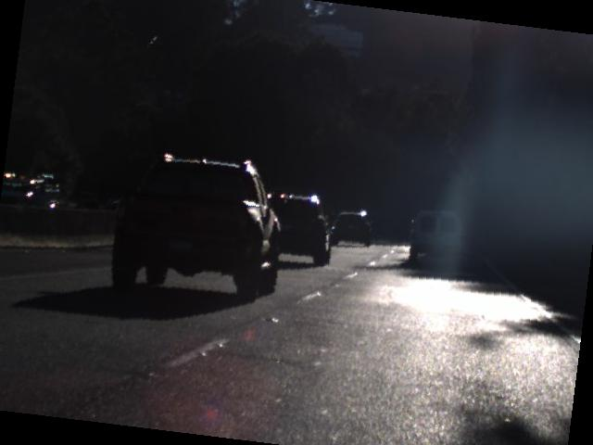
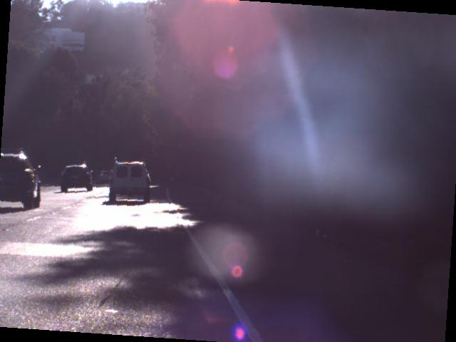
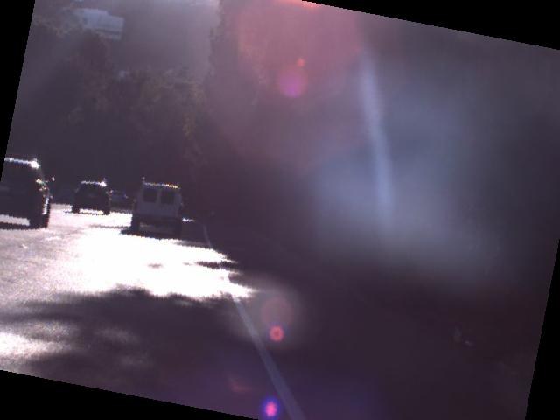
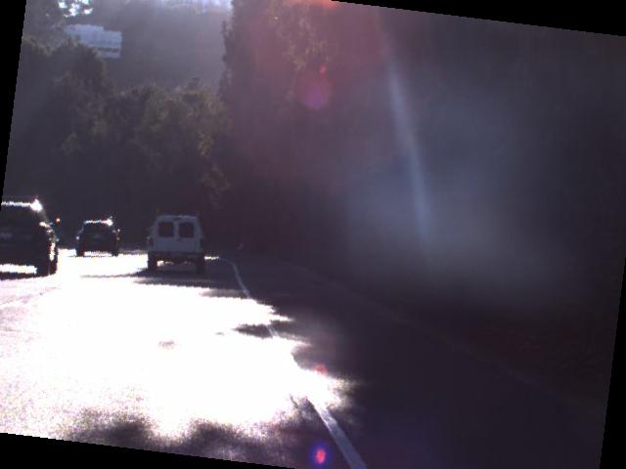
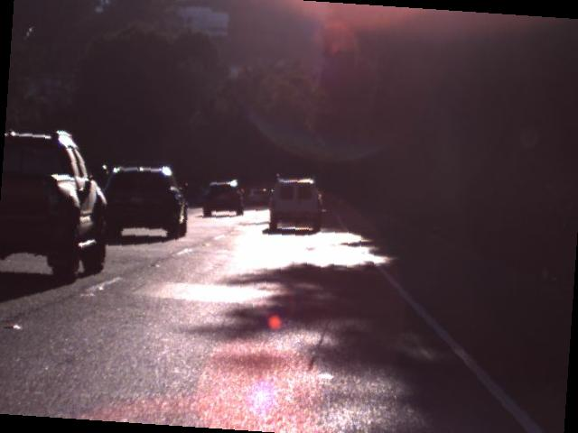
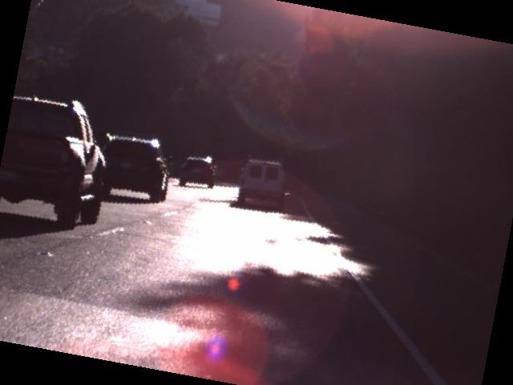
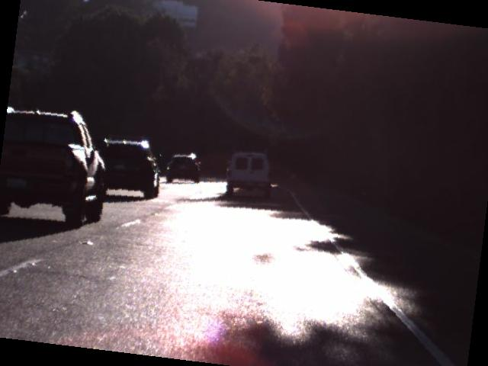
HMB1
13,203 images
…
…
3 * 19 images
Random Augmentation
p = {0.4, 0.5, 0.6}
*0.1
*1
*0.1
augmentation intensity
…
3 * 19
augmented images
…
hmb1_L2_{p}
13,203
augmented + un-augmented images

