Slide 1
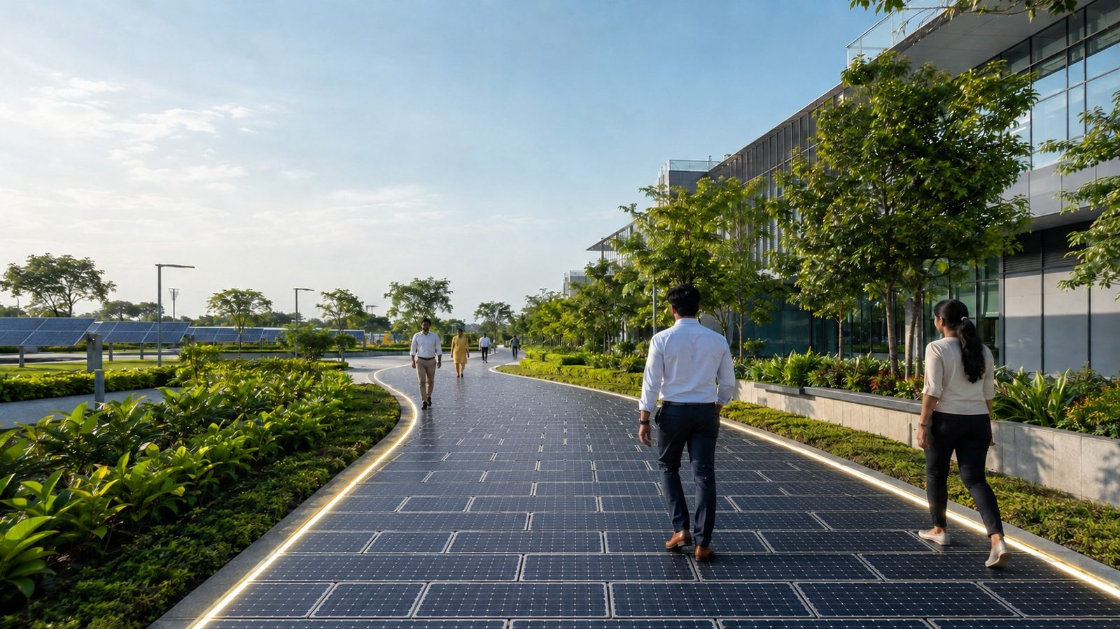

GridMats® Solar Walkway
PILOT PROPOSAL · [CLIENT]
A pilot walkway that generates power on your campus
Prepared for [Client legal entity]
[Campus or site name], [City, State] · [Month Year]
GroundReality Enterprises Pvt. Ltd., Bengaluru · Indian Patent 398992
Concept visualization
Notes:
Open with the idea: a 20 m² walkway on the [Client] campus that people walk on and that generates power. It is a pilot: GridMats Solar Walkway is pre-commercial, and the pilot exists to measure output, heat, grip and upkeep on [Client]'s own site before any rollout.

Slide 2
The proposal on one page
A 20 m² generating walkway on the [Client] campus, measured for 3 months before any rollout decision.
1
What
20 m² GridMats Solar Walkway: 80 walkable 40 W modules on a recycled-plastic GridMats base, 3.2 kWp in all.
THE PILOT AT A GLANCE
3.2 kWp
4,300 kWh
2
Output
on 20 m² (80 modules)
a year, estimated
About 4,300 kWh a year (11.8 kWh a day on average), metered and sensed from day one.
3
Cost
[Client] pays ₹2.66 L ex-GST (₹1,234/sq ft). GridMats contributes ₹4.14 L: design, 50% of the PV layer, supervision, IoT study.
₹2.66 L
7.6 years
[Client] pays, ex-GST
payback on [Client]'s outlay
4
Decision
3-month evaluation against an agreed scorecard, monitoring for 12 months. At campus scale (1,000 m²) the model shows a 10.2-year payback at today's prices.
All figures from the companion model (base case). Money ex-GST. The GridMats Solar Walkway is pre-commercial; yield, life and upkeep are estimates the pilot measures.
Notes:
Four lines and one ask. The ask: a 20 m² pilot for which [Client] pays about ₹2.66 L ex-GST, with GridMats carrying design, 50% of the PV layer, supervision and a 12-month performance study.

Slide 3




Why a walkway at [Client]
Every paved surface can do more: use it, build it from recycled plastic, and make power on it.
Roofs are already busy
A visible proof point
Roofs carry plant, tanks and access; walkways are open sky that is paved anyway.
People walk on the power plant every day: sustainability goals made tangible.
Measured and connected
Small, safe first step
Every tile is metered and sensed, with a live dashboard.
A pilot of 20-25 m², low-voltage DC, built in days; decide on rollout with measured data.
USE EXISTING SURFACES
RECYCLE INTO STRUCTURE
GENERATE CLEAN ENERGY
Notes:
Why this site: the roof is already committed, walkways are open sky that is paved anyway, and a walkway is where people see it. The three chevrons are the GridMats Solar Walkway proposition.

Slide 4
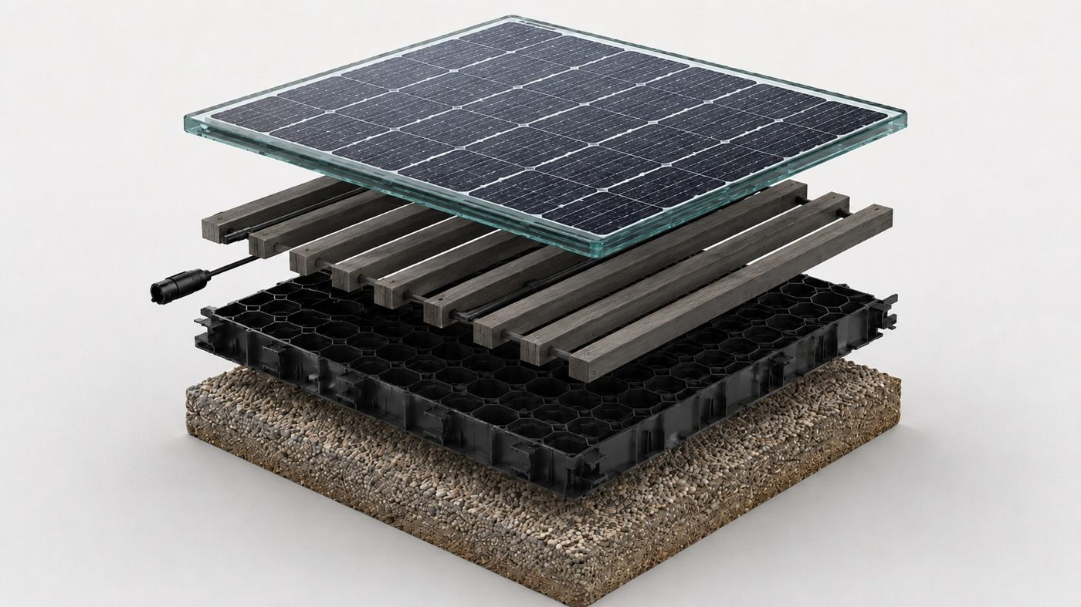
What it is
A modular surface that carries people and produces electricity.
PV
1. Walkable photovoltaic layer
12 mm toughened glass over a 40 W module; modular, so one module can be replaced without lifting the walkway.
DC
2. MLP lumber electrical layer
40 × 40 mm recycled MLP lumber carries the wiring, with about 50 mm open gaps for airflow and drainage.
GM
3. Patented GridMats structural base
100% recycled polypropylene grid (500 × 500 mm, 4 per m²) gives confinement, stability and a level bed.
GP
4. Prepared ground
Well-compacted subgrade, geotextile fabric, 100 mm wet mix macadam and 20 mm M-sand bedding (soil CBR under 8).
Concept visualization
Design basis: 40 W per 550 × 400 mm module · 4 modules per m² · about 160 W per m² of walkway · 15-16% surface efficiency · no extra land or mounting
GridMats Solar Walkway flier (6 Oct 2026) and Client/Partner Deck v2. Status: pre-commercial; pilot validation under way.
Notes:
Three layers plus the ground beneath them. Walkable PV on top, MLP lumber that carries the wiring and lets water and air through, the patented GridMats base, and a prepared bed: compacted soil, geotextile, WMM and M-sand. The WMM is 100 mm where the soil CBR is under 8 and 50 mm otherwise, so the site soil test matters. Design basis about 160 W per square metre of walkway.

Slide 5

How it works, and how it stays safe
A proven GridMats platform extended into distributed energy; safety is designed in and verified in the pilot.
01
Capture
Walkable PV modules harvest sunlight on a surface already in use.
Safety by design
02
Connect
Textured toughened glass: target R11 or wet PTV ≥ 36
Load target 4 kN/m² and 4.5 kN point load (IS 875 Part 2)
Extra-low-voltage DC strings; IP68 junction boxes at grade
BIS-registered modules (IS 14286, IS/IEC 61730)
50 mm gaps drain and cool; edge ramps; one-module repairs
Low-voltage DC wiring runs inside the MLP lumber, out of sight and out of the way.
03
Convert
An inverter feeds the campus low-voltage board, behind the meter.
04
Use and measure
Tested at handover and through the pilot; no result is claimed until it is measured.
Every kWh is metered; sensors log module heat, moisture and uptime.
Notes:
Walk through the four steps, then safety. Be clear that walkability, load and heat are pilot measurements; GridMats does not claim test results it does not yet have.

Slide 6
Built on the latest TOPCon cells
n-type TOPCon runs cooler and ages slower than PERC, which matters on a hot, flat walkway.
25.6-26%
26.66%
TOPCon cell efficiency in mass production (2026)
record industrial TOPCon cell, M10 wafer (Feb 2026)
−0.29%/°C
1% + 0.4%/yr
power loss per degree, against −0.35%/°C for PERC
degradation: first year, then each year
Same 4 kWp pilot | Heat loss | 20-yr MWh | W/m² (derived)
Mono PERC | 9.4% | 77.6 | 159
TOPCon | 7.8% | 80.5 | 176
HJT | 6.8% | 82.3 | 180
TOPCon generates 3.8% more than PERC over 20 years on this walkway. Rated on the 40 W design basis; a TOPCon-derived rating of about 176 W/m² is the upgrade path, to be validated.
pv-magazine (25 Feb 2026); taiyangnews; Canadian Solar TOPHiKu6 and Jinko Tiger Neo datasheets; JMK Research (Apr 2026). Losses are model assumptions the pilot measures.
Notes:
Cell technology matters more on a walkway than on a roof: the modules lie flat, run hot and collect dust. TOPCon's lower temperature coefficient and slower degradation are worth a few percent of lifetime energy over PERC; HJT, which Reliance makes at Jamnagar, is slightly better again and is a candidate for a co-developed module.

Slide 7
The pilot on the [Client] campus
[Campus or site name]: 10.0 m × 2.0 m of walkway, 80 modules, behind the meter.
Pilot specification
Area
20.0 m² (215 sq ft)
2.0 m
Modules
80 × 40 W
Cells
TOPCon (n-type)
10.0 m
Rated power
3.2 kWp
Build
New walkway
Campus LV board
(≤ 30 m)
Inverter +
energy meter
Connection
Behind the meter, campus LV board
40 W module on a 500 × 500 mm GridMats grid
Monitoring
12 months, live dashboard
Sensors: module temperature, moisture, reference cell
Install time
2-3 days on site
Low-voltage cable route
Indicative layout; final layout follows the site assessment (shade, footfall, drainage, connection point).
Notes:
This is the pilot as drawn: four modules across, one per 500 mm grid, the cable run to an inverter and meter, then to the nearest low-voltage board. Sensor positions are indicative.

Slide 8
What it will generate
Bengaluru sunshine, TOPCon (n-type) modules, 73% performance ratio after losses, 5% site shading.
4,300 kWh
a year, estimated
11.8 kWh
a day on average
455 / 297
kWh in the best and the monsoon month
3.1 t
CO2 avoided a year (CEA grid factor)
Sunshine: typical-year Bengaluru profile, 1,935 kWh/m²/yr (replace with site data after the site walk). Specific yield 1,345 kWh/kWp/yr.
Notes:
Generation follows the sun: strongest in March to May, weakest in the monsoon. The pilot will measure the real monthly figures against this curve; that comparison is the first line of the scorecard.

Slide 9
What the pilot costs, and who pays
List value of the pilot scope against what [Client] pays. Ex-GST; GST extra at the applicable rate.
Scope | List | GridMats covers | [Client] pays
Site assessment and engineering design | ₹0.40 L | ₹0.40 L | Included
Ground preparation and GridMats OC-LW 40 base | ₹0.21 L | - | ₹0.21 L
Walkable PV layer (80 × 40 W, MLP lumber, wiring) | ₹3.27 L | ₹1.64 L | ₹1.64 L
Electrical BOS, grid integration and metering | ₹0.46 L | - | ₹0.46 L
Logistics and installation | ₹0.34 L | - | ₹0.34 L
GridMats supervision, training and travel | ₹0.85 L | ₹0.85 L | Included
IoT sensors, dashboard and performance study | ₹1.25 L | ₹1.25 L | Included
Total, ex-GST | ₹6.79 L | ₹4.14 L | ₹2.66 L
₹2.66 L
[Client] pays, ex-GST: ₹1,234/sq ft (₹2.89 L with GST)
₹4.14 L
GridMats contributes (61% of list): design, 50% of the PV layer, supervision, IoT study
Defect liability: 12 months from handover, with joint inspections. PV layer price ₹1,521/sq ft (₹16,373/m²).
Co-funding of the PV layer: 50% (pilot offer, needs MD approval). Full physical installed cost before co-funding: ₹4.29 L (₹1,994/sq ft).
Notes:
The offer: [Client] pays for the ground preparation, the base, 50% of the PV layer, the electrical work and installation; GridMats carries engineering, 50% of the PV layer, supervision and the monitoring study. Prices shown per sq ft first.

Slide 10
Pilot economics, and what rollout looks like
The pilot is for evidence; the business case is the campus rollout at 1,000 m².
PILOT
₹1,860/sq ft
7.6 years
installed at rollout (₹20,020/m²)
payback on [Client]'s ₹2.66 L outlay
10.2 years
payback, net of the walkway it replaces
11.8 years
payback on the full ₹4.29 L installed cost, without co-funding
8%
IRR over 20 years, pre-tax
Year-1 bill saving about ₹38,400 at ₹9.00/kWh.
₹11.98
per kWh, against grid power at ₹9.00
Rollout uses the rollout PV-layer price (₹15,984/m²), the GridMats price ladder and a ₹1,200/m² credit for the paver walkway it replaces. 3% tariff escalation, 10% discount rate.
Notes:
Separate the two cases. The pilot is an evidence purchase, made cheaper by co-funding. The rollout case at today's prices pays back in 10.2 years and delivers power at ₹11.98/kWh against ₹9.00 from the grid, so say plainly that it is not yet a pure energy-savings case. It improves with the walkway credit, a higher tariff, volume pricing and measured yield; the pilot measures the yield.

Slide 11
How it compares
Rooftop solar is cheaper per kWp. The walkway wins where roofs are full and a walkway is being built anyway.
On the same footprint | Walkway | Rooftop | Carport | Pavers + rooftop
Payback (years) | 12.2 | 3.0 | 4.7 | 3.5
Walking surface | Yes | No | Shade, not a walkway | Yes
Roof or structure | No | Roof | Steel canopy and footings | Roof
Recycled plastic (t) | 4.0 | - | - | -
Positioning: on walkways that are being built or relaid, on campuses where the roof is spoken for, and where visibility matters.
Footprint 1,000 m². Rooftop ₹40/Wp and carport ₹61/Wp all-in (earlier GridMats ROI model benchmarks). Payback on year-1 figures, before any walkway credit.
Notes:
Be honest here: per kWp, a roof is cheaper and pays back faster. The walkway is not a replacement for rooftop solar; it adds generation where the roof is full and turns a walkway budget into a generating asset.

Slide 12
What moves the payback
Campus-rollout payback in years: power price against performance ratio. Base case: ₹9.00/kWh, 73%.
₹ / kWh ↓ · PR → | 60% | 65% | 70% | 75% | 80%
₹8 | 16.9 | 15.3 | 14.0 | 12.9 | 11.9
₹9 | 14.6 | 13.2 | 12.1 | 11.2 | 10.4
₹10 | 12.9 | 11.7 | 10.7 | 9.9 | 9.2
₹11 | 11.5 | 10.4 | 9.6 | 8.9 | 8.2
₹12 | 10.4 | 9.4 | 8.7 | 8.0 | 7.5
₹13 | 9.4 | 8.6 | 7.9 | 7.3 | 6.8
₹14 | 8.7 | 7.9 | 7.3 | 6.7 | 6.3
Reading the table
Green: 6 years or less
Amber: 6 to 9 years
Red: above 9 years
Pilot payback on [Client]'s outlay vs GridMats co-funding of the PV layer
Co-funding | 0% | 25% | 50% | 75%
Payback (yrs) | 13.5 | 10.9 | 8.3 | 5.8
The pilot measures the performance ratio; the electricity bill sets the power price.
Model sheet 'Sensitivity'. Simple payback on year-1 figures, net of the walkway it replaces.
Notes:
Two numbers drive everything: the landed power price at the campus and the real performance ratio of flat, walk-on modules. The bill gives the first; the pilot gives the second.

Slide 13
Measured, not assumed
A scorecard agreed with [Client] before installation and reviewed at 3 months.
KPI | Target | Weight
Energy generation vs estimate | ≥ 90% of the model's monthly estimate | 20%
Performance ratio achieved | ≥ PR used in the model | 10%
Pedestrian and maintenance-cart load | 4 kN/m² uniform and 4.5 kN point load (IS 875 Part 2); no cracking or movement | 15%
Surface temperature (peak) | Within module specification | 5%
Slip resistance and walking comfort | R11 (DIN 51130) or wet pendulum PTV ≥ 36 | 10%
Drainage and water ingress | No ponding, no ingress | 10%
Electrical uptime | ≥ 98% | 10%
Cleaning and maintenance effort | Within O&M assumption | 5%
Module survival and repairability | No irreparable failures | 10%
Visual finish and user acceptance | Client acceptance | 5%
Live pilot dashboard
Energy: kWh per day and W per m²
Module temperature and ventilation
Moisture, rainfall and drainage
Uptime and fault alerts
Data exportable to the campus IoT stack
GridMats Pavement Monitor, extended for the Solar Walkway.
KPIs and weights from the earlier GridMats Solar Walkway ROI model (pilot scorecard). Targets are finalised jointly before installation.
Notes:
The scorecard is the decision tool: ten measures, weighted, agreed before a single module goes down. The dashboard makes the data visible to the client's team throughout.

Slide 14
From site walk to switch-on
About six weeks to switch-on, a 3-month evaluation, then monitoring through the monsoon.
M1
M2
M3
M4
M5
M6
M7
M8
M9
M10
M11
M12
M13
M14
Site walk, shading and generation estimate
Engineering, electrical and safety approvals
Order; supply date fixed in the PO
Install (2-3 days) and commission
Evaluation against the scorecard (3 months)
Decision gate: rollout or refine
Monitoring, live dashboard (12 months)
Built by teams GridMats trains, with a GridMats engineer on site for the whole installation.
Notes:
Indicative timing. The supply date is fixed in the purchase order once the site is ready; GridMats does not promise a fixed number of days before that.

Slide 15
From pilot to campus
Year-1 figures at each step; later phases use rollout prices for their area.
Pilot
Phase 2
Campus
Portfolio
20 m²
200 m²
1,000 m²
5,000 m²
3.2 kWp
32 kWp
160 kWp
800 kWp
rated power
rated power
rated power
rated power
4.3 MWh
43.0 MWh
215 MWh
1,076 MWh
a year
a year
a year
a year
₹0.4 L
₹3.9 L
₹19.4 L
₹96.9 L
electricity saved a year
electricity saved a year
electricity saved a year
electricity saved a year
3.1 t
30.6 t
152.8 t
764.1 t
CO2 avoided a year
CO2 avoided a year
CO2 avoided a year
CO2 avoided a year
12.5 years
11.7 years
11.5 years
11.4 years
payback at full pilot cost
payback, net of walkway credit
payback, net of walkway credit
payback, net of walkway credit
Portfolio: [Other sites] (illustrative). Phase areas are editable on the model's 'Client' sheet.
Notes:
The rollout path. Each phase is a decision on its own, taken on measured data from the one before.

Slide 16
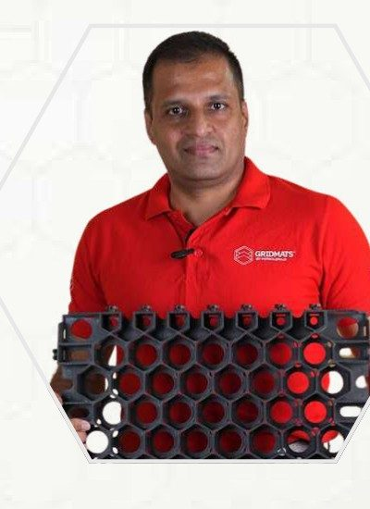

Built on the GridMats platform
The structural platform is proven in roads and surfaces; the Solar Walkway is the next product on it.
32 sites, 65,081 m²
1 million+ sq ft
Indian Patent 398992
Dr. Prathap Bhimasena Rao
built across 12 states
of GridMats supplied
patented 3D recycled-polymer grid
Founder & Managing Director
CII GreenPro
IISc · IIT Hyderabad
100% recycled PP
certified green product
R&D and pavement testing partners
post-consumer polypropylene base
26 years in leadership and innovation
Ex-Indian Air Force; Global VP, Hewlett-Packard (2010-11)
Two PhDs in management science
Figures and customers relate to existing (non-solar) GridMats road and surface applications. The Solar Walkway is pre-commercial.
Notes:
Credentials with the approved figures. Make the distinction explicit: customers and metrics are for the existing GridMats platform; the Solar Walkway is entering its first pilots.

Slide 17
Let's walk the site
What GridMats needs from [Client], and the four steps to a measured result.
FROM [CLIENT]
1
Site walk and opportunity assessment
A sunny 10-14 m stretch of walkway, about 2 m wide, with little shade from 9 am to 4 pm
A low-voltage connection point within about 30 m
Permission for a 2-3 day installation window and a safety induction
A soaked CBR test of the subgrade at the pilot stretch (done at the site walk, one test per 25 m²)
A facilities contact for monthly readings and the 3-month review
Shade, footfall, drainage and the electrical connection.
2
Concept layout and generation estimate
Module layout, monthly kWh, final price.
3
Pilot engineering and order
Electrical, safety and monitoring details; PO with the supply date.
4
Install, measure, decide
2-3 days on site; 3-month scorecard review.
Dr. Prathap Bhimasena Rao · prathap@gridmats.com · sales@gridmats.com · +91 63626 46287 · www.gridmats.com
Notes:
Close on the site walk: name the walkway, the connection point and the facilities contact, and the pilot can be engineered within weeks.

Slide 18
Key assumptions and sources
Every value is an input in the companion model; change it there and rebuild the deck.
Assumption | Value | Source / basis
Design basis | 40 W module · 4 per m² · 160 W/m² | Flier (6 Oct 2026); Client/Partner Deck v2
Sunshine | Bengaluru: 1,935 kWh/m²/yr | Typical year; replace with site data
Cell technology | TOPCon (n-type): -0.29%/°C; 1% then 0.6%/yr | 2026 datasheets; walk-on wear +0.2%/yr
Performance ratio; shading | 73% (seven losses); 5% | Loss stack on 'Product & Costs'; site assessment
Power price; escalation | ₹9.00/kWh; 3%/yr | [Site electricity bill]
PV layer price | ₹1,521/sq ft pilot; ₹1,485/sq ft rollout | GridMats pilot and volume pricing, Oct 2026
Ground, base, electrical | Prep ₹34/sq ft (100 mm WMM); OC-LW 40 ₹64/sq ft; electrical ₹6.7/Wp | Site soil CBR 6% (confirm by test); price ladder Sep 2026
O&M; life | 1.5% of capex/yr; 20 years | Earlier ROI model
Rooftop; carport | ₹40/Wp; ₹61/Wp all-in | Earlier ROI model benchmarks
GST | 8.9% composite (5% goods, 18% services) | Notification 9/2025, from 22 Sep 2025
Walkway power is the 160 W/m² design basis (Oct 2026). Prices are GridMats pilot prices, ex-GST. Performance ratio 73% from a seven-loss stack, not a flat figure.
Notes:
Reference slide. Every value here is an editable input in the model.

