Slide 1
Capgemini India – PeopleSoft Practice
Capgemini India – PeopleSoft PeopleCode Presentation

Slide 2
Agenda
PeopleCode Editor
PeopleCode Language
PeopleCode Programs and Events
PeopleCode Component Processor
Component Buffer
Using Errors and Warnings
System Variables
Meta SQL
PeopleCode Debugger

Slide 3
Capgemini India – PeopleSoft Practice
PeopleCode Editor

Slide 4
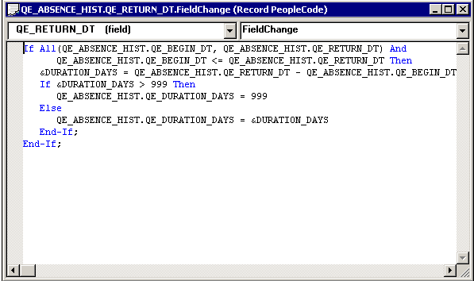
PeopleCode Editor…
PeopleSoft Application Designer supplies an independent editor window for each parent definition, such as a record definition, menu or message, for which you invoke the editor.

Slide 5
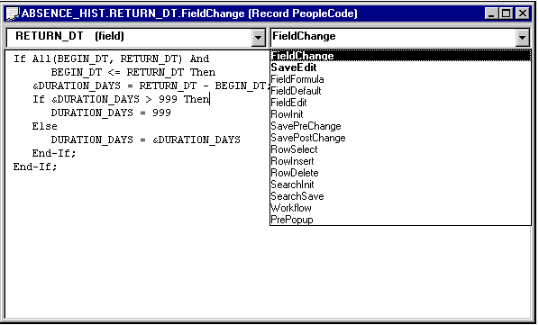
PeopleCode Editor
Use the PeopleCode Editor’s drop-down event list to select an event from the event set of the currently selected definition. Use this event list to navigate between PeopleCode programs that are associated with that definition. For every definition-event combination with associated PeopleCode, the event name is displayed in bold, and it appears at the top of the event list.

Slide 6
Capgemini India – PeopleSoft Practice
PeopleCode Language

Slide 7
PeopleCode Language…
In its fundamentals, PeopleCode syntax resembles other programming languages.
Every PeopleCode is associated with an Object(Record, Component, AE Step etc.) and Event (FieldChange, SavePreChange, OnExecute etc.)
It includes
  Data types.
  Comments
  Statements.
  Functions.
  Expressions .
  Operators.

Slide 8
PeopleCode Language – Data Types
The data types are divided into two categories
  Conventional data types.
  Object data types.

Slide 9
PeopleCode Language – Conventional Data types
Any - When variables and function return values are declared as Any, the data type is indeterminate, enabling PeopleTools to determine the appropriate type of value based on context. Undeclared local variables are Any by default.
Boolean
Date
DateTime
Float
Integer
Number
Object
String
Time

Slide 10
PeopleCode Language – Object Data types
PeopleCode includes these data buffer access types:
  Field
  Record
  Row
  Rowset
PeopleCode includes these display data types:
  Chart
  Grid
  GridColumn
  Page

Slide 11
PeopleCode Language – Object Data types
PeopleCode includes these miscellaneous data types:
  AESection
  Array
  Exception
  File
  JavaObject
  Message
  ProcessRequest
  SoapDoc
  SQL
  XmlDoc
  XmlNode

Slide 12
PeopleCode Language – Comments
The following are the ways to insert comments into PeopleCode:
You can surround comments with /* at the beginning and */ at the end.
You can also use a REM (remark) statement for commenting.
Put a semicolon at the end of a REM comment. If you do not, everything up to the end of the next statement is treated as part of the comment.
You can surround commented text with <* at the start and *> at the end.
Generally use this when you're testing code and want to
comment out a section that already contains comments.
<* this program is no longer valid;
/* Next row is based on new value of EFFDT. */
calc_next_compchg(EFFDT, EFFSEQ, 0);
/* Next row is based on new value of EFFDT. */
*>
calc_next_compchg(EFFDT, EFFSEQ, 0);

Slide 13
PeopleCode Language – Statements
A statement can be a declaration, an assignment, a program construct (such as a Break statement or a conditional loop), or a subroutine call.
This section includes:
  Separators.
  Assignment statements.
  Language Constructs.
    Branching statements. (If and Evaluate)
    Conditional loops. (For, Repeat, and While)
  variableName = expression;

Slide 14
PeopleCode Language – Statements
If, Then, and Else statements
If condition Then
  [statement_list_1]
  [Else
  [statement_list_2]]
  End-if;
Evaluate Statement
    evaluate &USE_FREQUENCY
    when = "never"
    PROD_USE_FREQ = 0;
    Break;
    when = "sometimes"
    PROD_USE_FREQ = 1;
    Break;
    when = "frequently"
    PROD_USE_FREQ = 2;
    Break;
    when-other
    Error "Unexpected value assigned to &USE_FREQUENCY."
    end-evaluate;

Slide 15
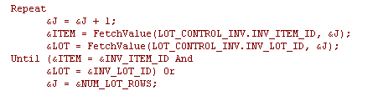

PeopleCode Language – Statements
Repeat Statement
When Statement

Slide 16
PeopleCode Language – Functions
Supported functions.
Function definitions.
Function declarations.
Function calls.
Function return values.
Function naming conflicts.

Slide 17
PeopleCode Language – Supported Functions
PeopleCode supports the following types of functions:
  Built-in: The standard set of PeopleCode functions. These can be called without being declared. E.g. Winmessage, Error, CallAppEngine, Commitwork, Substring etc
  Internal: Functions that are defined (using the Function statement) within the PeopleCode program in which they are called.
  External PeopleCode: PeopleCode functions defined outside the calling program. These are generally contained in record definitions that serve as function libraries.
  External non-PeopleCode: Functions stored in external (C-callable) libraries.

Slide 18
PeopleCode Language – Functions definitions
PeopleCode functions can be defined in any PeopleCode program. Function definitions must be placed at the top of the program, along with any variable and external function declarations.
By convention, PeopleCode programs are stored in records whose names begin in FUNCLIB_, and they are always attached to the FieldFormula event (This would be studied later in the session).

Slide 19
PeopleCode Language – Functions Definitions
Example:
  If DeleteRow(RECORD.BUS_EXPENSE_PER, &L1_ROW, RECORD.BUS_EXPENSE_DTL, &L2_ROW) then
  WinMessage("Row deleted.");
  else
  WinMessage("Sorry -- couldn’t delete that row.");
  end-if;

Slide 20
PeopleCode Language – Functions declarations
An external call to a function from a PeopleCode program, it must declare be declared at the top of the program.
For e.g
  Declare Function UpdatePSLOCK PeopleCode FUNCLIB_NODES.MSGNODENAME FieldFormula;

Slide 21
PeopleCode Language – Functions calls and Return values
Functions are called with this syntax:
  function_name([param_list])
  The parameter list (param_list),is a list of expressions,
  separated by commas, that the function expects you to supply.
  Items in the parameter list can be optional or required.
Functions can return values of any supported data type; some functions do not return any value.

Slide 22
PeopleCode Language – Functions naming conflicts
If a function is defined with the same name as a built-in function, the function that one defines takes precedence over the built-in function.
During compilation, a warning message appears in the Validate tab, indicating that a user-defined function has the same name as an existing built-in function.

Slide 23
PeopleCode Language – Expressions
Constants
  Numeric Constants
  String Constants
  Boolean Constants
  Null Constants
  User-Defined Constants
Variables
  User Defined variables
  System Variables
    Local String &MyString = "New";
    Local Date &MyDate = %Date;
    You can declare more than one variable on a single line but you can only
    initialize one variable on a line. The following code creates a syntax error
    when you try to save the program:
    Local Number &N1, &N2 = 5;

Slide 24
PeopleCode Language – Variables Declaration and Scope
The difference between the variable declarations concerns their life spans:
Global
  The variable is valid for the entire session.
Component
  The variable is valid while any page in the component in which the variable is defined stays active.
Local
  The variable is valid for the duration of the PeopleCode program or function in which the variable is defined.
You can declare variables using the Global, Local, or Component statements, or you can use local variables without declaring them.
Examples:
Local Number &AGE;
Global String &OPER_NICKNAME;
Component Rowset &MY_ROWSET;

Slide 25
Capgemini India – PeopleSoft Practice
PeopleCode Programs and Events

Slide 26
PeopleCode Programs and Events
Understanding how Peoplecode programs are associated with events.
  Access PeopleCode in PeopleSoft Application Designer.
  Access record field PeopleCode.
  Access component record field PeopleCode.
  Access component record PeopleCode.
  Access component PeopleCode.
  Access page PeopleCode.
  Access menu item PeopleCode

Slide 27
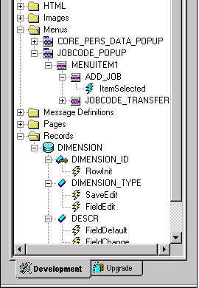
Access PeopleCode in PS Application Designer
PeopleCode can be accessed with PS App Designer definitions in several ways.
  With record fields and pop-up menu items, the Project view displays PeopleCode programs within the project hierarchy using a lightning bolt symbol.
  Double-click a record field or pop-up menu item program in the Project view to start the PeopleCode Editor and load that program for editing.

Slide 28
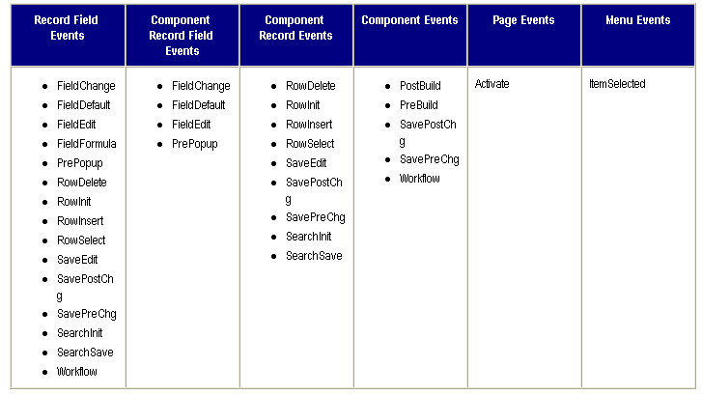
PeopleCode Events

Slide 29
Access record field PeopleCode…
A record is a table-level definition. There are different types of record definitions, such as Structured Query Language (SQL) table, dynamic view, derived/work, and so on.
Record fields are child definitions of records. Record field PeopleCode programs are child definitions of record fields. A record field can have zero or one PeopleCode programs for each event in the record field event set.

Slide 30
Access record field PeopleCode
The following are the events that are associated with a record field:
  FieldChange Event
  FieldDefault Event
  FieldEdit Event
  FieldFormula Event
  RowInit Event
  RowSelect Event
  RowDelete Event
  PrePopup Event
  SaveEdit Event
  SavePreChange Event
  Workflow Event
  SavePostChange Event
  SearchInit Event
  SearchSave event

Slide 31
Access component record field PeopleCode
Component record field PeopleCode is associated with a record field, but only with respect to a particular component and one of its events. This PeopleCode is only accessible through the component structure view, not from a record definition.
The following events are associated with a component record field:
  FieldChange Event
  FieldDefault Event
  FieldEdit Event
  PrePopup Event

Slide 32
Access component record PeopleCode
Component record PeopleCode is associated with a record field, but only with respect to a particular component and one of its events. This PeopleCode is only accessible through the component structure view, not from a record definition.
The following events are associated with a component record:
  SearchInit Event
  SearchSave Event
  RowDelete Event
  RowInit Event
  RowSelect Event
  SaveEdit Event
  SavePostChange Event
  SavePreChange Event

Slide 33
Access component PeopleCode
To access PeopleCode associated with a component record, open the component’s structure view, select a record, right-click the record name, and select View PeopleCode.
Component PeopleCode is associated with a component definition and an event.
The following events can be associated with a component:
  PostBuild Event
  PreBuild Event
  SavePostChange Event
  SavePreChange Event
  Workflow Event

Slide 34
Access page PeopleCode
Page PeopleCode is associated with a page definition. The page event set consists of a single event, the Activate event, which fires every time the page is activated. This event is valid only for pages that are defined as standard or secondary, and is not supported for subpages.

Slide 35
Access menu item PeopleCode
PeopleTools menus are either one of two types
  pop-up and
  standard,
both of which are standalone definitions in the project
hierarchy. However, you can only associate PeopleCode with
menu items in pop-up menus.
The menu item event set consists of a single event, the ItemSelected Event. This event fires whenever an user selects a menu item from a pop-up menu.

Slide 36
PeopleCode Events - Activate
The Activate event is initiated each time that a page is activated, including when a page is first displayed by a user, or if a user presses Tab between different pages in a component. Each page has its own Activate event.
Usage- Objects hiding, page security.

Slide 37
PeopleCode Events - FieldChange
Use FieldChange PeopleCode to recalculate page field values, change the appearance of page controls, or perform other processing that results from a field change other than data validation. To validate the contents of the field, use the FieldEdit event.
FieldChange PeopleCode is often paired with RowInit PeopleCode.
This is associated with record field and comp. record field.

Slide 38
PeopleCode Events - FieldDefault
The FieldDefault PeopleCode event enables you to programmatically set fields to default values when they are initially displayed. This event is initiated on all page fields as part of many different processes;
However, it triggers PeopleCode programs only when the following conditions are all true:
The page field is still blank after applying any default value specified in the record field properties.
This is true if there is no default specified, if a null value is specified, or if a 0 is specified for a numeric field.
The field has a FieldDefault PeopleCode program.

Slide 39
PeopleCode Events - FieldEdit
Use FieldEdit PeopleCode to validate the contents of a field, supplementing standard system edits. If the data does not pass the validation, the PeopleCode program should display a message using the Error statement, which redisplays the page, displaying an error message and turning the field red.

Slide 40
PeopleCode Events - FieldFormula
The FieldFormula event is not currently used. Because FieldFormula PeopleCode initiates in many different contexts and triggers PeopleCode on every field on every row in the component buffer, it can seriously degrade application performance. Use RowInit and FieldChange events rather than FieldFormula.

Slide 41
PeopleCode Events - PostBuild
The PostBuild event is initiated after all the other component build events have been initiated. This event is often used to hide or unhide pages. It’s also used to set component variables.
PostBuild PeopleCode is only associated with components.

Slide 42
PeopleCode Events - PreBuild
The PreBuild event is initiated before the rest of the component build events. This event is often used to hide or unhide pages. It’s also used to set component variables.

Slide 43
PeopleCode Events - RowInit
The RowInit event is initiated the first time that the Component Processor encounters a row of data. Use it to set the initial state of component controls. This occurs during component build processing and row insert processing. It also occurs after a Select or SelectAll Rowset method, or a ScrollSelect or related function, is executed. RowInit is not field-specific: it triggers PeopleCode on all fields and on all rows in the component buffer.
RowInit is not field-specific: it triggers PeopleCode on all fields and on all rows in the component buffer.

Slide 44
PeopleCode Events - RowInsert
When a user adds a row of data, the Component Processor generates a RowInsert event. You should use RowInsert PeopleCode for processing specific to the insertion of new rows. Do not put PeopleCode in RowInsert that already exists in RowInit, because a RowInit event always initiates after the RowInsert event, which will cause your code to be run twice.
The RowInsert event triggers PeopleCode on any field on the inserted row of data.

Slide 45
PeopleCode Events - RowDelete
The RowDelete event is initiated whenever a user attempts to delete a row of data from a page scroll area.
Use RowDelete PeopleCode to prevent the deletion of a row (using an Error or Warning statement) or to perform any other processing contingent on row deletion.
For example, you could have a page field called Total on scroll area level zero whose value is the sum of all the Extension page fields on scroll area level one. If the user deleted a row on scroll area level one, you could use RowDelete PeopleCode to recalculate the value of the Total field.
The RowDelete event triggers PeopleCode on any field on the row of data that is being flagged as deleted.

Slide 46
PeopleCode Events - RowSelect
The RowSelect event is initiated at the beginning of the component build process in any of the update action modes (Update, Update/Display All, Correction). RowSelect PeopleCode is used to filter out rows of data as they are being read into the component buffer. This event also occurs after a ScrollSelect or related function is executed.

Slide 47
PeopleCode Events - SaveEdit
The SaveEdit event is initiated whenever a user attempts to save the component. You can use SaveEdit PeopleCode to validate the consistency of data in component fields. Whenever a validation involves more than one component field, you should use SaveEdit PeopleCode. If a validation involves only one page field, use FieldEdit PeopleCode.
SaveEdit is not field-specific: it triggers associated PeopleCode on every row of data in the component buffers, except rows flagged as deleted.
An Error statement in SaveEdit PeopleCode displays a message and redisplays the component without saving data. A Warning statement enables the user to click OK and save the data, or to click Cancel and return to the component without saving.

Slide 48
PeopleCode Events - SavePreChange
The SavePreChange event is initiated after SaveEdit completes without errors. SavePreChange PeopleCode provides one final opportunity to manipulate data before the system updates the database; for instance, you could use SavePreChange PeopleCode to set sequential high-level keys. If SavePreChange runs successfully, a Workflow event is generated, and then the Component Processor issues appropriate Insert, Update, or Delete SQL statements.
SavePreChange PeopleCode is not field-specific: it triggers PeopleCode on all fields and on all rows of data in the component buffer.
SavePreChange PeopleCode can be associated with record fields, components, and component records.

Slide 49
PeopleCode Events - Workflow
Workflow PeopleCode executes immediately after the SavePreChange event and before the database update that precedes the SavePostChange event. The Workflow event segregates PeopleCode related to workflow from the rest of the application’s PeopleCode. Only PeopleCode related to workflow (such as TriggerBusinessEvent) should be in workflow programs. Your program should deal with the Workflow event only after any SavePreChange processing is complete.
Workflow PeopleCode is not field-specific: it triggers PeopleCode on all fields and on all rows of data in the component buffer.
WorkFlow PeopleCode can be associated with record fields and components.

Slide 50
PeopleCode Events - SavePostChange
After the Component Processor updates the database, it initiates the SavePostChange event. You can use SavePostChange PeopleCode to update tables not in your component using the SQLExec built-in function.
An error or warning in SavePostChange PeopleCode causes a runtime error. Avoid errors and warnings in this event.
The system issues a SQL Commit statement after SavePostChange PeopleCode completes successfully.
If you are executing Workflow PeopleCode, keep in mind that if the Workflow PeopleCode fails, SavePostChange PeopleCode is not executed. If your component has both Workflow and SavePostChange PeopleCode, consider moving the SavePostChange PeopleCode to SavePreChange or Workflow.

Slide 51
PeopleCode Events - SearchInit
The SearchInit event is generated just before a search, add, or data-entry dialog box is displayed. SearchInit triggers associated PeopleCode in the search key fields of the search record. This enables you to control processing before a user enters values for search keys in the dialog box. In some cases, you may want to set the value of the search dialog fields programmatically. For example, the following program in SearchInit PeopleCode on the component search key record field EMPLID sets the search key page field to the user’s employee ID, makes the page field unavailable for entry, and enables the user to modify the user’s own data in the component:
EMPLID = %EmployeeId;
Gray (EMPLID);

Slide 52
PeopleCode Events - SearchSave
SearchSave PeopleCode is executed for all search key fields on a search, add, or data-entry dialog box after a user clicks Search. This enables you to control processing after search key values are entered, but before the search based on these keys is executed. A typical use of this feature is to provide cross-field edits for selecting a minimum set of key information. This event is also used to force a user to enter a value in at least one field, even if it’s a partial value, to help narrow a search for tables with many rows
You can use Error and Warning statements in SearchSave PeopleCode to send the user back to the search page if the user entry does not pass validations implemented in the PeopleCode.

Slide 53
PeopleCode Events - PrePopup
The PrePopup event is initiated just before the display of a pop-up menu.
You can use PrePopup PeopleCode to control the appearance of the pop-up menu.

Slide 54
PeopleCode Events - ItemSelected
The ItemSelected event is initiated whenever a user selects a menu item from a pop-up menu. In pop-up menus, ItemSelected PeopleCode executes in the context of the page field from where the pop-up menu is attached, which means that you can freely reference and change page fields, just as you could from a button.

Slide 55
Capgemini India – PeopleSoft Practice
PeopleCode Component Processor

Slide 56
PeopleCode Component Processor
The Component Processor is the PeopleTools runtime engine that controls processing of an application from the time that a user requests a component from an application menu until the database is updated and
processing of the component is complete.
Following points are covered in this section:
  Events Outside the Component Processor Flow
  How PeopleCode Programs Are Triggered
  Component Processor Behavior
  Processing Sequences
  PeopleSoft Internet Architecture Processing Considerations
  Deferred Processing Mode
  PeopleCode Execution in Multiple Scroll Pages

Slide 57
Events Outside the Component Processor Flow
Application Message events
PeopleCode in an Application Engine action
User-defined methods of Component Interface
PeopleCode in the Application Class

Slide 58
How PeopleCode Programs Are Triggered
PeopleCode can be associated with a PeopleCode record field, a component record, and many other items.
PeopleCode events fire at particular times, in particular sequences, during the course of the Component Processor's flow of execution. When an event fires, it triggers PeopleCode programs on specific objects.
E.g.: Tabbing out from a field
        FieldEdit PeopleCode of record field is executed first
        FieldEdit PeopleCode of the component record is executed next

Slide 59
How PeopleCode Programs Are Triggered
Execution order of Events
The PeopleCode program associated with the record field event is
initiated first, and then the PeopleCode program associated with the
like-named component event is initiated.
The following events occur after a user changes a field:
Record.recordA.fielda.FieldEdit ->
Component.recordA.fielda.FieldEdit ->
Record.recordB.fieldb.FieldEdit ->
Component.recordB.fieldb.FieldEdit ->
Record.recordA.fielda.FieldChange ->
Component.recordA.fielda.FieldChange ->
Record.recordB.fieldb.FieldChange ->
Component.recordB.fieldb.FieldChange ->

Slide 60
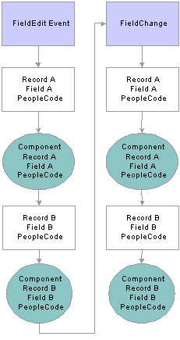
Peoplecode Component Processor

Slide 61
Component Processor Behavior
From Page Start to Page Display
End-user actions in the component

Slide 62
Component Processor Behavior
Component Processor Behavior from Page Start to Page Display
Before a user selects a component, the system is in reset state, in which no component is displayed. The Component Processor’s flow of execution begins when a user selects a component from a PeopleSoft menu. The Component Processor then:
Performs search processing, in which it obtains and saves search key values for the component.
Retrieves from the database server any data needed to build the component.
Builds the component, creating buffers for the component data.
Performs any additional processing for the component or the page.
Displays the component and waits for user action.

Slide 63
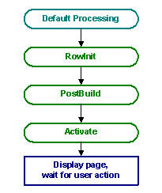
Component Processor Behavior
From Page Start to Page Display:

Slide 64
Component Processor Behavior
End-user actions in the component
After the component is built and displayed, the Component Processor can respond to a number of possible end-user actions
Row Insert Processing, Row Delete Processing, Field Modification, Prompts, Pop-up Menu Display, ItemSelected Processing, PushButtons, Save Processing, Exit Component

Slide 65
Processing sequences
Default processing.
Search processing in update mode.
Search processing in add mode.
Component build processing in update mode.
Row select processing.
Component build processing in add mode.
Field modification.
Row insert processing.
Row delete processing.
Buttons.
Prompts.
Pop-up menu display.
Selected item processing.
Save processing.

Slide 66
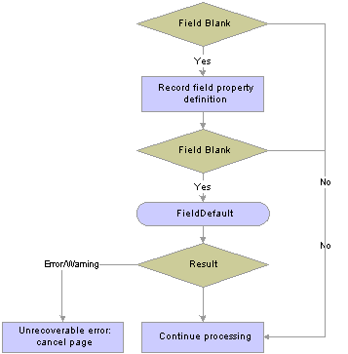
Processing sequences
Field Level Default Processing

Slide 67
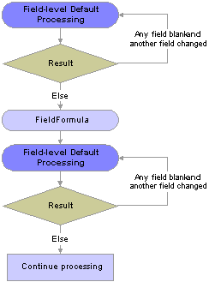
Processing sequences
Default Processing on Component level

Slide 68
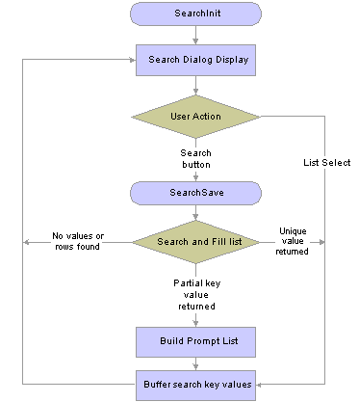
Processing sequences
Search Processing in Update mode

Slide 69
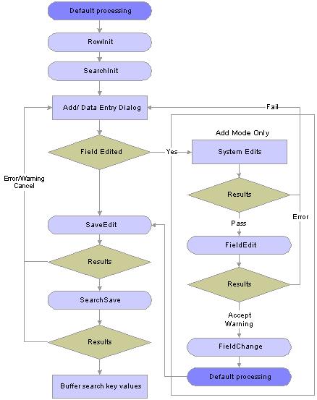
Processing sequences
Search Processing in Add mode

Slide 70
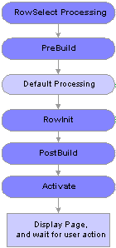
Processing sequences
Component Build Processing in Update Modes

Slide 71
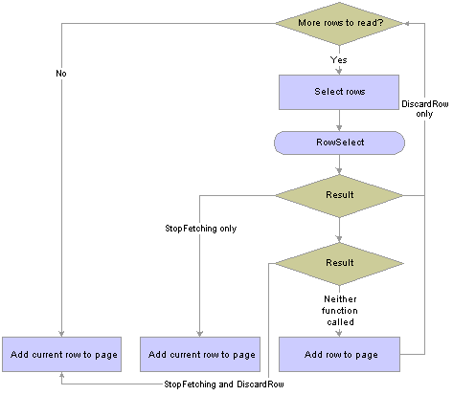
Processing sequences
Row Select Processing

Slide 72
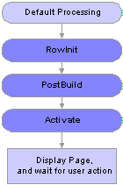
Processing sequences
Component Build Processing in Add Modes

Slide 73
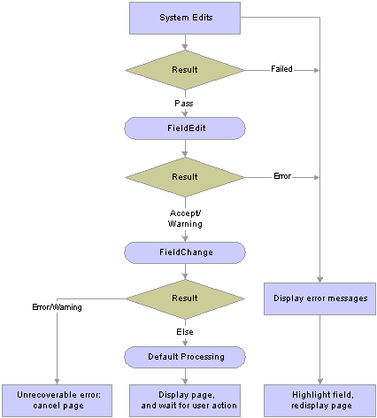
Processing sequences
Field Modification

Slide 74
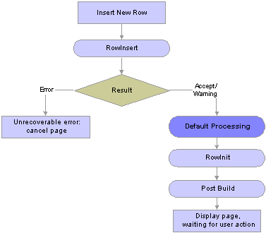
Processing sequences
Row Insert Processing

Slide 75
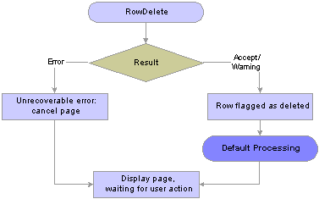
Processing sequences
Row Delete Processing

Slide 76
Processing sequences
Buttons
When a user presses a button, this initiates the same
processing as changing a field. Typically, PeopleCode
programs started by button are placed in the FieldChange
event.
Prompts
No PeopleCode event is initiated as a result of prompts,
returning to the search page or displaying a calendar. This
process is controlled automatically by the system.
Note. When the value of a field is changed using a prompt,
the standard field modification processing occurs.

Slide 77
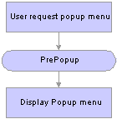
Processing sequences
Pop-Up Menu Display

Slide 78
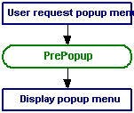
Processing sequences
Selected Item Processing

Slide 79
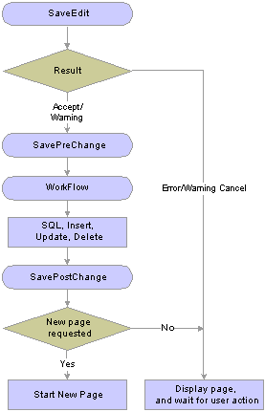
Processing sequences
Save Processing

Slide 80
PeopleSoft Internet Architecture Processing Considerations
If an end-user changes a field, but there is nothing to cause a trip to the server on that field, default processing and FieldFormula PeopleCode don't run.
In applications that run on the PeopleSoft portal, external, dynamic hyperlink information must be placed in RowInit PeopleCode. (If it's placed in FieldChange PeopleCode, it won't work.)

Slide 81
Deferred Processing Mode
Field modification processing is deferred.
Drop-down list box values are static.
No field modification processing is done during prompt
button processing.
Field modification processing executes in field layout order.
PeopleCode dependencies between fields on the page will
not work as expected.
Some pushbuttons do not cause field modification
processing to execute. E.g.. Specifically, External Link, List
(Search), and Process pushbuttons .
You can use a PeopleCode Command pushbutton to cause
field modification processing to execute.
A scroll pushbutton (hyperlink) causes field modification
processing to execute.

Slide 82
PeopleCode Execution in Multiple Scroll Pages
The Component Processor uses a "depth-first" algorithm to process rows in multiple-scroll pages.
Level One: The Component Processor processes record definitions at scroll level zero, then all rows of data at scroll level one. Data is retrieved for all rows with a single SELECT statement, and then merged with buffer structures.
Scroll Level Two: It processes a single row of data at scroll level one, then processes all its subordinate rows of data at scroll level two. After processing all subordinate data at scroll level two, it processes the next row for scroll level one, and all the subordinate data for that row.
Scroll Level Three: The Component Processor uses the same method for processing subordinate data at scroll level three.

Slide 83
Capgemini India – PeopleSoft Practice
Component Buffer

Slide 84
Component Buffer
PeopleCode frequently must refer to data in the Component Buffer—the area in memory that stores data for the currently active component.
There are two methods of specifying a piece of data in the Component Buffer from within PeopleCode:
  contextual references, which refer to data relative to the location of the currently executing PeopleCode program.
  references using scroll path syntax, which provide a complete—or absolute—path through the Component Buffer to the referenced component.

Slide 85
Component Buffer
Type and Location of Record | Presence in Component Buffer
Primary record on scroll levels greater than zero | On scroll levels greater than zero all record fields from the primary scroll record are in the Component Buffer. This means that on levels greater than zero PeopleCode can refer to any record field on the primary scroll record, even if it is not associated with a page control.
Primary record on scroll level 0 | If scroll level 0 of a page contains only controls associated with primary scroll record fields that are search keys or alternate search keys, then only the search key and alternate search key fields will be in the Component Buffer: not the entire record. The values for the fields come from the keylist, and the record won't run RowInit PeopleCode. If level 0 contains at least one record field from the primary scroll record that is not a search key or alternate search key, then all the record fields from the primary scroll record will be available in the buffer. (For this reason you may sometimes need to add one such record field at level 0 of the page to make sure that all the record fields of the level-zero primary record can be referenced from PeopleCode.)
Related display record fields | The buffer contains the related display record field, plus any record fields from the related display record that are referenced by PeopleCode programs. This means that you can reference any record field in a related display record.
Derived/work record fields | Only derived/work record fields associated with page controls are in the Component Buffer. Other record fields from the derived/work record cannot be referenced from PeopleCode.
Translate Table record fields | Only Translate Table fields associated with page controls are available in the Component Buffer. Other fields from the Translate Table cannot be referenced from PeopleCode.

Slide 86
Component Buffer
Rowsets and Scroll Areas
Rowset is a hierarchical data object that can represent an entire scroll area and all of its subordinate scroll areas.
A rowset can contain the entire contents of a component buffer, or the contents of any lower-level scroll area plus all of its subordinate buffer data. The hierarchical structure of component levels—scroll area, row, record, field—is provided by the new object data types, Rowset, Row, Record, and Field.
You can access any rowset, row, record, or field within the buffer using the dot notation inherent in PeopleTools 8 object-oriented programming. This enables you to reference fields within a record object, records within a row object, and rows within a rowset object as properties of the parent objects.

Slide 87
Component Buffer
Contextual Reference
The current context comprises a subset of the buffer fields in the component buffer, determined by the row of data where a PeopleCode program is executing. The current context includes:
All buffer fields in the row of data where the PeopleCode
program is executing.
All buffer fields in rows that are hierarchically superior to
the row where the PeopleCode program is executing.
A contextual row reference uses a RECORD.recordname component name reference to specify the scroll level of the intended row, resulting in a reference to the current row at the specified scroll level.

Slide 88
Component Buffer
A contextual buffer field reference is a type of PeopleCode expression that refers to a buffer field by specifying a record field. The row of the buffer field is determined by the current context of the PeopleCode program where the reference is made. You can use a contextual buffer field reference to retrieve or update the value in the buffer field, to pass the buffer field value to a function, or to reference an instance of a page control associated with the buffer field.
E.g. SOME_RECORD.SOME_FIELD = &VAL;

Slide 89
Component Buffer
Understanding Scroll Path
Scroll Path Syntax with RECORD.recordname
[RECORD.level1_recname, level1_row,
[RECORD.level2_recname, level2_row, ]]
RECORD.target_recname
Scroll Path Syntax with SCROLL.scrollname
[SCROLL.level1_scrollname, level1_row,
[SCROLL.level2_scrollname, level2_row, ]],
SCROLL.target_scrollname
Scroll paths using SCROLL.scrollname are functionally identical to
those using RECORD.recordname, except that SCROLL.scrollname
expressions are more strict: they can refer only to a scroll level’s
primary record; whereas RECORD.recordname expressions can refer
to any record in the scroll level which in some rare cases can result in
ambiguous references.

Slide 90
Capgemini India – PeopleSoft Practice
Data Buffer

Slide 91
Data Buffer
Definition:
Data buffer classes are used access the Component buffers
which are loaded when you open a component, or from
general data buffers, loaded by an Application Message, an
Application Engine program, a Business Component, and so
on.

Slide 92
Data Buffer Classes
The four data buffer classes relate to each other in a hierarchical manner:
  A field object, which is instantiated from the Field class, is a single instance of data within a record and is based on a field definition.
  A record object, which is instantiated from the Record class, is a single instance of a data within a row and is based on a record definition. A record object consists of one to n fields.
  A row object, which is instantiated from the Row class, is a single row of data that consists of one to n records of data. A single row in a component scroll is a row. A row may have one to n child rowsets. For example, a row in a level 2 scroll may have n level 3 child rowsets.
  A rowset object is a data structure used to describe hierarchical data. It is made up of a collection of rows. A component scroll is a rowset. You can also have a level 0 rowset.

Slide 93
Data Buffer Class Objects
Object Type | Code (Eg, for Component buffer access)
Rowset | &LEVEL0 = GetLevel0();
Row | &LEVEL0_ROW = &LEVEL0(1);
Rowset | &LEVEL1 = &LEVEL0_ROW.GetRowset(SCROLL.EMPL_CHECKLIST);
 | For &I = 1 to &LEVEL1.ActiveRowCount
Row | &LEVEL1_ROW = &LEVEL1(&I);
Rowset | &LEVEL2 = &LEVEL1_ROW.GetRowset(SCROLL.EMPL_CHKLST_ITM);
 | For &J = 1 to &LEVEL2.ActiveRowCount
Row | &LEVEL2_ROW = &LEVEL2(&J);
Record | &RECORD = &LEVEL2_ROW.EMPL_CHKLST_ITM;
Field | &FIELD = &RECORD.BRIEFING_STATUS;
 | /* Do processing */
 | End-For;
 | End-For;

Slide 94
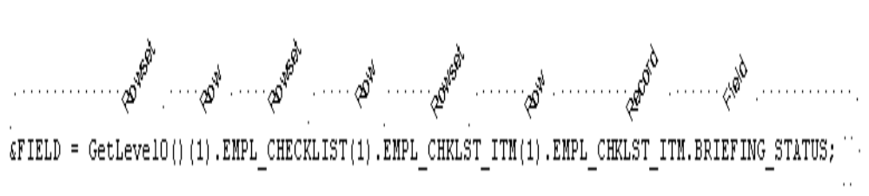
Data Buffer
Directly accessing a field

Slide 95
Data Buffer
Accessing Secondary Component Buffer Data
When a secondary page is run, the data for its buffers is copied from the parent component to a buffer structure for the secondary page. This means there are two copies of this data. The data buffer classes give access to both of these copies of the data. Direct field references (recname.fieldname) will always use the current context to determine which value to access. So, in general, when using a secondary page, make sure that all your references are based on the secondary page.

Slide 96
Capgemini India – PeopleSoft Practice
Using Errors and Warnings

Slide 97
Using Errors and Warning
Warning function in PeopleCode is to display a message alerting the end-user about a potentially incorrect data entry or change
Error function in PeopleCode is used to stop processing and display an error message.
  Errors and Warnings in FieldEdit
  Errors and Warnings in SaveEdit
  Errors and Warnings in RowSelect
  Errors and Warnings in RowDelete
  Errors and Warnings in Other Events

Slide 98
Errors and Warning in FieldEdit
An error in FieldEdit prevents the system from accepting the new value of a field. The Component Processor highlights the offending field. The user must either change the field back to its original value or to something else which does not trigger the error. A warning enables the Component Processor to accept the new data. The Component Processor does not highlight any field that has warnings.

Slide 99
Errors and Warning in SaveEdit
An error in SaveEdit prevents the system from saving any row of data. The Component Processor does not update the database for any field if one field has an error. Although the Component Processor displays an error message, it does not turn any field red. Unlike FieldEdit errors, SaveEdit errors can happen anywhere on the page or component, for any row of data. The data causing the error may appear on a different page within the same group, or a row of data not currently displayed. If this is the case, the field in error is brought into view by the system.
A warning in SaveEdit also is applied to all data in the page or component, but the Component Processor will accept the data, if told to by the user. In a FieldEdit warning, the Component Processor displays a message box with the text and two pushbuttons—OK and the standard Explain. In a SaveEdit warning, though, the message box contains an additional pushbutton, Cancel. OK accepts the data, overriding the warning and continuing the save process. Cancel ends the save process.

Slide 100
Errors and Warning in RowSelect
Errors and warnings should no longer be used in RowSelect processing: instead, use DiscardRow and StopFetching.
RowSelect PeopleCode filters out rows of data after the system applies search record criteria. It also can stop the Component Processor from reading additional rows of data.
A warning causes the Component Processor to reject the current row, but the Component Processor does continue reading more data. An error prevents any more data coming into the page or component. The Component Processor accepts the row that causes the error, but doesn't read any more data. If you want to reject the current row and stop loading additional rows, you must issue a warning and an error.
You must specify text for an error or warning, but the Component Processor does not display messages from RowSelect. You can still use the message text as a way of documenting the program.

Slide 101
Errors and Warning in RowDelete
When you delete a row of data (F8), the system prompts you to confirm. If you do confirm, RowDelete PeopleCode takes place, that is, any record field RowDelete PeopleCode fires, and any component record RowDelete PeopleCode. Errors and warnings in RowDelete display a message box.
A warning from RowDelete presents two choices—accept the RowDelete (the OK pushbutton), or cancel the RowDelete (the Cancel pushbutton). Perhaps after they read the warning message, the user will appreciate the RowDelete. An error from RowDelete PeopleCode prevents the Component Processor from removing that row of data from the page.

Slide 102
Errors and Warning in Other Events
You should not put errors or warning in PeopleCode attached to any of the remaining events (FieldDefault, FieldFormula, RowInit, FieldChange, RowInsert, SavePreChange, WorkFlow, and SavePostChange). However, the Component Processor may issue its own errors and warnings when performing PeopleCode. When this happens, it means the Component Processor tried to do something and failed, and it cannot recover from the error.
These Event types activate processing that an user has no direct control over. So, if the Component Processor comes across an error condition, the user cannot fix it. The Component Processor cancels the transaction to avoid unpredictable results.

Slide 103
Capgemini India – PeopleSoft Practice
System Variables

Slide 104
System Variables
PeopleTools provides a number of system variables that provide access to system information
System variables are prefixed with the '%' character
One can use these system variables, passing them as parameters to functions or assigning their values to fields or to temporary variables or using it as a constant.

Slide 105
System Variables
There are many different System variables provided by PeopleTools. Listed below are few frequently used ones
  %AsOfDate
  %Component
  %CompIntfcName
  %Currency
  %FilePath
  %Page
  %PasswordExpired
  %PermissionLists
  %Portal
  %Roles
  %RowSecurityPermissionList
  %ServerTimeZone
  %Session
  %Time
  %UserId

Slide 106
Capgemini India – PeopleSoft Practice
PeopleCode Debugger

Slide 107
PeopleCode Debugger
PeopleCode Debugger
  an integrated part of PeopleSoft Application Designer.
  has a visual indicator of breakpoints, an arrow indicating the current line and the ability to step through code.
  can inspect the value of a variable by 'hovering' your cursor over it and reading the pop-up bubble help.
  provides variable inspection windows for Globals, Locals, Function Parameters, and Component scoped variables.
  enables PeopleCode objects to be "expanded", so you can inspect their component parts.
  Access: Select Debug – PeopleCode Debugger Mode

Slide 108
PeopleCode Debugger Features
PeopleCode Debugger features are listed below
  Visible current line of execution.
  Visible breakpoints.
  Hover inspect.
  Single debugger.
  Variable panes.

Slide 109
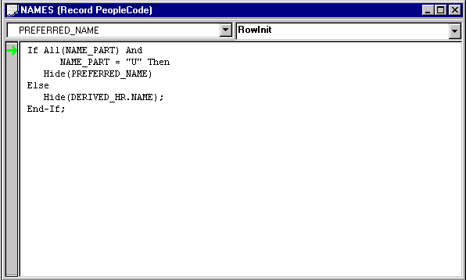
Visible current line of execution
The current line indicator (green arrow displayed in left-hand gutter) is shown in the following illustration

Slide 110
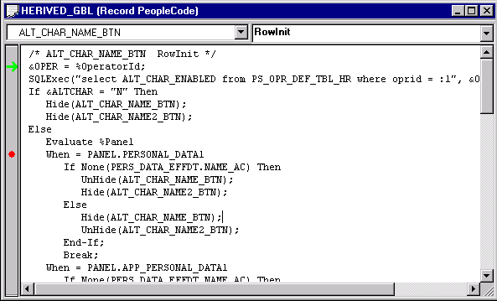
Visible breakpoints
Visual indicators that signify breakpoint locations. In the following example, the current line indicator (green arrow) is shown at the first line, and the breakpoint (red dot displayed in left-hand gutter) is on line 8

Slide 111
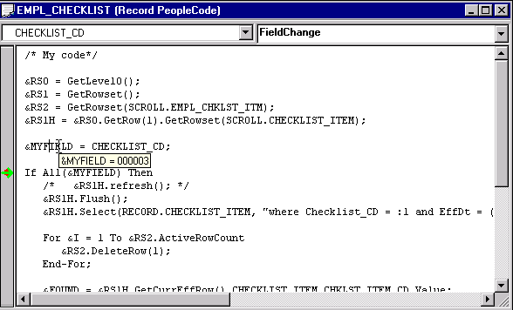
Hover inspect
If the program is already running, you can see the actual values for the variables by holding the cursor over them. The current value is displayed in a pop-up window, as shown in the following example

Slide 112
Single Debugger
Each PeopleSoft session running on a machine can have its own debugging session.
However, there can only be one instance of the PeopleCode debugger per session. If more than one instance of PeopleSoft Application Designer is running for a session, only one may be the active debugger at a given time.
If the session is in debug mode, any component that is started and that belongs to that session automatically goes into debug mode.

Slide 113
Single Debugger
After you exit debug mode by selecting Debug, Exit Debug Mode or by exiting PeopleSoft Application Designer, all components in that session go out of debug mode.
If you exit a component, debugging continues with any remaining open and running components.

Slide 114
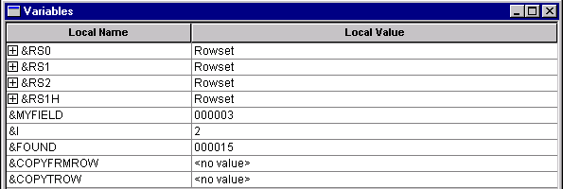
Variable panes
There are four types of variables panes:
  Local
  Global
  Component
  Parameter
The Local, Global, and Component variable panes show local, global, and component variables, respectively.
The Parameter variable pane shows the value of parameters passed in function declarations.

Slide 115
Capgemini India – PeopleSoft Practice
Thank You

