Slide 1
PeopleCode Course notes
Component Processor Flow - animated
Component Processor Flow - all-in-one
Variables
Writing functions
Using functions
The buffer: what loads and fires?
Buffer object pointers
OO Code build up and simplification
SQL in PeopleCode

Slide 2
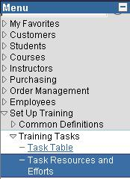
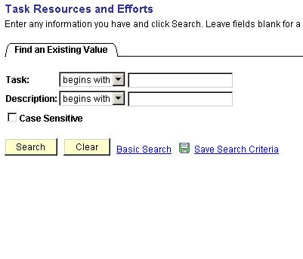
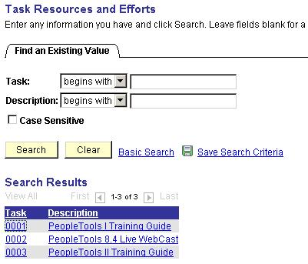
Searching a key value
SearchInit
select on chosen
value search key
Collect data from database on basis of
chosen search key value
select * from PS_PSU_TASK_TBL
where <key>=<searchkeyval>;
select * from PS_PSU_TASK_RSRC
where <key>=<searchkeyval>;
select * from PS_PSU_TASK_EFFORT
where <key>=<searchkeyval>;
SearchSave
Build the component
Prepare
Process selected data row by row
from database buffers
PostProduction
PreBuild
FieldDefault
Only blank fields
PostBuild
RowInit
Once per row

Slide 3
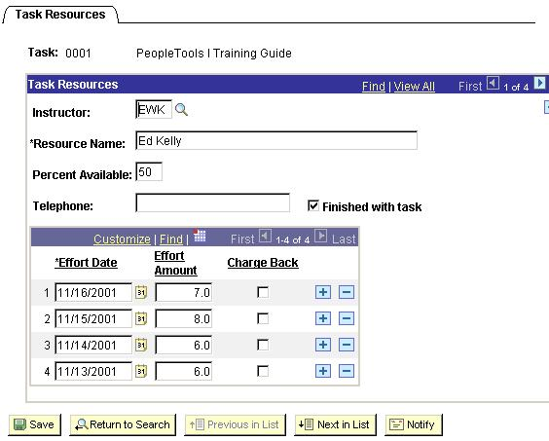
Searching a key value
Component Build
SearchInit
select on chosen
value search key
PreBuild
FieldDefault
RowInit
PostBuild
SearchSave
Activate Page
FieldEdit
Save Events
FieldChange
SaveEdit
SavePreChange
RowInsert
WorkFlow
RowDelete
SavePostChange
User Activity

Slide 4
Searching a key value
Component Build
SearchInit
select on chosen
value search key
PreBuild
L
FieldDefault
L
C
RowInit
PostBuild
E
SearchSave
Activate Page
E
FieldEdit
FieldChange
Save Events
C
L
SaveEdit
E
E
L
SavePreChange
RowInsert
L
WorkFlow
RowDelete
E
C
L
SavePostChange
User Activity

Slide 5
Variables
System
User defined
Comments
Name starts with
%
&
How many
50 to 100
unlimited
Max 1000 chars,
1st 18 unique
Life Span
Session
Local
Component
Global
Program
Session
Need to declare?
-
Local
Component
Global
No but best practice
Always
Always
Declare where?
-
Local
Component
Global
<scope>
Component
Anywhere
Before 1st executable stm
Before 1st executable stm
<datatype> &<var>
integer &i;
Use on page directly?
No
No
Use DERIVED/WORK field

Slide 6
Functions – Writing a function
Procedure
function mult
DERIVED_ED_SVCS.TOTAL_PRICE = PSU_PO_DTL.QTY * PSU_PODTL.PRICE;
end-function;
Called in program as: mult();
Procedure with parameters
function mult (&in1 as float, &in2 as float, &out as float)
&out = &in1 * &in2;
end-function;
Called in program as:
mult(PSU_PO_DTL.QTY, PSU_PO_DTL.PRICE, DERIVED_ED_SVCS.TOTAL_PRICE);
Function with parameters
function mult (&in1 as float, &in2 as float) returns float
return &in1 * &in2;
end-function;
Called in program as:
DERIVED_ED_SVCS.TOTAL_PRICE = mult(PSU_PO_DTL.QTY, PSU_PO_DTL.PRICE);

Slide 7
Functions – Using a function
PeopleCode
Internal
PeopleCode
External
Non - PeopleCode
External
Code stored
in
Program that calls
the function
After var. declares
Before 1st statement
FieldFormula event on afunclib.afield
in .dll (windows)
or .so (unix)
Declare function
-
declare function mult peoplecode
funclib_xx.afield fieldformula;
declare function mult library
afile.dll;
Call
[&var = ] mult([...]);
[&var = ] mult([...]);
&var = mult([...]);

Slide 8
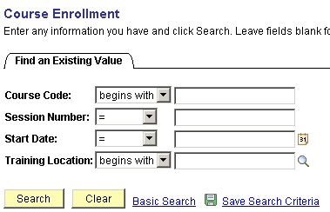
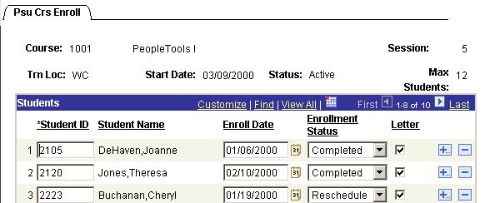
Loading the Component Buffer
Lvl
Record
Field
Type
Loads
Pcode
fires?
L0
PSU_CRS_SESSN
COURSE
SK
At least field
Not now
L0
PSU_COURSE_TBL
DESCR
Related
This field
Never
L0
PSU_CRS_SESSN
SESSION_NBR
SK
At least field
Not now
L0
PSU_CRS_SESSN
SESSION_STATUS
Primary
Entire Row
Yes
L1
PSU_STU_ENROLL
STUDENT_ID
Primary
Entire Row
Yes
L1
PSU_STUDENT_TBL
STUDENT_NAME
Related
This field +
Never
Field types: (Alternate) Search key / Related field / Primary record field

Slide 9
Buffer Object Pointers
2: Getlevel0() | 4: Level 1 Rowset | 7: Level 1 Record
3: Level 0 Row | 5: Level 1 Row | 8: Level 1 Field
PSU_TASK_TBL |  | PSU_TASK_RSRC |  | DERIVED_TRAIN | PSU_TASK_EFFORT
Task | Description | Resource Name | Pct Available | Resource Status | Effort Date | Effort Amount
0001 | PeopleTools I Guide
 |  | Ed Kelly | 50 | Semi-Dedicated
 |  |  |  |  | 16-11-2001 | 7,0
 |  |  |  |  | 15-11-2001 | 8,0
 |  |  |  |  | 14-11-2001 | 6,0
 |  |  |  |  | 13-11-2001 | 6,0
 |  | Jim Gutenkauf | 100 | Dedicated
 |  |  |  |  | 8-1-2002 | 9,5
 |  |  |  |  | 7-1-2002 | 10,0
 |  |  |  |  | 5-1-2002 | 12,0

Slide 10
Buffer Object Pointers
2: Getlevel0() | 4: Level 1 Rowset | 7: Level 1 Record
3: Level 0 Row | 5: Level 1 Row | 8: Level 1 Field
PSU_TASK_TBL |  | PSU_TASK_RSRC |  | DERIVED_TRAIN | PSU_TASK_EFFORT
Task | Description | Resource Name | Pct Available | Resource Status | Effort Date | Effort Amount
0001 | PeopleTools I Guide
 |  | Ed Kelly | 50 | Semi-Dedicated
 |  |  |  |  | 16-11-2001 | 7,0
 |  |  |  |  | 15-11-2001 | 8,0
 |  |  |  |  | 14-11-2001 | 6,0
 |  |  |  |  | 13-11-2001 | 6,0
 |  | Jim Gutenkauf | 100 | Dedicated
 |  |  |  |  | 8-1-2002 | 9,5
 |  |  |  |  | 7-1-2002 | 10,0
 |  |  |  |  | 5-1-2002 | 12,0

Slide 11
Buffer Object Pointers
2: Getlevel0() | 4: Level 1 Rowset | 7: Level 1 Record
3: Level 0 Row | 5: Level 1 Row | 8: Level 1 Field
PSU_TASK_TBL |  | PSU_TASK_RSRC |  | DERIVED_TRAIN | PSU_TASK_EFFORT
Task | Description | Resource Name | Pct Available | Resource Status | Effort Date | Effort Amount
0001 | PeopleTools I Guide
 |  | Ed Kelly | 50 | Semi-Dedicated
 |  |  |  |  | 16-11-2001 | 7,0
 |  |  |  |  | 15-11-2001 | 8,0
 |  |  |  |  | 14-11-2001 | 6,0
 |  |  |  |  | 13-11-2001 | 6,0
 |  | Jim Gutenkauf | 100 | Dedicated
 |  |  |  |  | 8-1-2002 | 9,5
 |  |  |  |  | 7-1-2002 | 10,0
 |  |  |  |  | 5-1-2002 | 12,0

Slide 12
Buffer Object Pointers
2: Getlevel0() | 4: Level 1 Rowset | 7: Level 1 Record
3: Level 0 Row | 5: Level 1 Row | 8: Level 1 Field
PSU_TASK_TBL |  | PSU_TASK_RSRC |  | DERIVED_TRAIN | PSU_TASK_EFFORT
Task | Description | Resource Name | Pct Available | Resource Status | Effort Date | Effort Amount
0001 | PeopleTools I Guide
 |  | Ed Kelly | 50 | Semi-Dedicated
 |  |  |  |  | 16-11-2001 | 7,0
 |  |  |  |  | 15-11-2001 | 8,0
 |  |  |  |  | 14-11-2001 | 6,0
 |  |  |  |  | 13-11-2001 | 6,0
 |  | Jim Gutenkauf | 100 | Dedicated
 |  |  |  |  | 8-1-2002 | 9,5
 |  |  |  |  | 7-1-2002 | 10,0
 |  |  |  |  | 5-1-2002 | 12,0

Slide 13
Buffer Object Pointers
2: Getlevel0() | 4: Level 1 Rowset | 7: Level 1 Record
3: Level 0 Row | 5: Level 1 Row | 8: Level 1 Field
PSU_TASK_TBL |  | PSU_TASK_RSRC |  | DERIVED_TRAIN | PSU_TASK_EFFORT
Task | Description | Resource Name | Pct Available | Resource Status | Effort Date | Effort Amount
0001 | PeopleTools I Guide
 |  | Ed Kelly | 50 | Semi-Dedicated
 |  |  |  |  | 16-11-2001 | 7,0
 |  |  |  |  | 15-11-2001 | 8,0
 |  |  |  |  | 14-11-2001 | 6,0
 |  |  |  |  | 13-11-2001 | 6,0
 |  | Jim Gutenkauf | 100 | Dedicated
 |  |  |  |  | 8-1-2002 | 9,5
 |  |  |  |  | 7-1-2002 | 10,0
 |  |  |  |  | 5-1-2002 | 12,0

Slide 14
Buffer Object Pointers
2: Getlevel0() | 4: Level 1 Rowset | 7: Level 1 Record
3: Level 0 Row | 5: Level 1 Row | 8: Level 1 Field
PSU_TASK_TBL |  | PSU_TASK_RSRC |  | DERIVED_TRAIN | PSU_TASK_EFFORT
Task | Description | Resource Name | Pct Available | Resource Status | Effort Date | Effort Amount
0001 | PeopleTools I Guide
 |  | Ed Kelly | 50 | Semi-Dedicated
 |  |  |  |  | 16-11-2001 | 7,0
 |  |  |  |  | 15-11-2001 | 8,0
 |  |  |  |  | 14-11-2001 | 6,0
 |  |  |  |  | 13-11-2001 | 6,0
 |  | Jim Gutenkauf | 100 | Dedicated
 |  |  |  |  | 8-1-2002 | 9,5
 |  |  |  |  | 7-1-2002 | 10,0
 |  |  |  |  | 5-1-2002 | 12,0

Slide 15
Buffer Object Pointers
2: Getlevel0() | 4: Level 1 Rowset | 7: Level 1 Record
3: Level 0 Row | 5: Level 1 Row | 8: Level 1 Field
PSU_TASK_TBL |  | PSU_TASK_RSRC |  | DERIVED_TRAIN | PSU_TASK_EFFORT
Task | Description | Resource Name | Pct Available | Resource Status | Effort Date | Effort Amount
0001 | PeopleTools I Guide
 |  | Ed Kelly | 50 | Semi-Dedicated
 |  |  |  |  | 16-11-2001 | 7,0
 |  |  |  |  | 15-11-2001 | 8,0
 |  |  |  |  | 14-11-2001 | 6,0
 |  |  |  |  | 13-11-2001 | 6,0
 |  | Jim Gutenkauf | 100 | Dedicated
 |  |  |  |  | 8-1-2002 | 9,5
 |  |  |  |  | 7-1-2002 | 10,0
 |  |  |  |  | 5-1-2002 | 12,0

Slide 16
Step 1 - Declare Buffer Objects
Local Rowset &RS_Level0, &RS_Level1;
Local Row &Row_Level0, &Row_Level1;
Local Record &Rec_TaskRsrc;
Local Field &Fld_PctAvail;
&RS_Level0 = GetLevel0();
&Row_Level0 = &RS_Level0.GetRow(1);
&RS_Level1 = &Row_Level0.GetRowSet(SCROLL.PSU_TASK_RSRC);
&Row_Level1 = &RS_Level1.GetRow(&I);
&Rec_TaskRsrc = &Row_Level1.GetRecord(RECORD.PSU_TASK_RSRC);
&Fld_PctAvail = &Rec_TaskRsrc.GetField(FIELD.PCT_AVAILABLE);

Slide 17
Step 2 – Get the Level 0 Rowset
Local Rowset &RS_Level0, &RS_Level1;
Local Row &Row_Level0, &Row_Level1;
Local Record &Rec_TaskRsrc;
Local Field &Fld_PctAvail;
&RS_Level0 = GetLevel0();
&Row_Level0 = &RS_Level0.GetRow(1);
&RS_Level1 = &Row_Level0.GetRowSet(SCROLL.PSU_TASK_RSRC);
&Row_Level1 = &RS_Level1.GetRow(&I);
&Rec_TaskRsrc = &Row_Level1.GetRecord(RECORD.PSU_TASK_RSRC);
&Fld_PctAvail = &Rec_TaskRsrc.GetField(FIELD.PCT_AVAILABLE);

Slide 18
Step 3 – Get the Level 0 Row
Local Rowset &RS_Level0, &RS_Level1;
Local Row &Row_Level0, &Row_Level1;
Local Record &Rec_TaskRsrc;
Local Field &Fld_PctAvail;
&RS_Level0 = GetLevel0();
&Row_Level0 = &RS_Level0.GetRow(1);
&RS_Level1 = &Row_Level0.GetRowSet(SCROLL.PSU_TASK_RSRC);
&Row_Level1 = &RS_Level1.GetRow(&I);
&Rec_TaskRsrc = &Row_Level1.GetRecord(RECORD.PSU_TASK_RSRC);
&Fld_PctAvail = &Rec_TaskRsrc.GetField(FIELD.PCT_AVAILABLE);

Slide 19
Step 4 – Get a Level 1 Rowset
Local Rowset &RS_Level0, &RS_Level1;
Local Row &Row_Level0, &Row_Level1;
Local Record &Rec_TaskRsrc;
Local Field &Fld_PctAvail;
&RS_Level0 = GetLevel0();
&Row_Level0 = &RS_Level0.GetRow(1);
&RS_Level1 = &Row_Level0.GetRowSet(SCROLL.PSU_TASK_RSRC);
&Row_Level1 = &RS_Level1.GetRow(&I);
&Rec_TaskRsrc = &Row_Level1.GetRecord(RECORD.PSU_TASK_RSRC);
&Fld_PctAvail = &Rec_TaskRsrc.GetField(FIELD.PCT_AVAILABLE);

Slide 20
Step 5 – Get a Level 1 Row
Local Rowset &RS_Level0, &RS_Level1;
Local Row &Row_Level0, &Row_Level1;
Local Record &Rec_TaskRsrc;
Local Field &Fld_PctAvail;
&RS_Level0 = GetLevel0();
&Row_Level0 = &RS_Level0.GetRow(1);
&RS_Level1 = &Row_Level0.GetRowSet(SCROLL.PSU_TASK_RSRC);
&Row_Level1 = &RS_Level1.GetRow(&I);
&Rec_TaskRsrc = &Row_Level1.GetRecord(RECORD.PSU_TASK_RSRC);
&Fld_PctAvail = &Rec_TaskRsrc.GetField(FIELD.PCT_AVAILABLE);

Slide 21
Step 6 – Get a Level 1 Record
Local Rowset &RS_Level0, &RS_Level1;
Local Row &Row_Level0, &Row_Level1;
Local Record &Rec_TaskRsrc;
Local Field &Fld_PctAvail;
&RS_Level0 = GetLevel0();
&Row_Level0 = &RS_Level0.GetRow(1);
&RS_Level1 = &Row_Level0.GetRowSet(SCROLL.PSU_TASK_RSRC);
&Row_Level1 = &RS_Level1.GetRow(&I);
&Rec_TaskRsrc = &Row_Level1.GetRecord(RECORD.PSU_TASK_RSRC);
&Fld_PctAvail = &Rec_TaskRsrc.GetField(FIELD.PCT_AVAILABLE);

Slide 22
Step 7 – Get a Level 1 Field
Local Rowset &RS_Level0, &RS_Level1;
Local Row &Row_Level0, &Row_Level1;
Local Record &Rec_TaskRsrc;
Local Field &Fld_PctAvail;
&RS_Level0 = GetLevel0();
&Row_Level0 = &RS_Level0.GetRow(1);
&RS_Level1 = &Row_Level0.GetRowSet(SCROLL.PSU_TASK_RSRC);
&Row_Level1 = &RS_Level1.GetRow(&I);
&Rec_TaskRsrc = &Row_Level1.GetRecord(RECORD.PSU_TASK_RSRC);
&Fld_PctAvail = &Rec_TaskRsrc.GetField(FIELD.PCT_AVAILABLE);

Slide 23
Start counting
Local Rowset &RS_Level0, &RS_Level1;
Local Row &Row_Level0, &Row_Level1;
Local Record &Rec_TaskRsrc;
Local Field &Fld_PctAvail;
&RS_Level0 = GetLevel0();
&Row_Level0 = &RS_Level0.GetRow(1);
&RS_Level1 = &Row_Level0.GetRowSet(SCROLL.PSU_TASK_RSRC);
For &I = 1 to &RS_Level1.ActiveRowCount
&Row_Level1 = &RS_Level1.GetRow(&I);
&Rec_TaskRsrc = &Row_Level1.GetRecord(RECORD.PSU_TASK_RSRC);
&Fld_PctAvail = &Rec_TaskRsrc.GetField(FIELD.PCT_AVAILABLE);
&TotalPct = &TotalPct + &Fld_PctAvail.Value;
End-for;

Slide 24
Simplify – Default Get Methods
Local Rowset &RS_Level0, &RS_Level1;
Local Row &Row_Level0, &Row_Level1;
Local Record &Rec_TaskRsrc;
Local Field &Fld_PctAvail;
&RS_Level0 = GetLevel0();
&Row_Level0 = &RS_Level0.GetRow(1);
&RS_Level1 = &Row_Level0.GetRowSet(SCROLL.PSU_TASK_RSRC);
For &I = 1 to &RS_Level1.ActiveRowCount
&Row_Level1 = &RS_Level1.GetRow(&I);
&Rec_TaskRsrc = &Row_Level1.GetRecord(RECORD.PSU_TASK_RSRC);
&Fld_PctAvail = &Rec_TaskRsrc.GetField(FIELD.PCT_AVAILABLE);
&TotalPct = &TotalPct + &Fld_PctAvail.Value;
End-for;

Slide 25
Simplify – Default Get Methods
Local Rowset &RS_Level0, &RS_Level1;
Local Row &Row_Level0, &Row_Level1;
Local Record &Rec_TaskRsrc;
Local Field &Fld_PctAvail;
&RS_Level0 = GetLevel0();
&Row_Level0 = &RS_Level0(1);
&RS_Level1 = &Row_Level0.GetRowSet(SCROLL.PSU_TASK_RSRC);
For &I = 1 to &RS_Level1.ActiveRowCount
&Row_Level1 = &RS_Level1(&I);
&Rec_TaskRsrc = &Row_Level1.PSU_TASK_RSRC;
&Fld_PctAvail = &Rec_TaskRsrc.PCT_AVAILABLE;
&TotalPct = &TotalPct + &Fld_PctAvail.Value;
End-for;

Slide 26
Simplify – Unnecessary Buffer Objects
Local Rowset &RS_Level0, &RS_Level1;
Local Row &Row_Level0, &Row_Level1;
Local Record &Rec_TaskRsrc;
Local Field &Fld_PctAvail;
&RS_Level0 = GetLevel0();
&Row_Level0 = &RS_Level0(1);
&RS_Level1 = &Row_Level0.GetRowSet(SCROLL.PSU_TASK_RSRC);
For &I = 1 to &RS_Level1.ActiveRowCount
&Row_Level1 = &RS_Level1(&I);
&Rec_TaskRsrc = &Row_Level1.PSU_TASK_RSRC;
&Fld_PctAvail = &Rec_TaskRsrc.PCT_AVAILABLE;
&TotalPct = &TotalPct + &Fld_PctAvail.Value;
End-for;

Slide 27
Simplify – Unnecessary Buffer Objects
Local Rowset &RS_Level0, &RS_Level1;
Local Row &Row_Level0, &Row_Level1;
Local Record &Rec_TaskRsrc;
Local Field &Fld_PctAvail;
&RS_Level0 = GetLevel0();
&Row_Level0 = &RS_Level0(1);
&RS_Level1 = &Row_Level0.GetRowSet(SCROLL.PSU_TASK_RSRC);
For &I = 1 to &RS_Level1.ActiveRowCount
&Row_Level1 = &RS_Level1(&I);
&Rec_TaskRsrc = &Row_Level1.PSU_TASK_RSRC;
&Fld_PctAvail = &Rec_TaskRsrc.PCT_AVAILABLE;
&TotalPct = &TotalPct + &Fld_PctAvail.Value;
&TotalPct = &TotalPct + &RS_Level1(&I). PSU_TASK_RSRC. PCT_AVAILABLE.Value;
End-for;

Slide 28
Simplify – Unnecessary Buffer Objects
Local Rowset &RS_Level0, &RS_Level1;
Local Row &Row_Level0, &Row_Level1;
Local Record &Rec_TaskRsrc;
Local Field &Fld_PctAvail;
&RS_Level0 = GetLevel0();
&Row_Level0 = &RS_Level0(1);
&RS_Level1 = &Row_Level0.GetRowSet(SCROLL.PSU_TASK_RSRC);
For &I = 1 to &RS_Level1.ActiveRowCount
&TotalPct = &TotalPct + &RS_Level1(&I). PSU_TASK_RSRC. PCT_AVAILABLE.Value;
End-for;

Slide 29
Simplify – Unnecessary Buffer Objects
Local Rowset &RS_Level0, &RS_Level1;
Local Row &Row_Level0, &Row_Level1;
Local Record &Rec_TaskRsrc;
Local Field &Fld_PctAvail;
&RS_Level0 = GetLevel0();
&Row_Level0 = &RS_Level0(1);
&RS_Level1 = &Row_Level0.GetRowSet(SCROLL.PSU_TASK_RSRC);
For &I = 1 to &RS_Level1.ActiveRowCount
&TotalPct = &TotalPct + &RS_Level1(&I). PSU_TASK_RSRC. PCT_AVAILABLE.Value;
End-for;

Slide 30
Result
Local Rowset &RS_Level1;
&RS_Level1 = GetLevel0()(1).GetRowSet(SCROLL.PSU_TASK_RSRC);
For &I = 1 to &RS_Level1.ActiveRowCount
&TotalPct = &TotalPct + &RS_Level1(&I). PSU_TASK_RSRC. PCT_AVAILABLE.Value;
End-for;

Slide 31
Result – From L0 Row Event
Local Rowset &RS_Level1;
&RS_Level1 = GetLevel0()(1).GetRowSet(SCROLL.PSU_TASK_RSRC);
For &I = 1 to &RS_Level1.ActiveRowCount
&TotalPct = &TotalPct + &RS_Level1(&I). PSU_TASK_RSRC. PCT_AVAILABLE.Value;
End-for;

Slide 32
Result – From L0 Row Event
Local Rowset &RS_Level1;
&RS_Level1 = GetRowSet(SCROLL.PSU_TASK_RSRC);
For &I = 1 to &RS_Level1.ActiveRowCount
&TotalPct = &TotalPct + &RS_Level1(&I). PSU_TASK_RSRC. PCT_AVAILABLE.Value;
End-for;

Slide 33
PeopleCode and SQL
SQL as string
SQL in SQL definition
SQLExec
SQLEXEC(“select sum(EFFORT_AMT)
from PS_PSU_TASK_EFFORT
where TASK = :1”, PSU_TASK_TBL.TASK, &sum_eff )
SQLEXEC(sql.sum_eff,
PSU_TASK_TBL.TASK, &sum_eff )
SQL definition: sum_eff
select sum(EFFORT_AMT)
from PS_PSU_TASK_EFFORT
where TASK = :1)
SQL class
Local SQL &sql_obj;
&sql_obj =
createsql(“select EFFORT_AMT
from PS_PSU_TASK_EFFORT
where TASK = :1”, PSU_TASK_TBL.TASK );
Local SQL &sql_obj;
&Sql_obj = getsql(sql.sel_rows, PSU_TASK_TBL.TASK );
SQL definition: sel_rows
select EFFORT_AMT
from PS_PSU_TASK_EFFORT
where TASK = :1)
Select from object:
While &sql_obj.fetch(&return_val)
.....
end-while
Insert, Update, Delete from object:
&sql_obj.execute(...)

