Slide 1

Predicting Cherry Blossom PBD for the Next Decade
Jonathan Abbamonte and Priyanjali Bukke
Image Source: https://livejapan.com/en/article-a0004907/

Slide 2
Covariates
Temperature
Precipitation
Snow Depth
Sunlight Duration
Sunlight from May-September
Wind Speed
Sea Level Pressure

Slide 3
Weather Stations
Location | Station
Kyoto | Kyoto
Liestal-Weideli | Basal Binningen
Vancouver | Vancouver International Airport
Washington DC | Reagan National Airport

Slide 4
Cherry Blossoms
Location | Species | Bloom Definition
Kyoto | Prunus jamasakura | 80%
Liestal-Weideli | Prunus avium | 25%
Vancouver | Prunus X yedoensis | 50%
Washington DC | Prunus X yedoensis | 70%

Slide 5
Washington DC Model
Multiple Linear Regression Model with
SARIMA (6,0,4)(6,0,3)[5] Errors
Covariates Included:
Cumulative SLP to PBD
Cumulative Precipitation to PBD
Avg Wind Speed
Average of cumulative TMIN and TMAX
Cumulative absolute difference between TMIN and TMAX
Chill Days
GDD
Average number of hours of sunlight (Jan-Mar)
Average number of hours of sunlight (May-Sep)

Slide 6
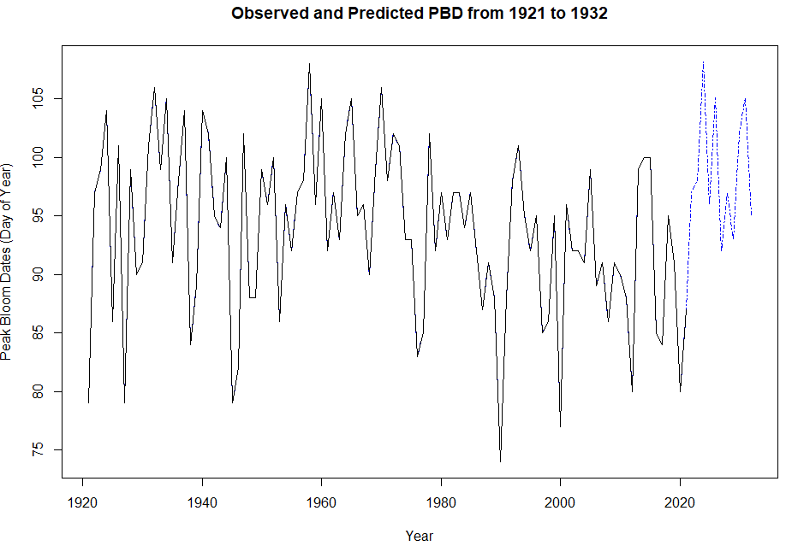
Washington DC Model

Slide 7
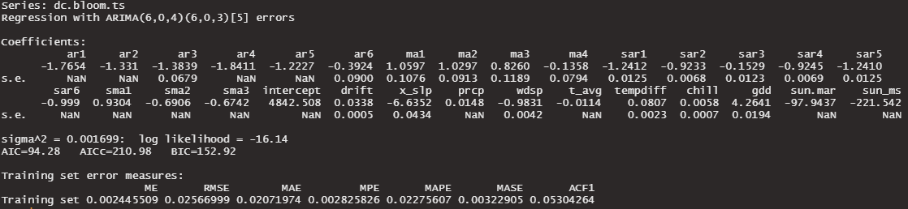
Washington DC Model

Slide 8
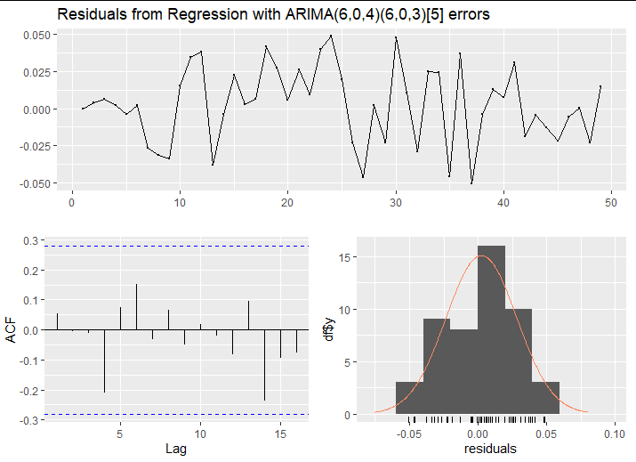
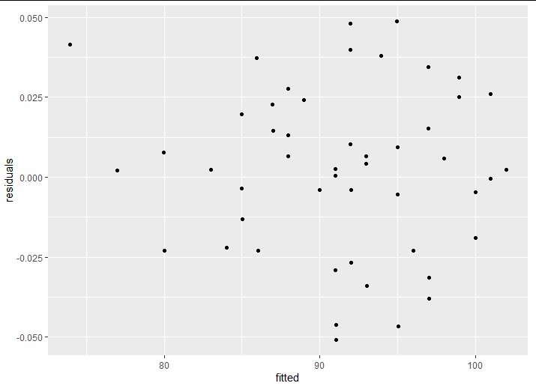
Washington DC Model

Slide 9
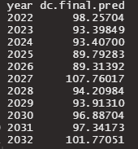
Forecast: Washington, DC

Slide 10
Liestal-Weideli Model
Multiple Linear Regression Model with
SARIMA (1,0,0)(2,0,5)[1] Errors
Covariates Included:
Average number of hours of sunlight (May-Sep)
Cumulative absolute difference between TMIN and TMAX
GDD
Average of cumulative TMIN and TMAX
Chill Days

Slide 11
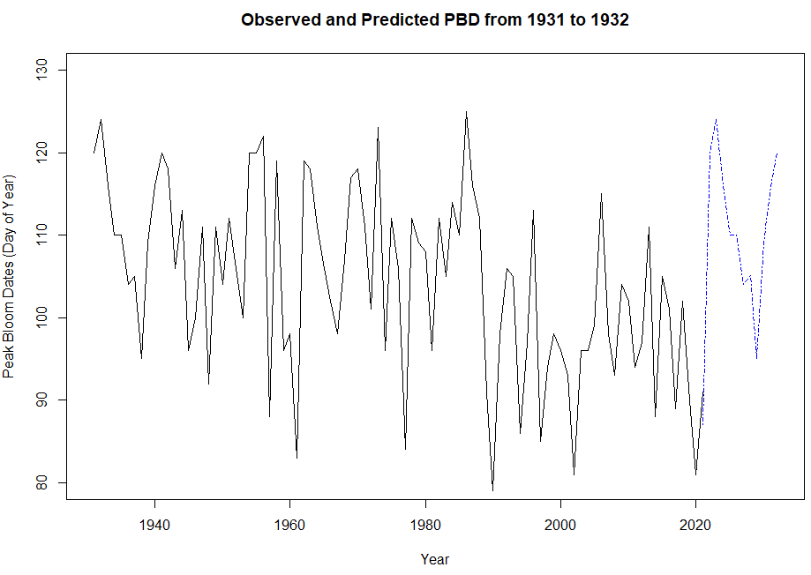
Liestal-Weideli Model

Slide 12
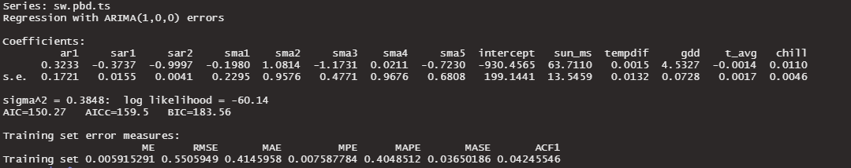
Liestal-Weideli Model

Slide 13
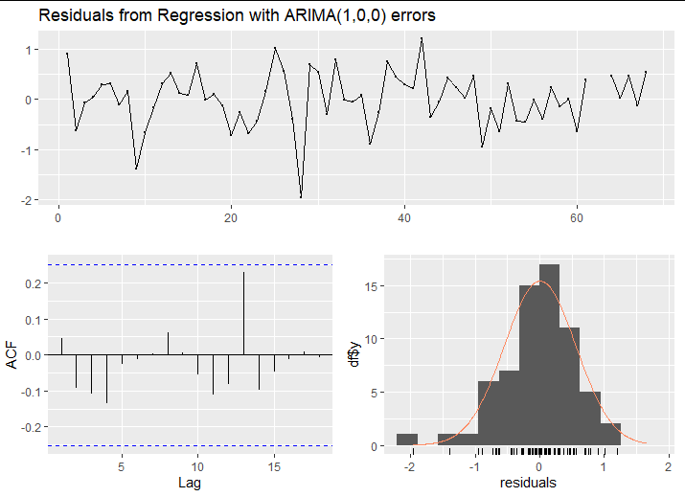
Liestal-Weideli Model

Slide 14
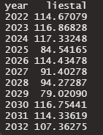
Liestal-Weideli Model

Slide 15
Kyoto Model
Multiple Linear Regression Model with
SARIMA (5,0,4)(1,0,2)[5] Errors
Covariates Included:
Average of cumulative TMIN and TMAX
Chill Days
GDD
Total solar time (Jan-Mar)
Cumulative SLP (Jan-Mar)

Slide 16
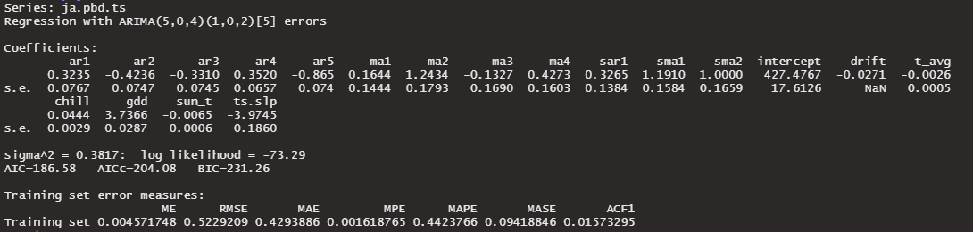
Kyoto Model

Slide 17
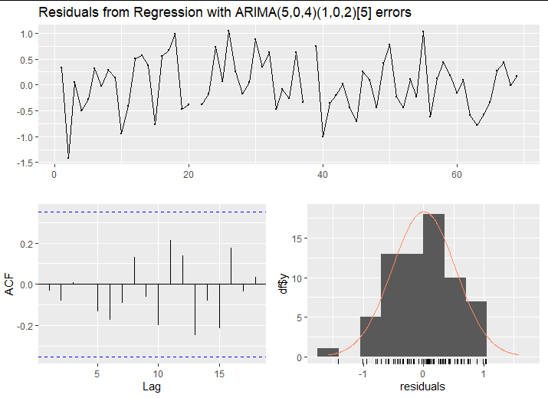
Kyoto Model

Slide 18
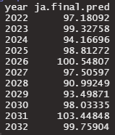
Forecast: Kyoto

Slide 19
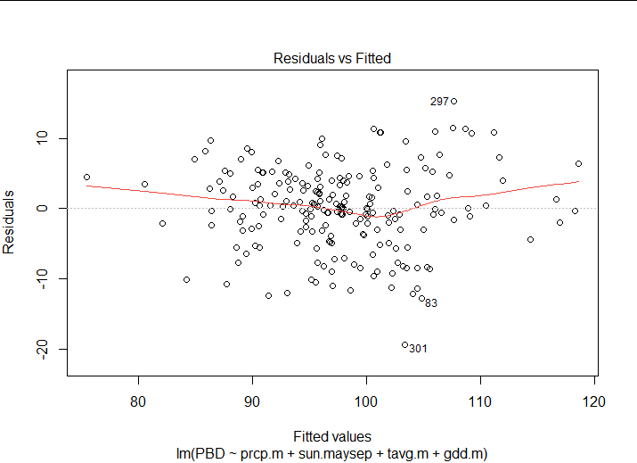
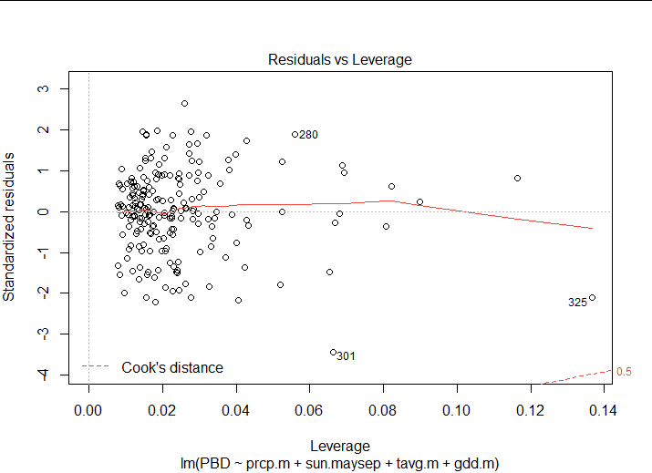
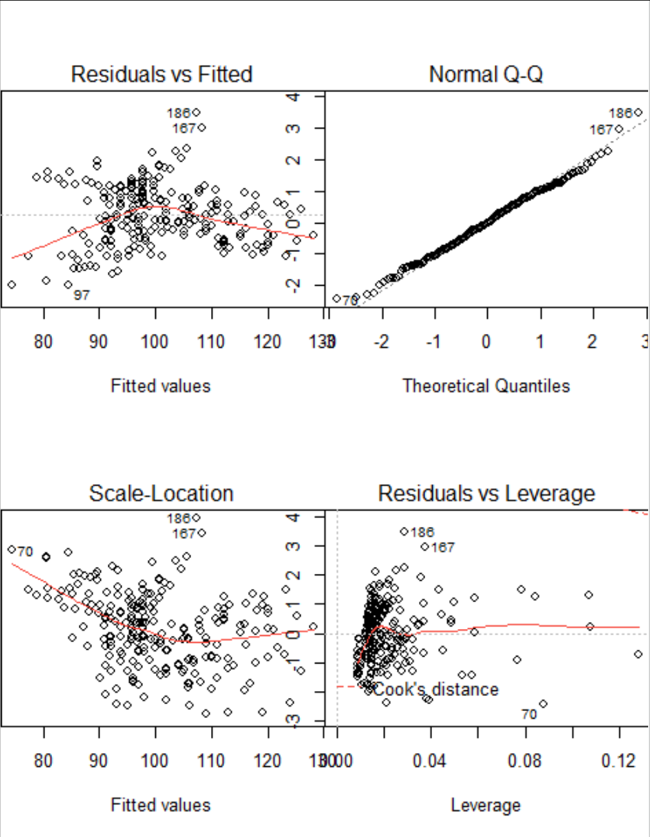
General Model - Vancouver

Slide 20
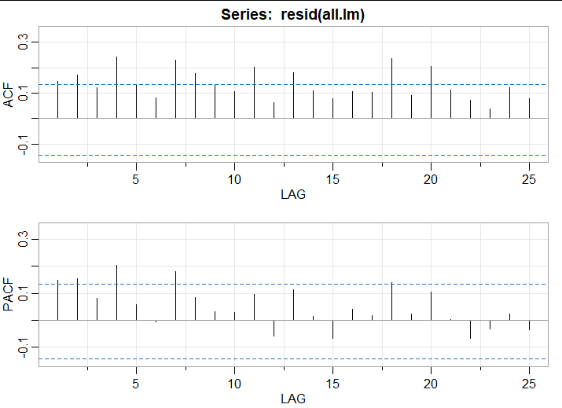
Autocorrelation in the linear model

Slide 21
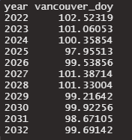
Linear Model
RMSE
DC: 5.85
Kyoto: 4.72
Liestal: 7.76

Slide 22
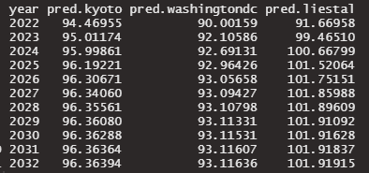
Vector Autoregressive Model

Slide 23
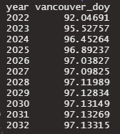
Forecast: Vancouver

Slide 24
Drawbacks of Methodology
&
Issues Faced

Slide 25
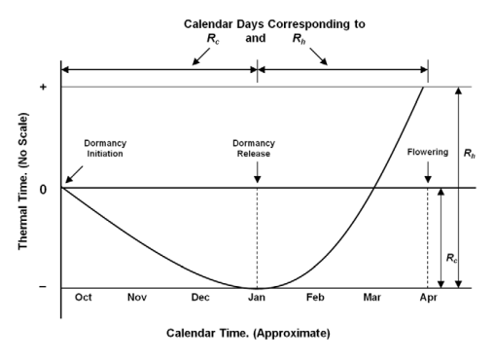
Exploring the Temperature Covariate
Two-Step Phenology Model. doi:10.1371/journal.pone.0027439.g001

Slide 26
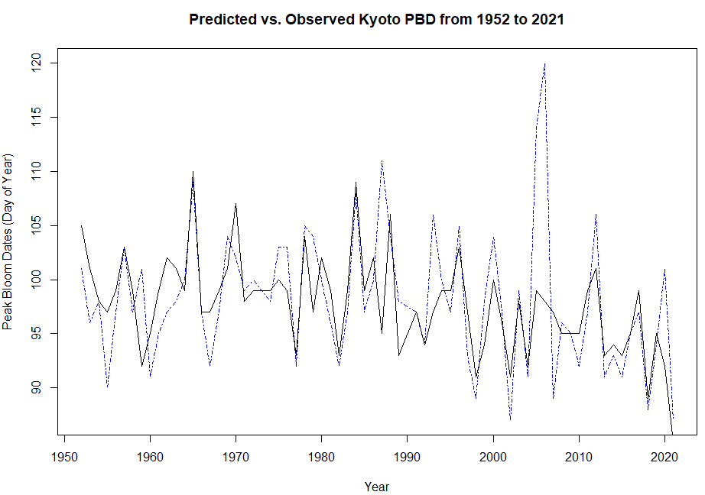
Tc = 6 °C
Rc = -125 °C
Rh = 235 °C

Slide 27
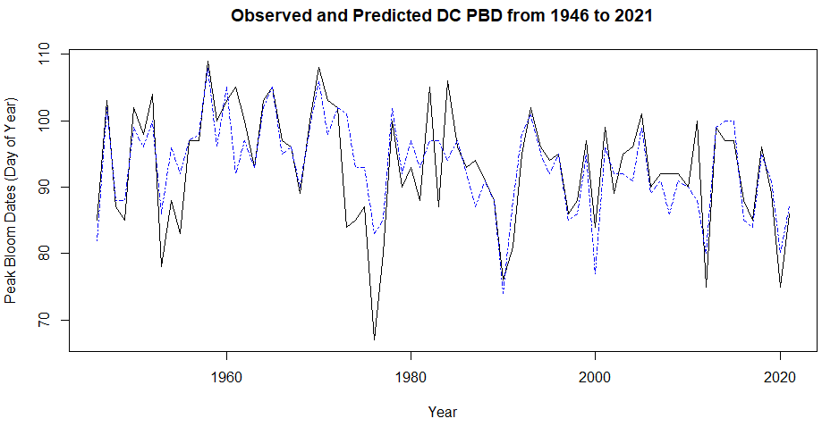
Tc = 5 °C
Rc = -140.1 °C
Rh = 264 °C

Slide 28
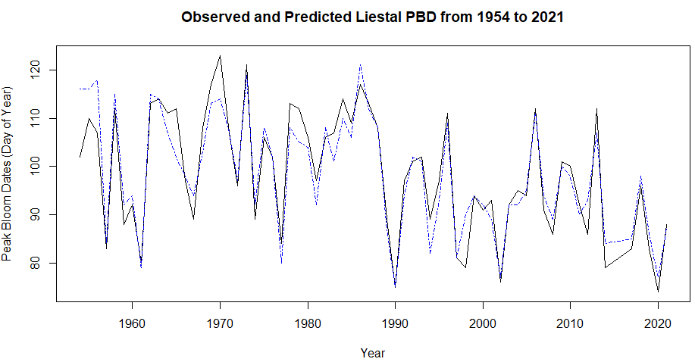
Tc = 5 °C
Rc = -68 °C
Rh = 210.5 °C

